Slide 1
OSTBAYE
Sci-fantasy ttRPG

Slide 2
PREMISE
PLAYERS incarnate a team sent by the Interplanetary Committee to OSTBAYE Moon
MISSION: to evaluate the moon’s potential for development as an interplanetary station

Slide 3
THEMES
Politics
Ethics
Philosophy
Exploration
Environmentalism

Slide 4


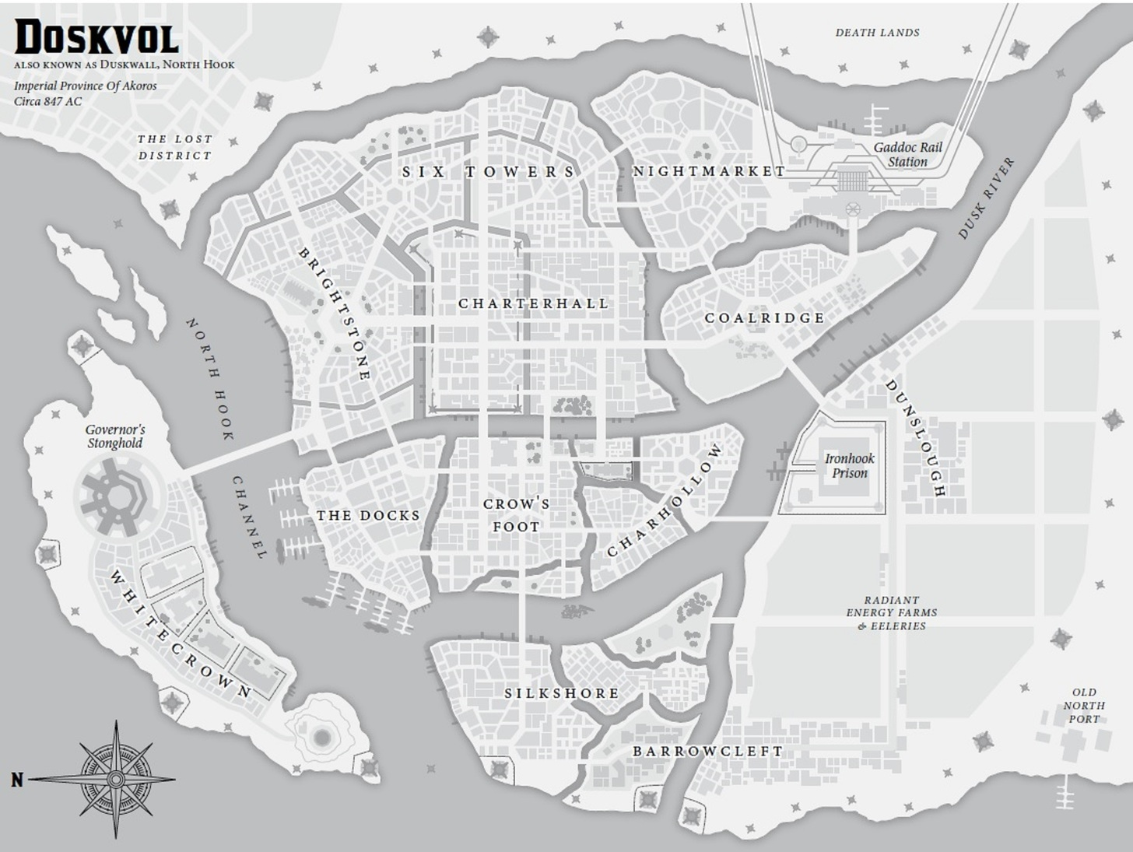
INSPIRATION BLADES IN THE DARK
Blades in the Dark is a TTRPG built from the Apocalypse World system.
In Blades in the Dark, you play as a crew of miscreats in a crime-infested, post-apocalyptic city
The world is premade, with set crews and entities in the city
The world responds to the players’ actions and interacts with them

Slide 5
INSPIRATION BLADES IN THE DARK
Similarly, Ostbaye Moon is a set environment: it contains loosely defined elements that interact with and react to the players
Independent research teams sent by the powers behind the Interplanetary Comittee
Ostbaye fauna and flora
Other entities…

Slide 6
IS OSTBAYE FIT FOR DEVELOPMENT
No right answer: the goal is to explore ethical and philosophical considerations
Managing the expectations of the Committee and the pressure of public opinion
Conflicts between crewmembers
The Interplanetary Committee defines sapience and prohibits the colonization of planets of planets host to sapient lifeforms. On Ostbaye, players will find lifeforms that sit in a grey zone relative to the Committee’s definition.

Slide 7
PLAYER CHARACTERS
SPECIE
SPONSOR
OCCUPATION
Least mechanically relevant
Adds flavor, background
Influences the choice of sponsor
Influences the consequences of failed rolls
Who got you the opportunity to be dispatched to Ostbaye station?
The Sponsor is usually one of the powers behind the Interplanetary Committee
Players have to manage political pressure from their sponsors between missions
Is your player a researcher, a cook, a pilot, or something else?
Most relevant during expeditions
Player’s occupation influences their abilities on the field

Slide 8







PLAYER SPECIES

