Slide 1


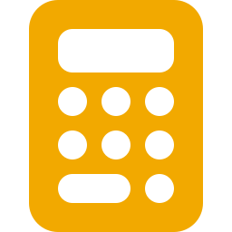
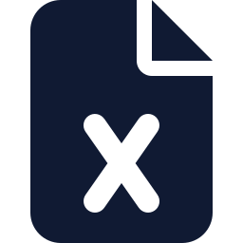
AfriPlan Electrical
PDF & DWG drawings
Read & measure
Drawings in, priced Bill of Quantities out — a user guide
Price at SA rates
For South African electrical contractors, estimators and engineers · October 2026
Tender BoQ
Notes:
AfriPlan turns a set of electrical drawings — PDF, DWG/DXF or both — into a priced, SANS-style Bill of Quantities. This deck covers the problem it solves, how it works, how to use the web app and the Claude Code (DOE) workflow, and how accurate it is today, measured against a real human-priced bill.

Slide 2
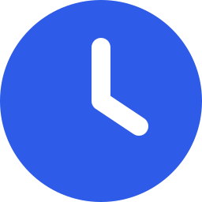


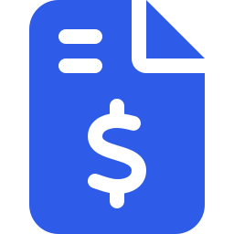
Every tender is priced against the clock, on a thin margin
14–30
4.8%
1 in 5
≈1%
days
margin
tenders won
of value per bid
to price a public tender — clarifications close 5 working days earlier
SA construction profit margin in 2024 — one missed item can erase it
about four of every five estimates earn nothing directly
spent on each bid — paid again on every bid that is lost
Official · MFMA SCM Regs, CIDB
Official · Stats SA via TimesLIVE
Independent · Ireland, CIF/IDIRO 2022
Independent · Ireland, CIF/IDIRO 2022
No study measures SA electrical take-off hours, SA win rates or manual take-off error rates — figures above are the best independent evidence (research report, Oct 2026).
Notes:
Public tenders close in 14 to 30 days (municipal SCM regulations; national/provincial minimum 21 days), and clarifications close 5 working days before. Stats SA puts the construction industry's 2024 profit margin at 4.8%. The only independent bid-cost data is Irish (CIF/IDIRO 2022): contractors win about 1 in 5 public tenders and each bid costs about 1% of project value. So most estimating effort is spent on bids that are lost, and a single missed feeder or board can wipe out a job's profit.

Slide 3




Work is moving to small firms that cannot carry an estimator
93%
32.2%
of ~130,000 CIDB contractors are Grade 1–4
of construction income earned by small & micro firms (2024)
R1.07 tn
8.3 GW
public infrastructure planned over three years
rooftop solar installed by June 2026
Sources: CIDB Annual Performance Plan (via PMG), Stats SA construction industry 2024, Budget 2026 (IOL), Engineering News. No official count of electrical contractors exists; ECA(SA) reports 3,000–4,000 members.
Notes:
CIDB register, end of 2024: 108,224 active Grade 1 contractors and 21,331 in Grades 2–9, of which 12,647 are Grades 2–4 — about 93% of roughly 130,000 contractors are Grade 1–4. Small and micro firms earned 32.2% of construction income in 2024 (25.0% in 2014) and gave 55.3% of construction jobs (Stats SA). Demand for electrical work grows: R1.07 trillion public infrastructure over three years (Budget 2026) and 8.3 GW of rooftop solar by June 2026.

Slide 4

Today's tools leave the expensive part of the bill to a person
Tool family | Examples | Cost (≈ R / year) | Where it falls short for SA electrical work
Generic take-off | Bluebeam, PlanSwift, CostX, WinQS | R4.6k – R36k | A person still clicks every symbol and prices in Excel; no electrical logic
US electrical estimators | Accubid, McCormick, ConEst | R25k – R270k / seat | US labour units and products; no rand pricing, no SANS 10142-1
AI take-off | Togal, Kreo Pro, Beam AI | R37k – R64k / user | Counts symbols on PDFs; weak on cable routes and single-line diagrams (vendors' own words)
SA tender apps | TenderSmart, TenderProSA | from R699 / month | Price or manage an existing BoQ; no evidence they read drawings
AfriPlan reads what the others hand back: single-line diagrams, feeder lengths measured on the site plan, DWG and PDF of the same project together, SA rates in rand — and it audits a supplied BoQ.
Vendor pricing pages 2025–2026 converted at R17.9/USD; vendor accuracy claims ("98–99%", "70–90% faster") are unverified and not used here.
Notes:
Four tool families exist. Generic take-off tools measure but a person clicks every symbol and prices in Excel. US electrical estimators run on US labour units with no rand pricing or SANS logic. AI take-off tools count symbols on PDFs but their own vendors admit weakness on cable routing and single-line diagrams. SA tender apps price an existing BoQ. Rand prices are conversions at R17.9/USD. No tool found reads a DWG set and a PDF set together, prices at SA rates and audits a supplied BoQ — an absence-of-evidence finding.

Slide 5



The bill's value sits in boards, feeders and trenches
Feeders & trenches
Cable size from the single-line diagram, length measured on the electrical site plan.
Distribution boards
One per board, never twice across sheets; priced from its contents.
Symbols are the small part
Fittings, outlets and switches: a perfect symbol counter alone scores below 10%.
Measured on a real, human-priced 7-building reference bill (priced building lines; contingency, VAT and P&Gs excluded).
Notes:
Share of the real bill's value by bill section on the 7-building reference project. Section A — distribution boards, main feeder cables, trenching and earthing — is about 60% of the value. Lighting is about 21%. The fittings, outlets and switches that symbol counters handle well are a small part: a perfect symbol counter alone would score below 10%. That is why AfriPlan reads single-line diagrams and measures feeder routes on the site plan.

Slide 6


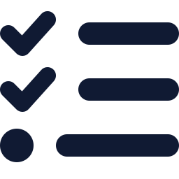

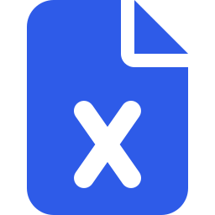





Two readers, one set of findings, one pricer
PDF reader
PDF drawings
Combine
Excel
AI reads each page into strict forms
Findings
stronger evidence wins, nothing counted twice
scanned or exported
with evidence
measured
› counted
› written
› seen
› assumed
PDF
CAD reader
Gaps
Price once
DWG / DXF drawings
counts symbols, reads SLDs, measures routes
SA rate model: crew × hours, DB build-up
the CAD set
Score
The AI is the eyes; Python is the brain — the AI never invents a quantity, a length or a rate.
Notes:
Both readers state findings with their evidence — measured beats counted beats written beats seen beats assumed. The PDF reader uses an AI as its eyes (Claude API, Gemini, or Claude Code on your subscription); the CAD reader is pure geometry: it counts symbols, reads single-line diagram text and measures feeder routes on the electrical site plan. Combining pairs PDF pages with their CAD sheet by the words both print; the stronger evidence wins and nothing is counted twice. One pricer turns findings into lines with the SA rate model.

Slide 7




Four rules keep the bill honest
AI reads, Python decides
Never silent
The AI only reports what is drawn, through strict forms. Python counts, measures, validates and prices — no AI-invented numbers or rates.
Every estimated quantity is tagged INFERRED, ASSUMED or PROVISIONAL, carries its assumption and appears in “things to check”.
Stronger evidence wins
Markup applied once
A measured route beats a written length beats an assumed one. The same item read twice is billed once.
Rates already carry the material markup; the extra markup starts at 0 % so nothing is charged twice.
Notes:
These rules are enforced in code and tests, not just in documentation. Every estimated quantity carries a tag and an assumption and appears in the gap report, so an estimator always knows what to check first.

Slide 8


Two ways to produce a BoQ — pick the one that fits the job
Web app
DOE workflow
in the browser
VS Code + Claude Code
Best for
contractors, quick DWG/DXF jobs, demos
Best for
your own estimating on a real project folder
How
upload drawings → Take-off → BoQ → export
How
“estimate the project in <folder>”
PDF reading
Claude API (paid) or Gemini (free, slower, daily limit)
PDF reading
Claude Code reads every page — on your subscription, no API bill
DWG/DXF
free and exact, about 1–2 minutes
DWG/DXF
the same CAD reader, combined with the PDF forms
Output
BoQ on screen, Excel & PDF tender document
Output
Excel + PDF + things to check + accuracy report in the folder
Best measured accuracy today: the DOE workflow (PDF + DWG combined) — see the accuracy section.
Notes:
The web app is for contractors and demos: upload in the browser, see the take-off, price, export. The DOE workflow runs inside VS Code with Claude Code: point it at a project folder and Claude reads the PDF pages on your subscription, so there is no API bill — and it gives the best scores so far.

Slide 9








The web app in seven steps
1
2
3
4
5
6
7
Sign in
Upload
Take-off
BoQ
Pricing
Export
Audit
demo login, pre-filled
DXF/DWG, PDF or both
live progress, then the drawing set & gaps
every line with its evidence
supplier quotes, apply one
Excel & PDF, email
check any BoQ
Start it: python scripts/dev.py start then open http://127.0.0.1:5180 (macOS: python3)
Notes:
Sign in (demo login, pre-filled). Upload the drawings and choose the engine. The Take-off page shows progress and then the drawing set, legend, coverage and gaps. The BoQ page lists every line with its evidence. Pricing requests supplier quotes. Export produces the tender Excel and PDF and can email them. Audit a BoQ checks any bill, including one you did not make with AfriPlan.

Slide 10


Upload: choose the engine that fits your drawings
DXF / DWG
PDF
Both
Free · exact · 1–2 min
AI reads every page
run both, then compare
Select the whole set: SLDs, layouts and the electrical site plan
Feeder lengths measured on the site plan
Older revisions skipped automatically
Optional: AI names unnamed symbols (≈ R1–2)
Claude API: ≈ R2.50 a page, ≈ 5 min for 18 pages
Gemini: free, slower; stops at Google's daily limit
Live progress: page X of Y, AI waits shown
A vector site plan PDF is measured too
Runs the CAD and PDF engines side by side
Shows where they agree and disagree
Comparison report as PDF
Best when some sheets exist only as PDF
Tip: without an API key, DWG/DXF estimating, audit and exports still work. Keys go in api/.env (never committed).
Notes:
DXF/DWG: select the whole set at once — single-line diagrams, lighting and plug layouts and the electrical site plan — so feeders are measured on the site plan; an older revision of a sheet is skipped automatically. Optional AI symbol names cost about R1–2 per set. PDF: an AI reads every page; Claude API costs about R2.50 a page and about 5 minutes for 18 pages; Gemini is free but limited per minute and per day. Both: runs the two engines and shows where they agree and disagree.

Slide 11
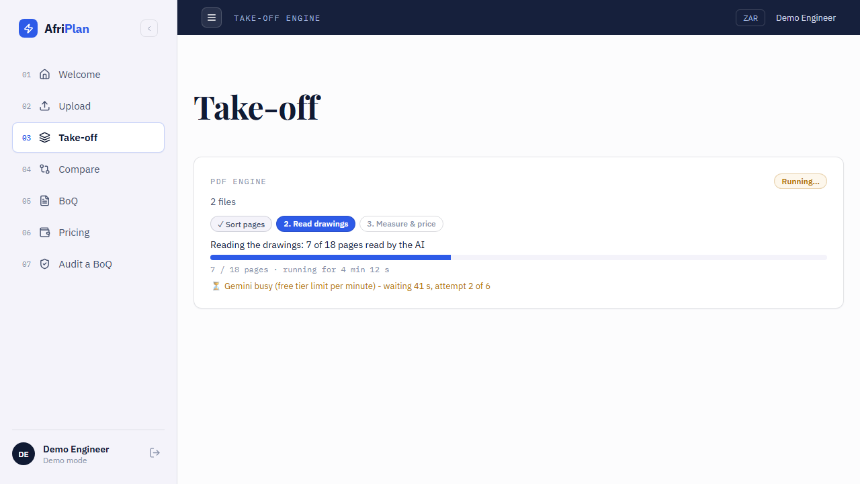


Take-off: watch the progress, then read the gaps
Live progress
step, pages done, time so far and the AI's “busy, waiting” note
Failures say why
e.g. Gemini's free daily limit is used up — and what to do instead
Then the results
drawing set, legend, coverage and the gap report
The Take-off page during a PDF run on the free Gemini tier
Notes:
While a PDF run works, the Take-off page shows the step (sort pages, read drawings, measure and price), pages done of total, the time so far and the AI provider's wait notes — so a slow free-tier run no longer looks dead. If it fails, the page says why, for example that Gemini's free daily limit is used up and what to do. When it passes: the drawing set panel, the legend, coverage and the gap report.

Slide 12



BoQ, pricing and export: the tender document
Bill of Quantities
every line with quantity, rate and its evidence tag; measured lines show their route
Audit a BoQ
any bill — yours, the QS's or the engineer's
Things to check
Arithmetic errors
Unpriced or untotalled lines
Duplicated lines
Roll-up and contingency errors
Sheets missing from the summary
Missing companion items
Which drawings a complete BoQ still needs
every assumption, most serious first — start the review here
Live pricing
request supplier quotes and apply the one you choose
Export & email
tender Excel and PDF, made on the server, ready to submit
Notes:
The BoQ lists every line with its quantity, rate and evidence tag. The gap report lists what to check, most serious first. Live Pricing requests quotes from suppliers and applies the one you pick. Export produces the tender Excel and PDF, with an email option. Audit a BoQ checks any bill — arithmetic, unpriced or untotalled lines, duplicates, roll-ups and contingencies, orphan sheets, missing companion items — and says which drawings a complete BoQ still needs.

Slide 13



DOE workflow: any project folder in, a priced BoQ out
1 · Prepare
2 · Read
3 · Finish
AfriPlan_Output
Python
Claude Code · subscription
Python
in the project folder
finds every PDF and DWG/DXF, sets old revisions aside, renders each page (whole, zoomed, legend, text)
reads every page and fills one strict form per page — only what is drawn
checks every form, reads the CAD set, combines both readers, prices once
Excel + PDF BoQ, things to check, summary — and an accuracy report when scored
Say to Claude Code: estimate the project in C:\Projects\My Job
It runs: $PY doe/execution/project.py prepare "<folder>" … finish "<folder>"
Notes:
Open the AfriPlan folder in VS Code with Claude Code and say: estimate the project in <folder>. Step 1 and step 3 are deterministic Python; only step 2 uses the AI, and it runs on your Claude subscription. Python renders every PDF page (whole page, zoomed quarters, the legend table, the text layer) and writes the form instructions; Claude Code reads each page and fills one strict form per page; Python checks every form — a missing or invalid form stops the run — reads the CAD set, combines both readers and prices once. The forms are saved, so every result can be reproduced.

Slide 14


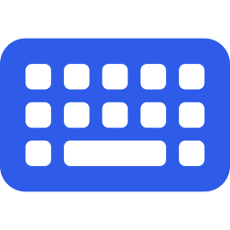
Set up on Windows or Mac in two commands
Tool | Version | Windows | macOS
Git | any | git-scm.com | xcode-select --install
Python | 3.12+ | python.org | brew install python@3.12
Node.js | 20+ | nodejs.org | brew install node
LibreDWG (optional) | 0.14 | releases → dwg2dxf.exe | brew install libredwg
Claude Code (optional) | latest | claude.com/claude-code | same
# once per computer
git clone https://github.com/
Jonathan-Lukwichi/afriplan-ai.git
cd afriplan-ai
python scripts/dev.py setup
# every time
python scripts/dev.py start
On a Mac, type python3 instead of python.
On Windows, clone into a short path (e.g. C:\dev) — very deep folders can break installs.
Keys (optional) go in api/.env: ANTHROPIC_API_KEY or GEMINI_API_KEY.
Notes:
Install Git, Python 3.12 or newer and Node.js 20 or newer. LibreDWG is optional and only needed for .dwg uploads (macOS: brew install libredwg). Claude Code is needed only for the DOE workflow. Then clone the repository and run setup once; start runs the backend and the app together. API keys are optional and go in api/.env, which is never committed.

Slide 15




We measure accuracy against a real, human-priced bill
Coverage
Reproduction Score (RS) — the headline
share of the real bill's value we produced at all
Σ value × found × quantity accuracy
÷ Σ value of the real bill
Precision
share of what we priced that belongs in the bill
Quantity accuracy
Example: a feeder worth R100 000 in the real bill, found with 90 % of the right length, adds R90 000 of the R100 000. An item never produced adds nothing. 100 % = every item, exact quantities.
how close our quantities are, where we have the item
Rate accuracy
how close our rates are — not in RS; moves the total
Weighted by rand value: a big feeder counts far more than a socket — that is how a tender is won or lost.
Total accuracy
bill total vs real total — can be right by luck
Notes:
Our bill is compared line by line with the quantity surveyor's priced Excel bill, matched by building and item type, so different wordings of the same item match. Every item is weighted by its rand value in the real bill. The headline is the Reproduction Score: the share of the real bill's value we reproduced with the right quantity. Coverage says whether we produced the item at all, precision whether what we priced belongs, quantity accuracy how close the quantities are. Rates are reported separately because they come from our pricing policy, not from reading drawings. Total accuracy can look good by luck when misses and extras cancel out.

Slide 16
Accuracy rose from 17 % to 58.5 % in two weeks
Frozen scorer (ADR-0003) on one real 7-building reference project. One project is not proof of general accuracy — a second reference project is the next step.
Notes:
Left: the best Reproduction Score on each date, all on the same reference project with the same frozen scorer (23 Sep PDF 16.9%; 26 Sep 17.8%; 27 Sep DXF as one project with site-plan routes 44.6%; 28 Sep combined DWG + PDF 47.2%; 2 Oct DOE combined 55.8%, then 58.5% with new form boxes). Right: today's DOE run by reader — CAD alone 48.7%, PDF read by Claude Code 50.6%, combined 58.5%. Coverage of the combined bill is 83%, precision 89%.

Slide 17
Where the missing 41.5 points are lost
17.0 pts
never produced — item in the real bill, absent from ours
12.1 pts
quantity too low — item present, too little of it
12.4 pts
quantity too high — item present, too much of it
Notes:
The missing points add up exactly to 100 minus the Reproduction Score. Section A — boards, feeders and trenches — loses 26.5 of the 41.5 points: 5.7 never produced, 10.2 with quantities too low, 10.6 too high. Wiring and trunking (B) loses 7.6, mostly never produced. Lighting loses only 1.4. By cause: 17.0 points are items never produced, 12.1 quantities too low and 12.4 too high.

Slide 18

Where the pipeline still misses — and the fix for each gap
# | What is missed | Points | Why | Approach
1 | Feeder network: cable sizes, earth, trench, sleeves, manholes | ≈ 19 | Sizes per feeder differ from the bill; trench measured per feeder; crossings never counted | Per-feeder size check (volt-drop sizing); trench as the union of routes; sleeves & manholes from the site plan
2 | Installation material: trunking, conduit, wire | ≈ 9 | Not drawn as symbols, so never produced | Run the completer on the delivered bill now (+2–3 pts); later measure trunking runs
3 | Distribution boards counted twice | 6.2 | The same board under two names in CAD and PDF | Better name pairing when the two readers are combined
4 | Connection fee | 1.5 | Never on any drawing | Rule: new supply on the SLD → provisional sum + gap item
5 | Fittings slightly over-counted | ≈ 1.4 | The same fitting read on two sheets | Check the sheet pairing for lighting and plug sheets
Rates move the total, not the score: board, trench and kiosk rates differ from the reference by 20–50 %. Refit them only after a second reference project — one bill is not enough.
Notes:
Ranked by points to win. 1: feeder network, about 19 points — our total cable length is close to the real one but the cable sizes per feeder differ from the bill; the earth cable, trench and sleeves follow the feeders; the trench is measured per feeder instead of once per shared route; sleeves and manholes are never produced. 2: derived installation material, about 9 points — trunking, conduit and wire never produced; the completer already adds 2 to 3 points but is not yet used on the delivered bill. 3: boards counted twice, 6.2 points. 4: connection fee, 1.5 points — never on a drawing. 5: fittings counted on two sheets, about 1.4 points.

Slide 19
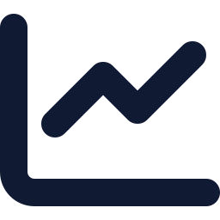


Conclusion: what to remember
58.5 % of the real bill
A first draft, reviewed
reproduced from the drawings alone today — 83 % of its value found, 89 % of what we price belongs
read “things to check” before you submit — every assumption is listed, most serious first
Use the right workflow
Next: feeders, material, a 2nd project
DOE in Claude Code for your own estimates (best score, no API bill); the web app for DWG/DXF jobs and demos
close the ≈ 19-point feeder gap, add installation material, then prove it on a second real project
Metric details: docs/accuracy-metrics.md · research: reports/SA electrical BoQ estimation problem.md
Notes:
AfriPlan already reproduces 58.5% of a real human-priced bill (83% coverage, 89% precision) from the drawings alone, and every doubt is listed. It is a fast, honest first draft that an estimator reviews, not a replacement for one. The next gains are known and ranked: feeder sizes and routes, installation material, board de-duplication, the connection-fee rule, and a second reference project to prove the numbers hold beyond one job.

