Slide 1


Fuel Calculator
Meeting presentation – 14.12.22

Slide 2
What we’ve done so far?

Slide 3
Theoretical research (Alon)
3 essential models for prediction car’s fuel consumption:
Engineer model – based on car’s and driving route’s parameters
Statistic model – based on the statistic on user’s drives.
Hybrid model – based on both former models
Advantages and disadvantages of each approach:
Statistic model | Engineer model

Slide 4
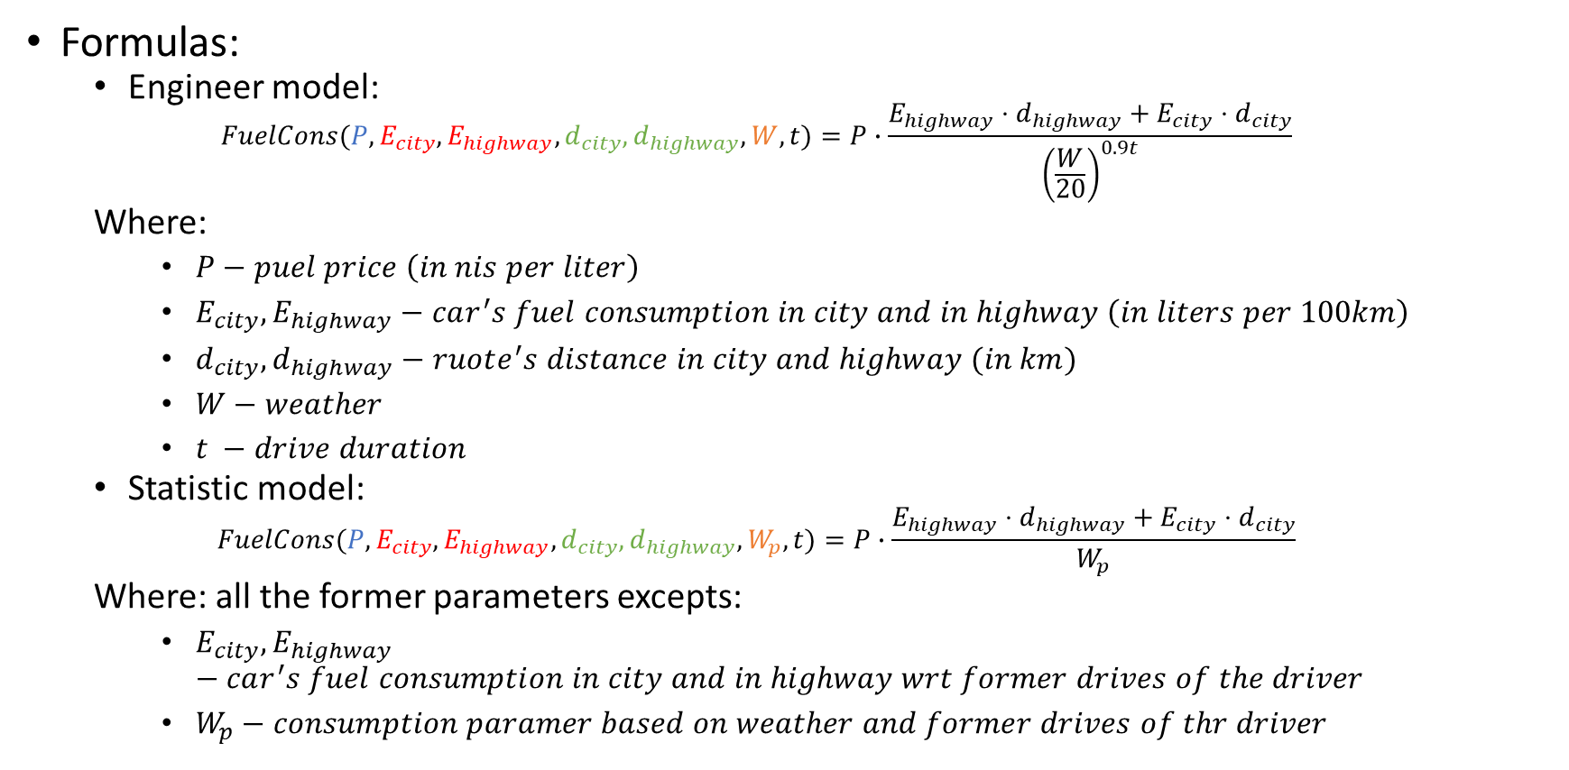
Theoretical research (Alon)
Formulas:
Engineer model:
$$FuelCons(P,E_{city},E_{highway},d_{city},d_{highway},W,t)=P∙\frac{E_{highway}⋅d_{highway}+E_{city}⋅d_{city}}{{\left(\frac{W}{20}\right)}^{0.9t}}$$
Where:
$P−puel price \left(in nis per liter\right)$
$E_{city},E_{highway}−car^{′}s fuel consumption in city and in highway \left(in liters per 100km\right)$
$d_{city},d_{highway}−ruote^{′}s distance in city and highway (in km)$
$W−weather$
$t −drive duration$
Statistic model:
$$FuelCons(P,E_{city},E_{highway},d_{city},d_{highway},W_{p},t)=P∙\frac{E_{highway}⋅d_{highway}+E_{city}⋅d_{city}}{W_{p}}$$
Where: all the former parameters excepts:
$E_{city},E_{highway}−car^{′}s fuel consumption in city and in highway wrt former drives of the driver$
$W_{p}−consumption paramer based on weather and former drives of thr driver$

Slide 5
Theoretical research (Alon)
Read more:

Slide 6
Data resources research (Liad)
Car’s fuel consumption:
Hebrew data can be extract from web form in auto.com website.
Large amount of data can be saved as .csv files from the Canadian government website.
Fuel prices:
All fuel types prices can be extract from Ali Ben-Atar website.
Supervised fix price of gasoline 95 can be extract form Ministry of Energy website.
Tools and methods:
Extract data from websites by http requests.
Understanding the http requests of each website – using Google chrome inspect tool.
Getting the asked data – using request python library.
Arranging and Saving the data to .csv files – using DataFrame object of pandas library in python.

Slide 7
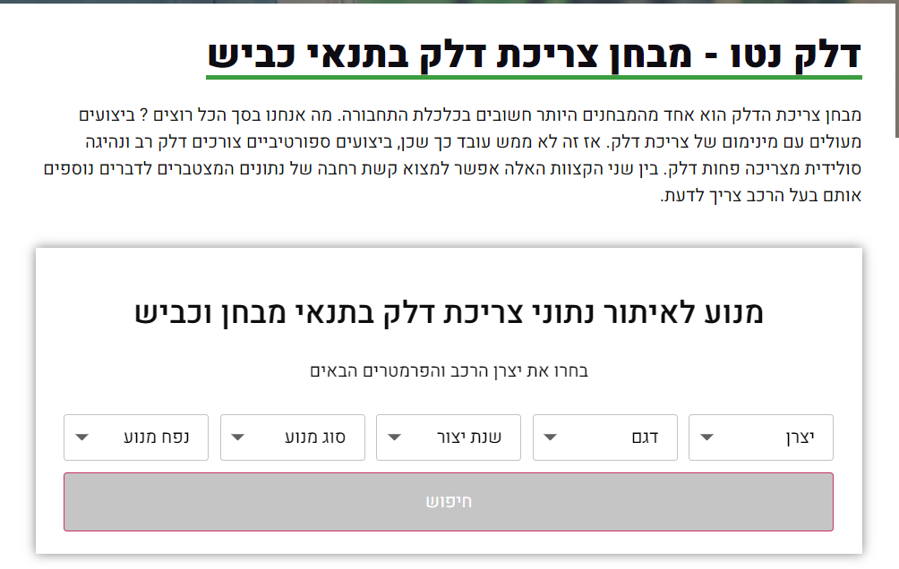
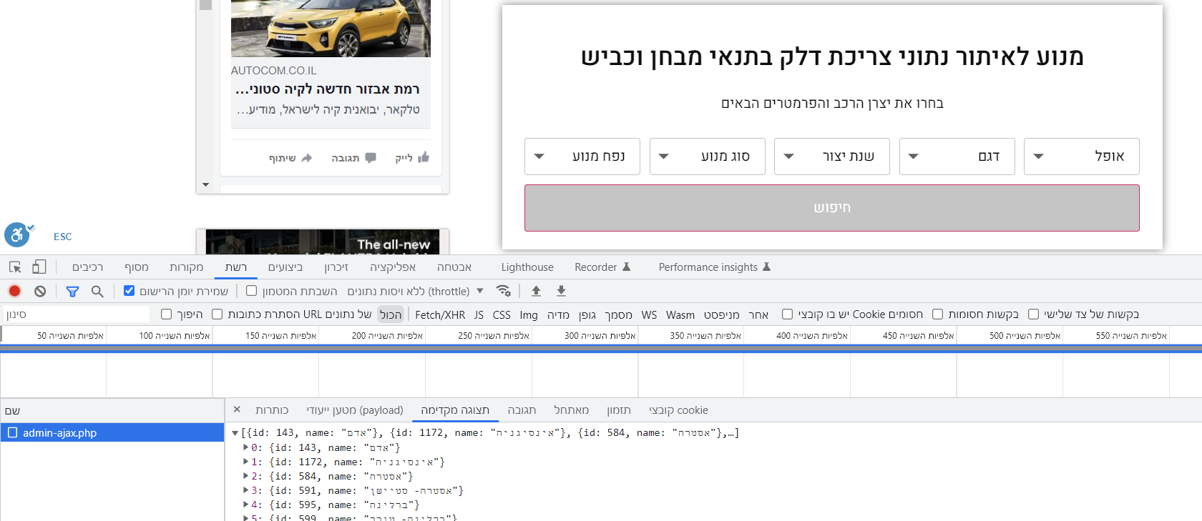
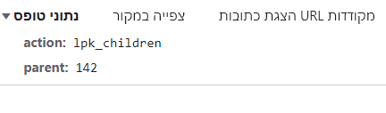
Data resources research (Liad)
Inspect http requests – auto.com:
Using inspect tool of Google chrome

Slide 8
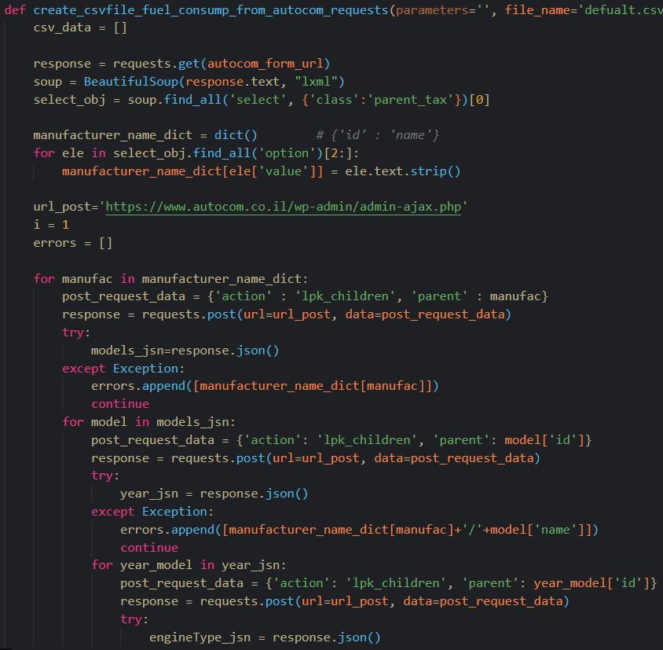
Data resources research (Liad)
Extract data:
Using python request library and BeautifulSoup library.
Save data into .csv file:
Using DataFrame objedt of pandas library in python.
Code examples:

Slide 9
Technical research (Jonathan)
GoogleMaps API, Waze API, Moovit API
Code Examples
Read more

Slide 10
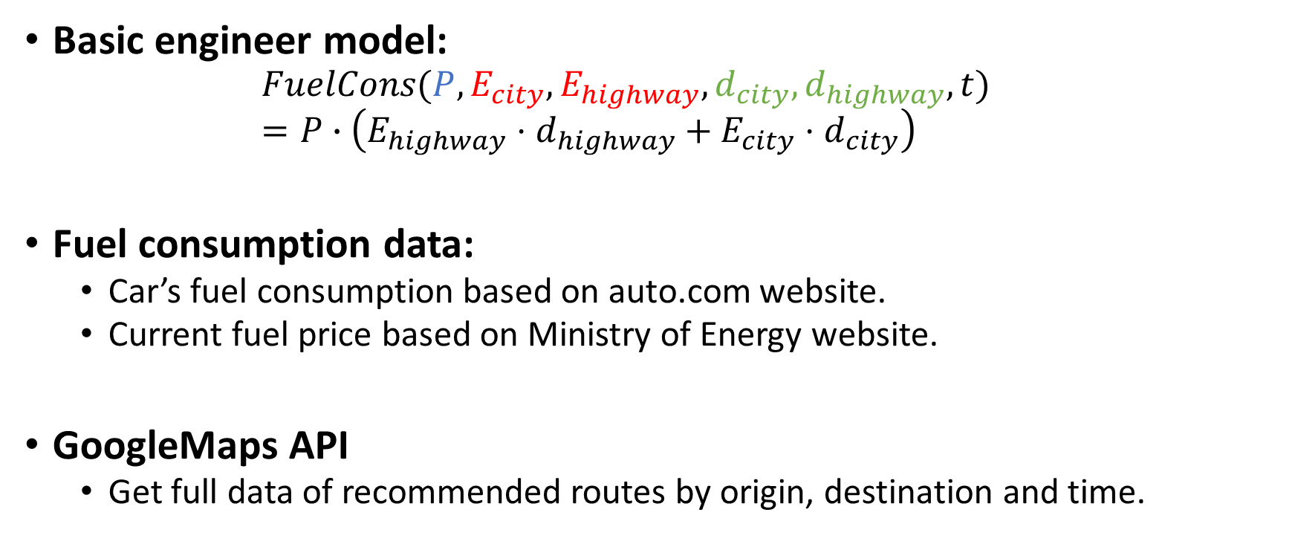
First version – Basic model design
Basic engineer model:
$$FuelCons(P,E_{city},E_{highway},d_{city},d_{highway},t)=P∙\left(E_{highway}⋅d_{highway}+E_{city}⋅d_{city}\right)$$
Fuel consumption data:
Car’s fuel consumption based on auto.com website.
Current fuel price based on Ministry of Energy website.
GoogleMaps API
Get full data of recommended routes by origin, destination and time.

Slide 11
First version – Basic model design
Code languages:
Backend – python
Frontend – html & javascript
Data base model:
Arrange in table.
.csv files contains car’s fuel consumption and current fuel price.

Slide 12
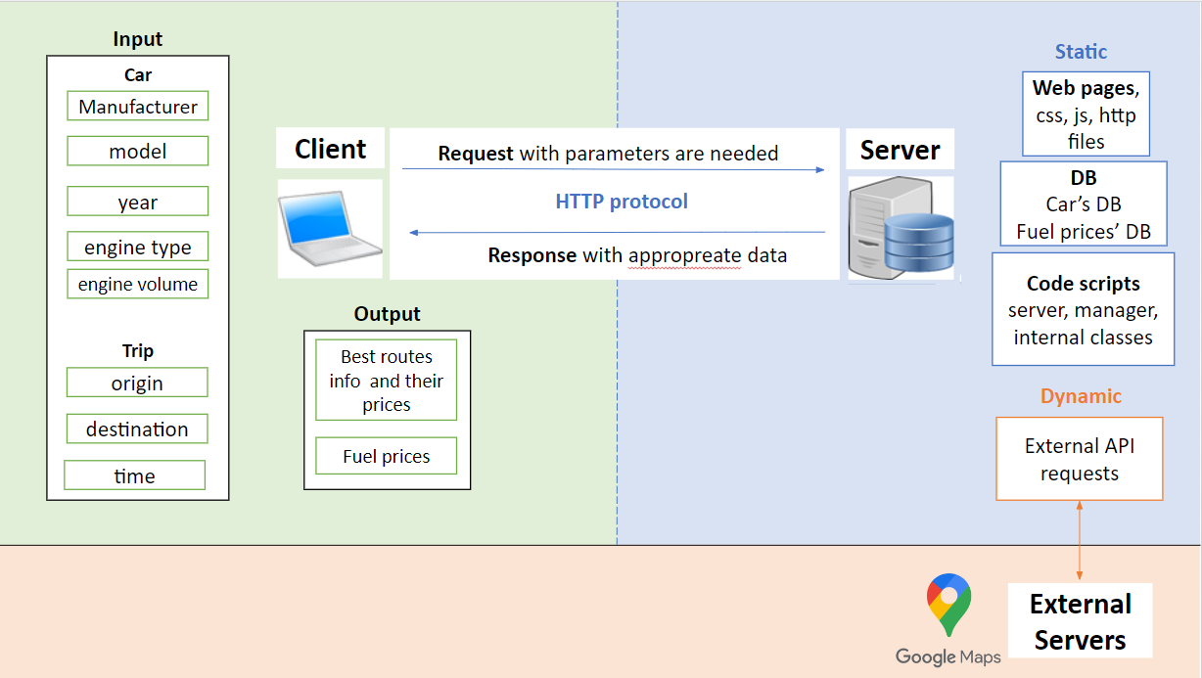
Client-Server Model and Base Logic

Slide 13
Project folders and files hierarchy:
Base Folder:
server.py .py server code (flask framework)
src codes
db_request.py .py class for db requests
google_maps_api_request.py .py class for googleMaps api requests
templates http pages
index.html .http home page
static
db Data base files
cleanDB_encoded.csv .csv table of cars consumption
fuel_prices_db.csv .csv fuel prices
js javascript files
app.js .js file with all the javascript code of index.html
style stylesheets files
style.css

Slide 14
Running examples

Slide 15
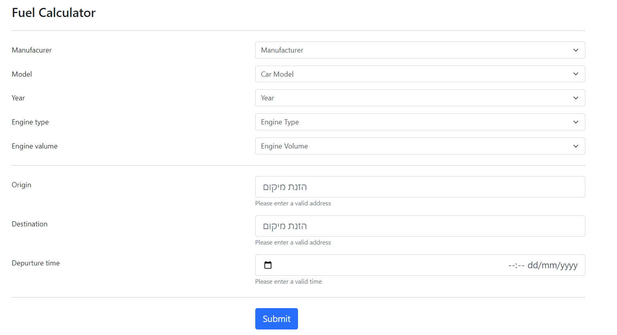
index.html

Slide 16
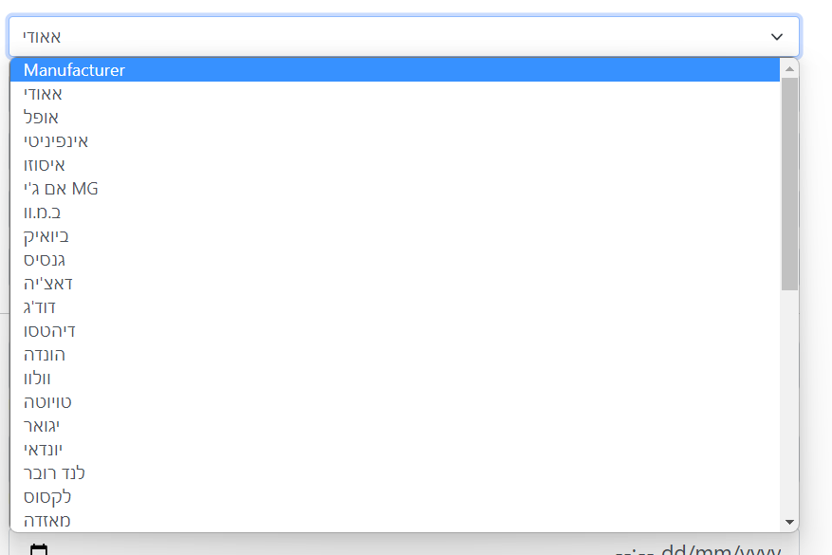


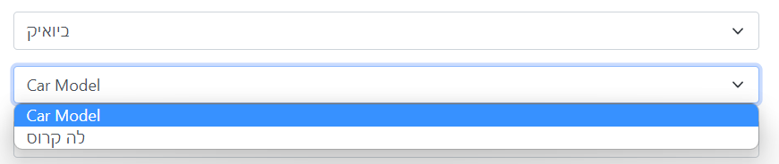

index.html
Server http request:
General:
Data:
DB request
Server http response:

Slide 17
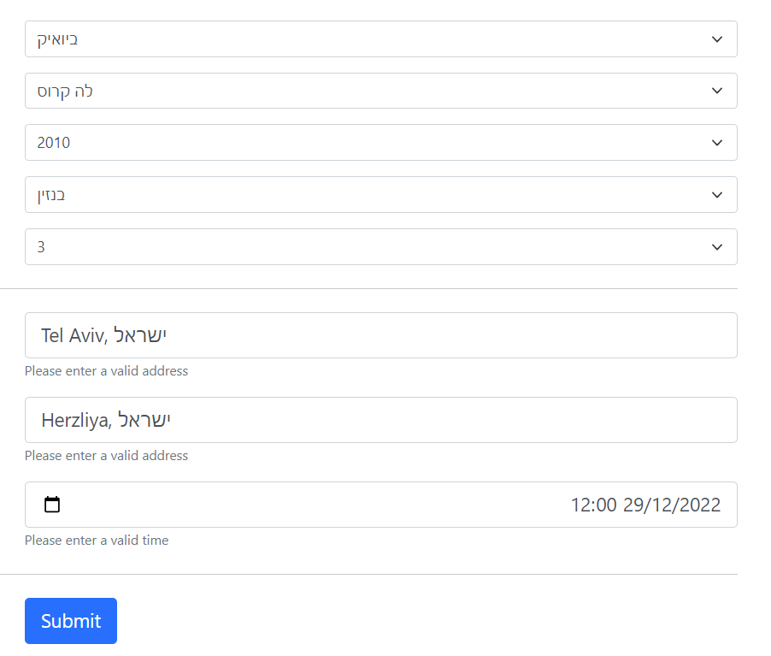

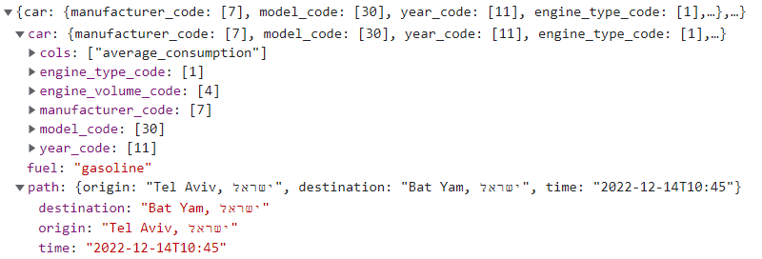
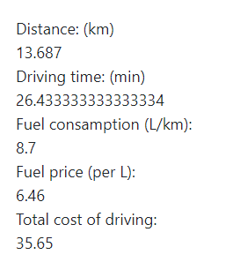
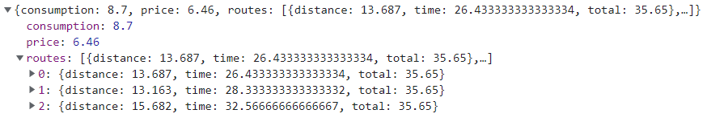
index.html
Server http request:
General:
Data:
DB request
GoogleMaps API requests
Server http response:

Slide 18
What are our next steps to Full first appropriate model?
Html page styling:
Easy web tools to style an http page
Example 1
DB extract code: Need to optimate and comment the code.
Routes data –
Is distance and time enough?
What about city and highway partition?
Get exact places in GoogleMaps and not only cities.
Model hierarchy and folders design:
https://itnext.io/best-folder-structure-for-your-next-project-a0d18ad1483a
https://climbtheladder.com/10-web-project-folder-structure-best-practices/
https://stackoverflow.com/questions/35807001/web-projects-folders-directories-structure-best-practices

Slide 19
What are our next steps to Full first appropriate model?
Create business logical layer: Object oriented code layer which will be the connection between the server (http requests) and other layers (such GoogMapsAPI, DB etc.)
Errors and input correctness handling:
Create our own errors which provide more information to client when error is occurred in server. Package response with errmsg and respstatus properties.
Check Input in client side using javascript and in server side using business layer.
Testing
Documenting

Slide 20
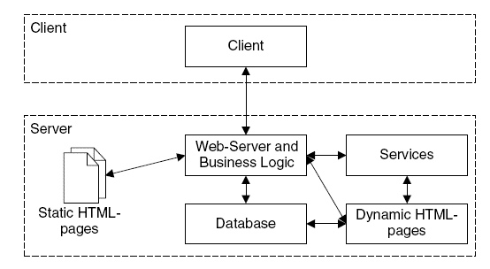
Example of web application model
Missing layer

Slide 21
Discussion

