Slide 1
Dividend Discount Model (DDM)

Slide 2
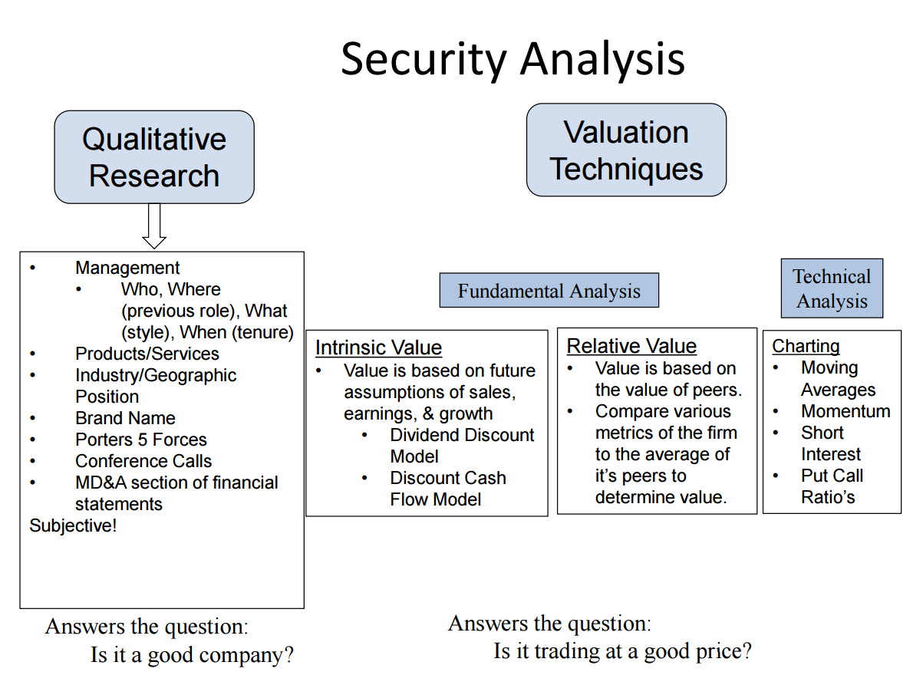

Slide 3
How to value a company
Add the cash flows?
Year 1 | Year 2 | Year 3
$100 | $100 | $100

Slide 4
Time Value of Money
Would you rather get $100:
Today OR
1 year from now

Slide 5
Cost of Capital
The rate at which company can raise capital
The rate that your debt holders/investors demand
Debt:
The rate you can get from a bank

Slide 6
Cost of Capital - Equity
Estimate risk that an investor takes on
Measure risk with Beta and Capital Asset Pricing Model
CAPM Rate = R_{f} + B(R_{m}-R_{f})
Risk Free Rate
Beta
Market Risk Premium

Slide 7

Time Value of Money
Discount Rate: 10%
Would you rather get $100:
Today OR
1 year from now
$$\frac{\$100}{1+r}=\frac{\$100}{1+0.1}=\frac{\$100}{1.1}=\$90.91$$
$$\$90.91×\left(1+r\right)=\$90.91×1.1=\$100$$

Slide 8
How to value a company
Discount Rate: 10%
Add the cash flows? NO, must discount
Year 1 | Year 2 | Year 3
$100 | $100 | $100
$$\frac{\$100}{(1+r)}+\frac{\$100}{{\left(1+r\right)}^{2}}+\frac{\$100}{{\left(1+r\right)}^{3}}=\$90.91+\$82.64+\$75.13=\$248.68$$
Year 1
Year 2
Year 3

Slide 9

Terminal Value
Discount Rate: 10% (r)
8% Initial growth rate
Year 1 | Year 2 | Year 3 | Terminal Value
$100 | $108 | $116.64 | 4% terminal growth rate (g)
$$\frac{\$100}{(1+r)}+\frac{\$108}{{\left(1+r\right)}^{2}}+\frac{\$116.64}{{\left(1+r\right)}^{3}}+\frac{\$121×\left(1+g\right)}{r−g}$$
$$=\$90.91+\$89.26+\$87.63+\$2097.33=\$2365.13$$

Slide 10
Dividend Discount Model
Replace the cash flows with dividends
Dividends represent cash flows to investors
Discount at the cost of equity

Slide 11
DDM – Constant growth
Just use terminal value
Growth Rate
4%
Time

Slide 12
DDM – 2 stage growth
Initial high growth
8%
Growth Rate
4%
Time

Slide 13
DDM – H Model
High growth tapers to steady growth
8%
Growth Rate
4%
Time

Slide 14
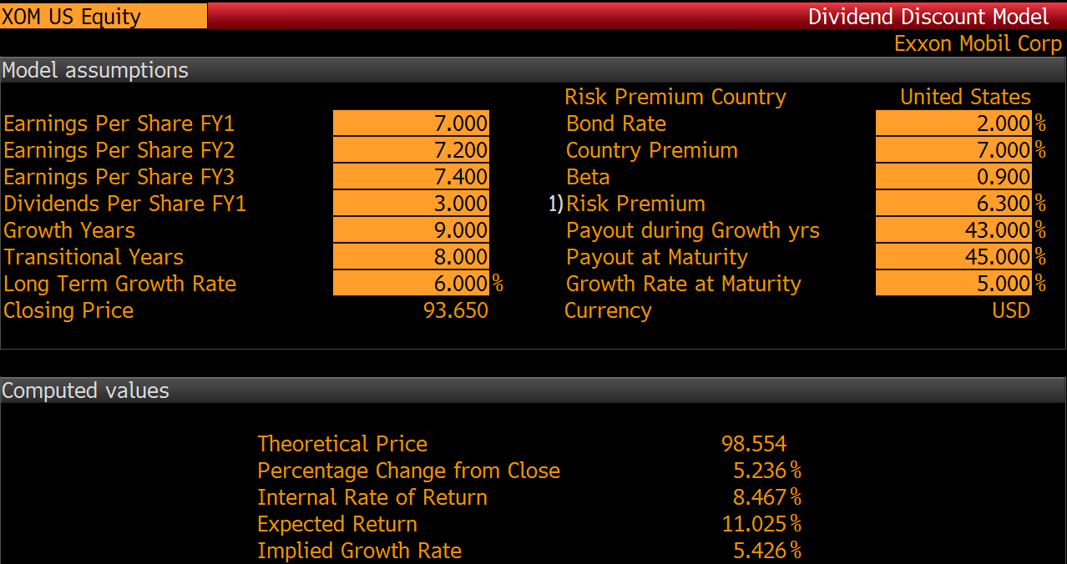
Dividend Payout Ratio Year 1 =
D/E = 3/7 = 43%
CAPM Rate = R_{f} + B(R_{m}-R_{f})
= 2 + 0.9(7) = 8.3%
Growth rate %
Years

Slide 15
DDM – What to focus on
# growth and transitional years
Initial growth rate and growth rate at maturity
Payout during growth and payout during maturity
Theoretical price vs current price
USE YOUR QUALITATIVE RESEARCH TO DETERMINE YOUR INPUTS

Slide 16
DDM – Additional thoughts
Is DDM reliable?
What if the company isn’t paying dividends?
Only 20% of US companies pay dividends
What if it’s a younger company?
Are dividends reflective of value?

