Slide 1
Leopard Gecko Enclosure Monitoring system (TempGecko)
Module: Technology Futures and Connected Living
Name: Jonathan Roddy
Knumber: K00212118
Programme: B.Sc. (Hons) in Software Development
Date: 06/04/21

Slide 2
TempGecko
This IoT application is a monitoring app. It allows the user to remotely monitor their pet gecko's enclosure from anywhere via an Android application.
This IoT application allows the user to activate a lightbulb, a heat mat, open a window as well as live streaming the enclosure online to the user. The android application reports on the status of the monitoring application, webcam, displays switches for the main light, heat mat and window as well as showing 3 views for the length of the light, current temperature, humidity and pressure.
The target audience for this app are primarily owners of leopard geckos as well as small lizards that need special conditions to have a healthy lifestyle.
Notes:
Clear and concise description of your app

Slide 3
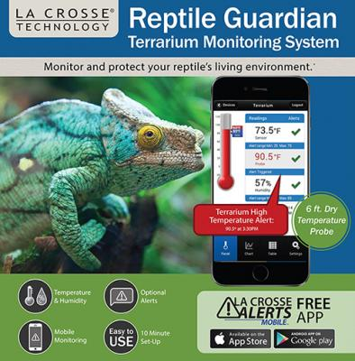
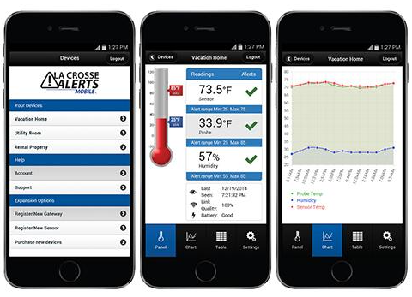
Reptile Guardian Monitoring System
Reptile Guardian Monitoring System is an Android application that is cloud based, wireless temperature, humidity and CO₂ monitoring System
It is used to monitor the current temperatures of your lizard's enclosure via .
Available in both basic and enhanced version which has more features for the end user to utilize.
Main features:
Includes one wireless temperature and humidity sensor with 6 ft. detachable dry temperature probe, gateway, LAN cable and AC adapter. Add up to 5 sensors (sold separately) per gateway.
Measures ambient air temperature and humidity and probe temperature (humidity NOT measured at the probe)
6 ft. detachable probe measures temperature of air, soil or other dry environments
Sensor LCD toggles temperature and humidity
Wall hanging or free standing weather resistant case
Sensor transmits to gateway in 200 ft. range
Humidity: 3% to 99% (%RH) and Temperature: -40°F to 140°F
2 “AAA” Alkaline batteries (not included)
Ref: reptilebasic.com 06/04/20
Ref: reptilebasic.com 06/04/20
Notes:
Detail at least one similar app in same domain: Ref: https://www.reptilebasics.com/thermometers/reptile-guardian-monitoring-system/

Slide 4
TempGecko
While Reptile Guardian is a great service for any lizard owner however where it is different to TempGecko is that it allows for actuation over the cloud.
Reptile Guardian is on sale for $69 and comes with one sensor with the option for an enhanced version that fives more features and sensors with an additional price.
TempGecko is a free application that can be downloaded and used for any user as long as they have, they hardware to match (Raspberry Pi, Sense Hat, LED’s, breadboard and a USB webcam)
TempGecko reports on the temperature, humidity and air pressure and updates the user via their Android application.
Notes:
Optional slide – maybe move to end of presentation but include this detail in your report
Ref: https://www.reptilebasics.com/thermometers/reptile-guardian-monitoring-system/

Slide 5
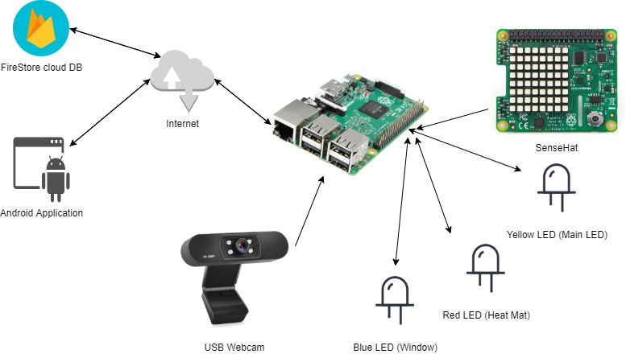
System Architecture
Notes:
Your system architecture Firebase Firestore Cloud Db
Raspberry Pi
SenseHat
3 LEDs to represent the actuations of the Main LED, Heat Mat and Window
Android Application

Slide 6
Sensors Used
I used Sense Hat which is an add-on for the Raspberry Pi that has many sensors available for the user.
The sensors that I used on the SenseHat are its Temperature, Humidity and Pressure sensors.
I am using these sensors to fetch the current values for each and store them on the cloud. The system checks if there is any difference every 1.5 seconds and updates each one accordingly.
Having these sensors available allows me to monitor the enclosure with high accuracy.

Slide 7
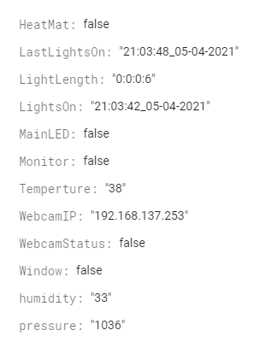
Web Server
For this application I am utilising Firebase as my Web Server to store variables online for later use. These variables can be access from both the Android application as well as the Raspberry Pi. Firebase is a cloud database offered by Google that allows user to start a free low tier cloud database that can be accessed via a web or android application.
I am also running a web server on the Raspberry Pi to be able to have a constant livestream based on its IP. This will then be available from my pc or android as long as they are on the same Wifi.
Firebase Attributes
Notes:
NB: In your report you should outline pros and cons of using a web service like AWS if you used one or if you would use one

Slide 8
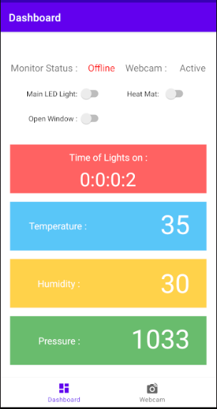
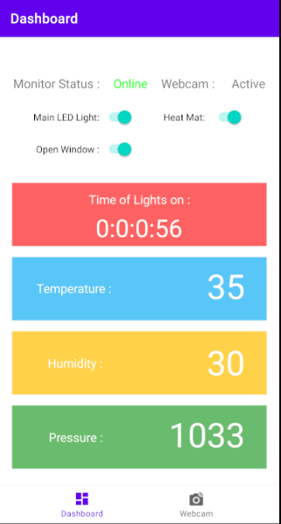
Actuation
TempGecko allows its users to turn on 3 devices that are connected to the system: Main over head LED, Heat mat and opening or closing a window.
This is all done manually over the cloud and will only work when the monitoring system is online.

Slide 9
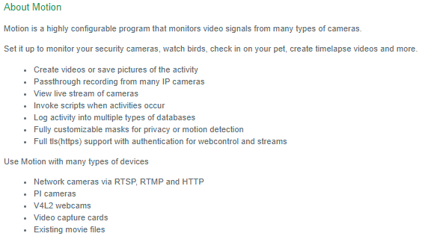
Additional Feature
An additional Feature I have enabled the use of a USB webcam that is always online so that the user may be able to watch over the enclosure.
For this livestream to work I had to instantiate a webserver on the raspberry pi for it to broadcast on its IP.
I had to install a library called ‘Motion’ which is a free download which is a highly configurable program that monitors video signals from many types of cameras.
After configuring this program, I was able to set the camera, framerate, size, stream port, quality and capture rate for the live stream.
If the Pi is online, it will broadcast this feed over the internet using its IP as the gateway to connect.
Ref: motion-project.github.io
Notes:
Ref: https://motion-project.github.io/index.html

Slide 10
Testing
Functional testing
I tested the system to be able to ensure that it installs and launches correctly
The system connects to the cloud correctly
Text Views, Switches, Views, WebView , Orientation working as intended.
The Raspberry pi launches correctly
Usability testing
Good layout and design principles utilised where appropriate.
Good response time
Installation testing
Android application installed and asked for web privileges.
Integration testing
Ran the system from start to finish to make sure the system is working as designed
System meets the needs of the requirements.
Connection with the Pi, Pi’s Motion webserver, Firebase and android studio working.
Notes:
I know testing will be limited given the circumstances!

Slide 11
Conclusion
TempGecko is a free application that can be downloaded to an Android device that allows its users to monitors their pet's enclosure remotely. Its goal was to show data to the user, allow them to activate lights, heat mat, a window while live streaming the feed to the user.
If this application was released normally the next steps, I would take it would be enabling a better data visualisation that allowed graphs like temp and humidity controls over a given timeframe. I could use this data to calculate the running cost on energy and find a coloration between the two. I would also like to bring this application to iOS and Web devices so that more people would be able to utilise this application.

