Slide 1
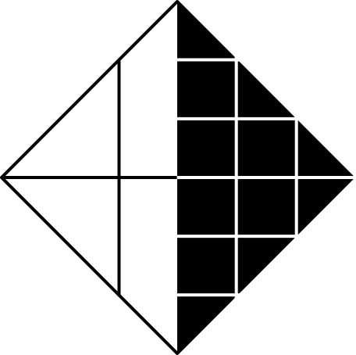


GPU / CUDA AND GRAPHICS PROCESSING TECHNOLOGY
陳家盛 111210554 資訊工程系二年級

Slide 2
Introduction to GPUs
What is a GPU?
A specialized hardware designed for accelerating graphics rendering and parallel computation.
Originally focused on graphics, now widely used in AI, machine learning, and scientific computing.
Why GPUs?
High parallel processing capability.
Efficiency in handling large-scale computations.

Slide 3
Evolution of GPUs
Early GPUs: Initially designed for 2D and 3D graphics rendering in video games, GPUs were limited to specific tasks.
Modern GPUs: Today, GPUs are used for general-purpose computing, driven by platforms like CUDA, which allow for high-performance computing in AI, scientific research, and more.

Slide 4
GPU Architecture
Core Design: GPUs have thousands of smaller cores for parallel processing, allowing them to handle massive data efficiently.
Memory Hierarchy: GPUs use multiple memory types, like global and shared memory, for different tasks, allowing for faster access and better performance.

Slide 5
Introduction to CUDA
What is CUDA?
CUDA (Compute Unified Device Architecture) is NVIDIA’s platform that allows developers to use C/C++ to program GPUs for general-purpose computing, not just graphics.
How CUDA Works:
CUDA allows for parallel computation by organizing threads into blocks and grids, enabling efficient execution of tasks across multiple cores.

Slide 6
Key Components of CUDA Programming
Programming Model: In CUDA, programs are divided into threads that are grouped into blocks and grids. This structure allows efficient parallel processing.
Memory Types: CUDA provides different memory types (global, shared, local) to optimize access and computation, making memory management key to performance.

Slide 7
Applications of GPUs
Gaming and Graphics: GPUs are essential for rendering high-quality graphics in real-time for video games, movies, and simulations.
AI and Machine Learning: GPUs accelerate tasks like training deep neural networks, where large datasets are processed in parallel.
Scientific Computing: GPUs speed up simulations and calculations in fields like climate modeling, physics, and medicine.

Slide 8
Benefits of Using GPUs and CUDA
Parallelism: GPUs can perform many calculations at the same time, making them ideal for tasks that require processing large datasets, such as machine learning and simulations. This parallelism leads to significant performance gains.
Efficiency and Speed: With thousands of cores, GPUs can handle complex computations much faster than CPUs. This is especially beneficial in fields like AI and scientific research, where large-scale processing is needed.
Cost-Effectiveness:While GPUs are expensive, their ability to handle massive workloads more efficiently reduces the need for additional hardware, making them a cost-effective solution for demanding applications.

Slide 9
Conclusion
Summary: GPUs, powered by CUDA, are not just for gaming anymore. They provide essential performance for high-performance computing, including AI, simulations, and data analysis.
Future of GPUs: As GPU technology evolves, it will continue to transform industries by enabling faster and more efficient computing. The future of GPUs is promising, with applications expanding across various fields.

Slide 10
Thank You
謝謝

