Slide 1
LLD
2013/11/21 cschen

Slide 2
LLD v.s. MCLinker
We're currently evaluating LLD and MCLinker. At the moment, MCLinker looks more promising. … (David )
Both use c++
  MCLinker: m_xxx (member variable is MFC style), not sync with llvm
    Since there is a bug in LLVM cmake script, we suggest you using auto-tools rather than cmake
  LLD: _xxx (Design Pattern style), c++11, sync with llvm (git llvm & lld and CMake build)
  LLVM, clang: Xaa (variable), xaa (function) (qt style) (function mixed style Xaa and xaa in llvm)
Size (.cpp and .h in lib, date:2013/11/21)
  Total (in lib/):
    MCLinker: 37,908+8,324=46,xxx
    LLD: 16,538+9,849=26,xxx
  X86+X86_64
    MCLinker: 4200
    LLD: 1300, but X86_64 work only for static link

Slide 3
Outline
What are linker doing : (2 slides)
LLD Introduction – from lld website : (slides 6..24).
  Extract from lld link steps from web
  Add code from lld source to explain the link steps
  Add Cpu0 backend code to explain the link steps how to work with your backend
ARM lld elf linker implementation ? : (1 slide)
C++11 : (1 slide)

Slide 4
What are linker doing
Resolve Relocation Records
Optimize
  Dead code stripping
  ...

Slide 5
Relocation Records
When the left hello world program be compiled, the following relocation records exist in obj.
extern int printf(const char *format, ...);
int main(void)
{
char *ptr = "Hello world!";
printf("%s\n", ptr);
}
llvm-objdump -r ch_hello.cpu0.o
...
RELOCATION RECORDS FOR [.rel.text]:
16 R_CPU0_HI16 $.str // %s
20 R_CPU0_LO16 $.str
32 R_CPU0_HI16 $.str1 // “Hello world!\n”
36 R_CPU0_LO16 $.str1
44 R_CPU0_PC24 printf
llvm-objdump -s ch_hello.cpu0.o
...
Contents of section .rodata.str1.1:
0000 48656c6c 6f20776f 726c6421 0025730a Hello world!.%s.
0010 00 .

Slide 6
LLD Introduction
The lld project aims to to be the built-in linker for clang/llvm. Currently, clang must invoke the system linker to produce executables. (from llvm web site)
http://lld.llvm.org/
Current Status
  lld is in its early stages of development.
  It can currently self host on Linux x86-64 with -static.
Build
  cmake -DCMAKE_CXX_COMPILER=g++ -DCMAKE_C_COMPILER=gcc -DCMAKE_CXX_FLAGS=-std=c++11 -DCMAKE_BUILD_TYPE=Debug -G "Unix Makefiles" ../src/

Slide 7
LLD Introduction - how
Internal structure Atom
  Like llvm IR, lld operating and optimize in Atom.
ELF reader/writer, Mach-O reader/writer, COFF
  Connect to any specific linker format by implement the concrete Read/Writer.
  e.g. Implement Microsoft link format Reader/Writer => extend lld to support Microsoft link format

Slide 8
Atom – list for reference... next page has figure
An atom is an indivisible chunk of code or data.
Typically each user written function or global variable is an atom.
In addition, the compiler may emit other atoms, such as for literal c-strings or floating point constants, or for runtime data structures like dwarf unwind info or pointers to initializers.

Slide 9
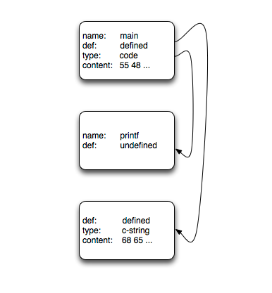
Atom
extern int printf(const char *format, ...);
int main(void)
{
char *ptr = "Hello world!";
printf("%s\n", ptr);
}
DefinedAtom
  95% of all atoms. This is a chunk of code or data
UndefinedAtom
  printf.
SharedLibraryAtom
  .so.
AbsoluteAtom
  This is for embedded support where some stuff is implemented in ROM at some fixed address.

Slide 10
Linking Steps
Command line processing
  lld -flavor gnu -target cpu0-unknown-linux-gnu hello.o printf-stdarg.o -o a.out
Parsing input files
  ELF reader (next slide) => create lld:File
Resolving
  dead code stripping
Passes/Optimizations
  Like llvm passes, give the backend chance to do something like optimization.
Generate output file
  Resolving Relocation Records (next slide) – I guess in this step

Slide 11
Parsing input files - Input Files
A goal of lld is to be file format independent.
The lld::Reader is the base class for all object file readers
Every Reader subclass defines its own “options” class (for instance the mach-o Reader defines the class ReaderOptionsMachO). This options class is the one-and-only way to control how the Reader operates when parsing an input file into an Atom graph

Slide 12
Parsing input files - Reader
Writer is same
~/test/lld/src/tools/lld/lib/ReaderWriter$ cat Reader.cpp
...
#include "lld/ReaderWriter/Reader.h"
#include "llvm/ADT/OwningPtr.h"
#include "llvm/ADT/StringRef.h"
#include "llvm/Support/MemoryBuffer.h"
#include "llvm/Support/system_error.h"
namespace lld {
Reader::~Reader() {
}
} // end namespace lld
~/test/lld/src/tools/lld/lib/ReaderWriter/ELF$ cat Reader.cpp
namespace lld {
namespace elf {
...
class ELFReader : public Reader {
public:
ELFReader(const ELFLinkingContext &ctx)
: lld::Reader(ctx), _elfLinkingContext(ctx) {}
error_code parseFile(std::unique_ptr<MemoryBuffer> &mb,
std::vector<std::unique_ptr<File> > &result) const {
…
private:
const ELFLinkingContext &_elfLinkingContext;
};
} // end namespace elf
std::unique_ptr<Reader> createReaderELF(const ELFLinkingContext &context) {
return std::unique_ptr<Reader>(new elf::ELFReader(context));
}
} // end namespace lld

Slide 13
Parsing input files - lld::File representations
In memory, abstract C++ classes (lld::Atom, lld::Reference, and lld::File).
  To be fast
textual (in YAML)
  atoms:
  - name: _main
  scope: global
  type: code
  content: [ 55, 48, 89, e5, 48, 8d, 3d, 00, 00, 00, 00, 30, c0, e8, 00, 00,
  00, 00, 31, c0, 5d, c3 ]
binary format (“native”)
  With this model for the native file format, files can be read and turned into the in-memory graph of lld::Atoms with just a few memory allocations. And the format can easily adapt over time to new features.

Slide 14
Resolving
Dead code stripping (if requested) is done at the end of resolving.
The linker does a simple mark-and-sweep. It starts with “root” atoms (like “main” in a main executable) and follows each references and marks each Atom that it visits as “live”.
When done, all atoms not marked “live” are removed.

Slide 15
Dead code stripping - example
Root atom
int main() {
return foo1();
}
static signed int i = 0;
void foo2(void) {
i = -1;
}
static int foo3() {
foo4();
return 10;
}
int foo1(void) {
int data = 0;
if (i < 0)
data = foo3();
data = data + 42;
return data;
}
void foo4(void) {
printf("Hi\n");
}
main
foo2
foo3
foo1
foo4

Slide 16
Linking Steps
Command line processing
  lld -flavor gnu -target cpu0-unknown-linux-gnu hello.o printf-stdarg.o -o a.out
Parsing input files
  ELF reader (next slide) => create lld:File
Resolving
  dead code stripping
Passes/Optimizations
  Like llvm passes, give the backend chance to do something like optimization.
Generate output file
  Resolving Relocation Records (next slide) – I guess in this step

Slide 17
Passes
stub (PLT) generation
GOT instantiation
order_file optimization
branch island generation
branch shim generation
Objective-C optimizations (Darwin specific)
TLV instantiation (Darwin specific)
DTrace probe processing (Darwin specific)
compact unwind encoding (Darwin specific)

Slide 18
Ild backend – file list
~/test/lld/src/tools/lld/lib/ReaderWriter/ELF/Cpu0$ ls
CMakeLists.txt Cpu0RelocationPass.cpp
Cpu0LinkingContext.cpp Cpu0RelocationPass.h
Cpu0LinkingContext.h Cpu0Target.h
Cpu0RelocationHandler.cpp Cpu0TargetHandler.cpp
Cpu0RelocationHandler.h Cpu0TargetHandler.h

Slide 19
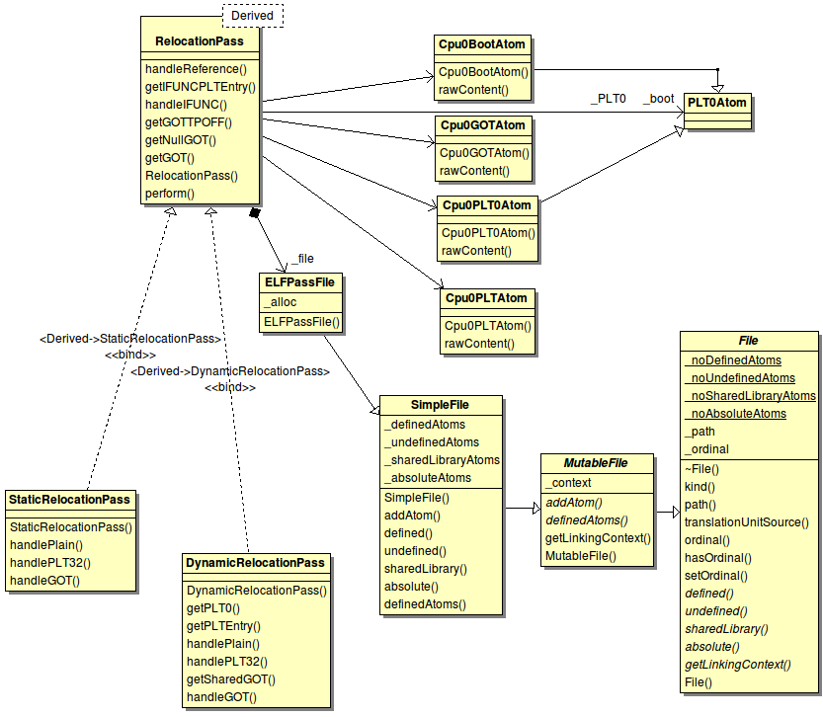
RelocationPass

Slide 20
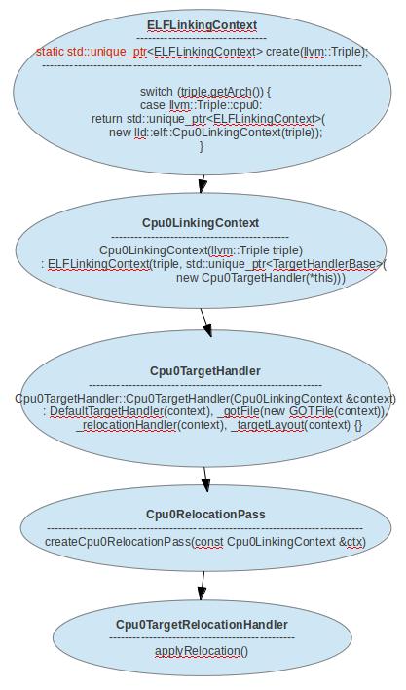
Register Relocation Pass
std::unique_ptr<Pass>
lld::elf::createCpu0RelocationPass(const Cpu0LinkingContext &ctx) {
switch (ctx.getOutputELFType()) {
case llvm::ELF::ET_EXEC:
if (ctx.isDynamic()) // 有參用到 shared lib
return std::unique_ptr<Pass>(new DynamicRelocationPass(ctx));
else
return std::unique_ptr<Pass>(new StaticRelocationPass(ctx));
case llvm::ELF::ET_DYN:
return std::unique_ptr<Pass>(new DynamicRelocationPass(ctx));
case llvm::ELF::ET_REL:
return std::unique_ptr<Pass>();
default:
llvm_unreachable("Unhandled output file type");
}
}

Slide 21
Linking Steps
Command line processing
  lld -flavor gnu -target cpu0-unknown-linux-gnu hello.o printf-stdarg.o -o a.out
Parsing input files
  ELF reader (next slide) => create lld:File
Resolving
  dead code stripping
Passes/Optimizations
  Like llvm passes, give the backend chance to do something like optimization.
Generate output file
  Resolving Relocation Records (next slide) – I guess in this step
After register Relocation Pass,
these 2 steps are executed interactively
(like the compiler parsing & code gen)

Slide 22
Generate Output File
All concrete writers (e.g. ELF, mach-o, etc) are subclasses of the lld::Writer class.
Every Writer subclass defines its own “options” class (for instance the mach-o Writer defines the class WriterOptionsMachO). This options class is the one-and-only way to control how the Writer operates when producing an output file from an Atom graph. – like reader (slide 11)

Slide 23
Generate output file - Writer
~/test/lld/src/tools/lld/lib/ReaderWriter$ cat Writer.cpp
...
#include "lld/Core/File.h"
#include "lld/ReaderWriter/Writer.h"
namespace lld {
Writer::Writer() {
}
Writer::~Writer() {
}
bool Writer::createImplicitFiles(std::vector<std::unique_ptr<File> > &) {
return true;
}
} // end namespace lld
~/test/lld/src/tools/lld/lib/ReaderWriter/ELF$ cat Writer.cpp
namespace lld {
std::unique_ptr<Writer> createWriterELF(const ELFLinkingContext &info) {
using llvm::object::ELFType;
...
switch (info.getOutputELFType()) {
case llvm::ELF::ET_EXEC:
if (info.is64Bits()) {
if (info.isLittleEndian())
return std::unique_ptr<Writer>(new
elf::ExecutableWriter<ELFType<support::little, 8, true>>(info));
else
return std::unique_ptr<Writer>(new
elf::ExecutableWriter<ELFType<support::big, 8, true>>(info));
...
} // namespace lld

Slide 24
Generate output file -
Link time address binding
ErrorOr<void> Cpu0TargetRelocationHandler::applyRelocation(
ELFWriter &writer, llvm::FileOutputBuffer &buf, const lld::AtomLayout &atom,
const Reference &ref) const {
switch (ref.kind()) {
case R_CPU0_NONE:
break;
case R_CPU0_HI16:
relocHI16(location, relocVAddress, targetVAddress, ref.addend());
break;
case R_CPU0_LO16:
relocLO16(location, relocVAddress, targetVAddress, ref.addend());
break;
...
}
return error_code::success();
}
extern int printf(const char *format, ...);
int main(void)
{
char *ptr = "Hello world!";
printf("%s\n", ptr);
}
extern int printf(const char *format, ...);
int main(void)
{
char *ptr = "Hello world!";
printf("%s\n", ptr);
}
main:
...
120: lui $2, 0 // R_CPU0_HI
124: addiu $2, $2, 0
128: st $2, 0($sp)
12c: jsub 16777212
llvm-objdump -r ch_hello.cpu0.o
...
RELOCATION RECORDS FOR [.rel.text]:
16 R_CPU0_HI16 $.str
20 R_CPU0_LO16 $.str
32 R_CPU0_HI16 $.str1
36 R_CPU0_LO16 $.str1
44 R_CPU0_PC24 printf
When meet this relocation record,
location: 120
targetVAddress: 0f28+7
llvm-objdump -s ch_hello.cpu0.o
...
Contents of section .rodata.str1.1:
0000 48656c6c 6f20776f 726c6421 0025730a Hello world!.%s.
0010 00 .
llvm-objdump -s a.out
...
Contents of section .rodata:
0f28 286e756c 6c290048 656c6c6f 20776f72 (null).Hello wor
0f38 6c642100 25730a00 7072696e 74662074 ld!.%s..printf t

Slide 25
Now, ...
Have show you how to
  add hook function to resolve relocation records
  Register Relocation Pass to enable hook function
Like llvm backend not just include .td; lld has backend structure to support backend
  List other part after presentation slides for reference

Slide 26
ARM lld elf linker implementation ?
Current backend exist in lld source code
  Hexagon, PPC, X86, X86_64
I bet the lld will have ARM in future
  Need time to wait. Use ld or MCLinker at this moment.
  Implement ARM lld will help us know ARM lld better than other IC design team.

Slide 27
c++11
std::unique_ptr
  The unique_ptr objects automatically delete the object they manage (using a deleter) as soon as they themselves are destroyed.
  Just like the Singlelten pattern in Design Pattern book or Smart Pointers in Effective C++ book.
  http://www.cplusplus.com/reference/memory/unique_ptr/
std::unique_ptr::get()
  pointer get() const noexcept;
  get pointer, Returns the stored pointer.
  http://www.cplusplus.com/reference/memory/unique_ptr/get/
std::move()
  for example:
  std::string bar = "bar-string";
  std::move(bar);
  // bar is null after std::move(bar);
  http://www.cplusplus.com/reference/utility/move/

