Slide 1
Tutorial: My LLVM backend Book Overview
Book License: LLVM license
Reference: http://jonathan2251.github.io/lbd/index.html
陳鍾樞

Slide 2
Motivation
LLVM has excellent material in front end document but NO good document in backend.
I learn backend by implement the LLVM backend code for Cpu0 which designed from my brother work for teaching purpose.
I learn backend through writing this tutorial since the LLVM backend complexity.
I join open source with this book.

Slide 3
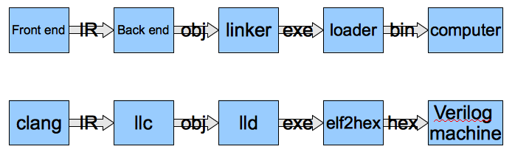
What I do

Slide 4
My book contents – Overview
Chapter 1: Preface and outline of chapters
Chapter 2: Cpu0 instruction set and LLVM structure
Chapter 3 – 9: Cpu0 mathematic instructions, Asm, Obj(ELF), Global variables, int, struct and arrays, other type, if else, while, for loop, function call
Chapter 10: ELF introduction and llvm-objdump -d support.
Chapter 11: AsmParser support.
Chapter 12: Verilog machine for Cpu0.
Chapter 13: lld linker for Cpu0.
Appendix A: LLVM source code and tools installation.

Slide 5
Tutorial: Creating an LLVM Backend for the Cpu0 Architecture
Over 600 pages of pdf book include full example code telling you how to write a llvm backend(llc), lld, elf2hex and verilog for Cpu0.
This is a professional book in compiler implementation, not just a concept of book
http://jonathan2251.github.com/lbd/index.html

