Slide 1
Tutorial: My LLVM backend Book Overview
Book License: LLVM license
Reference: http://jonathan2251.github.com/lbd/index.html
陳鍾樞

Slide 2
Agenda
Motivation
Book contents
Introduce Chapters 2 and 3 (Not quite details)
LLVM Backend document reference
Cpu0 reference
LLVM document
Q & A

Slide 3
Motivation
LLVM has excellent material in front end document but NO good document in backend.
I learn backend by implement the LLVM backend code for Cpu0 which designed from my brother work for teaching purpose.
I learn backend through writing this tutorial since the LLVM backend complexity.
I join open source with this book.

Slide 4
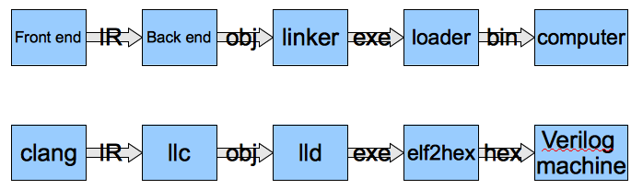
What I do

Slide 5
My book contents – Overview
Chapter 1: Preface and outline of chapters
Chapter 2: Cpu0 instruction set and LLVM structure
Chapter 3 – 9: Cpu0 mathematic instructions, Asm, Obj(ELF), Global variables, int, struct and arrays, other type, if else, while, for loop, function call
Chapter 10: ELF introduction and llvm-objdump -d support.
Chapter 11: AsmParser support.
Chapter 12: Verilog machine for Cpu0.
Chapter 13: lld linker for Cpu0.
Appendix A: LLVM source code and tools installation.

Slide 6
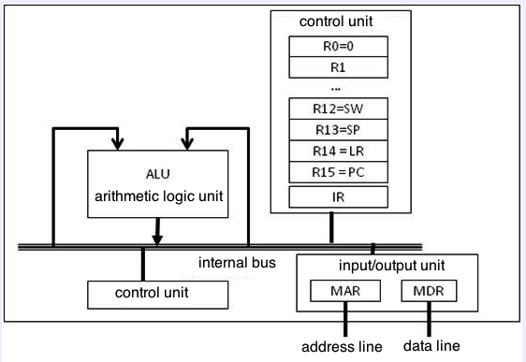
Ch 2 – Cpu0 arch.

Slide 7
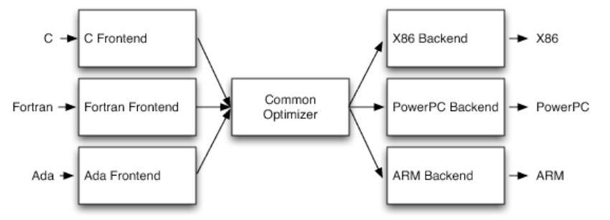
Ch 2 – LLVM structure -- 3 tier

Slide 8
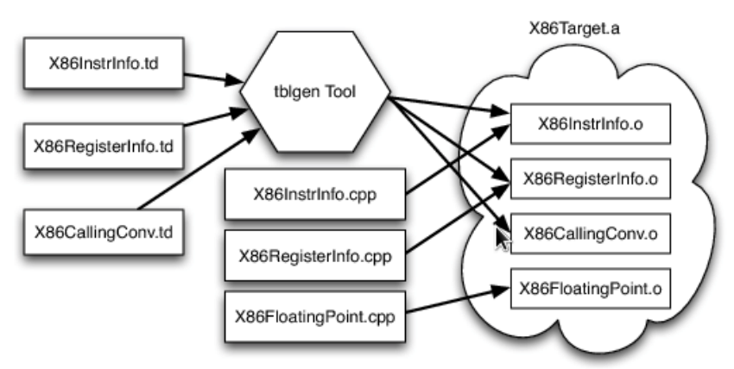
Ch 2 – .td file – target description

Slide 9
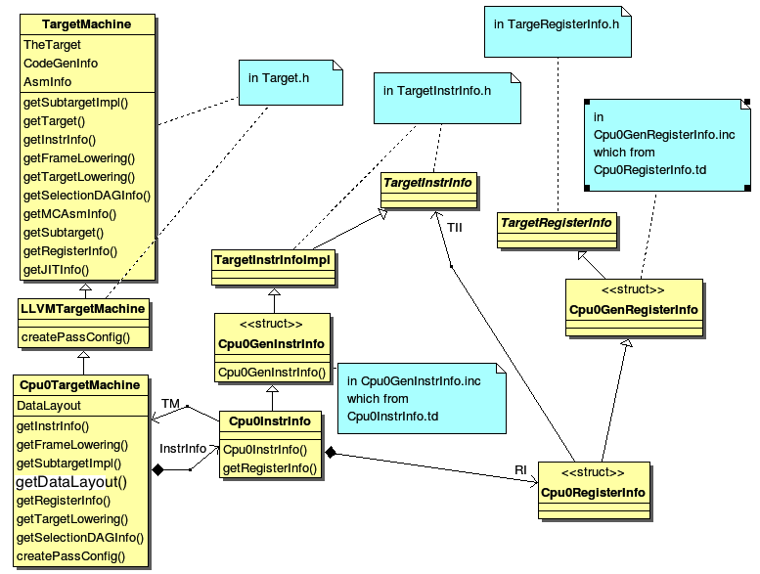
Ch 3 Backend structure – Cpu0TargetMachine

Slide 10
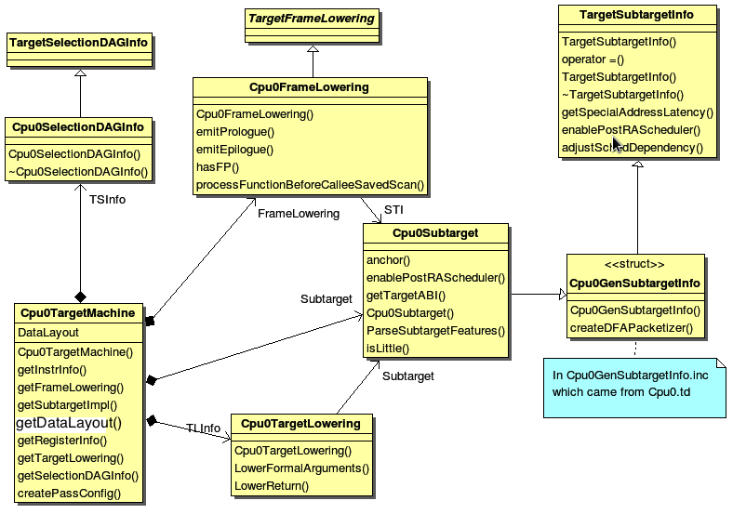
Ch 3 – Cpu0TargetMachine

Slide 11
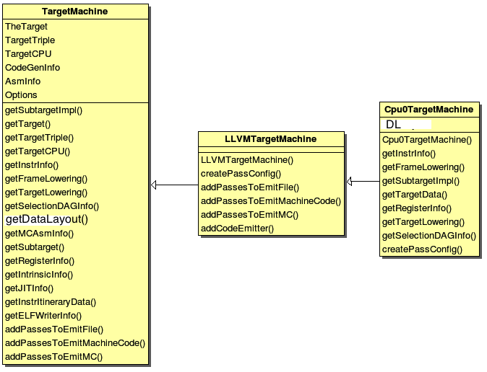
Ch 3 – TargetMachine members and operators

Slide 12
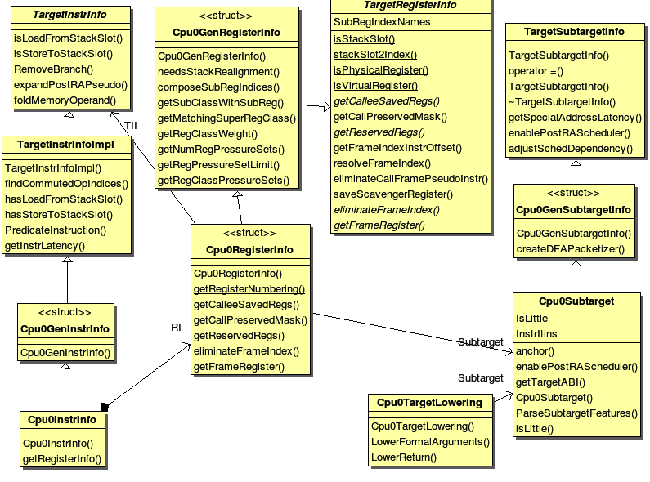
Ch 3 – Other class members and operators

Slide 13
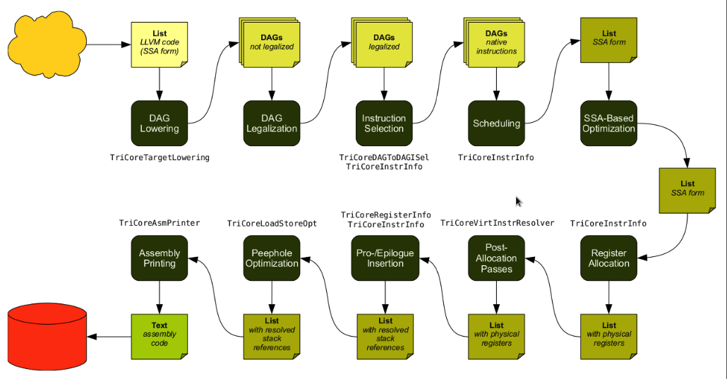
Ch 3 – Code generation sequence – Copied from tricore_llvm.pdf

Slide 14
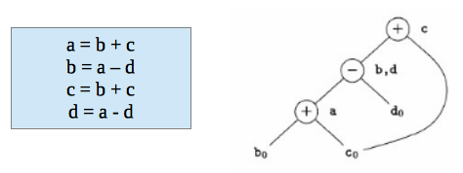
Ch 3 – DAG (Directed Acyclic Graph) example
a = b + c
d = a – d
c = d + c

Slide 15
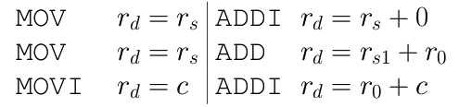
Ch 3 – IR and it’s corresponding machine instruction
MOV rd, rs | ADDI rd, rs, 0

Slide 16
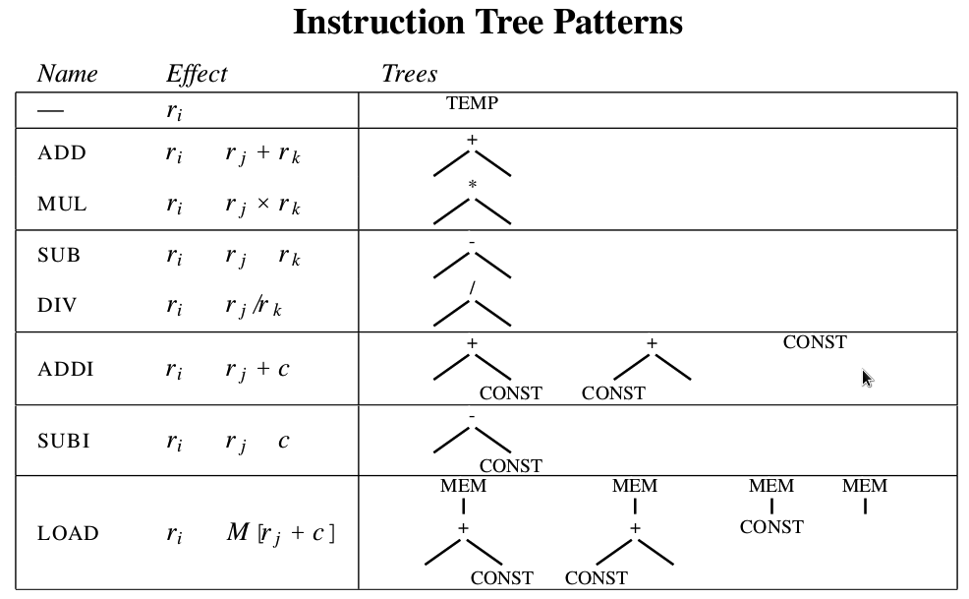
Ch 3 – Instruction DAG representation

Slide 17
File *.td.
*.td is Target Description.
Role: pattern for translate LLVM IR (Immediate Representation Code) DAG into Machine Instructions
As compiler book, pattern search for Code Generation. But more, it's a description language for pattern search and Instructions generation.

Slide 18
File *.td. – Example
class Cpu0Inst<dag outs, dag ins, string asmstr, list<dag> pattern,
InstrItinClass itin, Format f>: Instruction
{
field bits<32> Inst;
Format Form = f;
let Namespace = "Cpu0";
let Size = 4;
bits<8> Opcode = 0;
// Top 8 bits are the 'opcode' field
let Inst{31-24} = Opcode;
let OutOperandList = outs;
let InOperandList = ins;
let AsmString = asmstr;
let Pattern = pattern;
let Itinerary = itin;
// Attributes specific to Cpu0 instructions...
bits<4> FormBits = Form.Value;
// TSFlags layout should be kept in sync with Cpu0InstrInfo.h.
let TSFlags{3-0} = FormBits;
let DecoderNamespace = "Cpu0";
field bits<32> SoftFail = 0;
}

Slide 19
File *.td. – Example – cont.
class FL<bits<8> op, dag outs, dag ins, string asmstr, list<dag> pattern,
InstrItinClass itin>: Cpu0Inst<outs, ins, asmstr, pattern, itin, FrmL>
{
bits<4> ra;
bits<4> rb;
bits<16> imm16;
let Opcode = op;
let Inst{23-20} = ra;
let Inst{19-16} = rb;
let Inst{15-0} = imm16;
}
// Arithmetic and logical instructions with 2 register operands.
class ArithLogicI<bits<8> op, string instr_asm, SDNode OpNode,
Operand Od, PatLeaf imm_type, RegisterClass RC> :
FL<op, (outs RC:$ra), (ins RC:$rb, Od:$imm16),
!strconcat(instr_asm, "\t$ra, $rb, $imm16"),
[(set RC:$ra, (OpNode RC:$rb, imm_type:$imm16))], IIAlu> {
let isReMaterializable = 1;
}
def ADDiu : ArithLogicI<0x09, "addiu", add, simm16, immSExt16, CPURegs>;

Slide 20
Instruction Selection/Generation
class ArithLogicI<bits<8> op, string instr_asm, SDNode OpNode,
Operand Od, PatLeaf imm_type, RegisterClass RC> :
FL<op, (outs RC:$ra), (ins RC:$rb, Od:$imm16),
!strconcat(instr_asm, "\t$ra, $rb, $imm16"),
[(set RC:$ra, (OpNode RC:$rb, imm_type:$imm16))], IIAlu> {
let isReMaterializable = 1;
}
def ADDiu : ArithLogicI<0x09, "addiu", add, simm16, immSExt16, CPURegs>;
Tree
List
  (add %a, 5) → (addiu $r1, 5)
add
|
/ \
%a 5
addiu
|
/ \
$r1 5

Slide 21
Tutorial: Creating an LLVM Backend for the Cpu0 Architecture
Over 600 pages of pdf book include full example code telling you how to write a llvm backend(llc), lld, elf2hex and verilog for Cpu0.
This is a professional book in compiler implementation, not just a concept of book
http://jonathan2251.github.com/lbd/index.html

