Slide 1
Tutorial: LLVM backend
License: LLVM license
Reference: http://jonathan2251.github.com/lbd/index.html

Slide 2
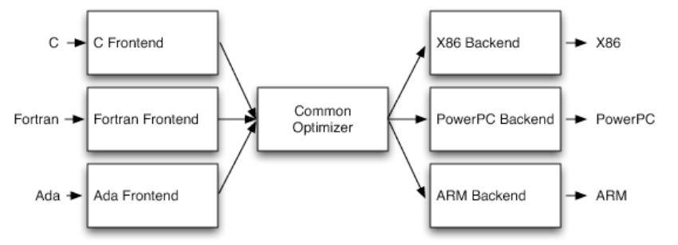
3 tier

Slide 3
File *.td.
*.td is Target Description.
Role: pattern for translate LLVM IR (Immediate Representation Code) DAG into Machine Instructions
As compiler book, pattern search for Code Generation. But more, it's a description language for pattern search and Instructions generation

Slide 4
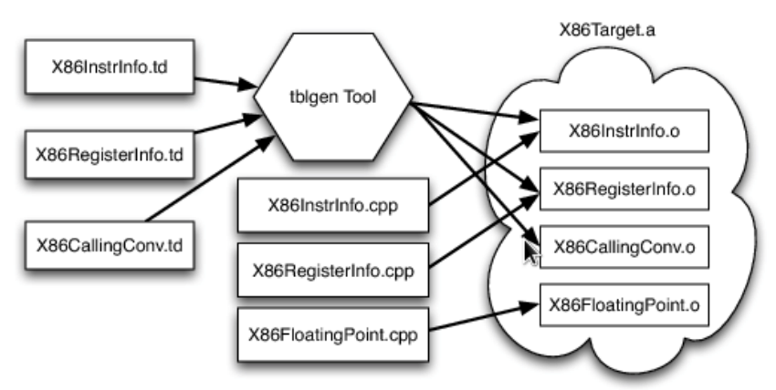
Target Description (.td)

Slide 5
File *.td. - Example:
class FL<bits<8> op, dag outs, dag ins, string asmstr, list<dag> pattern,
InstrItinClass itin>: Cpu0Inst<outs, ins, asmstr, pattern, itin, FrmL>
{
bits<4> ra;
bits<4> rb;
bits<16> imm16;
let Opcode = op;
let Inst{23-20} = ra;
let Inst{19-16} = rb;
let Inst{15-0} = imm16;
}
// Arithmetic and logical instructions with 2 register operands.
class ArithLogicI<bits<8> op, string instr_asm, SDNode OpNode,
Operand Od, PatLeaf imm_type, RegisterClass RC> :
FL<op, (outs RC:$ra), (ins RC:$rb, Od:$imm16),
!strconcat(instr_asm, "\t$ra, $rb, $imm16"),
[(set RC:$ra, (OpNode RC:$rb, imm_type:$imm16))], IIAlu> {
let isReMaterializable = 1;
}
def ADDiu : ArithLogicI<0x09, "addiu", add, simm16, immSExt16, CPURegs>;

Slide 6
Instruction Selection/Generation
class ArithLogicI<bits<8> op, string instr_asm, SDNode OpNode,
Operand Od, PatLeaf imm_type, RegisterClass RC> :
FL<op, (outs RC:$ra), (ins RC:$rb, Od:$imm16),
!strconcat(instr_asm, "\t$ra, $rb, $imm16"),
[(set RC:$ra, (OpNode RC:$rb, imm_type:$imm16))], IIAlu> {
let isReMaterializable = 1;
}
def ADDiu : ArithLogicI<0x09, "addiu", add, simm16, immSExt16, CPURegs>;
Tree
List
  (add %a, 5) → (addiu $r1, 5)
add
|
/ \
%a 5
addiu
|
/ \
$r1 5

Slide 7
Lower Operation - custom
Create IR DAG at run time
For example,
  2 different mode in global variable access
    Static (Absolute Addressing mode) and PIC (Program Independent Counter)
    llc -relocation-model=static;
    llc -relocation-model=pic;
Create IR DAG at run time of early DAG translation stage, and do instruction selection at later stage

Slide 8
  DAG - Global variable -static mode
Create (ADD (Hi(h1, h2), Lo (l1, l2))
SDValue Cpu0TargetLowering::LowerGlobalAddress(SDValue Op,
SelectionDAG &DAG) const {
...
if (getTargetMachine().getRelocationModel() != Reloc::PIC_) {
// %hi/%lo relocation
SDValue GAHi = DAG.getTargetGlobalAddress(GV, dl, MVT::i32, 0,
Cpu0II::MO_ABS_HI);
SDValue GALo = DAG.getTargetGlobalAddress(GV, dl, MVT::i32, 0,
Cpu0II::MO_ABS_LO);
SDValue HiPart = DAG.getNode(Cpu0ISD::Hi, dl, VTs, &GAHi, 1);
SDValue Lo = DAG.getNode(Cpu0ISD::Lo, dl, MVT::i32, GALo);
return DAG.getNode(ISD::ADD, dl, MVT::i32, HiPart, Lo);
}
...
}

Slide 9
  DAG - Global variable - pic mode
Create (load DAG.getEntryNode(), (Wrapper GetGlobalReg(), GA))
SDValue Cpu0TargetLowering::LowerGlobalAddress(SDValue Op,
SelectionDAG &DAG) const {
...
SDValue GA = DAG.getTargetGlobalAddress(GV, dl, ValTy, 0, GotFlag);
GA = DAG.getNode(Cpu0ISD::Wrapper, dl, ValTy, GetGlobalReg(DAG, ValTy), GA);
SDValue ResNode = DAG.getLoad(ValTy, dl, DAG.getEntryNode(), GA,
MachinePointerInfo(), false, false, false, 0);
...
}

Slide 10
Tutorial: Creating an LLVM Backend for the Cpu0 Architecture
200 pages of pdf book as well as Full Example Code tell you how to write a llvm backend
This is a professional book in compiler implementation, not just a concept of book
http://jonathan2251.github.com/lbd/index.html

