Slide 1
LLVM Polly evaluation
cschen 陳鍾樞2014/06/18
2015/03/31 update

Slide 2
Outline
Loop tiling
  Concept
    Reduce data cache miss (A*B) & correctness proof
  Analysis by oprofiler (loop bounds effect)
  Current limitation (polly is still improving)
Polybench-c-3.2 (tiling v.s. No-tiling)
Vectorize
Muti-core
Other optimization opportunity
Reference

Slide 3
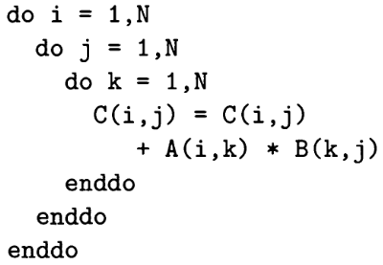
Data cache miss – regarding B
Assume data cache line size is 4 words,
After B(-,j) is read, the B(-,j+1) is in
cache too.
When N is large, the A(i,-)*B(-,j+1) will
be cache miss.
B(i,j) B(i,j+1): spatial locality.
j j+1
i
Cache line size = 16 bytes
A
B

Slide 4
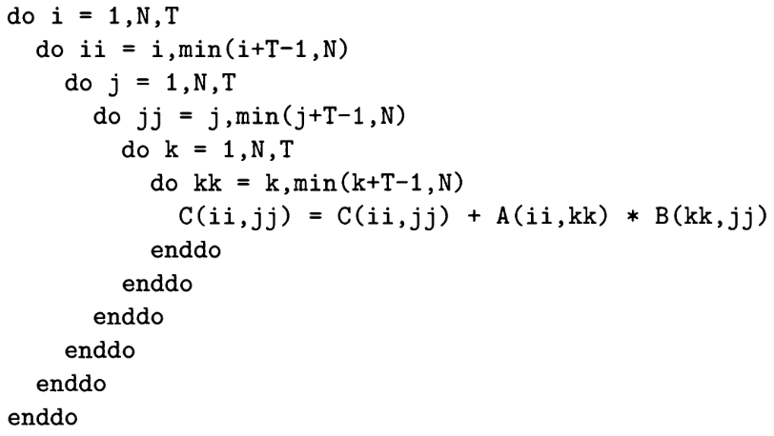
Tiling
Tile size

Slide 5
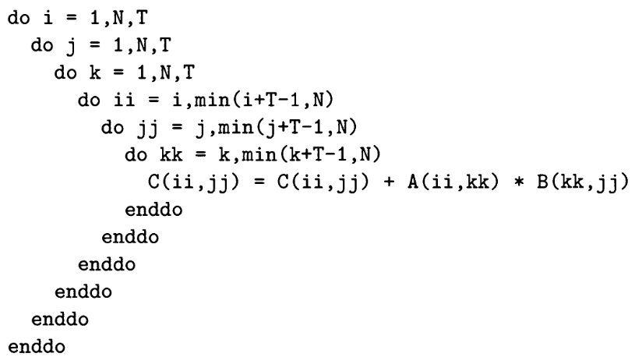
Tiling - Reduce data cache miss – Regarding B
Cache hit!
jj jj+1
ii
A
B

Slide 6
Tiling - Reduce data cache miss – Regarding A
1. a1*b1
2. a1*b2 cache hit
3. a1*b3 hit
…
a1 hit T-1 times, miss 1 time
b1 b2
a1
A
B

Slide 7
Data cache miss – Regarding A
1. A[1,1]*B[1,1]
…
2. A[1,N/2+1]*B[N/2+1]
(A[1,N/2+1] push A[1,1] out)
...
3. A[1,1]*B[2,1] (cache miss A[1,1])
…
A[1,1] never hit
Miss temporal locality
1 2
1
A
B

Slide 8
Tiling correctness – proof
1. a1*b1 (k=1)
2. aT1*bT1 (k=T+1)
3. aT2*bT2 (k=2T+1)
aT1
aT2
b1
a1
bT1
bT2
A
B

Slide 9
Tiling - note
Tile size select:
  The best value depends on:
    cache size, cache way, loop bounds, program
    Regard matmul.c. My X86-64 PC → 32; BG2 → 12
  So, the size is chosen by programmer as follows
    1. Init T refer to cache setting & program
    2. Try different T and choose the best value
Other name:
  Strip mine and interchange – original paper – Wolfe
  Unroll and jam - Callahan

Slide 10
Oprofile – analysis on X86-64
sudo time ./ocount --events=l1d_pend_miss:pending ./matmul
  l1d_pend_miss:
  0x01: (name=pending) L1D miss oustandings duration in cycles
matmul.c:
  As previous slide example code as well as the data type is float.
Compiler option:
  clang -O3 matmul.c (no tile)
  pollycc -mllvm -polly -mllvm -polly-ignore-aliasing -O3 matmul.c (tile)
My X86-64 Core i7:
  L1: data cache size 32KB, i cache size 32KB
  L2: 256KB
  L3: 8MB

Slide 11
Oprofile – analysis on X86-64
N=256
  (0.018 Sec/0.018=1, 0.332 Giga cycles/0.015=22)
N=512
  (0.16/0.13=1.2, 3.9/1.4=2.7)
N=768
  (1.35/0.42=3.2, 11.1/2.7=4.1)
N=1000
  (5.92/0.82=7.2, 13.19/0.19=69.4)
N=1024
  (6.62/1.21=5.4, 103.6/13.6=7.6)
N=1536
  (22.7/3.6=6.3, 277.5/34.8=7.9)
N=2048
  (65.8/9.6=6.8, 1792.4/93.9=19.0
N=3072
  (239.9/33.0=7.7, 6714.1/375.5=23.5)
N=4096
  (644.9/84.2=7.2, 18740.3/821.2=22.7) (661.5/83.9=7.8, 19326.8/793.2=24.3)
N=5120
  (1235.6/149.3=8.2, 33463.1/1447.0=23.1) (1198.8/150.0=7.9, 33551.3/1469.6=22.8)
Cache up 22 but the total data cache
miss amount is low as 0.332G. The
Instruction cycles take most of time
since matrix multiplication is
O(N*N*N).
When I use int instead of float result
(0.23/0.16=1.4, 0.286/0.012=23.8)
Note:
1. Both the instruction cycles and data cache miss is variable.
2. When N is small the data cache miss got 10 times variance if run the same program repeatedly, but when N is 3072 the variance is in 10%.

Slide 12
Oprofile – analysis on X86-64
A particular combination of
loop bounds and tile size
can be very effective for
Reducing collision misses
…
20.4.3 of ref 1.
Conclusion:
1. N up => (no tile / tile) data cache
miss up significantly.
2. N 1024 → 5120, data cache miss
7.6 → 23, speed up 5.4 → 8.2
(because instruction cycles
up too).

Slide 13
Matmul.c - tiling size 32 v.s. 12
For N=1000, best tile size
is 32 but not deserve to
pursue since low
difference.

Slide 14
Oprofile – on X86-64 – clang(O3/polly) vs gcc (O0/O3)
Clang -O3/-O3+polly
N=256
  (0.018 Sec/0.018, 0.332 Giga cycles/0.015)
N=512
  (0.16/0.13, 3.9/1.4)
N=768
  (1.35/0.42, 11.1/2.7)
N=1024
  (6.62/1.21, 103.6/13.6)
N=1536
  (22.7/3.6, 277.5/34.8)
N=2048
  (65.8/9.6, 1792.4/93.9)
N=3072
  (239.9/33.0, 6714.1/375.5)
Gcc -O0/O3
N=256
  (0.078 Sec/0.011, 0.285 Giga cycles/0.088)
N=512
  (0.56/0.05, 2.6/0.9)
N=768
  (2.50/0.35, 10.1/2.8)
N=1024
  (15.05/1.72, 85.9/24.5)
N=1536
  (58.8/6.1, 385.8/155.0)
N=2048
  (142.2/18.8, 1357.5/539.0)
N=3072
  (609.6/62.5, 5127.0/1850.1)

Slide 15
Current limitation
static int m = 1000;
static int n = 1000;
int i, j, j1, j2;
for (j = 0; j < m; j++)
{
mean[j] = 0.0;
for (i = 0; i < n; i++)
mean[j] += data[i][j];
mean[j] /= float_n;
}
#define M 1000
#define N 1000
for (j = 0; j < M; j++)
{
mean[j] = 0.0;
for (i = 0; i < N; i++)
mean[j] += data[i][j];
mean[j] /= float_n;
}

Slide 16
Current limitation
// polybench.h
/* Scalar loop bounds in SCoPs. By default, use parametric loop bounds. */
# ifdef POLYBENCH_USE_SCALAR_LB
# define POLYBENCH_LOOP_BOUND(x,y) x
# else
/* default: */
# define POLYBENCH_LOOP_BOUND(x,y) y
# endif
// covariance.h
# ifdef STANDARD_DATASET /* Default if unspecified. */
# define N 1000
# define M 1000
# endif
# define _PB_N POLYBENCH_LOOP_BOUND(N,n)
# define _PB_M POLYBENCH_LOOP_BOUND(M,m)

Slide 17
Current limitation
// covariance.c
static
void kernel_covariance(int mm, int nn,
DATA_TYPE float_n,
DATA_TYPE POLYBENCH_2D(data,M,N,m,n),
DATA_TYPE POLYBENCH_2D(symmat,M,M,m,m),
DATA_TYPE POLYBENCH_1D(mean,M,m))
{
static int m = 1000;
static int n = 1000;
int i, j, j1, j2;
...
/* Calculate the m * m covariance matrix. */
for (j1 = 0; j1 < _PB_M; j1++)
for (j2 = j1; j2 < _PB_M; j2++)
{
symmat[j1][j2] = 0.0;
for (i = 0; i < _PB_N; i++)
symmat[j1][j2] += data[i][j1] * data[i][j2];
symmat[j2][j1] = symmat[j1][j2];
}
...

Slide 18
Current limitation
Clang option and -D need:
  Polly-ignore-aliasing, -DPOLYBENCH_USE_SCALAR_LB
  Author (Tobias) mail as follows,
-polly-ignore-aliasing:
We still miss run-time alias checks, so you need to declare that no aliasing will happen
-DPOLYBENCH_USE_SCALAR_LB
Otherwise, polybench will generate a mix of scalar and parametric loop bounds. We can work with that, but the generated code still needs some tuning.
Cheers,
Tobias

Slide 19
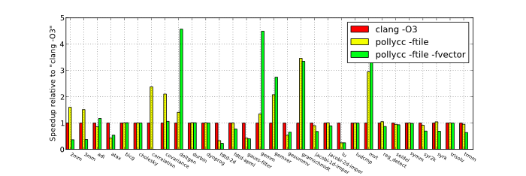
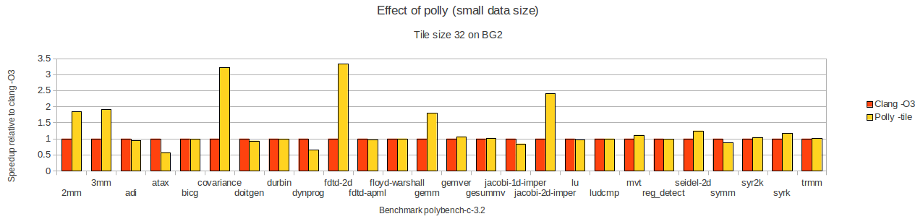
Polybench-c-3.2 - tiling v.s. No-tiling
Small data size
Result: My build and run on BG2

Slide 20
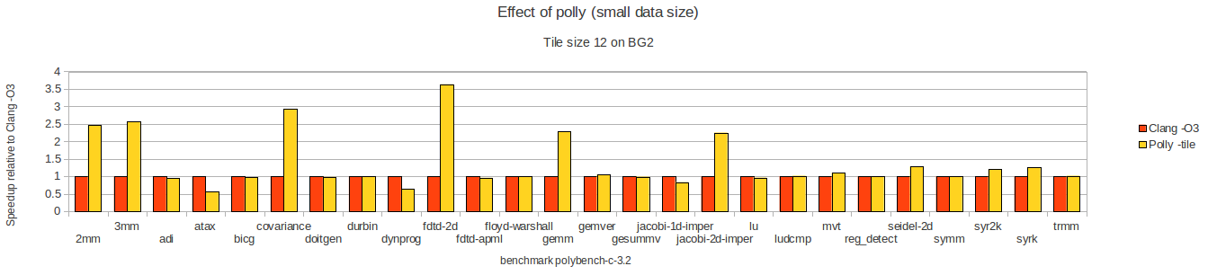
Polybench-c-3.2 – small data size - tiling size 32 v.s. 12
For different benchmark, the N is different.

Slide 21
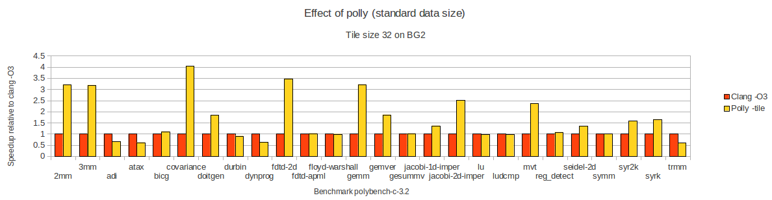

Polybench-c-3.2 – standard data size - tiling size 32 v.s. 12

Slide 22
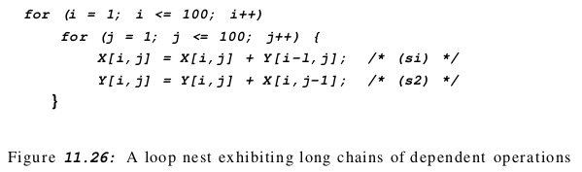
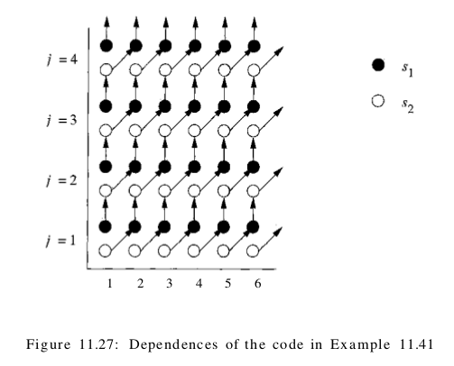
Loop optimization
– data locality & parallel
Data locality & parallel optiomization are same thing in loop optimization
Data dependence,
Synchronization,
communication

Slide 23
Loop optimization
– data locality & parallel
Create M[2][100][100] can formulate this example
By Polyhedra (convex region with polynomial form) is more effective to formulate dependence relationship
Polyhedra model is a systematic way for loop optimization in compiler
Leave the concept of Polyhedra introduction next time

Slide 24
Vectorize
Polly version 3.4 has no effect in vector instruction but the previous slide has it
  Clang has vectorizer now (as Tobias's following email)
Hi chencs,
the numbers you are seeing are from 2011 and should probably be updated. If you want to reproduce them, you need to use the corresponding LLVM/Polly versions.
If you are interested in the Polly version from today, the numbers probably do not apply any more. LLVM meanwhile got a vectorizer which should have improved the LLVM vector baseline. The benefits of tiling should still be as visible as before.
Cheers,
Tobias

Slide 25
Vectorize
Clang -O3: has vectorize
Polly has vectorize but clang is better
The order of options does not matter:
  Clang -O3 -mllvm -polly -mllvm -polly-vectorizer=polly
  Clang -mllvm -polly -mllvm -polly-vectorizer=polly -O3

Slide 26
Gcc-loops benchmark
1. Example 7
2. Example 12
3. Example3

Slide 27
Example7 – X86-64 -
Why polly make it worse
__attribute__((noinline))
void example7 (int x) {
int i;
/* feature: support for read accesses with an unknown misalignment */
for (i=0; i<N; i++){
a[i] = b[i+x];
}
}
vec(clang)+tile
define void @_Z8example7i(i32 %x) #2 {
.split:
%0 = zext i32 %x to i64
br label %polly.loop_header
polly.loop_exit: ; preds = %polly.loop_header
ret void
polly.loop_header: ; preds = %polly.loop_header, %.split
%polly.indvar = phi i64 [ 0, %.split ], [ %polly.indvar_next, %polly.loop_header ]
%p_ = add i64 %polly.indvar, %0
%p_scevgep = getelementptr [2048 x i32]* @a, i64 0, i64 %polly.indvar
%sext = shl i64 %p_, 32
%p_14 = ashr exact i64 %sext, 32
%p_18 = getelementptr inbounds [2048 x i32]* @b, i64 0, i64 %p_14
%vector_ptr = bitcast i32* %p_18 to <4 x i32>*
%_p_vec_full = load <4 x i32>* %vector_ptr, align 8
%vector_ptr22 = bitcast i32* %p_scevgep to <4 x i32>*
store <4 x i32> %_p_vec_full, <4 x i32>* %vector_ptr22, align 16
%polly.indvar_next = add nsw i64 %polly.indvar, 4
%polly.loop_cond = icmp slt i64 %polly.indvar, 1020
br i1 %polly.loop_cond, label %polly.loop_header, label %polly.loop_exit
}
None or vec(clang)
define void @_Z8example7i(i32 %x) #2 {
%1 = sext i32 %x to i64
%scevgep = getelementptr [2048 x i32]* @b, i64 0, i64 %1
%scevgep2 = bitcast i32* %scevgep to i8*
call void @llvm.memcpy.p0i8.p0i8.i64(i8* bitcast ([2048 x i32]* @a to i8*), i8* %scevgep2, i64 4096, i32 4, i1 false)
ret void
}
X86-64 ex7 is better while BG2 is tie
with vectorize. Why?
Can arm's memcpy be improved?

Slide 28
Example12 - X86-64
vec(clang)
define void @_Z9example12v() #2 {
vector.ph:
br label %vector.body
vector.body: ; preds = %vector.body, %vector.ph
%index = phi i64 [ 0, %vector.ph ], [ %index.next, %vector.body ]
%0 = getelementptr inbounds [2048 x i32]* @a, i64 0, i64 %index
%1 = trunc i64 %index to i32
%broadcast.splatinsert3 = insertelement <4 x i32> undef, i32 %1, i32 0
%broadcast.splat4 = shufflevector <4 x i32> %broadcast.splatinsert3, <4 x i32> undef, <4 x i32> zeroinitializer
%induction5 = add <4 x i32> %broadcast.splat4, <i32 0, i32 1, i32 2, i32 3>
%induction6 = add <4 x i32> %broadcast.splat4, <i32 4, i32 5, i32 6, i32 7>
%2 = bitcast i32* %0 to <4 x i32>*
store <4 x i32> %induction5, <4 x i32>* %2, align 16
%.sum7 = or i64 %index, 4
%3 = getelementptr [2048 x i32]* @a, i64 0, i64 %.sum7
%4 = bitcast i32* %3 to <4 x i32>*
store <4 x i32> %induction6, <4 x i32>* %4, align 16
%index.next = add i64 %index, 8
%5 = icmp eq i64 %index.next, 1024
br i1 %5, label %middle.block, label %vector.body, !llvm.loop !26
middle.block: ; preds = %vector.body
ret void
}
__attribute__((noinline))
void example12() {
for (int i = 0; i < N; i++) {
a[i] = i;
}
}
none
define void @_Z9example12v() #2 {
br label %1
; <label>:1 ; preds = %1, %0
%indvars.iv = phi i64 [ 0, %0 ], [ %indvars.iv.next, %1 ]
%2 = getelementptr inbounds [2048 x i32]* @a, i64 0, i64 %indvars.iv
%3 = trunc i64 %indvars.iv to i32
store i32 %3, i32* %2, align 4, !tbaa !1
%indvars.iv.next = add nuw nsw i64 %indvars.iv, 1
%exitcond = icmp eq i64 %indvars.iv.next, 1024
br i1 %exitcond, label %4, label %1
; <label>:4 ; preds = %1
ret void
}

Slide 29
Example12 - arm
vec(clang)
00008ef0 <_Z9example12v>:
8ef0: e30c1080 movw r1, #49280 ; 0xc080
8ef4: e3a00000 mov r0, #0
8ef8: e3401001 movt r1, #1
8efc: e28f202c add r2, pc, #44 ; 0x2c
8f00: eea20b90 vdup.32 q9, r0
8f04: f4620aef vld1.64 {d16-d17}, [r2 :128]
8f08: e2800004 add r0, r0, #4
8f0c: f26208e0 vadd.i32 q8, q9, q8
8f10: e3500b01 cmp r0, #1024 ; 0x400
8f14: f4410aef vst1.64 {d16-d17}, [r1 :128]
8f18: e2811010 add r1, r1, #16
8f1c: 1afffff6 bne 8efc <_Z9example12v+0xc>
8f20: e12fff1e bx lr
8f24: e320f000 nop {0}
8f28: e320f000 nop {0}
8f2c: e320f000 nop {0}
8f30: 00000000 .word 0x00000000
8f34: 00000001 .word 0x00000001
8f38: 00000002 .word 0x00000002
8f3c: 00000003 .word 0x00000003
__attribute__((noinline))
void example12() {
for (int i = 0; i < N; i++) {
a[i] = i;
}
}
none
00008c14 <_Z9example12v>:
8c14: e30c1080 movw r1, #49280 ; 0xc080
8c18: e3a00000 mov r0, #0
8c1c: e3401001 movt r1, #1
8c20: e7810100 str r0, [r1, r0, lsl #2]
8c24: e2800001 add r0, r0, #1
8c28: e3500b01 cmp r0, #1024 ; 0x400
8c2c: 1afffffb bne 8c20 <_Z9example12v+0xc>
8c30: e12fff1e bx lr

Slide 30
Example3 - X86-64
none
define void @_Z8example3iPiS_(i32 %n, i32* noalias nocapture %p, i32* noalias nocapture readonly %q) #2 {
%1 = icmp eq i32 %n, 0
br i1 %1, label %._crit_edge, label %.lr.ph
.lr.ph: ; preds = %0, %.lr.ph
%.05 = phi i32* [ %3, %.lr.ph ], [ %q, %0 ]
%.014 = phi i32* [ %5, %.lr.ph ], [ %p, %0 ]
%.023 = phi i32 [ %2, %.lr.ph ], [ %n, %0 ]
%2 = add nsw i32 %.023, -1
%3 = getelementptr inbounds i32* %.05, i64 1
%4 = load i32* %.05, align 16, !tbaa !1
%5 = getelementptr inbounds i32* %.014, i64 1
store i32 %4, i32* %.014, align 16, !tbaa !1
%6 = icmp eq i32 %2, 0
br i1 %6, label %._crit_edge, label %.lr.ph
._crit_edge: ; preds = %.lr.ph, %0
ret void
}
typedef int aint __attribute__ ((__aligned__(16)));
__attribute__((noinline))
void example3 (int n, aint * __restrict__ p, aint * __restrict q) {
/* feature: support for (aligned) pointer accesses. */
while (n--){
*p++ = *q++;
}
}
tile or vec(clang)+tile
define void @_Z8example3iPiS_(i32 %n, i32* noalias nocapture %p, i32* noalias nocapture readonly %q) #2 {
...
polly.loop_header13.preheader: ; preds = %polly.cond9
%6 = shl nuw nsw i64 %0, 2
call void @llvm.memcpy.p0i8.p0i8.i64(i8* %p29, i8* %q30, i64 %6, i32 4, i1 false)
br label %polly.merge
}
vec(clang)
define void @_Z8example3iPiS_(i32 %n, i32* noalias nocapture %p, i32* noalias nocapture readonly %q) #2 {
...
vector.body: ; preds = %.lr.ph.preheader, %vector.body
%index = phi i64 [ %index.next, %vector.body ], [ 0, %.lr.ph.preheader ]
%next.gep = getelementptr i32* %q, i64 %index
%next.gep33 = getelementptr i32* %p, i64 %index
...

Slide 31
Vector – my setting need to check!!!
Use llvm arm polly build they are same as follows,
cschen@cschen-BM6835-BM6635-BP6335:~/test/lbd/docs/BackendTutorial/note/gcc-loops$ ~/test/polly/llvm_arm_build/bin/clang++ -Xclang -load -Xclang ~/test/polly/llvm_arm_build/lib/LLVMPolly.so -O3 -fno-vectorize -S -emit-llvm gcc-loops.cpp -o gcc-loops-none.arm.ll
cschen@cschen-BM6835-BM6635-BP6335:~/test/lbd/docs/BackendTutorial/note/gcc-loops$ ~/test/polly/llvm_arm_build/bin/clang++ -Xclang -load -Xclang ~/test/polly/llvm_arm_build/lib/LLVMPolly.so -O3 -S -emit-llvm gcc-loops.cpp -o gcc-loops-clangvec.arm.ll
cschen@cschen-BM6835-BM6635-BP6335:~/test/lbd/docs/BackendTutorial/note/gcc-loops$ diff gcc-loops-clangvec.arm.ll gcc-loops-none.arm.ll

Slide 32
Multi-core
Multi-thread for multi-core → OpenMP
Hi Tobias,
How about the multi-thread take multi-core advantage through OpenMP? Is it clang inside now or polly has this feature.
That one is polly specific.

Slide 33
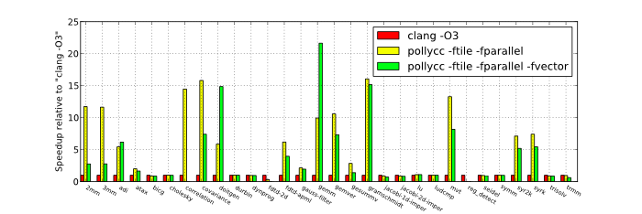
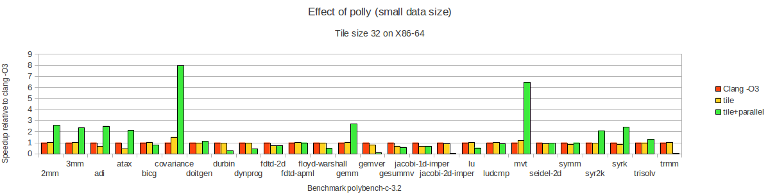
Multi-core -
Small data size

Slide 34
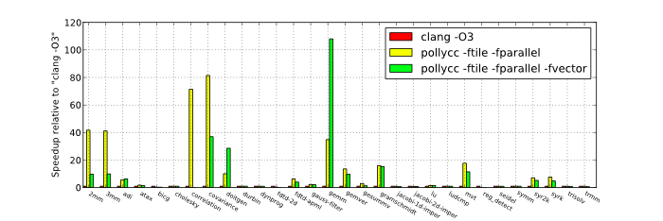
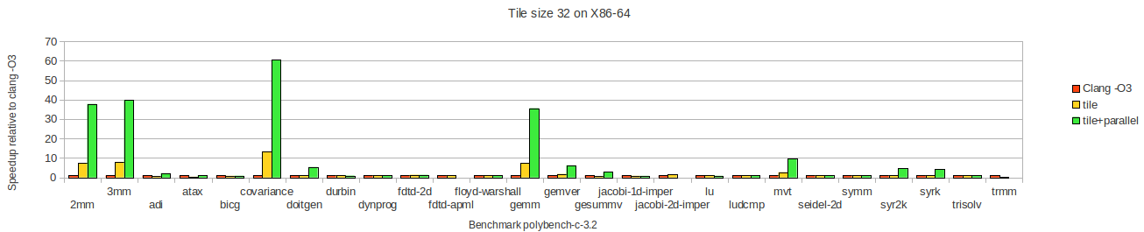
Multi-core -
Large data size
Segmentation fault for:
fdtd-apml,
jacobi-2d-imper,
trmm

Slide 35
Multi-core -
Large data size
2mm.c
define i32 @main(i32 %argc, i8** nocapture readonly %argv) #0 {
.split:
%omp.userContext.i = alloca { [2000 x double]*, double }, align 8
%omp.userContext35.i = alloca { [2000 x double]* }, align 8
%omp.userContext37.i = alloca { [2000 x double]*, double, [2000 x double]*, [2000 x double]* }, align 8
%omp.userContext39.i = alloca { [2000 x double]*, [2000 x double]*, [2000 x double]* }, align 8
...
call fastcc void @init_array(double* %alpha, double* %beta, [2000 x double]* %5, [2000 x double]* %6, [2000 x double]* %7, [2000 x double]* %8)
...
%16 = getelementptr inbounds { [2000 x double]*, double }* %omp.userContext.i, i64 0, i32 0
store [2000 x double]* %8, [2000 x double]** %16, align 8
%17 = getelementptr inbounds { [2000 x double]*, double }* %omp.userContext.i, i64 0, i32 1
store double %10, double* %17, align 8
call void @GOMP_parallel_loop_runtime_start(void (i8*)* @kernel_2mm.omp_subfn, i8* %12, i32 0, i64 0, i64 2000, i64 32) #3
call void @kernel_2mm.omp_subfn(i8* %12) #3
call void @GOMP_parallel_end() #3
%18 = getelementptr inbounds { [2000 x double]* }* %omp.userContext35.i, i64 0, i32 0
store [2000 x double]* %11, [2000 x double]** %18, align 8
call void @GOMP_parallel_loop_runtime_start(void (i8*)* @kernel_2mm.omp_subfn6, i8* %13, i32 0, i64 0, i64 2000, i64 32) #3
call void @kernel_2mm.omp_subfn6(i8* %13) #3
call void @GOMP_parallel_end() #3
…
}

Slide 36
Multi-core -
Large data size
The segmentation fault can be stopped by command ulimit as below
cschen@cschen-BM6835-BM6635-BP6335:~/test/polybench-c-3.2/polybench$ ulimit -s
8192
cschen@cschen-BM6835-BM6635-BP6335:~/test/polybench-c-3.2/polybench$ ulimit -s unlimited
cschen@cschen-BM6835-BM6635-BP6335:~/test/polybench-c-3.2/polybench$ ulimit -s
unlimited
cschen@cschen-BM6835-BM6635-BP6335:~/test/polybench-c-3.2/polybench$ ./jacobi-2d-imper.tile.parallel
4.319366
cschen@cschen-BM6835-BM6635-BP6335:~/test/polybench-c-3.2/polybench$ ./trmm.tile.parallel
102.427773
Reboot if not work.

Slide 37
Multi-core -
Large data size
Hi cschen,
I can reproduce these failures. It seems when we try to parallelize the initialization routine there is a problem. If you limit Polly to the kernel with -mllvm -polly-only-func=kernel_fdtd_apml, everything works nicely.
I currently did not investigate further. Would you be interested to do so? Johannes also recently worked with OpenMP, so he might have an idea what is going on as well.
I will post 2 codegen bugs/fixes later (related to OpenMP) and I will look into these segfaults, but this may take till next week.
Best regards,
Johannes

Slide 38
Multi-core - note
2mm.c has no #pragma omp
  But polly translate 2mm.c into @GOMP_parallel_loop_runtime_start in IR
Still has limits
  Segmentation fault in fdtd-apml, jacobi-1d-imper, trmm
  Polly team member Johannes is fixing it
Fail to open polly parallel feature for ARM in build? Fixed, by put on /usr/libgomp.so.1 on BG2
  Currently, I can run it on X86-64 only and has segmentation fault limitation
  Put in /usr/lib/libgomp.so.1 then work in BG2
  Segmentation fault: gesummv, durbin: 20140618 check out
  No result: fdtd-apml

Slide 39
Other optimization opportunity - fusion
for(i=0; i<N; i++) {
for(j=0; j<N; j++) {
C[i][j] = 0;
for(k=0; k<N; k++)
C[i][j] = C[i][j] + A[i][k] * B[k][j];
D[i][j] = 0;
for(k=0; k<N; k++)
D[i][j] = D[i][j] + A[i][k] * 2.0;
}
}
for(i=0; i<N; i++) {
for(j=0; j<N; j++) {
C[i][j] = 0;
D[i][j] = 0;
for(k=0; k<N; k++) {
C[i][j] = C[i][j] + A[i][k] * B[k][j];
D[i][j] = D[i][j] + A[i][k] * 2.0;
}
}
}
for(i=0; i<N; i++) {
for(j=0; j<N; j++) {
C[i][j] = 0;
for(k=0; k<N; k++)
C[i][j] = C[i][j] + A[i][k] * B[k][j];
}
}
for(i=0; i<N; i++) {
for(j=0; j<N; j++) {
D[i][j] = 0;
for(k=0; k<N; k++)
D[i][j] = D[i][j] + A[i][k] * 2.0;
}
}

Slide 40
Future work
Can memcpy be improved on arm?
Gcc tile size tune on marvell platform for matmul.c & some other program
  Matmul.c: best T=32 (next slide)
  Much time/effort for many program depend on cache+loop bound if allow different T for different program
Polytope model & llvm polly enable
Llvm polly
  Work from N to→ n
  Segmentation fault in polly parallel

Slide 41
Gcc tile size for matmul.c on BG2
~/marvell/work/assigned-job/run_released_benchmark/armv7-marvell-linux-gnueabi-hard-4.6.4_x86_64_rc2_20140325/bin/arm-marvell-linux-gnueabi-gcc -O3 -mcpu=cortex-a9 -mfloat-abi=hard -mfpu=neon -floop-strip-mine --param loop-block-tile-size=51 matmul.c -o matmul.51
# time ./matmul.tiledefault (51)
real 0m 17.97s
user 0m 17.97s
sys 0m 0.00s
# time ./matmul.12
real 0m 18.15s
user 0m 18.14s
sys 0m 0.01s
# time ./matmul.16
real 0m 14.83s
user 0m 14.81s
sys 0m 0.01s
# time ./matmul.24
real 0m 18.31s
user 0m 18.29s
sys 0m 0.01s
# time ./matmul.32
real 0m 11.54s
user 0m 11.53s
sys 0m 0.01s
# time ./matmul.48
real 0m 18.03s
user 0m 18.00s
sys 0m 0.03s

Slide 42
Run Marvell benchmark
Run with tile option only (with omp)
  No improvement and 1 benchmark cannot build.
  Results in dir polly-benchmark/

Slide 43
Reference
Advanced compiler design implementation
  20.4.2 Loop Transformations
  20.4.3 Locality and Tiling
Book, chapter 11 of compilers principles, techniques, & tools
http://en.wikipedia.org/wiki/Loop_tiling
http://en.wikipedia.org/wiki/Polytope_model
http://pluto-compiler.sourceforge.net/
  http://drona.csa.iisc.ernet.in/~uday/publications/uday-cc08.pdf
http://polly.llvm.org

