Slide 1
LLVM
能幫Marvell做甚麼?
Start: 2013/08/30
Update: 2013/09/04
cschen

Slide 2

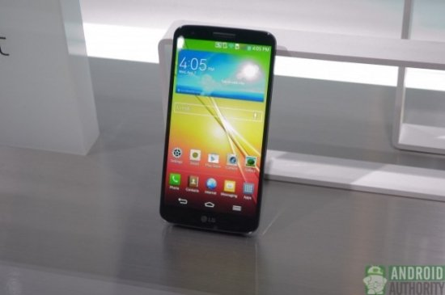
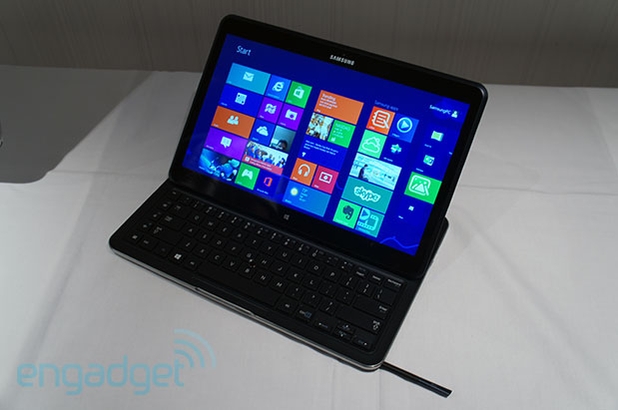
我用java寫了一個找車位的app
期望可以在Android手機與平板電腦上跑

Slide 3
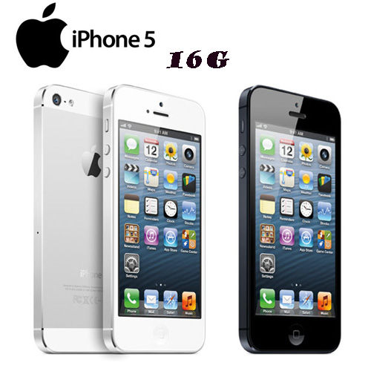
我用object C寫了一個app
期望可以在iOS手機與平板電腦上跑
但可不可以在Android上跑?

Slide 4
可能嗎?
object C
Java
修改clang: object C → Byte code
clang
Java compiler
IR
修改LLVM: IR → Byte code
Byte code
LLVM
JVM/Android
MachO
還有io display functions:
iOS library/system call → Android library/system call
object C → Java is better
IOS/Apple

Slide 5
同樣的

Slide 6
我用java寫了一個app
期望可以在Android手機與平板電腦上跑
但可不可以在iOS上跑?

Slide 7
可能嗎?
object C
Java
修改java compiler: IR ← Java
clang
Java compiler
IR
增加cross compiler: IR ← Byte code
Byte code
LLVM
JVM/Android
MachO
還有io display functions:
iOS library/system call → Android library/system call
IOS/Apple

Slide 8
這只是no limitation的idea思考過程
Please focus on market possibility
“Doable” in implementation and efforts is the next stage of thinking process.
如果太離譜請多包含

Slide 9
可能有更多應用嗎?
修改llvm: IR → Java byte code
  可以讓任何llvm支援的languages跑在Java platform
Search C++(qt),object C,C# → Java byte code
  可以讓上列的languages跑在Java platform
Write once and run everywhere

Slide 10
Other benefits
LLVM license allow NOT open source code

Slide 11
References
App market:
  http://eblog.cisanet.org.tw/23861254/article/content.aspx?ArticleID=717
  http://www.otc.org.tw/ch/about/publish/monthly/monthly_dl.php?DOC_ID=1139
  http://www.runpc.com.tw/content/content.aspx?id=109324
  http://gamedev.stackexchange.com/questions/15588/objective-c-to-java-conversion-for-porting-iphone-apps-to-android
Competitors / Solutions:
  http://stackoverflow.com/questions/4934707/is-it-possible-to-transform-llvm-bytecode-into-java-bytecode
  http://www.98173.com.tw/News/News_Page_New.aspx?nid=11861
  http://www.instantcsharp.com/Product_Details/Products.html
  http://www.experts-exchange.com/Programming/Languages/Q_20435140.html
  http://www.nextcomputers.org/NeXTfiles/Software/WebObjects/Guides/PortingObjectiveCtoJava.pdf
  https://code.google.com/p/j2objc/
    Open source handle non-UI from Google. No UI support in future.
  http://code.google.com/p/objc2j/
    Now is Open source handle non-UI, goal: handle UI. Future will be private program (Guess as below).
    The ObjC2J project is sponsored by Apportable. You can use Apportable to cross-compile Objective-C to run natively on Android, without converting to Java.
  http://vmkit.llvm.org/OpenProjects.html
    Create a VM to run Java byte code and IDL.
Current status:
  http://in.answers.yahoo.com/question/index?qid=20130214000913AAryeQP

Slide 12
IR-> Byte code:如何做?
object C
Java
clang
Java compiler
IR → C; C→Byte code
IR
Byte code
LLVM
JVM/Android
Reference:
IR → C: 似乎不可行?
  llc -march=c(or cpp) -o code.c code.ll?
  http://stackoverflow.com/questions/5180914/llvm-ir-back-to-human-readable-source-language
C → Byte code:
  http://www.ehow.com/how_6565055_translate-code-java.html
  http://www.instantcsharp.com/Product_Details/Products.html
MachO
IOS/Apple

Slide 13
VMKit

Slide 14
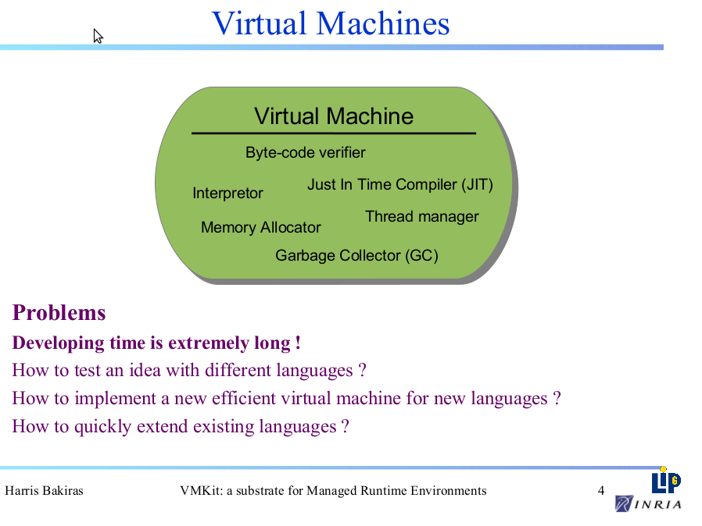

Slide 15


