Slide 1
Principle of Polyhedral model
– for loop optimization
cschen 陳鍾樞2014/6/11

Slide 2
Outline
Abstract model
  Affine expression, Polygon space → Polyhedron space, Affine Accesses
Data reuse → Data locality
Space partition
  Formulate include:
    Iteration (Variable) space: loop index i, j, …
    Data dependence
    Processor mapping
    Code generation
    Primitive affine transforms
Synchronization Between Parallel Loops
Pipelining
  Formulate
Other uses of affine transforms
  Machine model & features

Slide 3
Affine expression
Such expressions are informally known as linear expressions.
Strictly speaking, an affine expression is linear only if is zero.

Slide 4


Iteration Spaces – Construct

Slide 5
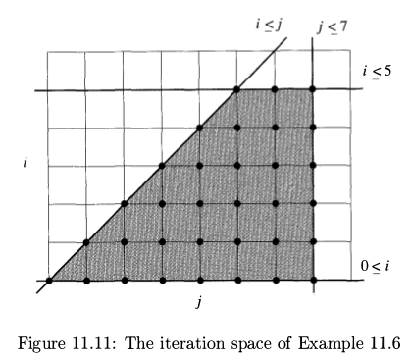
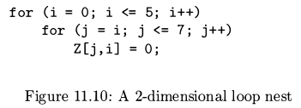
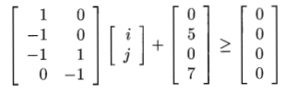

Polygon space

Slide 6
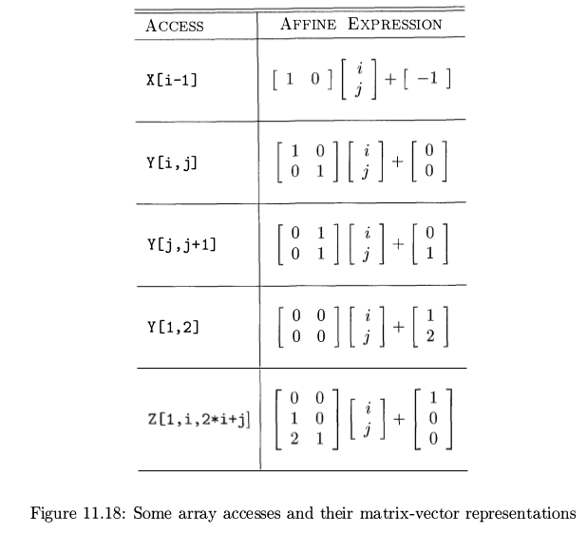
Affine Accesses

Slide 7
Data Reuse
Self vs Group
  Self: from the same access
  Group: from different accesses
Temporal vs Spatial
  Temporal: same exact location
  Spatial: same cache line

Slide 8
Data Reuse
float Z[n] ;
for ( i = 0 ; i < n ; i++)
for (j = 0 ; j < n ; j ++)
Z [ j + 1] = ( Z [ j ] + Z [ j + 1] + Z [ j +2] ) /3 ;
group-temporal
group-spatial
(0,0),(1,0) Z[ j ]: self-temporal
(0,0),(0,1) Z[ j ]: self-spatial

Slide 9
Data reuse – Null space
The set of all solutions to the equation Fv = 0 is called the null space of F.
Thus, two iterations refer to the same array element if the difference
of their loop-index vectors belongs to the null space of matrix F.
for (i = 0; i <= m; i++)
for (j = 1; j <= n; j++) {
...Y[ j, j+1];
}

Slide 10
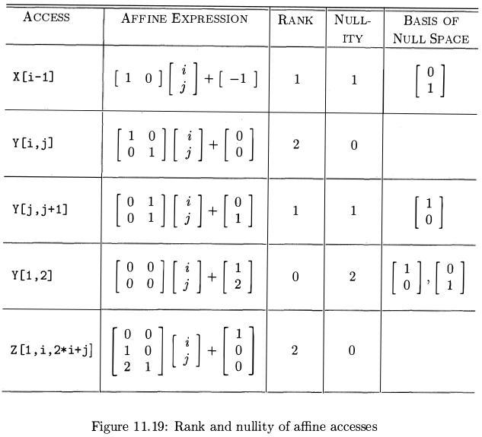
Data reuse – Null space
for (i = 0; i <= m; i++)
for (j = 1; j <= n; j++)
...Y[1, 2];
for (i = 0; i <= m; i++)
for (j = 1; j <= n; j++)
...Y[ i, j ];
All j iterations accesses to the same array

Slide 11
Data Reuse –
Self-spatial Reuse
for (i = 0; i <= m; i++)
for (j = 0; j <= n; j++)
X[i, j] += Y[1, i, 2*i+j];
take array elements to share a cache line if they differ only in the last dimension.
In null space
for (j = 0; j <=n; j++)
for (i = 0; i <= m; i++)
X[i, j] += Y[1, i, 2*i+j];
Not in null space

Slide 12
Data Reuse –
Self-Temporal Reuse
for (k = 1; k <= n; k++)
for (i = 1; i <= n; i++)
for (j = 1; j <= n; j++) {
Out(1, i, j, A[i, j, i+j]);
Out(2, i, j, A[i+1, j, i+j]);
}

Slide 13
Data Reuse –
Self-Temporal Reuse
for (k = 1; k <= n; k++)
for (i = 1; i <= n; i++)
for (j = 1; j <= n; j++) {
Out(1, i, j, A[i, j, i+j]);
Out(2, i, j, A[i+1, j, i+j]);
}
for (i = 1; i <= n; i++)
for (j = 1; j <= n; j++)
for (k = 1; k <= n; k++) {
Out(1, i, j, A[i, j, i+j]);
Out(2, i, j, A[i+1, j, i+j]);
}

Slide 14
Data Reuse –
Self-Temporal Reuse
for (k = 1; k <= n; k++)
for (i = 1; i <= n; i++)
for (j = 1; j <= n; j++) {
Out(1, i, j, A[i, j, i+j]);
Out(2, i, j, A[i+1, j, i+j]);
}
for (i = 1; i <= n; i++)
for (j = 1; j <= n; j++)
for (k = 1; k <= n; k++) {
Out(1, i, j, A[i, j, i+j]);
Out(2, i, j, A[i+1, j, i+j]);
}

Slide 15
Data Reuse –
Group Reuse
for (i = 1; i <= n; i++)
for (j = 1; j <= n; j++)
for (k = 1; k <= n; k++) {
Out(1, i, j, A[i, j, i+j ]);
Out(2, i, j, A[i+1, j, i+j ]);
}
A[1..n, 1..n, i+j];
A[2..n+1, 1..n, i+j];
for (j = 1; j <= n; j++)
for (k = 1; k <= n; k++)
Out(1, 1, j, A[1, j, 1+j ]);
for (i = 2; i <= n; i++) {
for (j = 1; j <= n; j++)
for (k = 1; k <= n; k++) {
Out(1, i, j, A[i, j, i+j ]);
Out(2, i-1, j, A[i, j, i+j ]);
}
for (j = 1; j <= n; j++)
for (k = 1; k <= n; k++)
Out(2, n, j, A[n+1, j, n+j ]);
A[1, 1..n, i+j];
A[2..n, 1..n, i+j];
A[2..n, 1..n, i+j];
A[n+1, j, i+j];

Slide 16
Data Reuse –
Self Reuse
for (i = 1; i <= n; i++)
for (j = 1; j <= n; j++) {
if (i == j)
...A[i, j];
else
...B[ j ];
for (i = 1; i <= n; i++)
for (j = 1; j <= n; j++)
If (i == j)
...A[i, j];
for (j = 1; j <= n; j++)
for (i = 1; i <= n; i++) {
If (i != j)
...B[ j ];
Self-Spatial reuse
Self-Temporal reuse

Slide 17
Data Reuse –
Data dependence
for (i = 1; i <= n; i++)
for (j = 1; j <= n; j++) {
if (i == j)
a += A[i, j];
else {
b |= B[ j ];
c += C[ j ];
}
for (i = 1; i <= n; i++)
for (j = 1; j <= n; j++)
If (i == j)
a += A[i, j];
for (j = 1; j <= n; j++)
for (i = 1; i <= n; i++) {
If (i != j)
b |= B[ j ];
for (j = 1; j <= n; j++)
for (i = 1; i <= n; i++) {
If (i != j)
c += C[ j ];
Self-Spatial reuse
Self-Temporal reuse
Overflow or not.

Slide 18
Data Reuse –
Data dependence
for (i = 1; i <= n; i++) {
for (j = 1; j <= n; j++) {
if (i == j)
...
else {
C[ i ] += A[ j, i ];
B[ i ] -= A[ j, i ];
}
c += C[ i ];
b += B[ i ];
}
for (j = 1; j <= n; j++) {
for (i = 1; i <= n; i++)
If (i != j)
C[ j ] += A[ j, i ];
c += C[ j ];
for (j = 1; j <= n; j++)
for (i = 1; i <= n; i++) {
If (i != j)
B[ j ] -= A[ j, i ];
b -= B[ j ];
Ignore Overflow
Ignore Overflow
For operators with commutativity and associativity, like + or *, it work.
But without commutativity and associativity, like – or /, it not work.
Anyway it is far too complex for compiler.

Slide 19
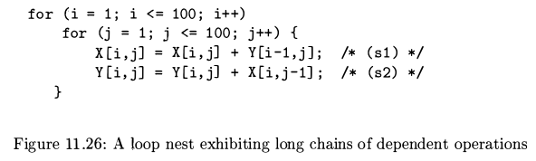
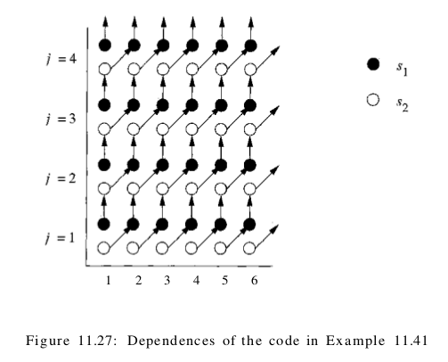
Loop optimization
– data locality & parallel
Data dependence,
Synchronization,
communication

Slide 20
Processor (partition) mapping

Slide 21
Processor (partition) mapping

Slide 22
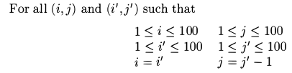
Processor mapping – get mapping function

Slide 23
Processor mapping – get mapping function

Slide 24
Formulate – variable space & processor mapping

Slide 25
Formulate – variable space & processor mapping
<=>
Convex region in d-dimension
space.
It can be reduced to
integer-linear-programming
which use linear algebra.

Slide 26
Formulate – data dependence
If no solution → no data dependence → full parallel like matrix multiplication.

Slide 27
NP-complete problem
Search for integer solutions that satisfy a set of
linear inequalities, which is precisely the
well-known problem of integer linear programming.
Integer linear programming is an NP-complete problem.

Slide 28
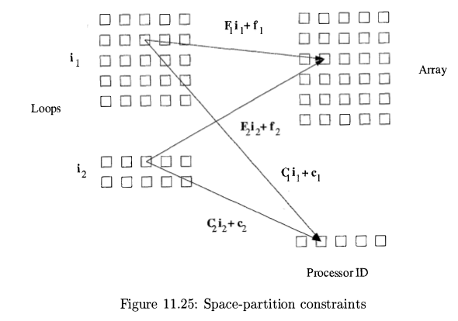
Formulate – variable space, data dependence & processor mapping

Slide 29
Formulate – variable space dimension
int X[100][100][100][100];
for (i=0; i<100; i++)
for (j=0; j<100; j++)
for (k=0; k<100; k++)
for (l=0; l<100; l++)
X[i][j][k][l] = X[i][j][k+1][l-1];
for (k=0; k<100; k++)
for (l=0; l<100; l++)
X[k][l][k][l+1] = X[k][l][k][l];

Slide 30
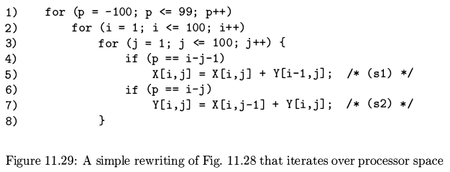
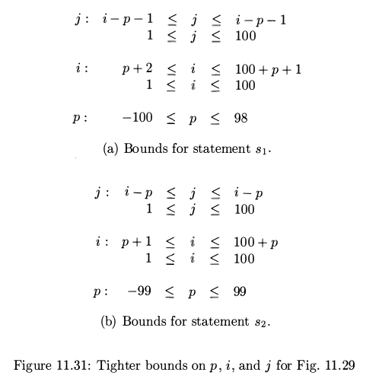
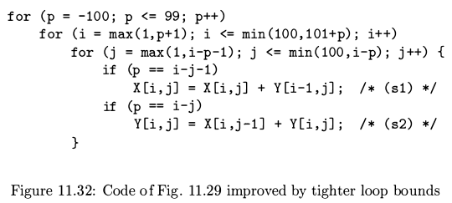
Code generation
Eliminating Empty Iterations

Slide 31
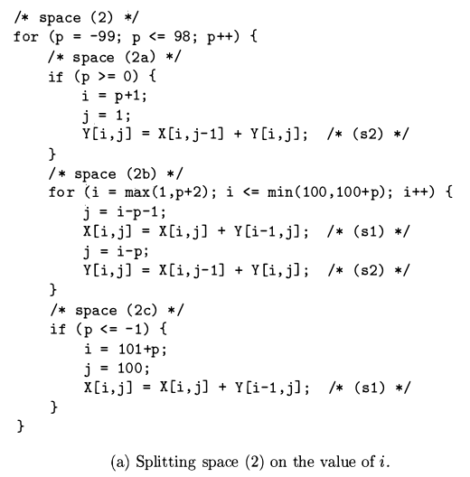
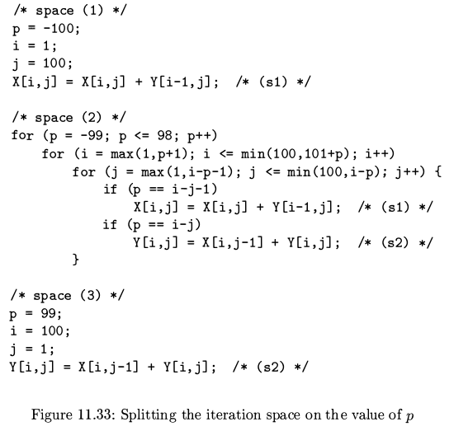
Code generation – Eliminating Test from Innermost Loops

Slide 32
Code generation – Eliminating Test from Innermost Loops
p=-99, i=max(1, -98)..min(100, 2)=1..2,
i:1, j=max(1, 99)..min(100, 100)=99..100
i:2, j=100..100
p=-98, i=max(1, -97)..min(100, 3)=1..3,
i:1, j=max(1, 98)..min(100, 99)=98..99
i:2, j=99..100
I:3, j=100..100
p=-99, i=1,
j=99 → s1, j=100 → s2
p=-99, i=2,
j=100 → s1

Slide 33
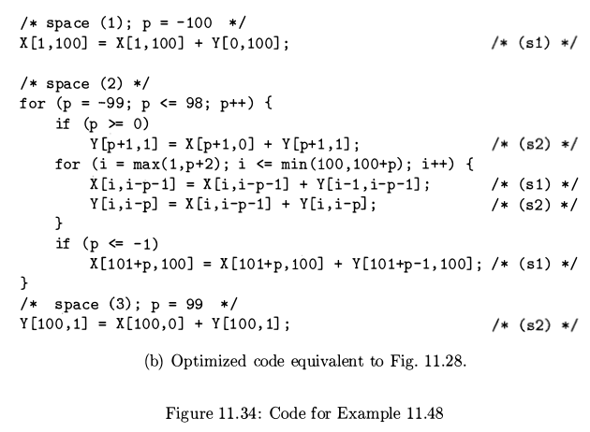
Code generation

Slide 34
Code generation –
MPMD (Multiple Program Multiple Data stream)
// processor[0]
/* space ( 1 ) ; p = - 100 */
X[1, 100] = X[1, 100 ] + Y[0, 100]; /* (s1) */
/* space ( 2 ) */
for (p = -99; p <= -50; p++) {
for (i = max(1 , p+2); i <= min(100 , 100+p) ; i++) {
X[i, i-p-1] = X[i, i-p-1] + Y[i-1, i-p-1] ; /* (s1) */
Y[i, i-p] = X[i, i-p-1] + Y[i, i-p] ; /* (s2) */
}
if (p <= -1)
X[101+p, 100] = X[101+p, 100] + Y[101+p-1, 100]; /* (s1) */
}
// processor[7]
/* space ( 2 ) */
for (p = 51; p <= 99; p++) {
if (p >= 0)
Y[p+1, 1] = X[p+1 , 0] + Y[p+1 , 1]; /* (s2) */
for (i = max(1 , p+2); i <= min(100 , 100+p) ; i++) {
X[i, i-p-1] = X[i, i-p-1] + Y[i-1, i-p-1] ; /* (s1) */
Y[i, i-p] = X[i, i-p-1] + Y[i, i-p] ; /* (s2) */
}
}
/* space (3) ; p = 99 */
Y[100, 1] = X[100, 0] + Y[100, 1];

Slide 35
Code generation –
SPMD
void AssignProcess() {
processor[0].assignProcess(-100, -99, -98, ...);
processor[1].assignProcess(-59, -58, -57, ...);
…
}
if (processor[pId].hasProcess(-100)) // pId: processor Id
/* space ( 1 ) ; p = - 100 */
X[1, 100] = X[1, 100 ] + Y[0, 100]; /* (s1) */
/* space ( 2 ) */
for (it=processor[pId].begin(); it != processor[pId].end(); it++) {
p = *it;
if (p >= 0)
Y[p+1, 1] = X[p+1 , 0] + Y[p+1 , 1]; /* (s2) */
for (i = max(1 , p+2); i <= min(100 , 100+p) ; i++) {
X[i, i-p-1] = X[i, i-p-1] + Y[i-1, i-p-1] ; /* (s1) */
Y[i, i-p] = X[i, i-p-1] + Y[i, i-p] ; /* (s2) */
}
if (p <= -1)
X[101+p, 100] = X[101+p, 100] + Y[101+p-1, 100]; /* (s1) */
}
If (processor[pId].hasProcess(99))
/* space (3) ; p = 99 */
Y[100, 1] = X[100, 0] + Y[100, 1] ; /* (s2) */

Slide 36
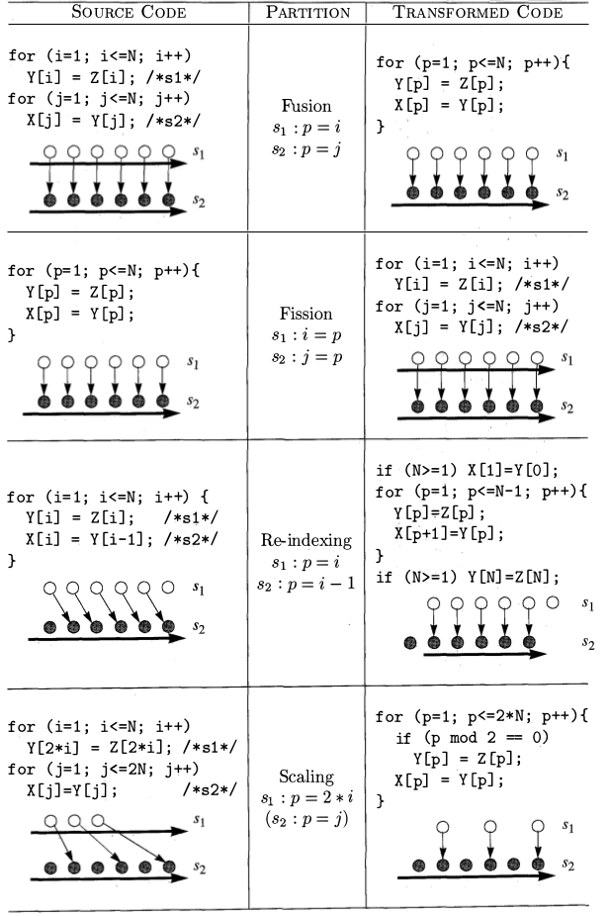
Primitive affine transforms

Slide 37
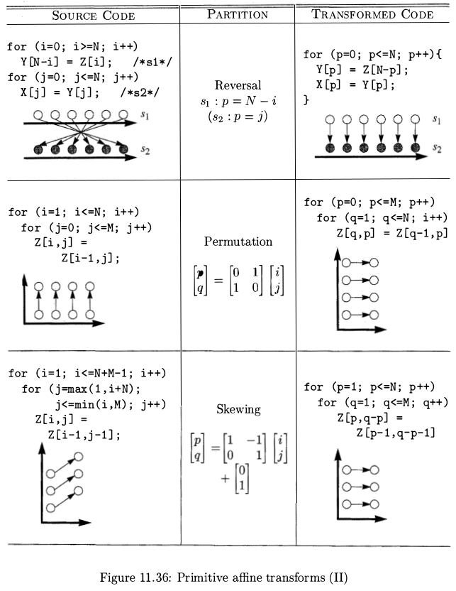
Primitive affine transforms
This example
is error

Slide 38
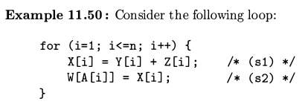
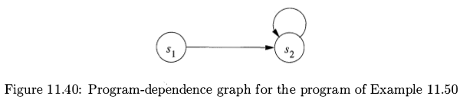
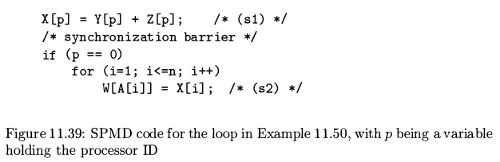
Synchronization Between Parallel Loops

Slide 39
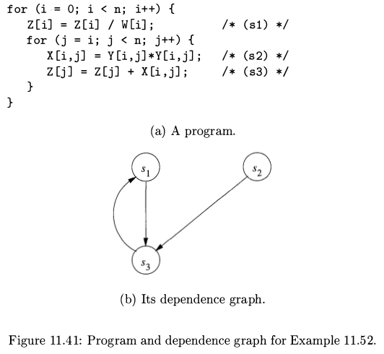
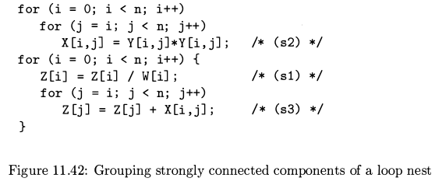
Synchronization Between Parallel Loops

Slide 40
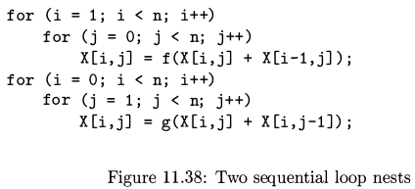
Synchronization Between Parallel Loops
Loop i
Loop j parallel
barrier
Loop i parallel
No cache locality for X:row-major.
The n barrier cost over 1 statement process.

Slide 41
Synchronization Between Parallel Loops
for (i = 0; i < n; i++)
for ( j = 0; j < n; j++)
for (j = 0; j < n; j++)
for ( i = 0; i < n; i++)
1 barrier as well as cache locality.
Cost with transpose X.

Slide 42
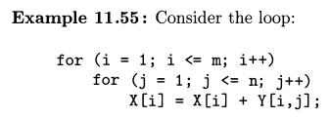
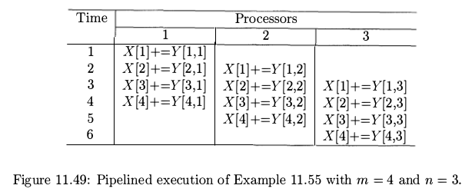
Pipelining
P1: X[1]+=Y[1,1], X[1]+=Y[1,2], X[1]+=Y[1,3]
P2: X[2]+=Y[2,1], X[2]+=Y[2,2], X[2]+=Y[2,3]
...

Slide 43
Pipelining
P1: X[1]+=Y[1,1], X[1]+=Y[1,2], X[1]+=Y[1,3]
P2: X[2]+=Y[2,1], X[2]+=Y[2,2], X[2]+=Y[2,3]
...
When Y is stored in column-major
→ locality in the same processor.

Slide 44
Beside treat processors as the core of CPU,
it can be function unit in CPU.

Slide 45
3 Pipeline – superscaler
Time | pipeline
 | 1 | 2 | 3
1 | X[1]+=Y[1,1]
1 | X[2]+=Y[2,1]
1 | X[3]+=Y[3,1]
2 | X[4]+=Y[4,1] | X[1]*=Y[1,2]
2 | X[5]+=Y[5,1] | X[2]*=Y[2,2]
2 | X[6]+=Y[6,1] | X[3]*=Y[3,2]
3 | X[7]+=Y[7,1] | X[4]*=Y[4,2] | X[1]-=Y[1,3]
3 | X[8]+=Y[8,1] | X[5]*=Y[5,2] | X[2]-=Y[2,3]
3 |  | X[6]*=Y[6,2] | X[3]-=Y[3,3]
4 |  | X[7]*=Y[7,2] | X[4]-=Y[4,3]
4 |  | X[8]*=Y[8,2] | X[5]-=Y[5,3]
4 |  |  | X[6]-=Y[6,3]
5 |  |  | X[7]-=Y[7,3]
5 |  |  | X[8]-=Y[8,3]
for ( i = 1 ; i <= m ; i++)
for ( j = 1 ; j <= 3; j++) {
X[i] = X[i] + Y [i , j ] ;
X[i] = X[i] * Y [i , j ] ;
X[i] = X[i] - Y [i , j ] ;
}
SIMD instruction
for ( i = 1 ; i <= 3 ; i++)
X[i] = X[i] + Y [i , 1 ] ;
for ( i = 4 ; i <= 6 ; i++)
X[i] = X[i] + Y [i , 1 ] ;
for ( i = 1 ; i <= 3 ; i++)
X[i] = X[i] * Y [i , 2 ] ;
for ( i = 7 ; i <= m ; i++) {
for ( j = 3 ; j <= n; j++) {
X[i] = X[i] + Y [i , j-2 ] ;
X[i-1] = X[i-1] * Y [i-1 , j-1 ] ;
X[i-2] = X[i-2] - Y [i-2 , j ] ;
}
...

Slide 46
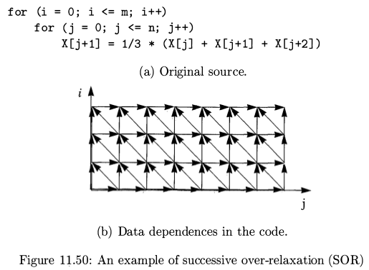
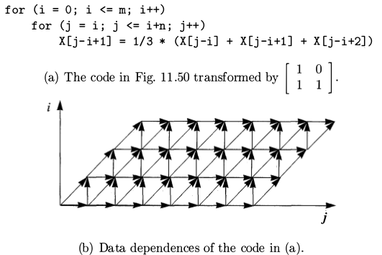
Pipelining

Slide 47
Pipelining
Linear, Ring above (mesh, cube)
connected processors.

Slide 48
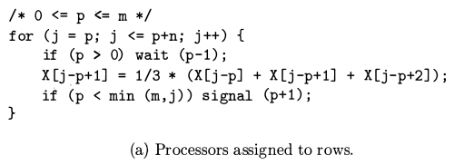
Pipelining - synchronize

Slide 49
Pipelining – linear connection – verify
if (p > 0) wait (p-1 ) ;
X[ j-p+1] = 1/3 * (X[ j-p]+X[ j-p+1]+X[ j-p+2]);
if (p < min(m , j ) ) signal(p+1) ;
for ( i = 0 ; i <= m ; i++)
for ( j = i ; j <= i+n ; j ++)
X[ j-i+1] = 1/3 * (X[ j-i] + X[ j-i+1] + X[ j-i+2]);
(i, j):
(0,0)
X[1] = 1/3 * (X[0]+X[1]+X[2]);
(0,1)
X[2] = 1/3 * (X[1]+X[2]+X[3]);
(0,2)
X[3] = 1/3 * (X[2]+X[3]+X[4]);
(1,1)
X[1] = 1/3 * (X[0]+X[1]+X[2]);
p=0; i=0; j=1;
if (p > 0) wait (p-1 ) ;
X[1-0+1] = 1/3 * (X[1-0]+X[1-0+1]+X[1-0+2]);
if (p < min(m , j ) ) signal(p+1) ;
p=1; i=1; j=1;
if (p > 0) wait (p-1 ) ;
X[1-1+1] = 1/3 * (X[1-1]+X[1-1+1]+X[1-1+2]);
if (p < min(m , j ) ) signal(p+1) ;

Slide 50
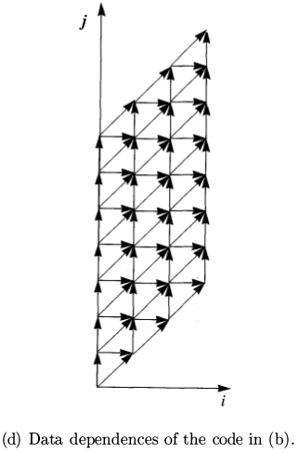
Pipelining
for (j = 0; j <= m+n; i++)
for (i = max(0,j-n); i <= min(m,j); j++)
X[j-i+1] = 1/3 * (X[j-i] + X[j-i+1] + X[j-i+2];

Slide 51
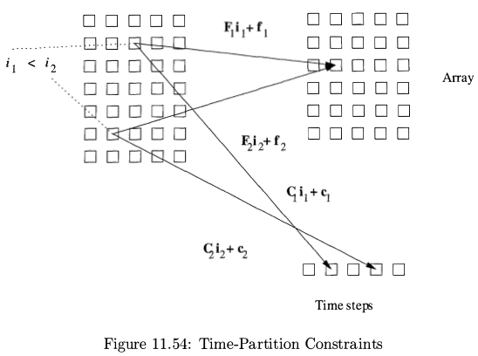
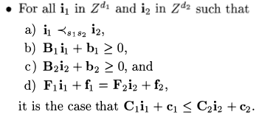
Pipelining formulate – variable space, data dependence & time steps mapping

Slide 52
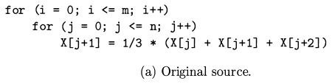
Pipelining – time steps mapping
consider all processors have the same time steps mapping function
1 . True dependence from write access X[ j + 1] to read access X[ j + 2]. eg. X[1+1](i=0,j=1), X[0+2](i'=1,j'=0).
2. Antidependence from read access X[ j + 2] to write access X[ j + 1] . eg. X[0+2](i=1,j=0), X[1+1](i'=1,j'=1).
3. Output dependence from write access X[ j + 1] back to itself. eg. X[0+1](i=1,j=0), X[1+0](i'=2,j'=0).
The rest of the dependences do not yield any new constraints.
Conclusion:

Slide 53
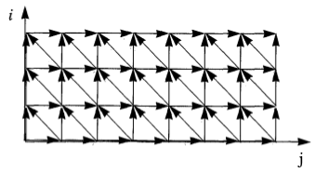
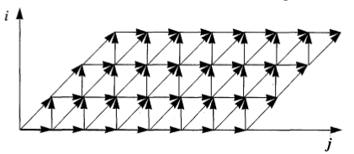
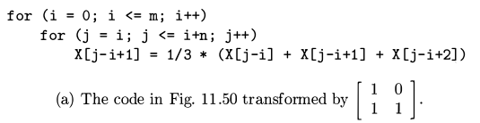
Pipelining – Code generation
for (i' = 0; i' <= m; i'++)
for (j' = i'; j' <= i'+n; j'++)
X[ j'-i'+1] = 1/3 * (X[ j'-i'] + X[ j'-i'+1] + X[ j'-i'+2];

Slide 54
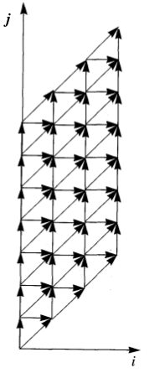
Pipelining – Code generation
for (i' = 0; i' <= m+n; i'++)
for (j' = 0; j' <= m; j'++) {
if ((i'-j' >= 0)&&(i'-j' <=n))
X[i'-j'+1] = 1/3 * (X[i'-j'] + X[i'-j'+1] + X[i'-j'+2];
}
for (j = 0; j <= m+n; j++)
for (i = max(0, j-n); i <= min(m, j); i++)
X[ j-i+1] = 1/3 * (X[ j-i] + X[ j-i+1] + X[ j-i+2];
for (i' = 0; i' <= m+n; i'++)
for (j' = max(0,i'-n); j <= min(m,i'); j'++)
X[i'-j'+1] = 1/3 * (X[i'-j'] + X[i'-j'+1] + X[i'-j'+2];
m=3,n=6
j=0 → i=0
=1 → i=0,1
=2 → i=0,1,2
=3 → i=0,1,2,3
=4 → i=0,1,2,3
=5 → i=0,1,2,3
=6 → i=0,1,2,3
=7 → i=1,2,3
=8 → i=2,3
=9 → i=3

Slide 55
Pipelining – time steps mapping – function unit
consider all processors have the same time steps mapping function
1 . True dependence from write access X[ j + 1] to read access X[ j + 2]. eg. X[1+1](i=0,j=1), X[0+2](i'=1,j'=0).
2. Antidependence from read access X[ j + 2] to write access X[ j + 1] . eg. X[0+2](i=1,j=0), X[1+1](i'=1,j'=1).
3. Output dependence from write access X[ j + 1] back to itself. eg. X[0+1](i=1,j=0), X[1+0](i'=2,j'=0).

Slide 56
Pipelining – time steps mapping – function unit
consider all processors have the same time steps mapping function
4 . True dependence from write access X[ j + 1] to read access X[ j + 1]. eg. X[1+1](i=0,j=1), X[0+2](i'=1,j'=1).
5. Antidependence from read access X[ j + 1] to write access X[ j + 1] . eg. X[0+2](i=1,j=1), X[1+1](i'=1,j'=1).
6 . True dependence from write access X[ j + 1] to read access X[ j ]. eg. X[1+1](i=0,j=1), X[0+2](i'=0,j'=2).
7. Antidependence from read access X[ j ] to write access X[ j + 1] . eg. X[0+2](i=0,j=1), X[1+1](i'=1,j'=0).

Slide 57
Pipelining – time steps mapping – function unit
Conclusion:
The other Conclusion:

Slide 58
Pipelining – Code generation – function unit
for (i' = 0; i' <= m; i'++)
for (j' = 2*i'; j' <= 2*i'+n; j'++)
X[ j'-2*i'+1] = 1/3 * (X[ j'-2*i'] + X[ j'-2*i'+1] + X[ j'-2*i'+2];
for (i = 0; i <= m; i++)
for (j = 2*i'; j <= 2*i+n; j++)
X[ j-2*i+1] = 1/3 * (X[ j-2*i] + X[ j-2*i+1] + X[ j-2*i+2];

Slide 59
Pipelining – function unit – verify
for (i = 0; i <= m; i++)
for (j = 2*i'; j <= 2*i+n; j++)
X[ j-2*i+1] = 1/3 * (X[ j-2*i] + X[ j-2*i+1] + X[ j-2*i+2];
(i, j):
(0,0)
X[1] = 1/3 * (X[0]+X[1]+X[2]);
(0,1)
X[2] = 1/3 * (X[1]+X[2]+X[3]);
(0,2)
X[3] = 1/3 * (X[2]+X[3]+X[4]);
(0,3)
X[4] = 1/3 * (X[3]+X[4]+X[5]);
(1,2)
X[1] = 1/3 * (X[0]+X[1]+X[2]);
(1,3)
X[2] = 1/3 * (X[1]+X[2]+X[3]);
(1,4)
X[3] = 1/3 * (X[2]+X[3]+X[4]);
(2,4)
X[1] = 1/3 * (X[0]+X[1]+X[2]);

Slide 60
Pipelining – time steps mapping – function unit – 2
for (i = 0; i <= m; i++)
for ( j = 0; j <= n; j++)
X[ j] = 1/3 * (X[ j] + X[ j+1] + X[ j+2];
consider all processors have the same time steps mapping function
1 . True dependence from write access X[ j ] to read access X[ j + 2]. eg. X[2](i=0,j=2), X[0+2](i'=1,j'=0).
2. Antidependence from read access X[ j + 2] to write access X[ j ] . eg. X[0+2](i=1,j=0), X[2](i'=1,j'=2).
3. Output dependence from write access X[ j ] back to itself. eg. X[0](i=1,j=0), X[0](i'=2,j'=0).

Slide 61
Pipelining – time steps mapping – function unit – 2
for (i = 0; i <= m; i++)
for ( j = 0; j <= n; j++)
X[ j] = 1/3 * (X[ j] + X[ j+1] + X[ j+2];
consider all processors have the same time steps mapping function
4 . True dependence from write access X[ j ] to read access X[ j + 1]. eg. X[1+1](i=0,j=2), X[0+2](i'=1,j'=1).
5. Antidependence from read access X[ j + 1 ] to write access X[ j ] . eg. X[0+2](i=1,j=1), X[1+1](i'=1,j'=2).
6 . True dependence from write access X[ j ] to read access X[ j ]. eg. X[1+1](i=0,j=1), X[0+2](i'=0,j'=2).
7. Antidependence from read access X[ j ] to write access X[ j ] . eg. X[0+2](i=0,j=1), X[1+1](i'=1,j'=1).

Slide 62
Pipelining – time steps mapping – function unit – 2
Conclusion:

Slide 63
Pipelining – Code generation – function unit – 2
for (i = 0; i <= m; i++)
for ( j = 0; j <= n; j++)
X[ j] = 1/3 * (X[ j] + X[ j+1] + X[ j+2];
for (i' = 0; i' <= m; i'++)
for (j' = 3*i'; j' <= 3*i'+n; j'++)
X[ j'-3*i'] = 1/3 * (X[ j'-3*i'] + X[ j'-3*i'+1] + X[ j'-3*i'+2];
for (i = 0; i <= m; i++)
for (j = 3*i'; j <= 3*i+n; j++)
X[ j-3*i] = 1/3 * (X[ j-3*i] + X[ j-3*i+1] + X[ j-3*i+2];

Slide 64
Pipelining – function unit – 2 – verify
for (i = 0; i <= m; i++)
for ( j = 3*i'; j <= 3*i+n; j++)
X[ j-3*i] = 1/3 * (X[ j-3*i] + X[ j-3*i+1] + X[ j-3*i+2];
(i, j):
(0,0)
X[0] = 1/3 * (X[0]+X[1]+X[2]);
(0,1)
X[1] = 1/3 * (X[1]+X[2]+X[3]);
(0,2)
X[2] = 1/3 * (X[2]+X[3]+X[4]);
(0,3)
X[3] = 1/3 * (X[3]+X[4]+X[5]);
(1,3)
X[0] = 1/3 * (X[0]+X[1]+X[2]);
(1,4)
X[1] = 1/3 * (X[1]+X[2]+X[3]);
(1,5)
X[2] = 1/3 * (X[2]+X[3]+X[4]);
(1,6)
X[3] = 1/3 * (X[3]+X[4]+X[5]);
(2,6)
X[1] = 1/3 * (X[0]+X[1]+X[2]);

Slide 65
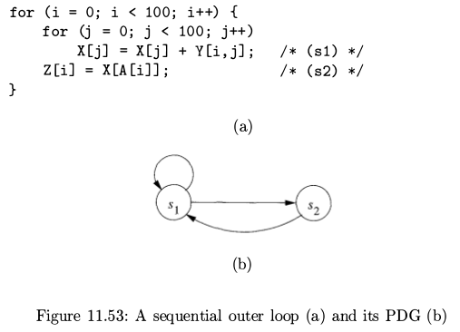
Pipelining – no time steps mapping

Slide 66
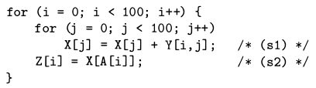
Pipelining – no time steps mapping
1. True dependence from write access X[ j ] to read access X[A[i]]
2. Anti-dependence from read access X[A[i]] to write access X[ j ]
According 1 and 2

Slide 67
Blocked (Tiling) in k-dimensions
If there exist k independent solutions to the time-partition constraints of a loop nest, then it is possible has k-deep, fully permutable loop nest.
A k-deep, fully permutable loop nest can be blocked in k-dimensions.

Slide 68
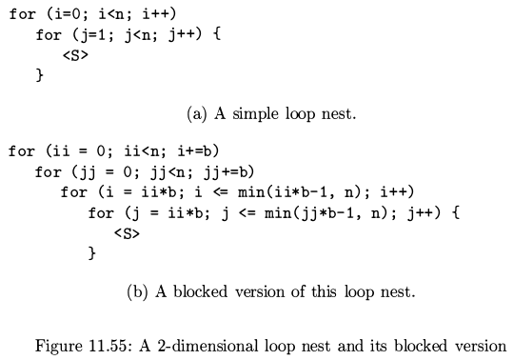
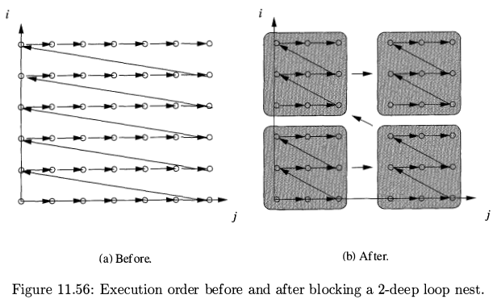
Blocked (Tiling) in 2-dimensions

Slide 69
Blocked (Tiling) in 2-dimensions
for (j = 0; j <= m+n; i++)
for (i = max(0,j-n); i <= min(m,j); j++)
X[j-i+1] = 1/3 * (X[j-i] + X[j-i+1] + X[j-i+2];

Slide 70
Blocked (Tiling) cannot in 2-dimensions

Slide 71
Other uses of affine transforms
Distributed memory machines
Multi-instruction-issue processors
  Suppose 4-issues with 2 adders
int n=1000;
int m=100;
for ( i = 0 ; i <= n ; i++)
for ( j = 0 ; j <= n; j++)
X[i] = X[i] + Y[ j , i ] ;
for ( i = 0 ; i <= m ; i++)
for ( j = 0 ; j <= n; j++)
W[i] = W[i] * Z[ j , i ] ;
int n=1000;
int m=100;
for ( j = 0 ; j <= n ; j++)
for ( i = 0 ; i <= m; i++) {
ii=i*10;
X[ii] = X[ii] + Y[ j , ii ] ;
X[ii+1] = X[ii+1] + Y[ j , ii+1 ] ;
...
X[ii+9] = X[ii+9] + Y[ j , ii+9 ] ;
W[i] = W[i] * Z[ j , i ] ;
}
i to inner
1. Spatial locality.
2. Try to make all functional units busy.

Slide 72
Other uses of affine transforms
Multi-instruction-issue processors
  Usage balance
int n=1000;
for ( i = 0 ; i <= n ; i++)
for ( j = 0 ; j <= n; j++)
X[i] = X[i] + Y[ j , i ] ; // memory bound (since cache miss)
for ( i = 0 ; i <= n ; i++)
for ( j = 0 ; j <= n; j++)
W[i] = W[i] / Z[ i , j ] ; // compute bound
int n=1000;
for ( i = 0 ; i <= n ; i++)
for ( j = 0 ; j <= n; j++) {
X[i] = X[i] + Y[ j , i ] ; // stall
W[i] = W[i] / Z[ i , j ] ; // balance stall
}
fusion

Slide 73
Other uses of affine transforms
Vector and SIMD instructions
  Vector:
    Elements fetched serial and compute parallel
    Scatter/gather for not contiguous elements in advanced machine
  SIMD:
    Elements fetched parallel, store them in wide registers, and compute parallel
    256-byte SIMD operands 256-byte alignment
Prefetching
  Issue llvm prefetch IR at best time in polly for marvell cpu.

Slide 74
Software pipeline
If it is static schedule machine, then do software pipeline after the pipelining of Polyhedral.
  Software pipeline will compact instructions cycles via RT table as chapter 10 of DragonBook.

Slide 75
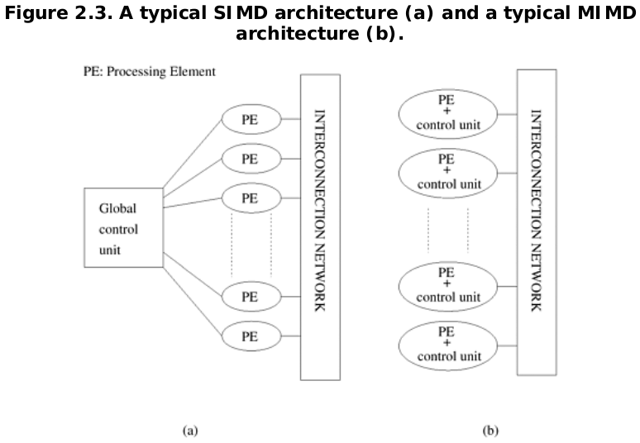
control

Slide 76
Interconnection Networks
MIMD can be created by use
Market CPUs + Interconnection Networks

Slide 77
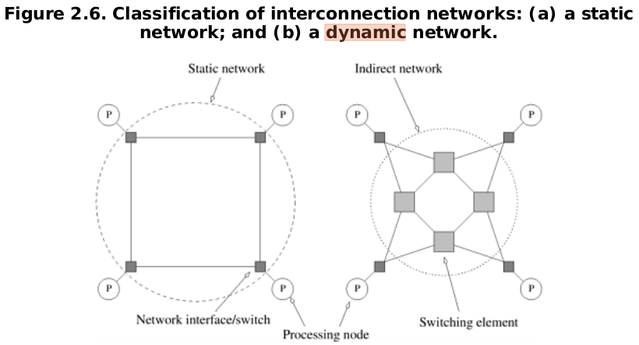
static v.s. dynamic

Slide 78
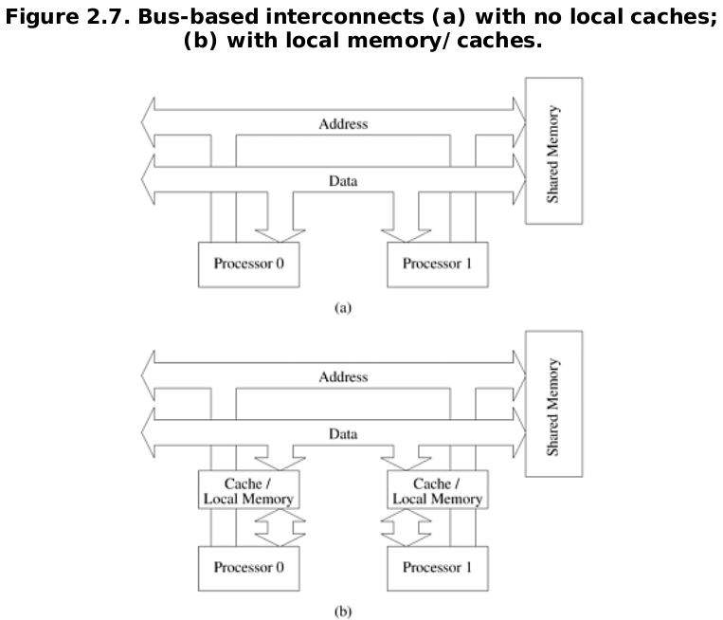
Dynamic Interconnection Network – Bus

Slide 79
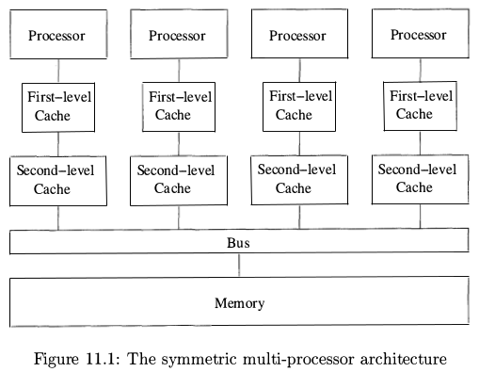
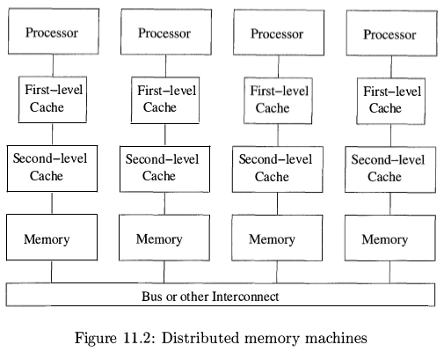
Dynamic Interconnection Network – Bus

Slide 80
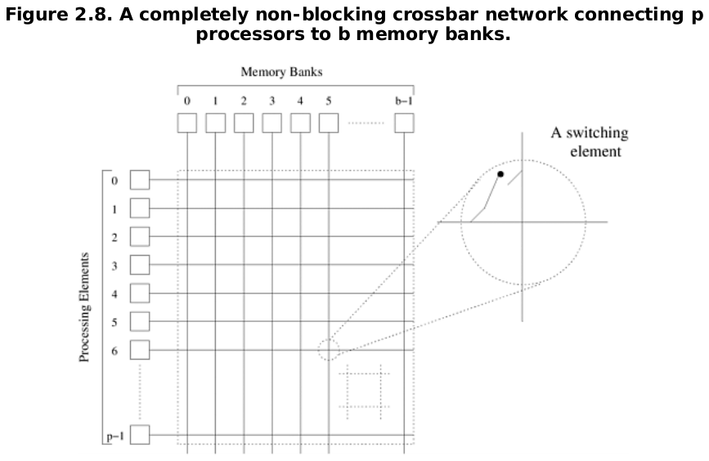
Dynamic Interconnection Network – Crossbar

Slide 81
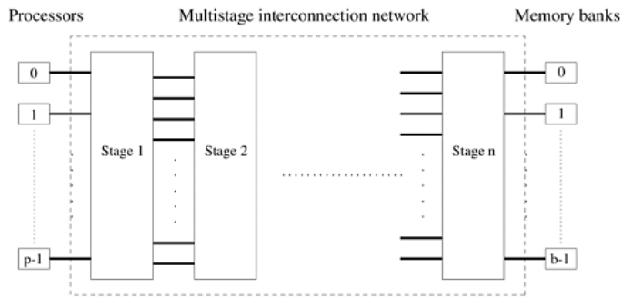
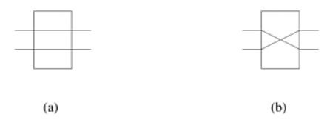
Dynamic Interconnection Network – Multistage

Slide 82
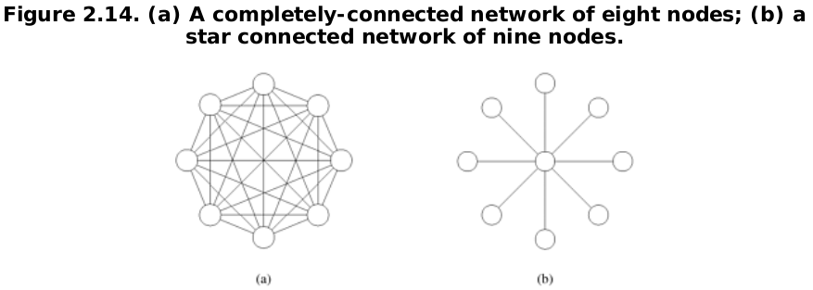
Static Interconnection Network – complete, star

Slide 83
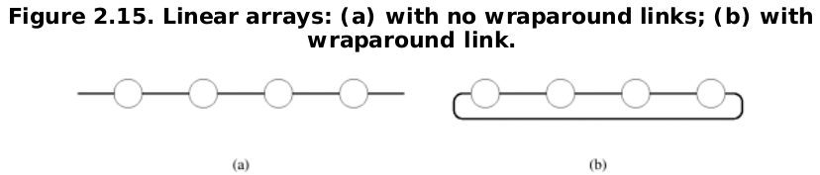

Static Interconnection Network – ring, mesh

Slide 84

Static Interconnection Network – cube

Slide 85


Tree

Slide 86
Parallel Model Reference
http://www.top500.org/lists/2013/11/#.U3G8zUl_W5k
http://www.top500.org/system/177975#.U3CTeEl_W5k
http://www.cray.com/Products/Computing/XE/Technology.aspx
http://en.wikipedia.org/wiki/NCUBE

Slide 87
Reference
Chapter 11 of Compilers principles, techniques, & tools 2nd edition
Chapter 2 of Introduction to Parallel Computing, by Ananth Grama, Anshul Gupta, George Karypis, Vipin Kumar

