Slide 1
Mini process mechanism
Part of Jonathan work

Slide 2

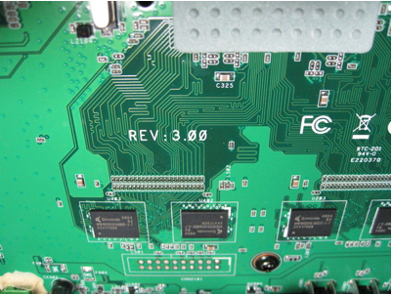
Normal Board Level Test Code (BLTC) Operating
BLTC (inside of board) do testing
board on production line.
And display error if find error.
03

Slide 3
Normal Board Level Test Code Operating
After finish all test items,
display error message on
TV screen. 0x03=0b00000011
meaning Flash and
USB test fail.
03
Test items list
1: Flash test
2: USB port test
…
9:Tuner id check

Slide 4
Motivation
In Board Level Testing Code, it has NO OS. No process/thread support.
When one item of test station hang on (maybe fall in loop forever), symptom as follows,

Slide 5
Symptom – hang on
..02 meaning it's running test item
2: USB port test. Suppose test item
2 need only 0.5 second. If it stays
on ..02 meaning the USB test
program has bug and hang on.
..02
Test items list
1: Flash test
2: USB port test
…
9:Tuner id check

Slide 6
Cause – hang on
TestItem(int n) {
UsbTest();
}
UseTest() {
...
While (1) {
If (attached) {
...
}
// Maybe the program logic has problem, and it will
// stay in while loop forever for some situation. Or
// maybe memory resource lock to incurs deadlock.
…
}
}

Slide 7
solution
Implement the process timeout mechanism for each item testing as follows,
U32 USB_Test() {
…
}
U32 Items::TI002() {
U32 (*pf)() = &USB_Test;
TimeOut = 5;
Error = Process.Create(pf, TimeOut);
}
// This routine is called by timer
// ISR for every 1 second.
Void Process::Update() {
If (TimeOut-- < 0) {
StopRun();
}
}

Slide 8
solution
With this solution, the hang problem is solved and never happen again. Operator always can get test result message, even a programmer make a forever loop or dead lock situation.
This solution need mips assembly code implementation as files Process.cpp, Timer_ISR_asm.cpp, Timer_ISR.cpp.

