Slide 1
USB 2.0 in short
Include linux-usb subsystem

Slide 2
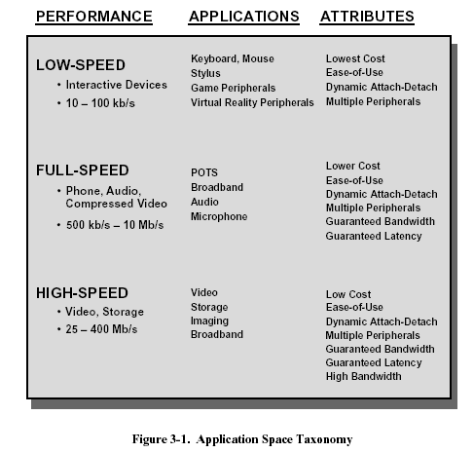

Slide 3
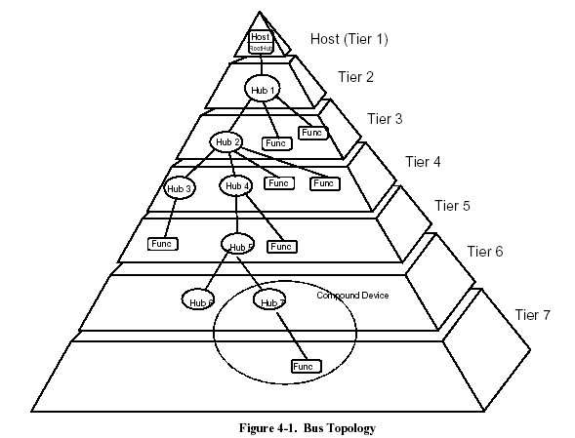

Slide 4
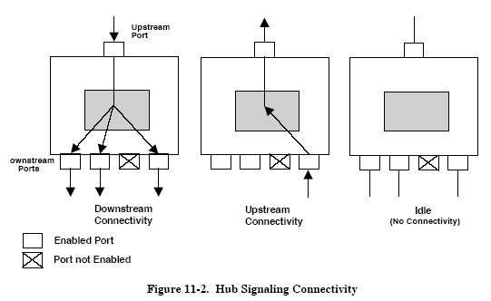
Message flow in Hub p299
When a
device or a hub transmits a packet upstream, only those hubs in line between the transmitting device and the
host will see the packet.
In the downstream direction, hubs operate in a broadcast mode.

Slide 5

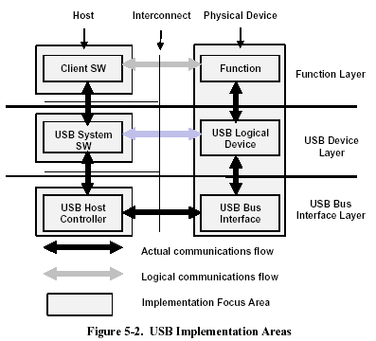

Slide 6
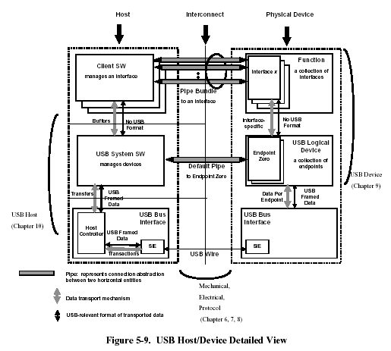
USB Driver (USBD)
Host Controller Driver (HCD)

Slide 7
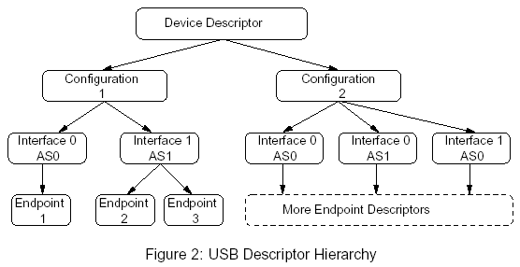

Slide 8
Configuration & Interface
Configurations can be activated exclusively by the standard control transfer set_configuration.
Alternate settings can be selected exclusively by the standard control transfer set_interface.
For example a multifunctional device like a video camera with internal microphone could have three alternate settings to change the bandwidth allocation on the bus.
Camera activated
Microphone activated
Camera and microphone activated

Slide 9
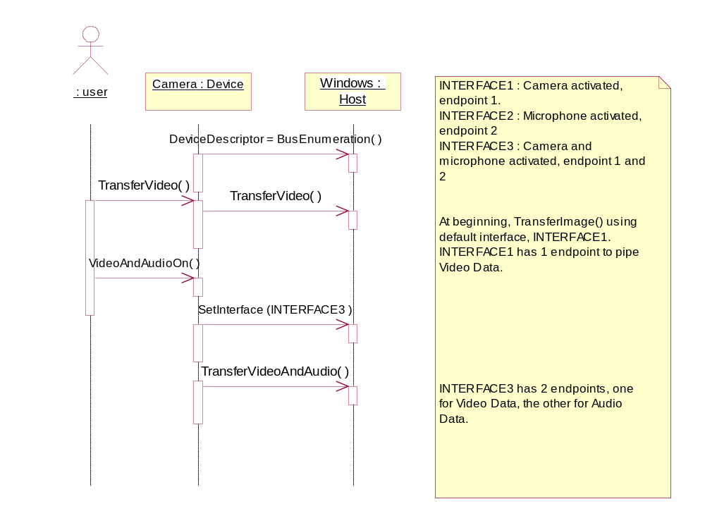
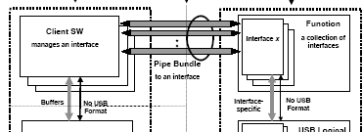
VideoCamera::MicrophoneOn

