Slide 1
USB 2.0

Slide 2
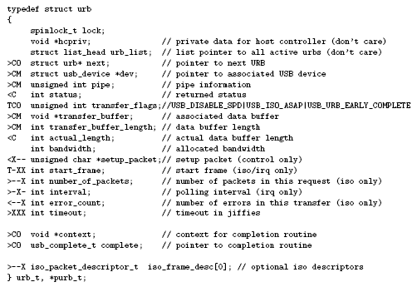

Slide 3
Agenda
ARCHITECTURAL OVERVIEW
USB DATA FLOW MODEL
PROTOCOL LAYE
USB Device Framework
  Example, USB Printer on Our System
  Bus Enumeration Procedure
    Control transfer and data structure those used on this procedure
    Compare descriptor of spec. and structure of linux-usb
    The code of bus enumeration in linux-usb
  Other Control transfer
    Example, usb printer meet the file format error
  USB time out
Hub

Slide 4
ARCHITECTURAL OVERVIEW (Chapter 4, 3, 7)

Slide 5
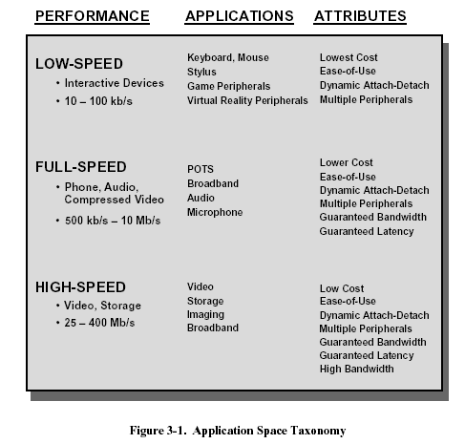

Slide 6
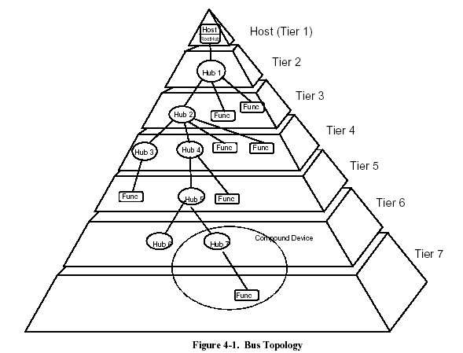
Self-power hub and bus-powered hub must interleaved

Slide 7
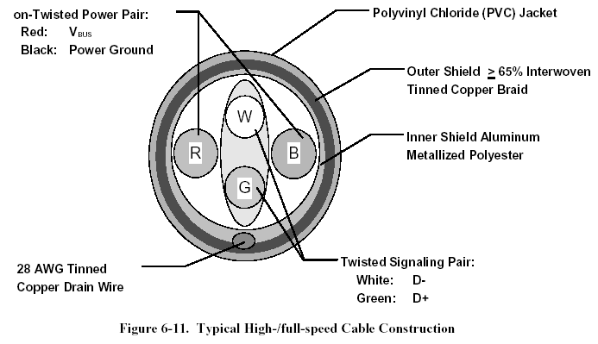
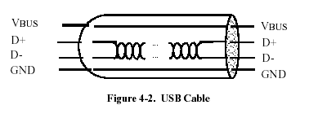
According to 馬克思威爾 equation:
X = y + z + …
So, twisted is for remove interfere
There are three data rates:
high-speed : 480 Mb/s.
full-speed : 12 Mb/s.
low-speed : 1.5 Mb/s.

Slide 8
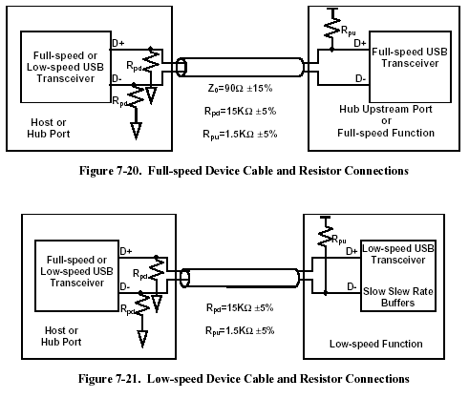

Slide 9
High Speed USB Identification
Resister Pull Up same as Full Speed
Run Reset in time as follows
Reset :
  Issue J, K state for a period
  J state is
  VHSOH(min) <= D+ <= VHSOH(max)
  VHSOL(min) <= D- <= VHSOL(max)
  K state is
  VHSOH(min) <= D- <= VHSOH(max)
  VHSOL(min) <= D+ <= VHSOL(max)
  Reference p142, p145, p153

Slide 10
USB DATA FLOW MODEL
(Chapter 5)

Slide 11

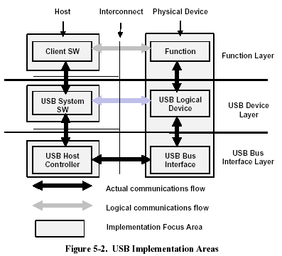

Slide 12
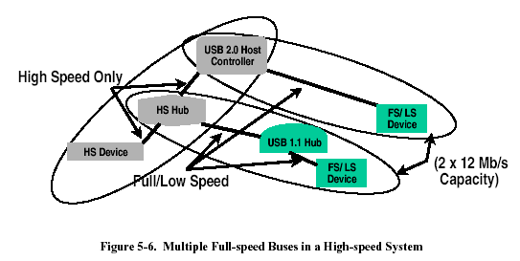

Slide 13
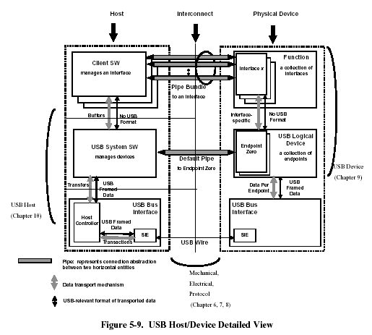
USB Driver (USBD)
Host Controller Driver (HCD)

Slide 14
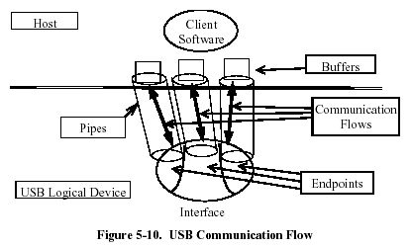

Slide 15
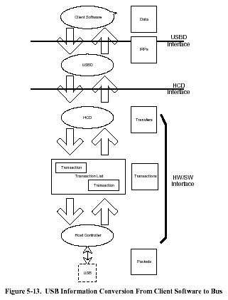

Slide 16
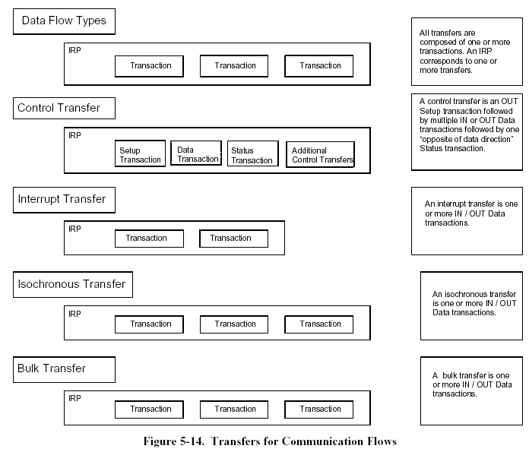

Slide 17
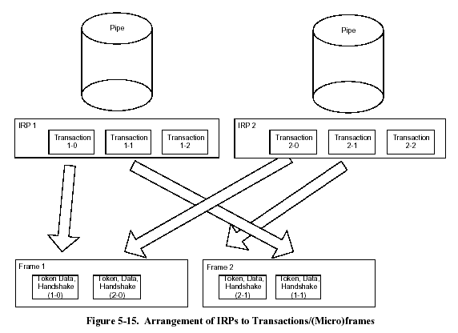
I/O Request Packets (IRPs)

Slide 18
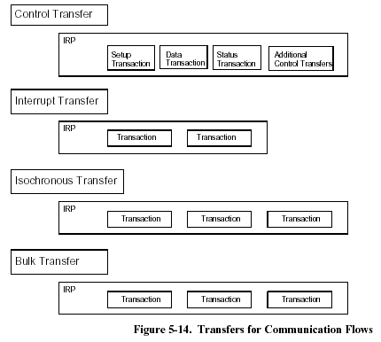
There are two mutually exclusive pipe communication modes:
• Stream: Data moving through a pipe has no USB-defined structure
• Message: Data moving through a pipe has some USB-defined structure

Slide 19
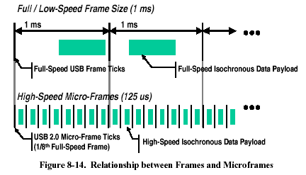
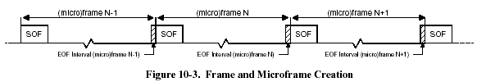
SOF See Start-of-Frame. SOP Start-of-Packet.
EOF End-of-(micro)Frame. EOP End-of-Packet.

Slide 20
Some features of USB
(device address, endpoint number, direction) : each endpoint be uniquely referenced. ⬄ (ip address, port).
Dynamic assign device address : since PnP.
Hub act as Multiplex.
USB net is a tree and Host is the root; Device notify root and root decide when to active message transfer.
Suspended state : conserve power

Slide 21
Electrical
(Chapter 7)

Slide 22
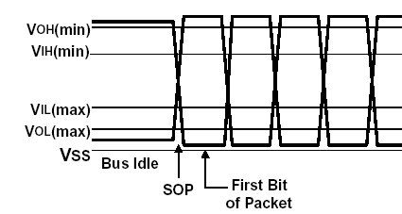
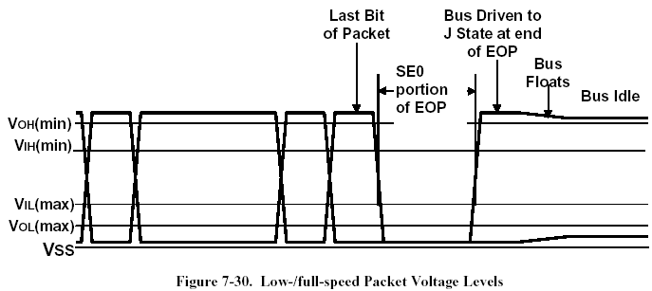
SOP : Not take any bit time, it’s a symbol from Bus Idle to switch voltage of D+, D-
HS EOP : 1111111…., more than six of 1
(P151,152,161)

Slide 23
PROTOCOL LAYER
(Chapter 8)

Slide 24

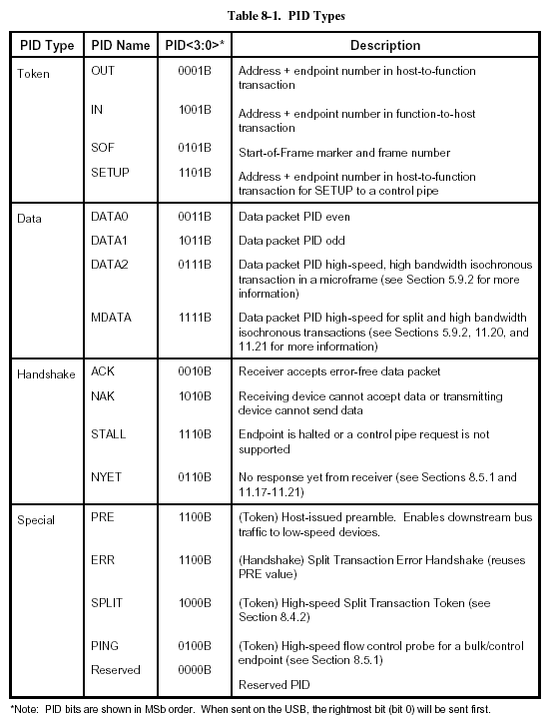

Slide 25


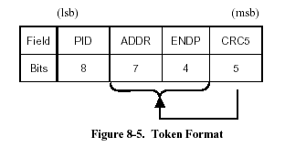
Token CRCs : G(X) = X5 + X2 + 1
Data CRCs : G(X) = X16 + X15 + X2 + 1
OUT, IN, SETUP, PING

Slide 26
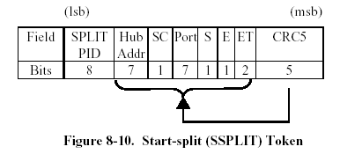
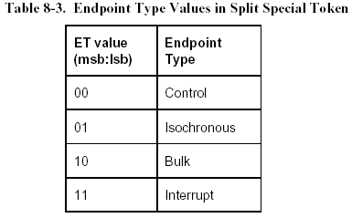
S (Speed) :
0 – Full speed 1 – Low speed

Slide 27
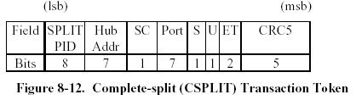
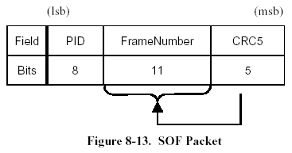
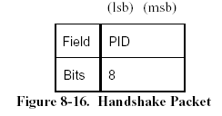
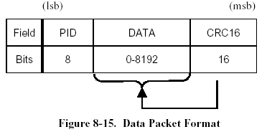
The U bit is reserved/unused and must be reset to zero(0B).
ACK, NAK, STALL, NYET, ERR
DATA0, DATA1, DATA2, MDATA

Slide 29
The allowable maximum control transfer data payload sizes (p39-53) :
LS : 8 bytes FS : 8, 16, 32, or 64 bytes HS : 64 bytes
Isochronous Transfer :
FS : <= 1023 HS : <= 1024
Interrupt Transfer :
LS : 0 – 8 FS : 0 – 64 HS : 0 – 1024
Bulk Transfer :
FS : 8, 16, 32, 64 HS : 512

Slide 30
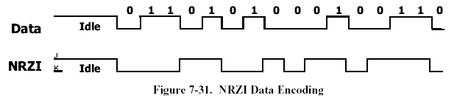
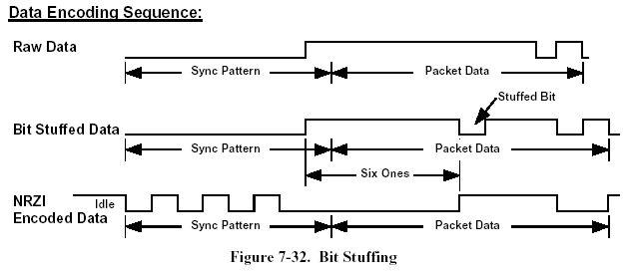
Data Encoding/Decoding (p157)
0:change, 1:no change
A 0 is inserted after every six consecutive 1 in the data stream

Slide 31
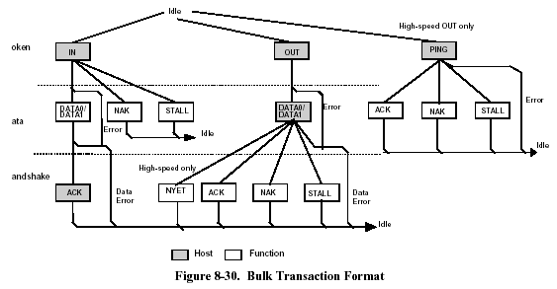
Bulk Transactions (p221)

Slide 32
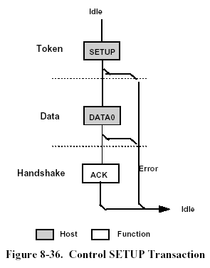
Setup Transactions

Slide 33
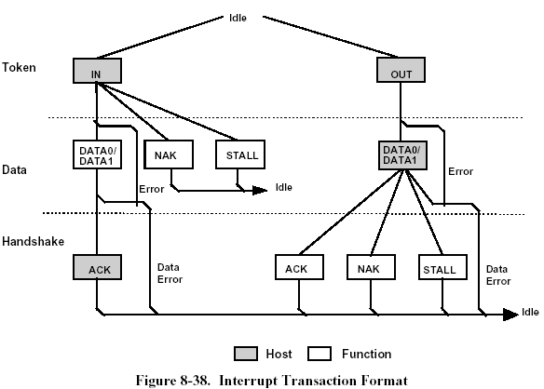
Interrupt Transactions

Slide 34
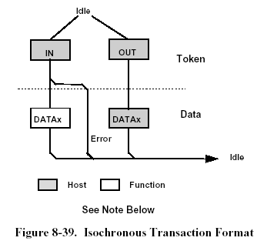
Isochronous Transactions

Slide 35
Data Synchronization (p208 8.4.6.3, p232)
sender receiver
Expect DATA0
Expect DATA0
DATA0
Expect DATA1
ACK (missing)
DATA0
Expect DATA1, but receive DATA0, so discard and return ACK
ACK
Expect DATA1

Slide 36
PING purpose (p217-220)
Without PING
  Host send OUT/DATA(e.q. large bytes) to Function several times until Function return ACK => waste bandwidth
With PING
  After Function return NAK.
  Host keep send PING(e.q. little bytes) until Function return ACK.
  And Host send OUT/DATA

Slide 37
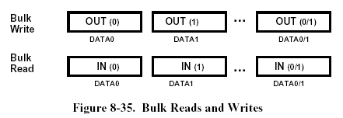
Bulk Reads and Writes

Slide 38
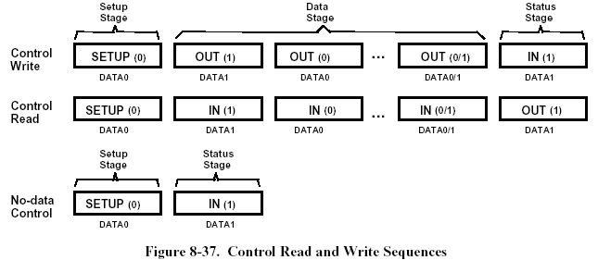
Control Transfers

Slide 39
Error Handling on the Last Data Transaction
Host Function Host Function
IN
OUT
DATA0
DATA0
ACK (missing)
ACK (missing)
OUT
OUT : host successfully received the data and start the status stage.
DATA0
Restart last DATA0, so it’s no problem.
Control Read
Control Write

Slide 40
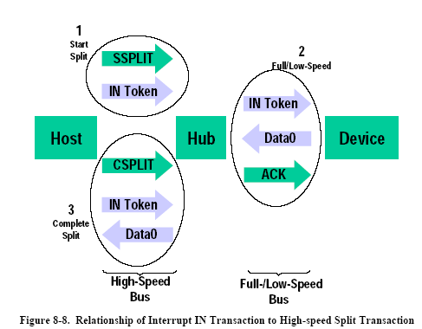
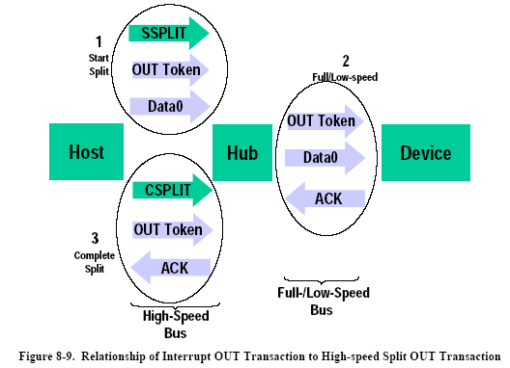
Hub adjust HS to FS/LS

Slide 41
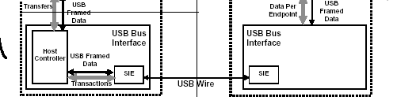
Summary of USB bus protocol (chapter 7, 8)
Packet
1.data packet is encoded by NZRI+bit stuffing
2.Bulk, Control, Interrupt, Isochronous Transaction

Slide 42
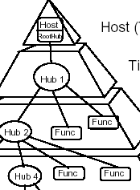
USB Routing

Slide 43
USB Device Framework
(Chapter 9)

Slide 44
Bus Access Constraints (p39-53)
Isochronous Transfer :
(2^{bInterval-1}) x F, F is 125 μs for HS and 1ms for FS.
Interrupt Transfer :
LS : 10 ms – 255 ms FS : 1 – 255 ms HS : (2^{bInterval-1})x 125 μs
High-speed endpoints can be allocated at most 80% of a microframe for periodic transfers.
The USB requires that no more than 90% of any frame be allocated for periodic (isochronous and interrupt) full-/low-speed transfers.

Slide 45
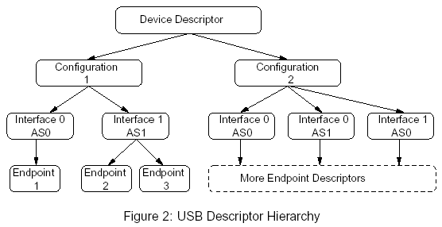
Enumeration & Device Descriptors
Enumerated : unique device number (1-127) is assigned.
And then the device descriptor is read.
An endpoint is not shared among interfaces within a single configuration, unless the endpoint is used by alternate settings of the same interface.

Slide 46
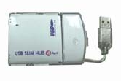
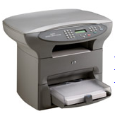

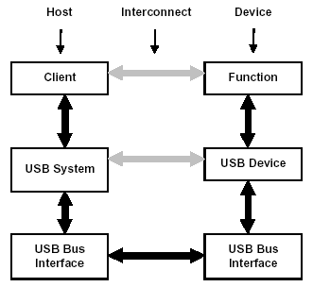
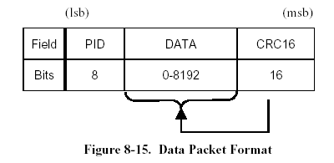
The “Bulk Write (a)” is” “message2” (without USB packet protocol header) rather than message1” (with USB packet protocol header).
Printer Overview
1.Attached, set address, get description
2. Reply description
3. Set Configure
3. Set Configure
4. Bulk Read (a)
4. Bulk Read (b)
Linux
5. Bulk Write (b) (several times)
5. Bulk Write (a) (several times)
Windows (with Printer Driver)
Bulk Write : For output data to printer.
Bulk Read : For status and other data received from printer.
Message2
Message1
Message1

Slide 47
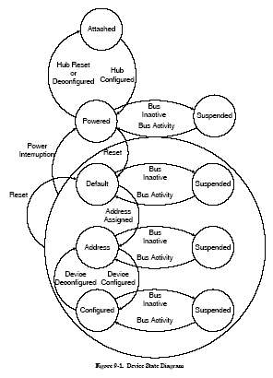
Visible Device States(p239)

Slide 48
Bus Enumeration (p243)
1. The hub informs the host status change.
2. The host determines the exact nature of the change by querying the hub.
3. The host then waits for at least 100 ms then issues a port enable and reset command to that port.
4. The hub performs the required reset processing for that port and it answers to the default address.
5. The host assigns a unique address to the USB device, moving the device to the Address state.
6. The host reads the configuration information from the device.
7. Based on the configuration information, the host assigns a configuration value to the device. Later, it is ready for use.

Slide 49
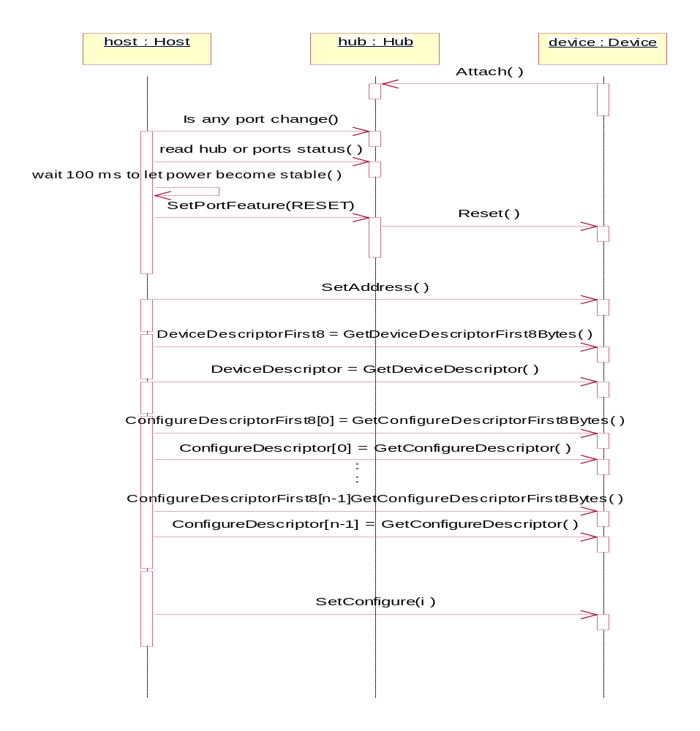
Bus Enumeration (p243)
Reset()
SetConfigure()

Slide 50

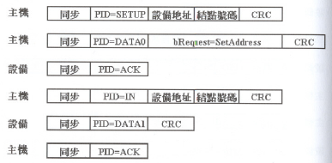
SetAddress()
SET_ADDRESS

Slide 51
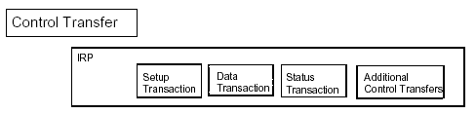

Slide 52
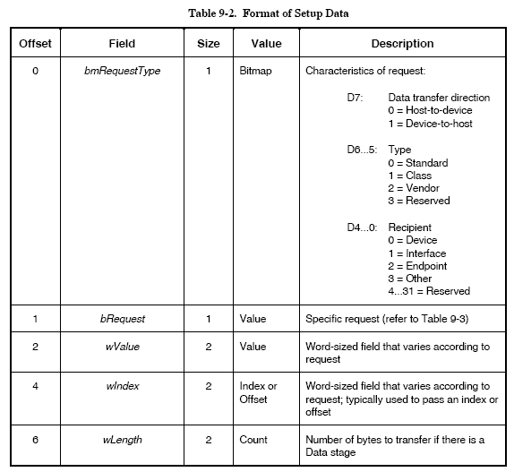
Setup Stage Format of Control Pipe

Slide 53
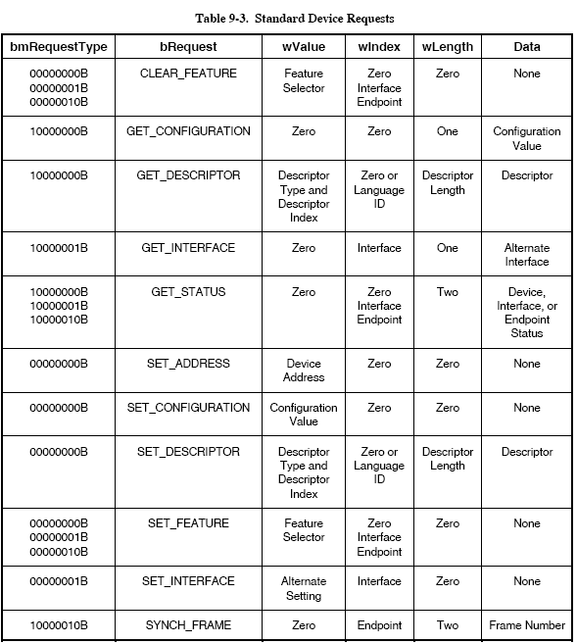
Standard Device Requests

Slide 54
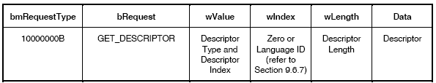



GetDeviceDescriptorFirst8Bytes() p39
/* Device descriptor */
struct usb_device_descriptor {
__u8 bLength;
__u8 bDescriptorType;
__u16 bcdUSB;
__u8 bDeviceClass;
__u8 bDeviceSubClass;
__u8 bDeviceProtocol;
__u8 bMaxPacketSize0;
__u16 idVendor;
__u16 idProduct;
__u16 bcdDevice;
__u8 iManufacturer;
__u8 iProduct;
__u8 iSerialNumber;
__u8 bNumConfigurations;
} __attribute__ ((packed));
8
After this, we know bMaxPacketSize0
GET_DESCRIPTOR

Slide 55

GetDeviceDescriptor()
12=sizeof(DeviceDescriptor)
GET_DESCRIPTOR
For example, bMaxPacketSize0=8, so this packet size is 8
this packet size is 4, and host sense this is last packet

Slide 56
GetConfigureDescriptorFirst8Bytes()
/* Configuration descriptor information.. */
struct usb_config_descriptor {
__u8 bLength __attribute__ ((packed));
__u8 bDescriptorType __attribute__ ((packed));
__u16 wTotalLength __attribute__ ((packed));
__u8 bNumInterfaces __attribute__ ((packed));
__u8 bConfigurationValue __attribute__ ((packed));
__u8 iConfiguration __attribute__ ((packed));
__u8 bmAttributes __attribute__ ((packed));
__u8 MaxPower __attribute__ ((packed));
struct usb_interface *interface;
unsigned char *extra; /* Extra descriptors */
int extralen;
};
8
After this, we know wTotalLength
GET_DESCRIPTOR

Slide 57
GetConfigureDescriptor()
wTotalLength
GET_DESCRIPTOR

Slide 58

SetConfigure()

Slide 59


Compare Descriptor between spec. and linux-usb
/* Device descriptor */
struct usb_device_descriptor {
__u8 bLength;
__u8 bDescriptorType;
__u16 bcdUSB;
__u8 bDeviceClass;
__u8 bDeviceSubClass;
__u8 bDeviceProtocol;
__u8 bMaxPacketSize0;
__u16 idVendor;
__u16 idProduct;
__u16 bcdDevice;
__u8 iManufacturer;
__u8 iProduct;
__u8 iSerialNumber;
__u8 bNumConfigurations;
} __attribute__ ((packed));

Slide 60
Compare Descriptor between spec. and linux-usb -- continue
/* Configuration descriptor information.. */
struct usb_config_descriptor {
__u8 bLength __attribute__ ((packed));
__u8 bDescriptorType __attribute__ ((packed));
__u16 wTotalLength __attribute__ ((packed));
__u8 bNumInterfaces __attribute__ ((packed));
__u8 bConfigurationValue __attribute__ ((packed));
__u8 iConfiguration __attribute__ ((packed));
__u8 bmAttributes __attribute__ ((packed));
__u8 MaxPower __attribute__ ((packed));
struct usb_interface *interface;
unsigned char *extra; /* Extra descriptors */
int extralen;
};

Slide 61


Compare Descriptor between spec. and linux-usb -- continue
/* Configuration descriptor information.. */
struct usb_config_descriptor {
__u8 bLength __attribute__ ((packed));
__u8 bDescriptorType __attribute__ ((packed));
__u16 wTotalLength __attribute__ ((packed));
__u8 bNumInterfaces __attribute__ ((packed));
__u8 bConfigurationValue __attribute__ ((packed));
__u8 iConfiguration __attribute__ ((packed));
__u8 bmAttributes __attribute__ ((packed));
__u8 MaxPower __attribute__ ((packed));
struct usb_interface *interface;
unsigned char *extra; /* Extra descriptors */
int extralen;
};

Slide 62
Linux-usb, usb_new_device()
int usb_new_device(struct usb_device *dev)
{
…
dev->epmaxpacketin [0] = 8;
dev->epmaxpacketout[0] = 8;
err = usb_set_address(dev);
…
wait_ms(10); /* Let the SET_ADDRESS settle */
err = usb_get_descriptor(dev, USB_DT_DEVICE, 0, &dev->descriptor, 8);
…
dev->epmaxpacketin [0] = dev->descriptor.bMaxPacketSize0;
dev->epmaxpacketout[0] = dev->descriptor.bMaxPacketSize0;
err = usb_get_device_descriptor(dev);
…
err = usb_get_configuration(dev);
…
/* we set the default configuration here */
err = usb_set_configuration(dev, dev->config[0].bConfigurationValue);
…
/* now that the basic setup is over, add a /proc/bus/usb entry */
usbdevfs_add_device(dev);
/* find drivers willing to handle this device */
usb_find_drivers(dev);
/* userspace may load modules and/or configure further */
call_policy ("add", dev);
return 0;
}

Slide 63


GetStringDescriptor()
Descriptor Index :
iManufacture, iProduct, …

Slide 64
Standard Interface Descriptor / Endpoint Descriptor
Standard Interface Descriptor p268
Standard Endpoint Descriptor p269

Slide 65







GetStatus device/interface/endpoint

Slide 66



Set Feature / Clear Feature

Slide 67

When to use Get Status / Clear Feature / Set Feature

Slide 68


Remote wake up ?

Slide 69
Time out of standard device P246
Any message
50 ms
5-second limit to finish 4 type of transfer with data stage
Any message
500 ms
500 ms
50 ms

Slide 70
Hub – chapter 11

Slide 71


Status Change Bitmap (p424)

