Slide 1
Chapter 1 Introduction: Local energy communities ?

Slide 2
Why local energy communities (in our opinion) ?

Slide 3
To be consistent with the energy transition: sufficiency, efficiency, renewables [1-4].
Yes but not only.
Proximité retrouvée
Trade-off ?
Leopold Kohr, Ivan Illich, Gilbert Simondon, Bruno Latour.
Renewables: e.g., solar panels
Efficiency: e.g., building insulation
Sufficiency: e.g., lower thermostat
[1] “RTE : Futurs énergétiques 2050”
[2] “ADEME : Transition(s) 2050”
[3] “Shift Project : le plan de transformation de l'économie française”
[4] “NégaWatt : Scénario 2022”

Slide 4
What are local energy communities (in our opinion) ?

Slide 5
Energy communities is a flexible concept [1] — i.e., our definition not absolute.
Two ingredients: geographic scope & temporal scope.
“A governance with the participation and effective control of local members whose primary economic activity is not the energy sector,
A primary purpose aimed at generating social and environmental benefits rather than a focus on financial profits.” [2]
[1] Brummer, ‘Community Energy – Benefits and Barriers’.
[2] Lowitzsch, Hoicka, and van Tulder, ‘Renewable Energy Communities under the 2019 European Clean Energy Package – Governance Model for the Energy Clusters of the Future?’

Slide 6
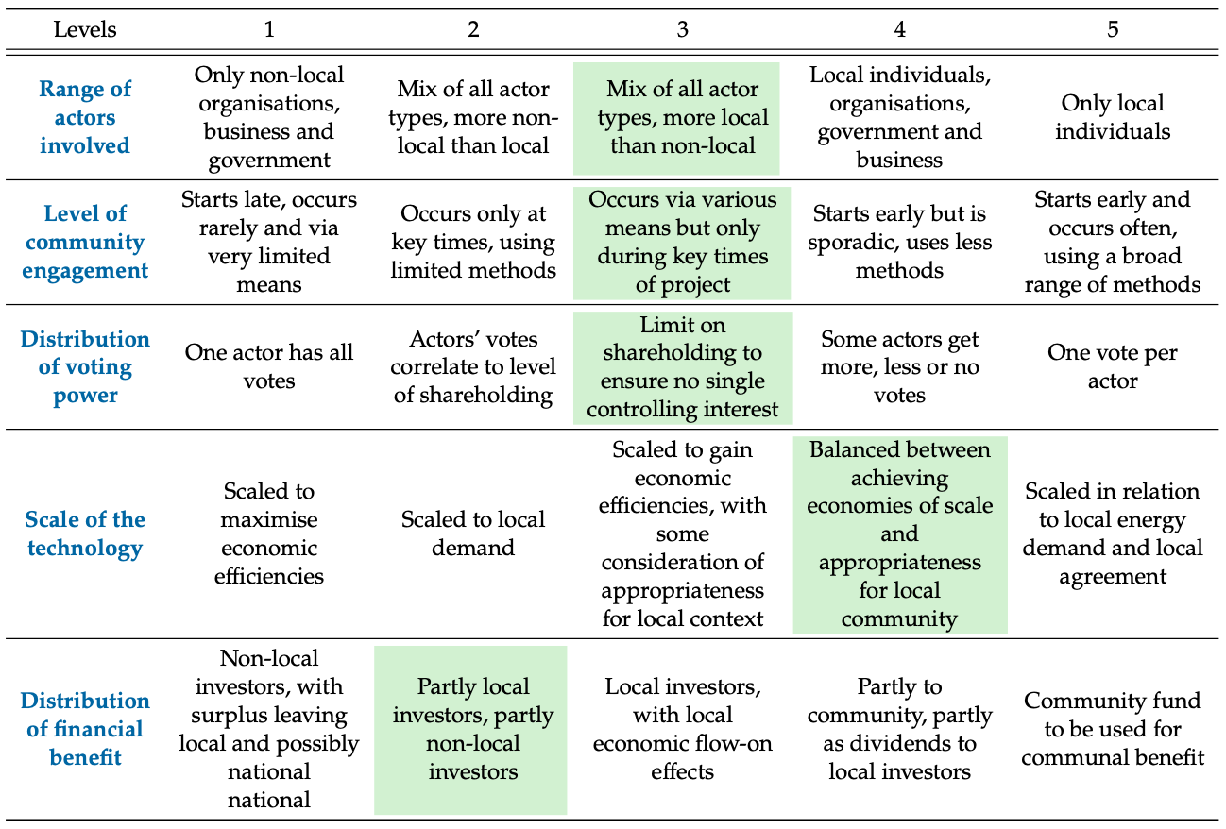
[1] Jarra Hicks and Nicola Ison. « An Exploration of the Boundaries of ‘Community’ in Community Renewable Energy Projects: Navigating between Motivations and Context ». In: Energy Policy 113 (Feb. 2018), pp. 523–534. doi: 10.1016/j.enpol.2017.10.031

Slide 7
Self-consumption (see chapter 2):
Power [kW]
Consumption
Production
Surplus
Local consumption
Grid consumption
Morning
Noon
Evening

Slide 8
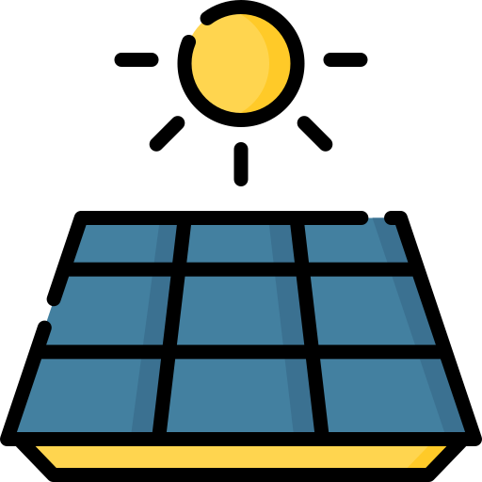


…
In France:
Electrical grid
…
…
30 minutes
1 km radius
1 km radius
Producers
Consumers
Sharing keys:
Static
Dynamic default
Dynamic
Organizing Legal Entity
Billing
Metering data
Distribution System Operator
Energy
supplier
Sharing « keys »
Notes:
Objet social (communauté d’hommes et de femmes)
On utilise le réseau d’électricité publique (pas d’autarcie)
Chaque consommateur garde un fournisseur extérieur pour couvrir le complément d’électricité
Notion de prise de décision collective sur la répartition du productible.
Couche physique et couche contractuelle

Slide 9
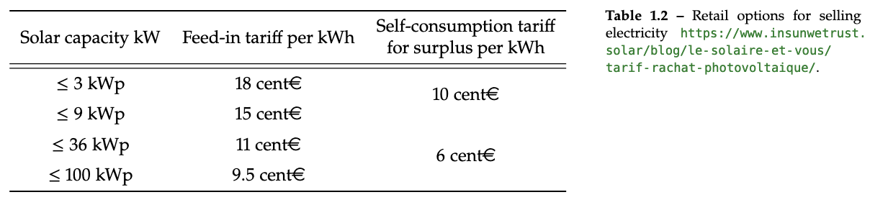
In August 2021, the regulated price of electricity is 9.74 cent€/kWh before taxes [16], and includes 3.71 cent€/kWh for network fees (TURPE) which means that producers can expect to sell electricity at about 6 cent€/kWh.
With the 2022 regulated price, and if we remove 3.71 cent€/kWh for grid fees, this leaves a potential value of 10 cent€/kWh for producers selling within a community,
If consumers are willing to accept a larger TURPE in the winter, solar power could be sold at about 13 cent€/kWh with a 0.73 cent€/kWh TURPE and still fall below the regulated electricity price.
[PV + battery LCOE] This would enable a price of electricity at 20 cent€/kWh plus 3.71 cent€/kWh and 3.2 cent€/kWh in TURPE and local taxes and a 20 % VAT for a total cost after tax of 32.3 cent€/kWh.
Whether local energy communities can extend on the public grid or not, is a major difference between national implementations in Europe.

Slide 10
Research landscape and questions.

Slide 11
Research question #1:
How to coordinate local consumption with production within a community?

Slide 12
Research question #2:
Is more renewable energy systems always better for local energy communities?

Slide 13
Chapter 2 What does it means to “self-consume” ?

Slide 14

Feed-in-tariff
Self-consumption
Production
Demand
Production
Demand
Meter #1
Meter #2
Meter #1
Distribution grid
Distribution grid
Notes:
Différence physique limité (compteurs)
Différence économique et « philosophique » marquées

Slide 15
Power [kW]
Consumption
Production
Surplus
Local consumption
Grid consumption
Morning
Noon
Evening
Self-consumption =
Self-sufficiency =
+
+

Slide 16
What’s the impact of time intervals ?

Slide 17
With 30 min intervals:
self-sufficiency = 100%
prod(t)
load(t)
…
…
10 AM
10:30 AM
With 15 min intervals:
self-sufficiency = 50%

Slide 18
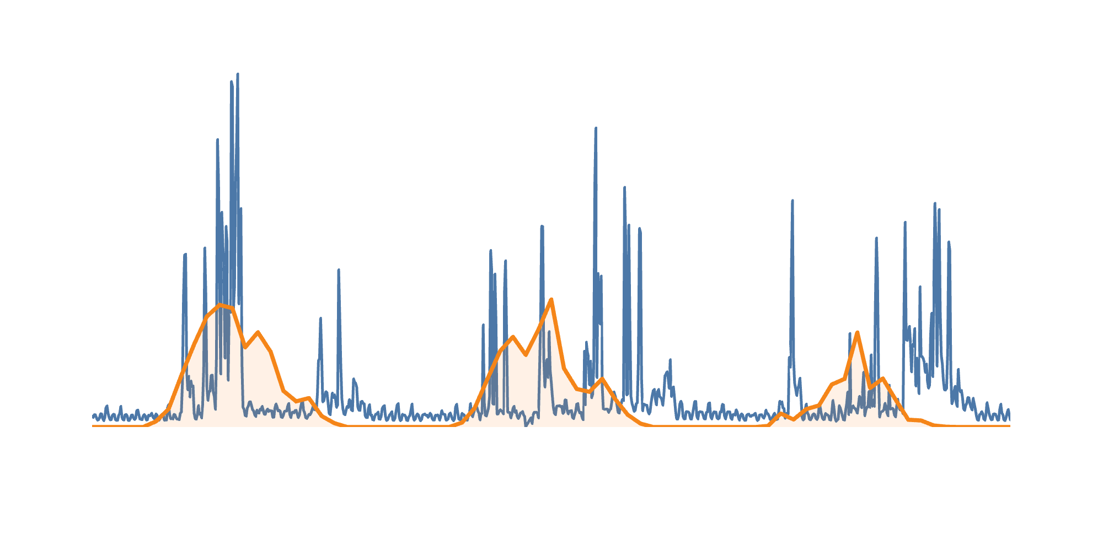
6
5
Solar production
4
Load profile
Power [kW]
3
2
1
0
00:00
12:00
00:00
12:00
00:00
12:00
00:00
Jun 1, 2014
Jun 2, 2014
Jun 3, 2014
Jun 4, 2014

Slide 19
1 year
90
Seasonal
value gap
(26%)
80
70
Weekly
value gap
(5%)
1 month
1 week
60
1 day
50
Self-sufficiency [%]
Diurnal
value gap
(31%)
40
60 min
30 min
30
15 min
5 min
20
10
0
0
1
2
3
4
5
PV size [kWp]

Slide 20
How to include storage ?

Slide 21


4
3
Consumption
Storage
3
2
2
Production
1
+
Power [kW]
0
1
0
-1
-1
-2
00:00
06:00
12:00
18:00
00:00
06:00
12:00
18:00
a) Storage = production
b) Storage = production & demand
4
4
3
3
2
2
Power [kW]
1
1
0
0
-1
-1
00:00
06:00
12:00
18:00
00:00
06:00
12:00
18:00
Self-sufficiency $=\frac{12}{24}=50\%$
Self-sufficiency $=\frac{15}{24}=62.5\%$
Notes:
Storage = demand
SS = 12 / 21 = 57%

Slide 22
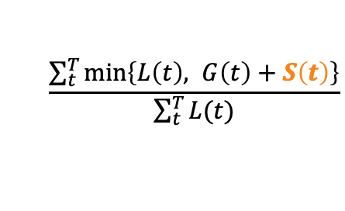
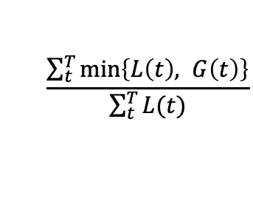
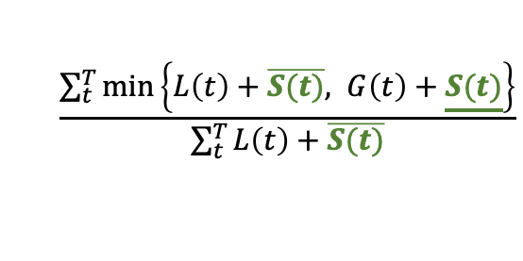
5
Battery profile
4
Solar production
3
Load profile
2
1
Household power [kW]
0
−1
−2
−3
00:00
03:00
06:00
09:00
12:00
15:00
18:00
21:00
Jun 2, 2014
$$\frac{\sum_{t}^{T}{\min\left\{L\left(t\right), G\left(t\right)\right\}}}{\sum_{t}^{T}{L(t)}}$$
No storage
Metrics
Definition 1
$$\frac{\sum_{t}^{T}{\min\left\{L\left(t\right), G\left(t\right)+S\left(t\right)\right\}}}{\sum_{t}^{T}{L(t)}}$$
Definition 2
$$\frac{\sum_{t}^{T}{\min\left\{L\left(t\right)+\overline{S(t)}, G\left(t\right)+\underline{S(t)}\right\}}}{\sum_{t}^{T}{L\left(t\right)+\overline{S(t)}}}$$
−10
−5
0
5
10
15
20
25
30
35
40
45
Self-sufficiency [%]

Slide 23
5
4
Solar production
3
Household power [kW]
Load profile
2
1
0
Battery profile
00:00
03:00
06:00
09:00
12:00
15:00
18:00
21:00
Jun 2, 2014
80
70
60
50
(35%) Definition 2
Self-sufficiency [%]
40
(33%) Net-metering
30
20
(31%) Definition 1
10
0
0
0.5
1
1.5
2
2.5
PV size [kWp]

Slide 24
Do we need storage to “self-consume” ?

Slide 25
Solar production
60
50
40
Load profile
Power [kW]
30
20
10
0
00:00
12:00
00:00
12:00
00:00
12:00
00:00
12:00
00:00
May 1, 2019
May 2, 2019
May 3, 2019
May 4, 2019
May 5, 2019

Slide 26
Battery SOC
60
50
40
Load profile
30
Power [kW] — SOC [kWh]
20
10
0
−10
Solar production
Battery power profile
−20
00:00
06:00
12:00
18:00
00:00
06:00
12:00
18:00
00:00
May 1, 2019
May 2, 2019
May 3, 2019

Slide 27
100
1 year
90
A
B
C
80
1 day
10%
8 kWh
70
6 kWh
60
4 kWh
Self-sufficiency [%]
50
2 kWh
40
No storage
10%
30
20
10
0
0
1
1.5
2
3
4
5
PV size [kWp/household]

Slide 28
What is the impact of load on self-sufficiency ?

Slide 29
100
1 year
90
Self-consumption
80
70
Natural
self-sufficiency
60
Self-sufficiency [%]
50
40
30
20
10
Self-sufficiency
0
0
1
2
3
4
5
PV size [kWp/household]

Slide 30
Solar production
35
30
25
20
Power [kW]
10% NSS
15
10
42% NSS
5
0
90% NSS
00:00
03:00
06:00
09:00
12:00
15:00
18:00
21:00
Jun 11, 2019

Slide 31
100
1 year
90
90% NSS
80
80% NSS
Original data
NSS = 35.5%
70
70% NSS
60
60% NSS
Self-sufficiency [%]
50% NSS
50
40
40% NSS
30
30% NSS
20
20% NSS
10
10% NSS
0
0.5
1
1.5
2
2.5
3
3.5
4
4.5
PV size [kWp/household]

Slide 32
Chapter 3 How to coordinate self-consumption within communities?
Notes:
Historical narrative (see ”quoi de neuf” avoid the innovative narrative)
What level of complexity do we expect our communities ?
Not just a question of physical coordination

Slide 33
An old topic, yet little implementations in local energy communities.
Basis of any microgrid/grid (physique), → microgrid with batteries and voltage control. Water dynamo or Edison dynamo how to maintain balance?
1981 - Homeostatic control (information),
…
Notes:
Old (pas dans le récit de l’innovation) yet under developed for local energy communities
Economic reasons, also strong distribution grids…
Coordination as “automation” not an end in of itself (keep a sense of proximity)
Homeostatic control — (At the same time that it is important to have a close interaction between customers and the utility, it is equally important for customers to make independent decisions. It is more efficient for a customer to make the decision to reschedule or even to shed load than it is for an external source, such as an electric utility controller, to make the decision to manage or shed customer load. Industrial customers are far more able to judge the value of electricity to their processes at any given point in time than is the utility controller who has little, if any, information concerning the process.)
Under Homeostatic Control the utility does not "cross the meter line" and the customer retains complete freedom of decision making. Homeostatic Control achieves the two principles of feedback and independence using the concepts of an energy marketplace.

Slide 34
An old topic, yet little implementations in local energy communities.
Mostly communities driven by solar panel production
Small central storage units
Not a surprise : Economic reasons, strong distribution grid, social acceptance, regulatory…
Automation of flexible assets is not an end, “the right automation” (if we want to keep a sense of proximity)
Notes:
Old yet under developed for local energy communities
Economic reasons, also strong distribution grids…
Coordination as “automation” not an end in of itself (keep a sense of proximity)

Slide 35
What is the expected complexity of local energy communities ?

Slide 36


What is the expected complexity of local energy communities (at each scale)?
Community #1
« less complex »
Community #2
« more complex »
2, 3, 4
Grid
Grid
1
1
1
1
DSO
Coordination actions to maximize revenues
« Individual » actions
« Individual » actions
« Collective » actions
« Temporal » actions
« Spatial » actions
…
[1] Siegenfeld and Bar-Yam, ‘An Introduction to Complex Systems Science and Its Applications’.
Notes:
More or less complex energy communities (with different scales involved, coherent or corrolated)
Coordination with more actions can be necessary but never sufficient for better performance (good action)
Unforeseen evolution of communities, how to design an evolutionary coordination (keep good mutations)?

Slide 37
Non-exhaustive list of expectations:
Individuals with multiple :
batteries,
but also shapeable loads,
and deferrable loads,
or nothing;
Maximize revenues for all individuals considering :
individual time of use pricings,
fees from the DSO for power exchanges,
cost of equipment ageing,
cost of lost of comfort;
Multiple participants (residential, commercial building, office buildings, …) within a 2km diameter;
Individuals with production units or not;
Resources directly own by the community;
Keep individual load profiles secured and private;
Communities rapidly changing size with on-boarding and off-boarding of individuals;
Interface with individual members to support behavioural nudges;
Ensure that grid constraints are not violated;
Provide some interface for grid services with the DSO, and TSO levels.
Notes:
Non exhaustive list some expectations, we dont’ prioritize last 4 for reasons that we can discuss later
Coordination strategies themselve form complex systems (i.e., many actions interact with each others)

Slide 38
What “eco-system” around coordination strategies ?

Slide 39
Not only physical coordination.
Local energy community
Environment
(regulatory, physical scale)
Physical
coordination
Cost
allocation
Community governance
[1] Mengelkamp et al., ‘Designing Microgrid Energy Markets’.
[2] Cox, Arnold, and Villamayor Tomás, ‘A Review of Design Principles for Community-Based Natural Resource Management’.
Notes:
started by thinking about physical coordination as a standalone, but it is tied to « cost allocation » and « community governance »
If we were to take away a box, it would be « physical coordination » most communities in France do.

Slide 40
Costs allocation has some degrees of freedom with physical flux:
Physically at 12:15 pm
Economically at 12:15 pm
kWh
kWh
3
3
3
2
2
cons. #3
2
1.33
prod. #1
1.0
1.0
1
1
0.66
cons. #2
Production
Consumption
Pro rata of total consumption
Prioritization of cons. #2
share #2 = 33% of 2kWh
share #3 = 66% of 2kWh
share #2 = 1kWh
share #3 = 2kWh - 1kWh
The price is another adjustment variable.
[1] Diva et al., ‘’.
Notes:
Not only is possible to do without (expected from passive communities)
The economical dispatch has some degree of freedom with regard to physical flux
Physically use all resources « together » and still economically « reward » resource owners (increase the cake size, and still share it how we want).

Slide 41
Sharing keys:
Cons. 1
…
Cons. n
Prod. 1
1 | … | 0
… | … | …
0.75 | … | 0.1
=100%
…
=100%
Prod. n
=100%
…
12:15 pm
12:30 pm
1:00 pm
Time

Slide 42
A review of coordination strategies
Centralized / Decentralized
Individualist / Collaborative
Notes:
Expected complexity we want to reach at each scale (house, community, inter-communities, national)
Physical coordination depends on cost allocation and human organization
Cost allocation can provide a level of abstraction from physical flux (to some extend)
2 axes of review for coordination strategies.

Slide 43
Decentralized versus centralized ?

Slide 44
Centralized / Decentralized
Decentralized structure handle more complexity;
Distributed energy resources --> distributed control system Not so simple.
Requires to discriminate domains (ICT, control, power system) [1]
What level of complexity is expected at what scale ?
Is the complexity already matched by the governance / cost allocations?
[1] Han et al., ‘Taxonomy for Evaluation of Distributed Control Strategies for Distributed Energy Resources’.
Notes:
ICT = communication (blockchain, virtual machines on a server (agent), central influx, MQTT)
Control = algorithm = ADMM or central optimization or PID, …
Power system = central battery or many small batteries ? Physical distribution of resources
For 3 batteries centralized controller will be more efficient, for 1 million…
Centralized system choosen by a distributed governance ? Is it still distributed ?

Slide 45
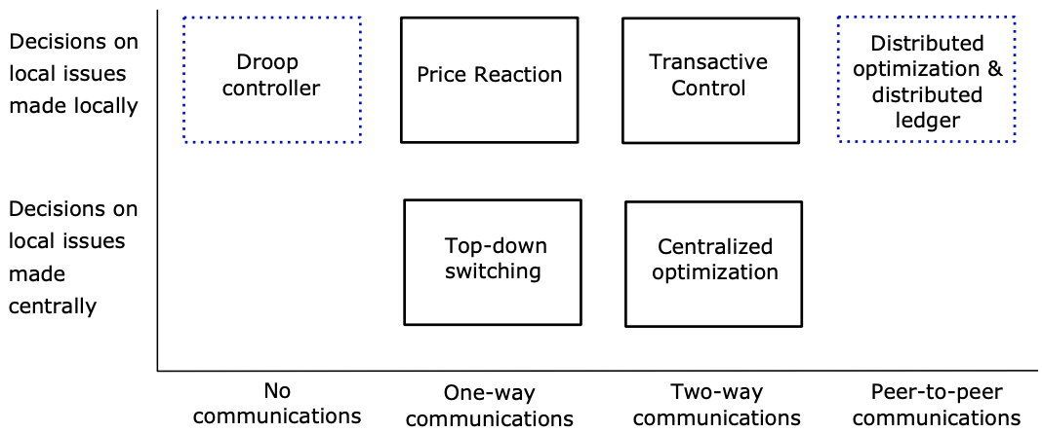
Centralized / Decentralized
Classification based on communication capabilities between devices and a platform (i.e., 1-way or 2-way), and whether local decisions are taken locally or not [1].
[1] Kok and Widergren, ‘A Society of Devices’ (smart energy management matrix).
Notes:
ICT = communication (blockchain, virtual machines on a server (agent), central influx, MQTT)
Control = algorithm = ADMM or central optimization or PID, …
Power system = central battery or many small batteries ? Physical distribution of resources
For 3 batteries centralized controller will be more efficient, for 1 million…
Centralized system choosen by a distributed governance ? Is it still distributed ?

Slide 46
Centralized / Decentralized
Lower communication requirement (broadcast signal, BBC?), but when internet we often have 2 ways.
Yes / no to a blockchain, flowchart.
Nanoé (hazardous with our definition of proximity)
Iterative / determinant
[1] Kok and Widergren, ‘A Society of Devices’ (smart energy management matrix).
Notes:
ICT = communication (blockchain, virtual machines on a server (agent), central influx, MQTT)
Control = algorithm = ADMM or central optimization or PID, …
Power system = central battery or many small batteries ? Physical distribution of resources
For 3 batteries centralized controller will be more efficient, for 1 million…
Centralized system choosen by a distributed governance ? Is it still distributed ?

Slide 47
Local energy communities
Do you need to store state?
yes
Are there
multiple
writers?
yes
Can you use
an always
online TTP?
no
Are all
writers
known?
no
Permissionless
Blockchain
no
no
yes
yes
Are all
writers
trusted?
no
Is public
verifiability required?
yes
Public
Permissioned
Blockchain
yes
no
Private
Permissioned
Blockchain
Don’t use
Blockchain
TTP = Trusted Third party

Slide 48
Individualist versus collaborative ?

Slide 49
Individualist / Collaborative
Different strategies (regardless of decentralized/centralized):
Individualist coordination → energy market + settlement
Collaborative coordination → central dispatch + cost allocation
(It is a spectrum, and this association is simply a trend)
Why one rather than the other ?
Competitive → Scalability and privacy, but liquidity and uncertainties (notion of scale),
Competitive → empowerment (willingness to buy) and adaptive (standard bids),
Community environment (security, equality, trust) → collaboration,
Env.: abundance → competition, where lack → collaboration,
In complex system both come together (competition → collaboration, and vice versa).
Notes:
Win individually / as a group (together)
Competition best fit player → increase collaboration between player
Invisible hand of the market / Management of common goods

Slide 50
Technique d’intelligence collective

Slide 51
Compare Alg 1 if everybody on its own or if community all together.

Slide 52
Individualist / Collaborative
Review and position a few coordination strategies:
PowerMatcher is it competitive ? For what reasons ?
XXXXX is it collaborative ? For what reasons ?
Notes:
ICT = communication (blockchain, virtual machines on a server (agent), central influx, MQTT)
Control = algorithm = ADMM or central optimization or PID, …
Power system = central battery or many small batteries ? Physical distribution of resources
For 3 batteries centralized controller will be more efficient, for 1 million…
Centralized system choosen by a distributed governance ? Is it still distributed ?

Slide 53
A general objective / concepts
Historical context (not so much an innovation)
System complexity determining coordination complexity
Interdependent layers (technical but also economic dispatch and governance),
Cost allocation has some degrees of freedom with regard to physical flux.
A review of coordination strategies
Centralized / Decentralized
Individualist / Collaboration
Our strategy
Overview
Order book format
Central dispatch
Modularité vue graphiquement ?
Comparaison avec Alg. 1
Scalability du nombre de batteries
Forecast
Simple, auto-regressor, weather regressor
Adjustment
2D of piece-wise and tree view
Convergence

Slide 54
Central dispatch (impact of exchange price)
Alg. 1
Overall cost
Central dispatch limiting exchanges
Exchange price

Slide 55
Central dispatch (scalability)
Optimization time
# of batteries

Slide 56
Forecast (bare bone, autoregressive, weather)
Power profile
Reference
Time

Slide 57
Chapter 4

Slide 58
What's the impact of frequent forecast and redispatch?
Including stochastic variables in the dispatch
Relying on an heuristic strategy without forecast

Slide 59
Chapter 5 More solar panels is always better for GHG emissions ?

Slide 60
Self-sufficiency is desirable ?
High self-sufficiency is not desirable, but the right self-sufficiency is (we believe).
Our work is to find the "right level" from an GHG perspective.
Self-sufficiency is interesting to merge :
efficiency gains from large power plants,
and energy sufficiency from a more “physical understanding of production”.

Slide 61
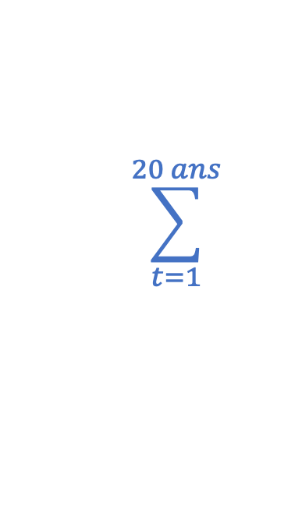
Pour atteindre une autoproduction de X%, quelle est la combinaison de panneaux solaires et batteries qui minimise l’émission de Gaz à Effet de Serre (GES) ?
les GES à la fabrication et
au démantèlement (l’investissement)
les GES dans la consommation (l’opération)
$$\sum_{t=1}^{20 ans}{ }$$
Émissions de GES
=
+
Notes:
L’énoncé du problème
2 composantes pour calculer les émissions (l’une sans l’autre n’a pas de sens)

Slide 62
Hypothèse d’une étude à l’échelle de la communauté
Producteurs
Consommateurs
0 gCO2/kWh
Production
locale
-0 gCO2/kWh
60 gCO2/kWh
- 60 gCO2/kWh
Import du
réseau
Notes:
1) On a fait un choix, une hypothèse forte
2) Évite les solutions qui consistent à surdimmenssioner le PV pour sa rentabilité carbone à l’export
(éviter de tomber dans une situation où on installe du PV en vu d’un impact National, reste à l’échelle locale).
It is a conservative assumption. We justify this scope with a least three reasons 1) exporting power has technical implications that are not carbon neutral (see Rémy's comment) 2) the philosophy of self-sufficient communities aim at calculating GHG emission at the scale of the community, and not to dilute it at the scale of a country 3) if all energy communities take the assumption of an “infinite” grid is not a sustainable solution system wide.

Slide 63
Pour atteindre une autoproduction de X%, quelle est la combinaison de panneaux solaires et batteries qui minimise les émissions GES ?
GES gCO2/kWh
Réseau électrique
60 gCO2/kWh
Autoproduction
0%
30%
100%
Notes:
Intuiter le résultat (expliquer les axes)
Autoproduction bénéfique pour les aspects émission de gaz à effet de serre
Autoproduction dans l’excès (disproportion des équipements) qui amène à quantativement empirer les émissions

Slide 64
Les cas de l’Allemagne
GES [gCO_{​2​}eq / kWh]
500
Communauté qui consomme la nuit
400
300
Réseau électrique
1%
10%
20%
30%
200
40%
50%
60%
70%
80%
100
90%
Communauté qui consomme le jour
100%
0
0
20
40
60
80
Autoproduction [%]
Notes:
Même graphique à cela qu’on le présente sous forme d’abaque pour différent types de communautés
Intuition validé, coude vers 70% autoproduction (en fait assez « loin »)

Slide 65
Les cas de la France
GES [gCO_{​2​}eq / kWh]
180
160
140
120
10%
20%
100
30%
40%
50%
80
60%
70%
60
80%
Réseau électrique
90%
40
100%
0
20
40
60
80
Autoproduction [%]
Notes:
Même graphique, mais on commence à un niveau plus bas, grâce au réseau français plus vertueux
Intuition toujours présente, mais cette fois ci moins marqué, coude 20% autoproduction (assez facilement atteint)
De ce point de vue (sous entendu avec nos hypothèses), l’autoconsommation collective n’est pas une solution magique pour réduire nos émissions par kWh
À la fois c’est dommage, mais aussi tant mieux (presque) --> souligne qu’on ne peut pas prendre la solution de la facilité (le kWh à 0gCO2), on échappe aux questions d’usages et de rapport à l’énergie. Pas seulement un question quantitative de sobriété. Rapport à la machine à travers la réparation (ami). Rapport à l’échelle spatio-temporelles réorganisation autour du vélo/transport en commun versus voiture(l’échelle couvre beaucoup de sujet, exemple de la démocratie athénienne à 10 000 âmes pas la même échelle que la démocratie à l’échelle de 66 millions, pourtant ce sont les mêmes mots utilisés).

Slide 66
Annex 1 City radius ?

Slide 67
Today electric transport (90km/h) and refrigeration ⇒ Food can be produced anywhere in Europe and brought to cities. Take assumption that this is not available (obviously not realistic). The objective is :
Show without using energy physical limits are more apparent
Calculate a theoretical city size and compare it with pre-industrial cities (validate order of magnitude)
Compare order of magnitude for a city to current megapole
Method
We take a circular city with a radious k, to feed this city we need a circular farming area around with radius r, Finally we have a maximal radius R which considers how far food produce can travel. This is figure X.
Fig X.
The city radius and density of population are variables of our problem. For the rest the « farming » circle is defined by the consumption per inhabitant and crop yield per surface. The « travelling » circle is defined by the horse speed carrying food and duration of the trip (food peremption or other logistic matters).
We express the equation to find the radius of the farming circle as a function of the city radius and population density.
Eq X.

Slide 68
Results
To calculate the farming circle depends on surface to feed a human, we take this value from WHO. The upper traveling circle is more flexible but for now we set the limit based on horse speed and 3 day trip.
Fig 2 with different assumptions on population density (reading the curve)
Xaxis = city radius & Yaxis = farming circle
Fig 3 Placing pre-industrial big cities / modern small cities / big metropoles (Paris, Tokyo)
Xaxis = city radius & Yaxis = farming circle
Are we good on the validation side ?
Warning not realistic, order of magnitude nonetheless between small cities and big cities ?
Limits
Always careful when using over-simplified models. Rather here to show some trends, highlight potenital physical limits with less energy.
Surface farming per habitant ?
Some food don’t have peremption date, or can be transported alive.
Topology (mountain, river, sea side, circular city)
Train tracks

Slide 69
Archives / backup slides Random stuffs

Slide 70
(Society & Energy)
1760 – 1840: Industrial revolution
City:
Taux d’urbanisation / Taille des villes / Matériaux employés à la construction
Work:
70 – 80% of the population employed in agriculture until 1800 [1] against 1.5% in France nowadays.
1865: Abolition of slavery in the USA
Family:
Dispersion of family members: long distance mobility increases continuously during the 19th century [2].
[1] GRIGG, “The World’s Agricultural Labour Force 1800-1970”.
[2] Bourdieu et al., ‘La dispersion spatiale des familles’.

Slide 71
Individual self-consumption
« Less complex » system:
(see Alg. 1)
Maximize
revenues
Multiple
storages
A dwelling
Collective self-consumption
« More complex » system:
Maximize
revenues
Multiple
storages
Multiple dwellings
[1] Siegenfeld and Bar-Yam, ‘An Introduction to Complex Systems Science and Its Applications’.
Notes:
Adding a new scale keep equal or raise the overall complexity (# actions) that the system should consider. From a coherent system to a corralated system (explain).
Research field starts with recognizing this complex systems, and providing coordination designs for it (that exceed the complexity of decision makers within them).
Other complexities aside from the multi actors (revenues – time, distribution grid – localisation)
Complexity provides more action (manage common resources) but does not garantee to perform better (use alg. 1 has a lower bound) to see if we take good decision / the decision space is large enough (if exchange are too expensive…)

Slide 72
What is the expected complexity of local energy communities (at each scale)?
Community #1
« less complex »
Community #2
« more complex »
DSO
Grid
Grid
Boucle sur la communauté
Chiffre entre action
Coordination actions to maximize revenues
« Individual » actions
« Individual » actions
« Exchange » actions
« Temporal » actions
« Spatial » actions
…
[1] Siegenfeld and Bar-Yam, ‘An Introduction to Complex Systems Science and Its Applications’.
Notes:
More or less complex energy communities (with different scales involved, coherent or corrolated)
Coordination with more actions can be necessary but never sufficient for better performance (good action)
Unforeseen evolution of communities, how to design an evolutionary coordination (keep good mutations)?

Slide 73
System #1
« less complex »
System #2
« more complex »
Complexity of the system
at each scale
Multiple batteries
Maximize revenues
Individual houses
⇒ « Individual » actions
Multiple batteries
Maximize revenues
Multiple houses
⇒ « Individual » actions
⇒ « Exchange » actions
⇒ « Temporal » actions
⇒ « Spatial » actions
…
Complexity of the coordination at each scale
Notes:
Before thinking about the coordination strategy, we have to think about the expected complexity of our local energy community at each scale (house, community, DSO, TSO)
Illustrate examples, complexity of system 1, versus system 2
The complexity at each scale of our system will give us the complexity of coordination we need
It is necessary for our coordination to have at least the complexity of the system at a given scale (lower bound)
It is not sufficient as:
More available actions (complex coordination) do not guarantee a better performance (no because we still need to make good decisions, yes because we can manage exchanges). Individual case actually provide an interesting lower bound on our performance.
More action can be overwhelming/useless, some actions (degree of freedom) can potentially be eliminated (distribution grid is robust enough, exchange cost are prohibitive)
Accepting that a complex system (community) will present elements that were not considered ahead of time. Thus the question becomes : how to account for an evolutionary process of our coordination strategy (keeping the ”good mutation” and not the bad) ?

Slide 74
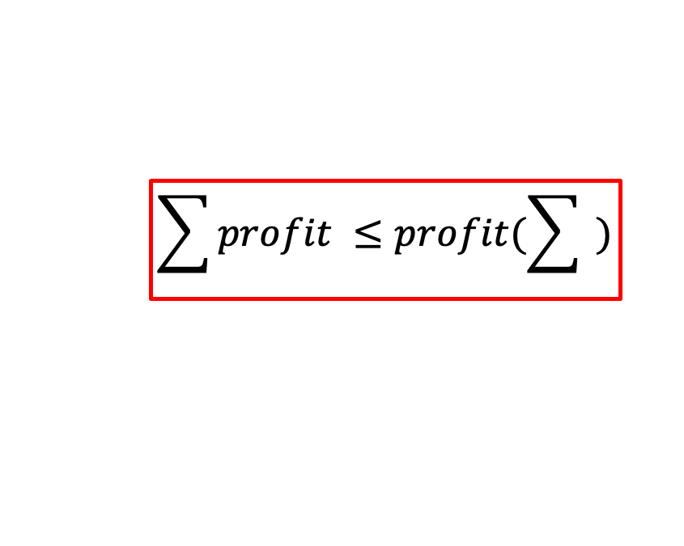
$$\sum{profit ≤profit(\sum{ )}}$$
Notes:
See reasons to create a community from chapter 1
From a technico-economic perspective, hope to validate equation (which is not the case in France).

Slide 75
Objectives:
Increase self-sufficiency
Increase revenues (time-of-use, grid services, …)
Lower GHG emissions
Consumption
Production
Means:
Power [kW]
Storage
Shapeable load
Deferable load
Nudges (human)
Surplus
Local consumption
Grid consumption
Morning
Noon
Evening

Slide 76
