Slide 1
Chapter 1 Introduction: Local energy communities ?

Slide 2
Power [kW]
Consumption
Production
Surplus
Local consumption
Grid consumption
Morning
Noon
Evening

Slide 3
Puissance [kW]
Consommation
Production
Surplus
Consommation
sur le réseau
Consommation locale
Matin
Midi
Soir

Slide 4



…
In France:
Electrical grid
…
…
1 km radius
Producers
Consumers
Organizing Legal Entity
Billing
Metering data
Distribution System Operator
Energy
supplier
Sharing « keys »
Notes:
Objet social (communauté d’hommes et de femmes)
On utilise le réseau d’électricité publique (pas d’autarcie)
Chaque consommateur garde un fournisseur extérieur pour couvrir le complément d’électricité
Notion de prise de décision collective sur la répartition du productible.
Couche physique et couche contractuelle

Slide 5
Chapter 2 What does it means to “self-consume” ?

Slide 6

Feed-in-tariff
Self-consumption
Production
Demand
Production
Demand
Meter #1
Meter #2
Meter #1
Distribution grid
Distribution grid
Notes:
Différence physique limité (compteurs)
Différence économique et « philosophique » marquées

Slide 7
Power [kW]
Consumption
Production
Surplus
Local consumption
Grid consumption
Morning
Noon
Evening
Self-consumption =
Self-sufficiency =
+
+

Slide 8
With 30 min intervals:
self-sufficiency = 100%
prod(t)
load(t)
…
…
10 AM
10:30 AM
With 15 min intervals:
self-sufficiency = 50%

Slide 9
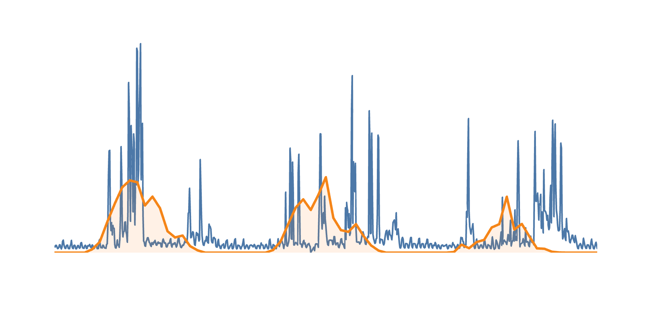
6
5
Solar production
4
Load profile
Power [kW]
3
2
1
0
00:00
12:00
00:00
12:00
00:00
12:00
00:00
Jun 1, 2014
Jun 2, 2014
Jun 3, 2014
Jun 4, 2014

Slide 10
1 year
90
Seasonal
value gap
(26%)
80
70
Weekly
value gap
(5%)
1 month
1 week
60
1 day
50
Self-sufficiency [%]
Diurnal
value gap
(31%)
40
60 min
30 min
30
15 min
5 min
20
10
0
0
1
2
3
4
5
PV size per household [kWp]

Slide 11


4
3
Consumption
Storage
3
2
2
Production
1
+
Power [kW]
0
1
0
-1
-1
-2
00:00
06:00
12:00
18:00
00:00
06:00
12:00
18:00
a)
Definition 1: Storage = production
b)
Definition 2: Storage = production & demand
4
4
3
3
2
2
Power [kW]
1
1
0
0
-1
-1
00:00
06:00
12:00
18:00
00:00
06:00
12:00
18:00
Self-sufficiency $=\frac{12}{24}=50\%$
Self-sufficiency $=\frac{15}{24}=62.5\%$
Notes:
Storage = demand
SS = 12 / 21 = 57%

Slide 12
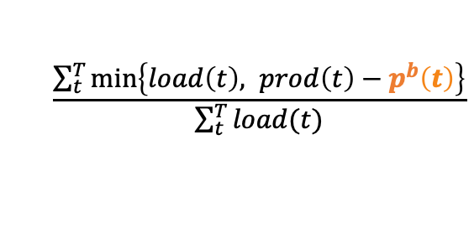
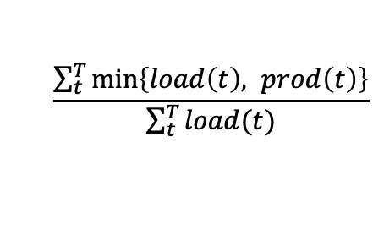
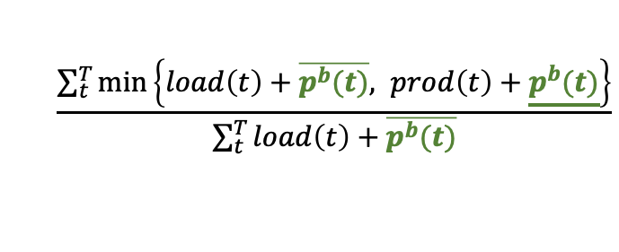
5
Battery profile
4
Solar production
3
Load profile
2
1
Household power [kW]
0
−1
−2
−3
00:00
03:00
06:00
09:00
12:00
15:00
18:00
21:00
Jun 2, 2014
$$\frac{\sum_{t}^{T}{\min\left\{load\left(t\right), prod\left(t\right)\right\}}}{\sum_{t}^{T}{load(t)}}$$
No storage
Metrics
Definition 1
$$\frac{\sum_{t}^{T}{\min\left\{load\left(t\right), prod\left(t\right)−p^{b}\left(t\right)\right\}}}{\sum_{t}^{T}{load(t)}}$$
Definition 2
$$\frac{\sum_{t}^{T}{\min\left\{load\left(t\right)+\overline{p^{b}(t)}, prod\left(t\right)+\underline{p^{b}(t)}\right\}}}{\sum_{t}^{T}{load\left(t\right)+\overline{p^{b}(t)}}}$$
−10
−5
0
5
10
15
20
25
30
35
40
45
Self-sufficiency [%]

Slide 13
5
4
Solar production
3
Household power [kW]
Load profile
2
1
0
Battery profile
00:00
03:00
06:00
09:00
12:00
15:00
18:00
21:00
Jun 2, 2014
80
70
60
50
(35%) Definition 2
Self-sufficiency [%]
40
(33%) Net-metering
30
20
(31%) Definition 1
10
0
0
0.5
1
1.5
2
2.5
PV size [kWp]

Slide 14
Solar production
60
50
40
Load profile
Power [kW]
30
20
10
0
00:00
12:00
00:00
12:00
00:00
12:00
00:00
12:00
00:00
May 1, 2019
May 2, 2019
May 3, 2019
May 4, 2019
May 5, 2019

Slide 15
Battery SOC
60
50
40
Load profile
30
Power [kW] — SOC [kWh]
20
10
0
−10
Solar production
Battery power profile
−20
00:00
06:00
12:00
18:00
00:00
06:00
12:00
18:00
00:00
May 1, 2019
May 2, 2019
May 3, 2019

Slide 16
100
1 year
90
A
B
C
80
1 day
10%
8 kWh
70
6 kWh
60
4 kWh
Self-sufficiency [%]
50
2 kWh
40
No storage
10%
30
20
10
0
0
1
1.5
2
3
4
5
PV size [kWp/household]

Slide 17
100
1 year
C) Seasonal storage
90
B) Daily storage
80
1 day
70
10%
A) No storage needed
60
Self-sufficiency [%]
50
40
No storage
10%
30
20
10
0
0
1
1.5
2
3
4
5
PV size [kWp/household]

Slide 18
100
1 year
90
80
1 day
8 kWh
70
6%
6 kWh
60
4 kWh
Self-sufficiency [%]
50
2 kWh
40
11%
No storage
30
20
10
0
0
1
2
3
4
5
PV size [kWp/household]

Slide 19
6
Score for a limited scope
5
4
Mean Absolute Percentage Error [%]
3
Score for the full scope
2
1
K = 5 weeks
0
2
4
6
8
10
12
14
16
18
20
22
24
26
28
30
32
34
36
38
40
42
44
46
48
50
52
Number of clusters

Slide 20
Whole data-set, i.e., 52 weeks
b = 30 kWh
100
b = 10 kWh
90
80
70
b = 4 kWh
60
b = 2 kWh
Self-sufficiency [%]
50
b = 0 kWh
40
30
20
Clustered data K = 5 weeks
10
0
0
1
2
3
4
5
6
7
8
9
10
11
12
13
14
15
16
17
18
19
20
Solar panel sizes [kWp]

Slide 21
100
1 year
90
Self-consumption
80
70
60
Natural self-sufficiency = 35%
Self-sufficiency [%]
50
40
30
20
10
Self-sufficiency
0
0
1
2
3
4
5
PV size [kWp/household]

Slide 22
Solar production
35
30
25
20
Power [kW]
10% NSS
15
10
42% NSS
5
0
90% NSS
00:00
03:00
06:00
09:00
12:00
15:00
18:00
21:00
Jun 11, 2019

Slide 23
100
1 year
90
90% NSS
80
80% NSS
Original data
NSS = 35.5%
70
70% NSS
60
60% NSS
Self-sufficiency [%]
50% NSS
50
40
40% NSS
30
30% NSS
20
20% NSS
10
10% NSS
0
0.5
1
1.5
2
2.5
3
3.5
4
4.5
PV size [kWp/household]

Slide 24
Chapter 3 How to coordinate self-consumption within communities? Part I
Notes:
Historical narrative (see ”quoi de neuf” avoid the innovative narrative)
What level of complexity do we expect our communities ?
Not just a question of physical coordination

Slide 25
Environment
(regulatory, physical)
Sharing
revenues
Physical
coordination
Economical coordination
Selecting
a methodology
Defining fairness
Social coordination
(governance)
[1] Mengelkamp et al., ‘Designing Microgrid Energy Markets’.
[2] Cox, Arnold, and Villamayor Tomás, ‘A Review of Design Principles for Community-Based Natural Resource Management’.

Slide 26
Physically from 12:00 to 12:15 pm
Economically from 12:00 to 12:15 pm
kWh
kWh
3
3
3
2
2
cons. #3
2
1.33
prod. #1
1.0
1.0
1
1
0.66
cons. #2
Production
Consumption
Pro rata of total consumption
Prioritization of cons. #2
share #2 = 33% of 2kWh
share #3 = 66% of 2kWh
share #2 = 1kWh
share #3 = 2kWh - 1kWh
The price is another adjustment variable.
[1] Diva et al., ‘’.
Notes:
Not only is possible to do without (expected from passive communities)
The economical dispatch has some degree of freedom with regard to physical flux
Physically use all resources « together » and still economically « reward » resource owners (increase the cake size, and still share it how we want).

Slide 27
70
Self-sufficiency for daily time intervals
Coordination
together
100% equipped
60
Coalition value
Individuals
100% equipped
Self-sufficiency [%]
50
Individuals
50% equipped
storage 2x larger
40
30
Self-sufficiency for 15 min intervals
20
0
1
2
3
4
5
6
7
8
9
10
Battery capacity per household [kWh]

Slide 28
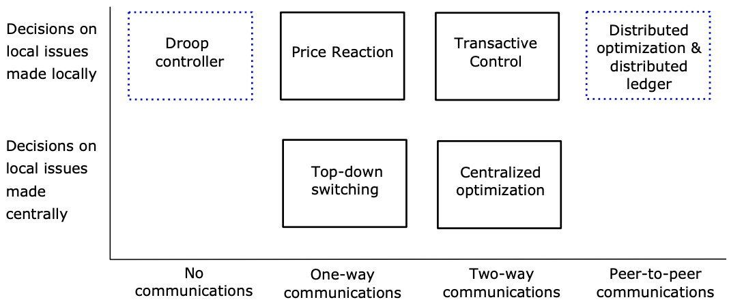
[1] Kok and Widergren, ‘A Society of Devices’ (smart energy management matrix).
Notes:
ICT = communication (blockchain, virtual machines on a server (agent), central influx, MQTT)
Control = algorithm = ADMM or central optimization or PID, …
Power system = central battery or many small batteries ? Physical distribution of resources
For 3 batteries centralized controller will be more efficient, for 1 million…
Centralized system choosen by a distributed governance ? Is it still distributed ?

Slide 29

#1
#2
#1
#2
#3
Local control
Local control
Communication

Slide 30

#1
#2
#1
#2
Communication
& control
Local control
Communication
& control

Slide 31
#1
#2
#3
#1
#2
Local control
Communication
& control
Communication

Slide 32
Local energy communities
Do you need to store state?
yes
Are there
multiple
writers?
yes
Can you use
an always
online TTP?
no
Are all
writers
known?
no
Permissionless
Blockchain
no
no
yes
yes
Are all
writers
trusted?
no
Is public
verifiability required?
yes
Public
Permissioned
Blockchain
yes
no
Private
Permissioned
Blockchain
Don’t use
Blockchain
TTP = Trusted Third party

Slide 33
Chapter 4 How to coordinate self-consumption within communities? Part II
Notes:
Historical narrative (see ”quoi de neuf” avoid the innovative narrative)
What level of complexity do we expect our communities ?
Not just a question of physical coordination

Slide 34




Predict & control horizon T
t = $0$
time
t
T
Time until next update
t = $∆$k
time
$∆$k
$∆$k + T

Slide 35

Communication channel
Member n
Asset i
Suggested schedule_{i}
Current
state and limits_{i}
Netload_{n}
Data layer
Forecast
Optimal scheduling

Slide 36
1.25
100 households under 75s
1
0.75
Time [minutes]
0.5
0.25
0
20
40
60
80
100
Number of participants

Slide 37
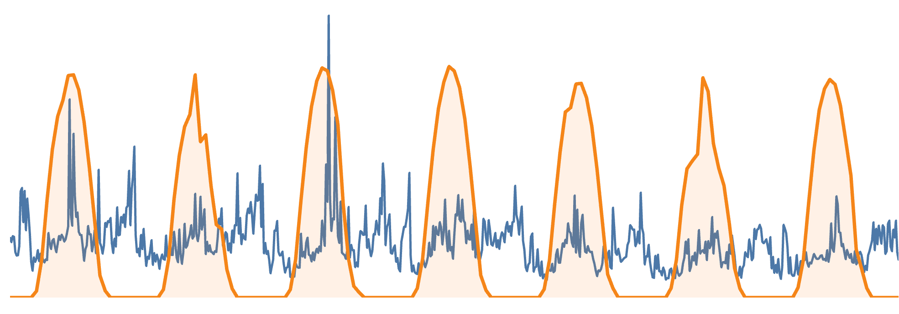
60
Solar production
Load profile
50
40
Power [kW]
30
20
10
0
May 28
May 29
May 30
May 31
Jun 1
Jun 2
Jun 3
Jun 4

Slide 38
100
Battery SOC
80
Solar production
60
Load profile
Power [kW] — SOC [kWh]
40
20
0
−20
Battery power profile
00:00
06:00
12:00
18:00
00:00
06:00
12:00
18:00
00:00
May 30, 2019
May 31, 2019
Jun 1, 2019

Slide 39
200
No storage
150
17.4 cent€/kWh
Individual strategy
Cost of electricity [€]
100
Optimal collaboration
50
Theoretical limit
3.71 cent€/kWh
0
0
0.02
0.04
0.06
0.08
0.1
0.12
0.14
0.16
Network fees [€/kWh]

Slide 40
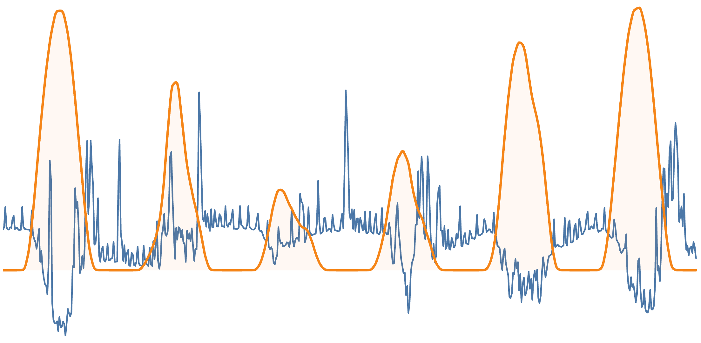
Training window (31 days)
Prediction window (2 days)
8
Netload
6
4
GHI
Netload [kW] & GHI [W/dm²]
2
0
−2
Apr 22
Apr 23
Apr 24
Apr 25
Apr 26
Apr 27
Apr 28
2022

Slide 41
Actual netload
5
Model 2
Weather &
no autoregressors
GOF = 30.6%
Model 3
Weather &
autoregressors
GOF = 33.7%
Model 1
No weather &
no autoregressors
GOF = 14.6%
4
3
2
Net load [kW]
1
0
−1
00:00
06:00
12:00
18:00
00:00
06:00
12:00
18:00
Apr 26, 2022
Apr 27, 2022

Slide 42
Actual netload
5
4
Incertitude intervals 80%
Model 3
3
2
Power [kW]
1
0
−1
−2
00:00
06:00
12:00
18:00
00:00
06:00
12:00
18:00
Apr 26, 2022
Apr 27, 2022

Slide 43
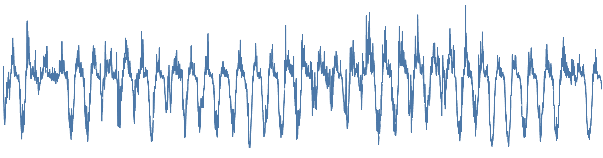
Training window
Prediction window
10
5
Netload [kW]
0
−5
−10
May 5
May 12
May 19
May 26
Jun 2
2019

Slide 44
Predicted netload
Actual netload
2
1
0
Netload [kW]
−1
−2
May 31
Jun 1
Jun 2
Jun 3
Jun 4
Jun 5
Jun 6
2019

Slide 45
Building ID
#2000964
#2000989
#2001139
#2000960
#2000926
72%
70
64%
65
64%
60
60%
55%
Goodness of Fit [%]
55
50
Moderate improvements
47%
45
40
39%
2 days
1 day
12 h
6 h
3 h
1 h
15 min
Periodicity of the forecast

Slide 46
200
150
80%
&
82%
Solar panel only
Dispatch freq.
= 15 min
Community import [kWh]
100
Dispatch freq.
= 2 days
50
Perfect dispatch
0
May 31
Jun 1
Jun 2
Jun 3
Jun 4
Jun 5
Jun 6
2019

Slide 47
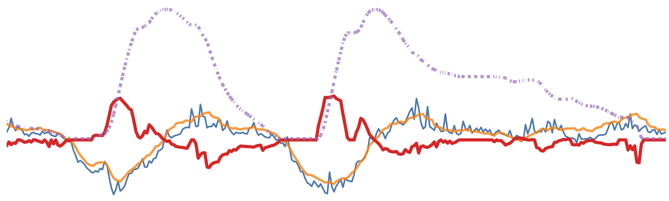
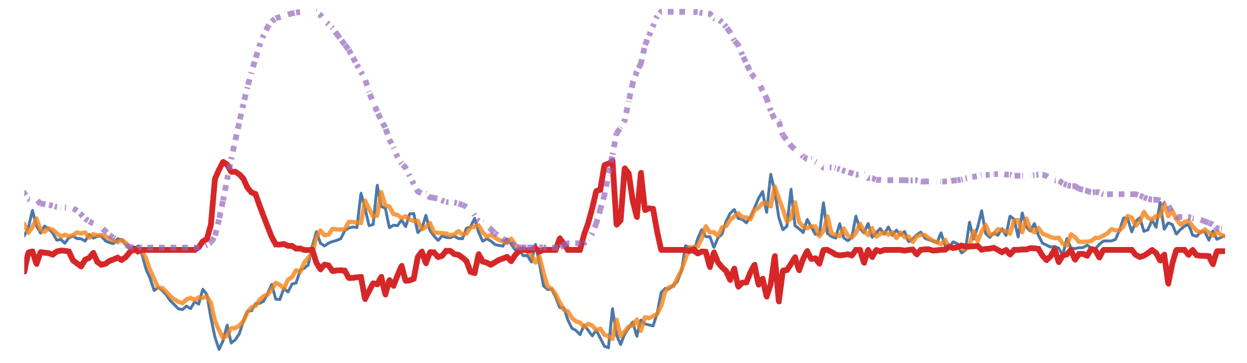

Dispatch freq. = 2 days
25
Battery SOC
Battery
power
profile
20
Netload
forecast
15
Community netload
10
5
0
−5
−10
Power [kW] & SOC [kWh]
Dispatch freq. = 15 minutes
25
20
15
10
5
0
−5
−10
00:00
12:00
00:00
12:00
00:00
12:00
00:00
Jun 2, 2019
Jun 3, 2019
Jun 4, 2019
Jun 5, 2019

Slide 48

Community netload
25
Battery
power
profile
Battery SOC
20
Netload
forecast
15
10
Power [kW] & SOC [kWh]
5
0
−5
−10
“Mirror” effect
00:00
12:00
00:00
12:00
00:00
12:00
00:00
Jun 2, 2019
Jun 5, 2019

Slide 49


200
150
80%
&
88.5%
Solar panel only
Penalty $ζ=1$e-6
Community import [kWh]
100
Penalty $ζ=0$
50
Perfect dispatch
0
May 31
Jun 1
Jun 2
Jun 3
Jun 4
Jun 5
Jun 6
2019

Slide 50
Solar panel only
35
30
Dispatch from forecast
25
20
Cost for the community [€]
Gap = 6.6%
15
10
Perfect dispatch
5
Gap = 14%
Gap = 12.6%
0
0
1
2
3
4
5
6
7
8
9
10
Battery sizes per household [kWh]

Slide 51
13
Solar panel only
Dispatch from forecast
12
11
10
9
8
7
Cost [€/member]
6
5
4
3
2
Perfect dispatch
1
0
0
20
40
60
80
100
120
Community sizes [members]

Slide 52
Self-consumption interval
Sub-intervals
7 PM
t
7:15 PM
time

Slide 53
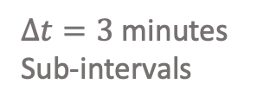
Observations
from t-1 to t
Sets actions
from t to t+1
7 PM
t
7:15 PM
time
$∆t=3$ minutes
Sub-intervals
Self-consumption intervals

Slide 54
React to
unctrl^{A}(t-1) + unctrl^{F}(t)
9
Interval start
Actual uncontrolled netload
8
7
6
Do nothing
Reactive battery dispatch
5
Power [kW]
4
3
React to unctrl^{A}(t-1)
2
1
0
22:00
22:05
22:10
22:15
22:20
22:25
22:30
May 30, 2019

Slide 55
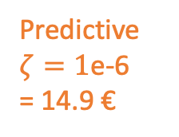
200
150
Solar panel only
Predictive
$ζ=1$e-6
= 14.9 €
Community import [kWh]
100
Perfect dispatch
= 11.6 €
50
Reactive dispatch
= 12.2 €
0
May 31
Jun 1
Jun 2
Jun 3
Jun 4
Jun 5
Jun 6
2019

Slide 56
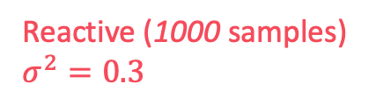
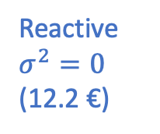

Predictive
$ζ=1$e-6
(14.9 €)
Reactive (1000 samples) $σ^{2}=0.3$
100
90
Reactive $σ^{2}=0$
(12.2 €)
80
70
60
Perfect dispatch
(11.6 €)
Cumulative distribution [%]
50
40
30
20
10
0
11
12
13
14
15
16
17
18
19
20
Cost for five households over one week [€]

Slide 57
70k
60k
Solar panel only
= 660 €/member
50k
Community import [kWh]
40k
30k
Reactive
dispatch
= 469 €/member
20k
Perfect
dispatch
= 456 €/member
10k
0
Jan 2019
Mar 2019
May 2019
Jul 2019
Sep 2019
Nov 2019

Slide 58
Chapter 6 Are more solar panels always better?

Slide 59
Local energy community
Producers
Consumers
0 gCO₂/kWh
Local power
Grid exports
Grid imports
0 gCO₂/kWh
60 gCO₂/kWh on average
Notes:
1) On a fait un choix, une hypothèse forte
2) Évite les solutions qui consistent à surdimmenssioner le PV pour sa rentabilité carbone à l’export
(éviter de tomber dans une situation où on installe du PV en vu d’un impact National, reste à l’échelle locale).
It is a conservative assumption. We justify this scope with a least three reasons 1) exporting power has technical implications that are not carbon neutral (see Rémy's comment) 2) the philosophy of self-sufficient communities aim at calculating GHG emission at the scale of the community, and not to dilute it at the scale of a country 3) if all energy communities take the assumption of an “infinite” grid is not a sustainable solution system wide.

Slide 60
GHG emission [gCO₂/kWh]
Grid emission: 60 gCO₂/kWh
0%
30%
100%
Self-sufficiency
Notes:
Intuiter le résultat (expliquer les axes)
Autoproduction bénéfique pour les aspects émission de gaz à effet de serre
Autoproduction dans l’excès (disproportion des équipements) qui amène à quantativement empirer les émissions

Slide 61
500
Grid emissions
400
300
Battery SOC
100% SOC
Battery SOC [kWh] & Grid emissions [gCO₂/kWh]
200
100
20% SOC
0
Sep 10
Sep 11
Sep 12
Sep 13
Sep 14
Sep 15
Sep 16
Sep 17
2019
Grid exports [kW]
Grid imports [kW]

Slide 62
Battery SOC
100% SOC
Grid emissions
140
120
100
80
Battery SOC [kWh] & Grid emissions [gCO₂/kWh]
60
40
20
20% SOC
0
Aug 6
Aug 7
Aug 8
Aug 9
Aug 10
Aug 11
Aug 12
Aug 13
2019
Grid imports [kW]
Grid exports [kW]

Slide 63
800
700
600
20 kWp/house
22 kWh/house
500
1.7 kWp/house
2.2 kWh/house
4.3 kWp/house
10.2 kWh/house
Carbon emission [kgCO​₂eq / MWh]
400
Grid only emission
300
200
0
10
20
30
40
50
60
70
80
90
100
Self-sufficiency [%]

Slide 64
350
300
7.7 kWp/house
18.1 kWh/house
250
200
3.1 kWp/house
7.4 kWh/house
1 kWp/house
0 kWh/house
Carbon emission [kgCO​₂eq / MWh]
150
100
Grid only emission
50
0
10
20
30
40
50
60
70
80
90
100
Self-sufficiency [%]

Slide 65
500
400
Natural self-sufficiency
Grid only emission
300
Carbon emission [kgCO​₂eq / MWh]
1%
10%
20%
200
30%
40%
50%
60%
70%
100
80%
90%
100%
0
0
20
40
60
80
Self-sufficiency [%]
Notes:
Même graphique à cela qu’on le présente sous forme d’abaque pour différent types de communautés
Intuition validé, coude vers 70% autoproduction (en fait assez « loin »)

Slide 66
180
160
Natural self-sufficiency
140
120
Carbon emission [kgCO​₂eq / MWh]
10%
20%
100
30%
Grid only emission
40%
50%
80
60%
70%
60
80%
90%
40
100%
0
20
40
60
80
Self-sufficiency [%]
Notes:
Même graphique, mais on commence à un niveau plus bas, grâce au réseau français plus vertueux
Intuition toujours présente, mais cette fois ci moins marqué, coude 20% autoproduction (assez facilement atteint)
De ce point de vue (sous entendu avec nos hypothèses), l’autoconsommation collective n’est pas une solution magique pour réduire nos émissions par kWh
À la fois c’est dommage, mais aussi tant mieux (presque) --> souligne qu’on ne peut pas prendre la solution de la facilité (le kWh à 0gCO2), on échappe aux questions d’usages et de rapport à l’énergie. Pas seulement un question quantitative de sobriété. Rapport à la machine à travers la réparation (ami). Rapport à l’échelle spatio-temporelles réorganisation autour du vélo/transport en commun versus voiture(l’échelle couvre beaucoup de sujet, exemple de la démocratie athénienne à 10 000 âmes pas la même échelle que la démocratie à l’échelle de 66 millions, pourtant ce sont les mêmes mots utilisés).

Slide 67
Germany
France
500
180
160
400
Natural self-sufficiency
140
Grid only emission
300
120
Carbon emission [kgCO​₂eq / MWh]
1%
10%
10%
20%
20%
100
30%
200
30%
40%
40%
50%
50%
60%
80
60%
70%
100
80%
70%
90%
60
100%
80%
90%
40
100%
0
0
20
40
60
80
0
20
40
60
80
Self-sufficiency [%]
Self-sufficiency [%]
Notes:
Même graphique à cela qu’on le présente sous forme d’abaque pour différent types de communautés
Intuition validé, coude vers 70% autoproduction (en fait assez « loin »)

Slide 68
500
Residential community #1
Residential community #2
Residential community #3
University building
31%
400
33%
29%
Grid only emission
300
1%
39%
10%
Carbon emission [kgCO​₂eq / MWh]
20%
30%
200
40%
50%
60%
70%
80%
100
90%
Natural self-sufficiency
100%
0
0
20
40
60
80
Self-sufficiency [%]

Slide 69
Chapter 7 Conclusion

Slide 70
Annex 1 City radius ?

Slide 71
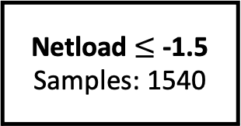
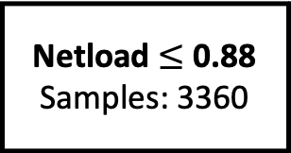
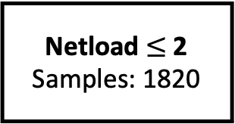
Netload $≤$ 0.88
Samples: 3360
Yes
No
Netload $≤$ -1.5
Samples: 1540
Netload$≤$ 2
Samples: 1820
Yes
No
Yes
No
…
…
…
Linear regression model

Slide 72
Median: 35.7%
25
20
15
Occurrence [%]
10
5
0
−100
−80
−60
−40
−20
0
20
40
60
80
100
Improvement with linear trees (closer to $\overset{∗}{p}$) [%]

Slide 73
Today electric transport (90km/h) and refrigeration ⇒ Food can be produced anywhere in Europe and brought to cities. Take assumption that this is not available (obviously not realistic). The objective is :
Show without using energy physical limits are more apparent
Calculate a theoretical city size and compare it with pre-industrial cities (validate order of magnitude)
Compare order of magnitude for a city to current megapole
Method
We take a circular city with a radious k, to feed this city we need a circular farming area around with radius r, Finally we have a maximal radius R which considers how far food produce can travel. This is figure X.
Fig X.
The city radius and density of population are variables of our problem. For the rest the « farming » circle is defined by the consumption per inhabitant and crop yield per surface. The « travelling » circle is defined by the horse speed carrying food and duration of the trip (food peremption or other logistic matters).
We express the equation to find the radius of the farming circle as a function of the city radius and population density.
Eq X.

Slide 74
Results
To calculate the farming circle depends on surface to feed a human, we take this value from WHO. The upper traveling circle is more flexible but for now we set the limit based on horse speed and 3 day trip.
Fig 2 with different assumptions on population density (reading the curve)
Xaxis = city radius & Yaxis = farming circle
Fig 3 Placing pre-industrial big cities / modern small cities / big metropoles (Paris, Tokyo)
Xaxis = city radius & Yaxis = farming circle
Are we good on the validation side ?
Warning not realistic, order of magnitude nonetheless between small cities and big cities ?
Limits
Always careful when using over-simplified models. Rather here to show some trends, highlight potenital physical limits with less energy.
Surface farming per habitant ?
Some food don’t have peremption date, or can be transported alive.
Topology (mountain, river, sea side, circular city)
Train tracks

Slide 75
Archives / backup slides Random stuffs

Slide 76
(Society & Energy)
1760 – 1840: Industrial revolution
City:
Taux d’urbanisation / Taille des villes / Matériaux employés à la construction
Work:
70 – 80% of the population employed in agriculture until 1800 [1] against 1.5% in France nowadays.
1865: Abolition of slavery in the USA
Family:
Dispersion of family members: long distance mobility increases continuously during the 19th century [2].
[1] GRIGG, “The World’s Agricultural Labour Force 1800-1970”.
[2] Bourdieu et al., ‘La dispersion spatiale des familles’.

Slide 77


What is the expected complexity of local energy communities (at each scale)?
Community #1
« less complex »
Community #2
« more complex »
DSO
Grid
Grid
Boucle sur la communauté
Chiffre entre action
Coordination actions to maximize revenues
« Individual » actions
« Individual » actions
« Exchange » actions
« Temporal » actions
« Spatial » actions
…
[1] Siegenfeld and Bar-Yam, ‘An Introduction to Complex Systems Science and Its Applications’.
Notes:
More or less complex energy communities (with different scales involved, coherent or corrolated)
Coordination with more actions can be necessary but never sufficient for better performance (good action)
Unforeseen evolution of communities, how to design an evolutionary coordination (keep good mutations)?

Slide 78
What is the expected complexity of local energy communities (at each scale)?
Community #1
« less complex »
Community #2
« more complex »
2, 3, 4
Grid
Grid
1
1
1
1
DSO
Coordination actions to maximize revenues
« Individual » actions
« Individual » actions
« Collective » actions
« Temporal » actions
« Spatial » actions
…
[1] Siegenfeld and Bar-Yam, ‘An Introduction to Complex Systems Science and Its Applications’.
Notes:
More or less complex energy communities (with different scales involved, coherent or corrolated)
Coordination with more actions can be necessary but never sufficient for better performance (good action)
Unforeseen evolution of communities, how to design an evolutionary coordination (keep good mutations)?

Slide 79
System #1
« less complex »
System #2
« more complex »
Complexity of the system
at each scale
Multiple batteries
Maximize revenues
Individual houses
⇒ « Individual » actions
Multiple batteries
Maximize revenues
Multiple houses
⇒ « Individual » actions
⇒ « Exchange » actions
⇒ « Temporal » actions
⇒ « Spatial » actions
…
Complexity of the coordination at each scale
Notes:
Before thinking about the coordination strategy, we have to think about the expected complexity of our local energy community at each scale (house, community, DSO, TSO)
Illustrate examples, complexity of system 1, versus system 2
The complexity at each scale of our system will give us the complexity of coordination we need
It is necessary for our coordination to have at least the complexity of the system at a given scale (lower bound)
It is not sufficient as:
More available actions (complex coordination) do not guarantee a better performance (no because we still need to make good decisions, yes because we can manage exchanges). Individual case actually provide an interesting lower bound on our performance.
More action can be overwhelming/useless, some actions (degree of freedom) can potentially be eliminated (distribution grid is robust enough, exchange cost are prohibitive)
Accepting that a complex system (community) will present elements that were not considered ahead of time. Thus the question becomes : how to account for an evolutionary process of our coordination strategy (keeping the ”good mutation” and not the bad) ?

Slide 80
Sharing keys:
Cons. 1
…
Cons. n
Prod. 1
1 | … | 0
… | … | …
0.75 | … | 0.1
=100%
…
=100%
Prod. n
=100%
…
12:15 pm
12:30 pm
1:00 pm
Time

Slide 81
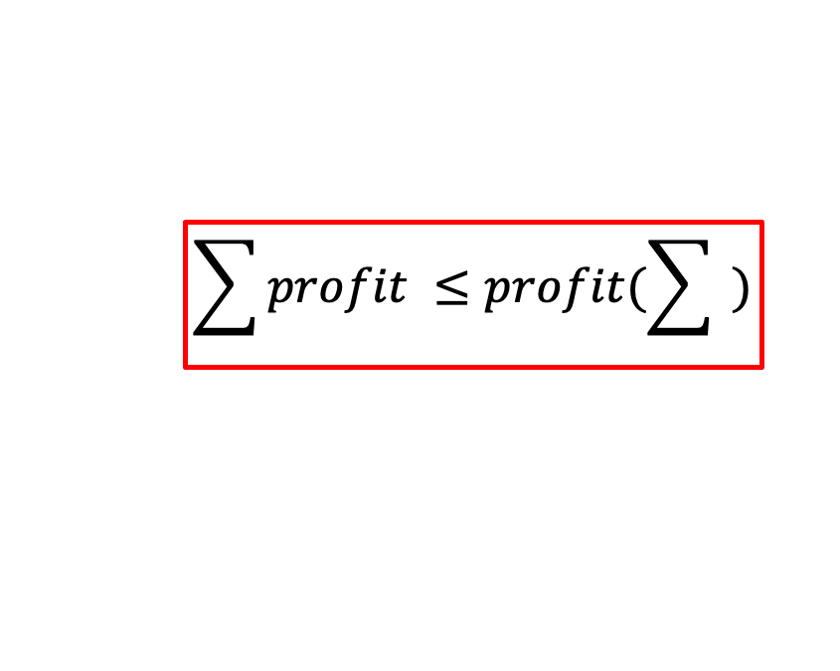
$$\sum{profit ≤profit(\sum{ )}}$$
Notes:
See reasons to create a community from chapter 1
From a technico-economic perspective, hope to validate equation (which is not the case in France).

Slide 82
Objectives:
Increase self-sufficiency
Increase revenues (time-of-use, grid services, …)
Lower GHG emissions
Consumption
Production
Means:
Power [kW]
Storage
Shapeable load
Deferable load
Nudges (human)
Surplus
Local consumption
Grid consumption
Morning
Noon
Evening

Slide 83
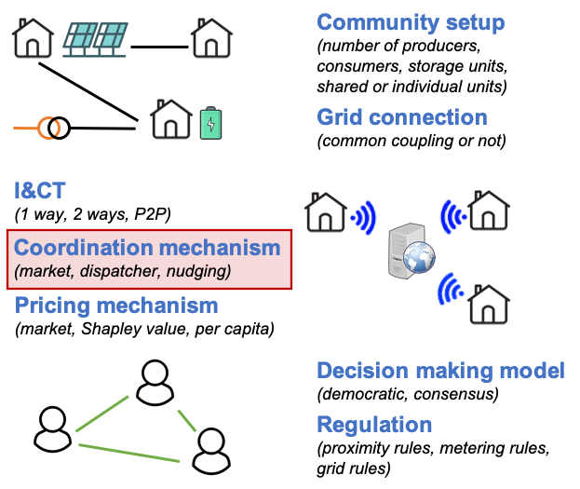

Slide 84
Optimization time for a full week
16
14 minutes for 100 households
14
12
10
Time [minutes]
8
6
4
2
0
20
40
60
80
100
Number of participants

