Slide 1

(/ɛʤ/)
Presenter: Jonathan Garza
Date: 12-20-2021

Slide 2

(Team members)
Jonathan Garza
“And now there were three!”
Previous Team Members
Eileen Chang
“When there is a will, there is always a way…to screw it up”
Jonathan Guzman
“It's Halloween, everyone's entitled to one good treat or trick”
Jonathan Ong
“Wait there’s two of them?”

Slide 3
What We Accomplished
AI Agent Optimization/Training/Evaluation CLI Tool
AI Flask Microservice

Slide 4
Major Libraries/Frameworks Used
Gym – For the AI environment
Stable-Baselines3 – for agent training and predictions
Specifically, PPO agent type
Optuna – for the optimization of the agent hyperparameters
Flask – for the API microservice
Setuptools – for packaging/install of the python namespace package
Stable-Baselines3 Zoo – to perform some training and optimization before tool was complete. Also, to compare my tool’s performance against
Argparse – for command line argument parsing

Slide 5
Project Layout
Is an installable python package “ac_carrier_scenario”
Installing will also create a command line script of the same name
Namespace: ac_carrier_scenario
Sub-Package: ai
Sub-Package: api
Sub-Package: common
Sub-Package: util

Slide 6
Sub-Package common
Contains the common classes/functionality between the ai and api packages
scenarios.py
AircraftCarrierScenario - Represents an aircraft carrier scenario's parameters
environment.py
AircraftCarrierScenarioEnv(Env) class - A gym Env subclass which represents a random aircraft carrier scenario
SpecificAircraftCarrierScenarioEnv(AircraftCarrierScenarioEnv) class - A gym Env subclass (through AircraftCarrierScenarioEnv) which represents a specific aircraft scenario
AircraftCarrierScenarioEnv is registered as a gym environment with the name “ACS-v0” and max step count of 250 (max step count is important)

Slide 7
Sub-Package common cont.
main.py
Represents the entry point for the console script
Can be run with the command, “ac_carrier_scenario” command [sub-command] [command/subcommand options]
Can parse a variety of CLI arguments to customize and run either the AI functionality or the API
For the AI, you can run either optimization, training or evaluation of an agent with a variety of different parameters
For the API, you can run the flask server with a specified port (or default)

Slide 8
Sub-Package ai
Contains the functionality to optimize, train and evaluate an agent on the aircraft scenario (random and ideal)

Slide 9
Sub-Package api
Contains the Flask microservice which has two API endpoints, “analysis” and “performance”
API receives a POST request with a JSON scenario
API process the scenario and generates analysis/performance results
API returns a response
The response is either the results in a JSON format or an HTTP error code

Slide 10
Sub-Package util
Contains the functionality to keep the OS awake while running long-running AI functions

Slide 11
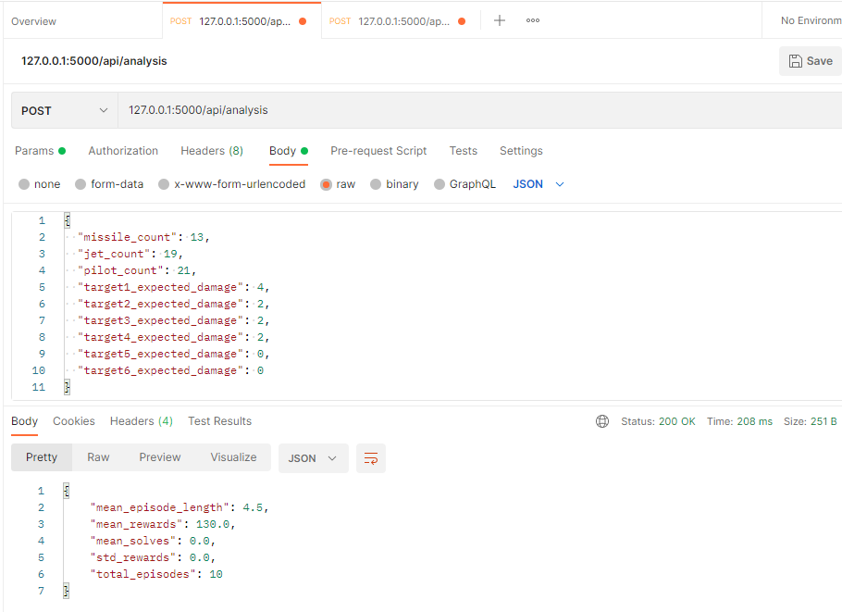
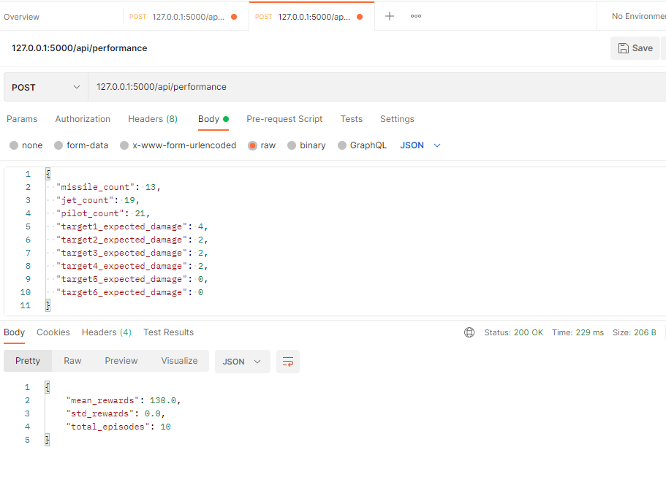
Flask API
A website or other application can make a POST HTTP request to the microservice
Can be run with the ac_carrier_scenario api [--port] command
Notes:
Analysis API endpoint runs against a given scenario and returns the analysis results

Slide 12
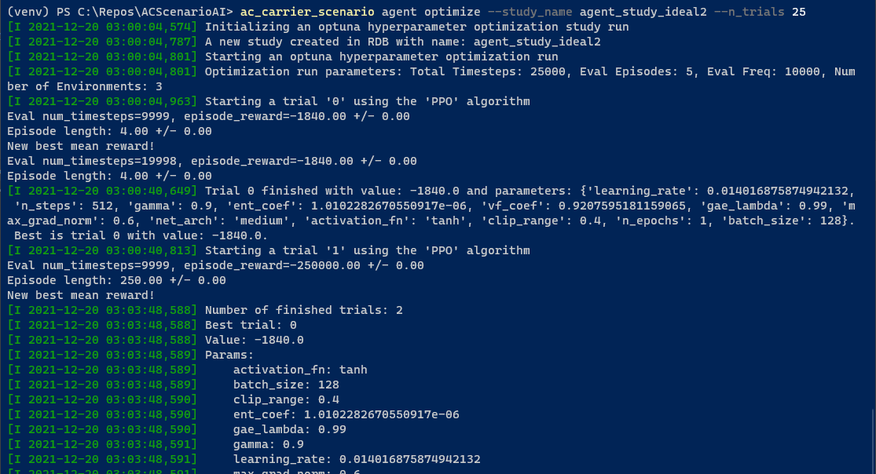
AI Agent Optimization
AI developer can run the optimization with ac_carrier_scenario agent optimize command
Different parameters can be specified using the CLI arguments
--study_name – Determines the study’s identity; used for filenames and allows continuing an optimization run
--n_trials – Determines how many trials will be run
--total_timesteps – Determines how many timesteps per trial
--eval_freq – Determines how long between evaluations
And more

Slide 13
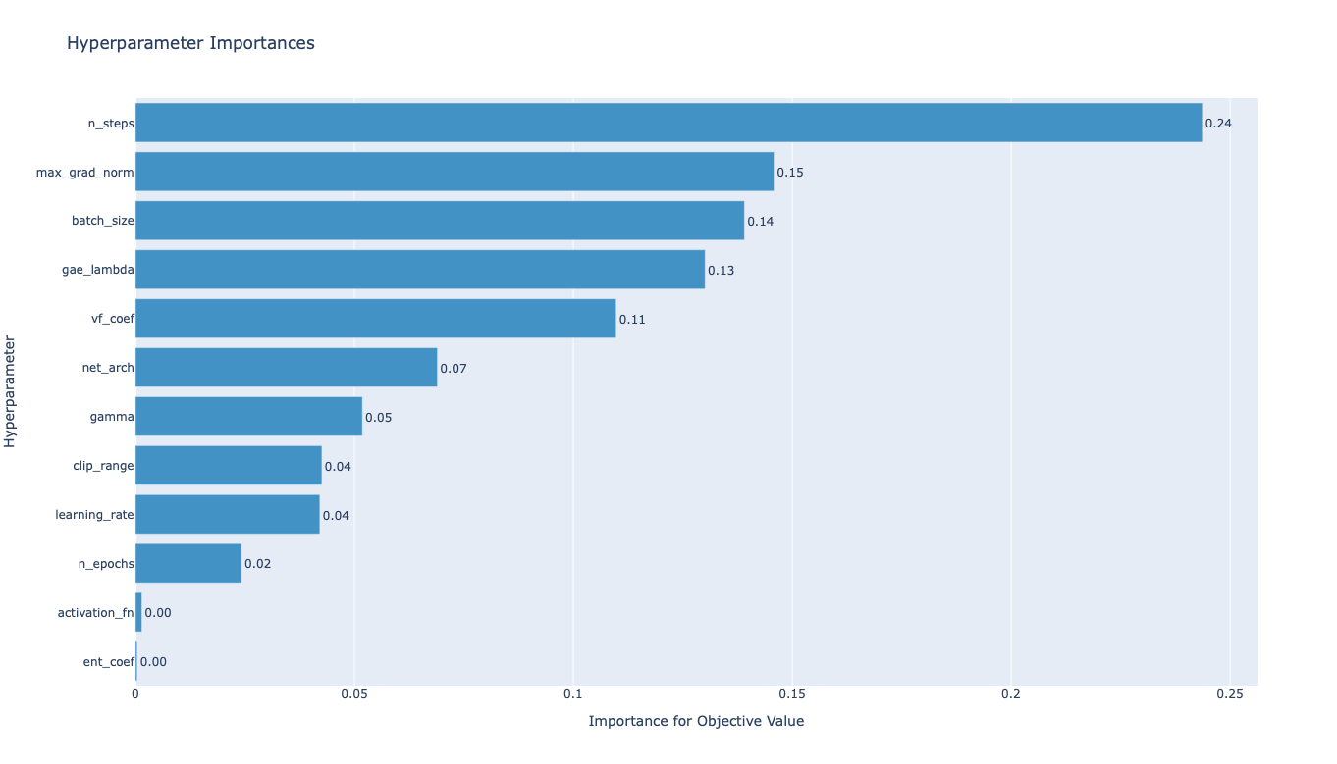
AI Agent Optimization cont.
After an optimization run, a plot of the importance of each hyperparameter is displayed

Slide 14
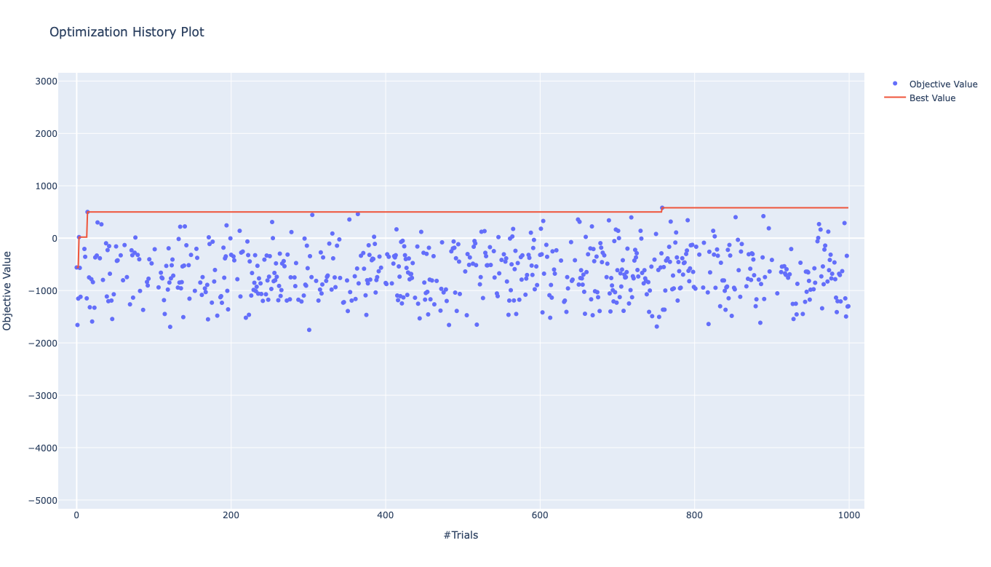
AI Agent Optimization cont.
After an optimization run, a plot of the history of the run is displayed
This displays the objective value, in this project, the best mean reward score, of each trial

Slide 15
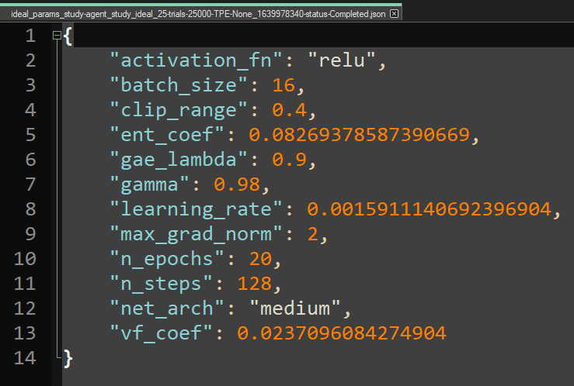
AI Agent Optimization cont.
After an optimization run (with at least one completed trial), a JSON file is created which contains the hyperparameters from the best trial
A CSV file is also saved which contains a report of all the trials that where run

Slide 16
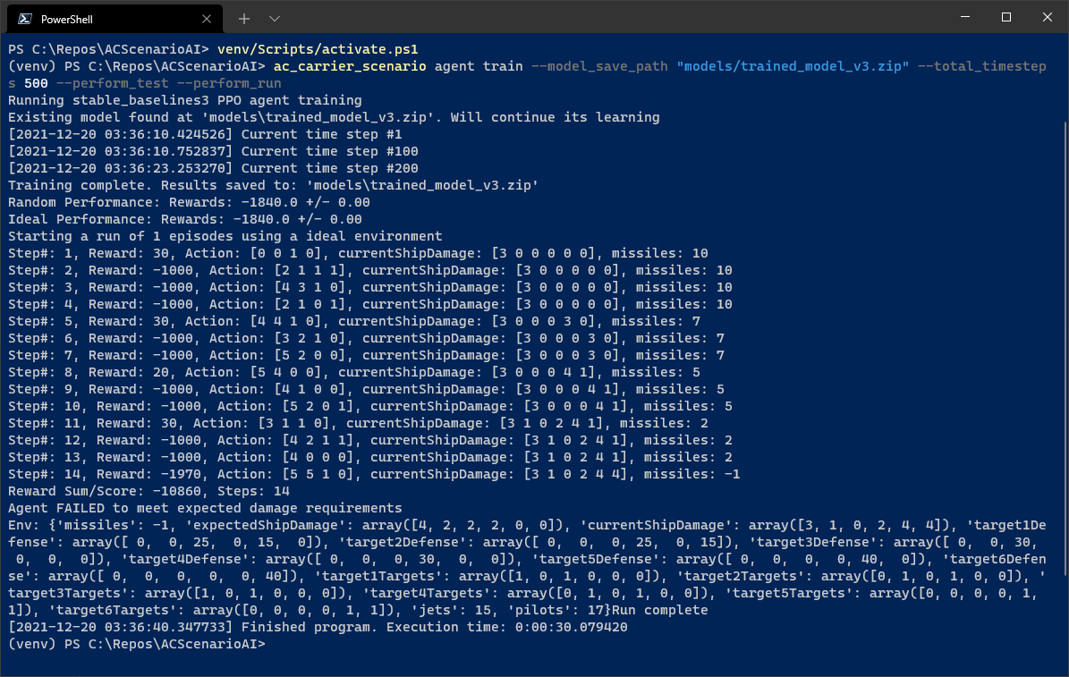
AI Agent Training
AI developer can run the training with ac_carrier_scenario agent train command
The length of the training can be specified with the --total_timesteps argument
--perform_test argument will run an evaluation of the trained agent after training completes
--perform_run argument will run through the ideal scenario using the trained agent
Training progress/length is displayed at 100 timestep intervals
The best model is saved when a new best score is achieved during training
Trained model is saved at end of training run
Training
Performance Evaluation
Run

Slide 17
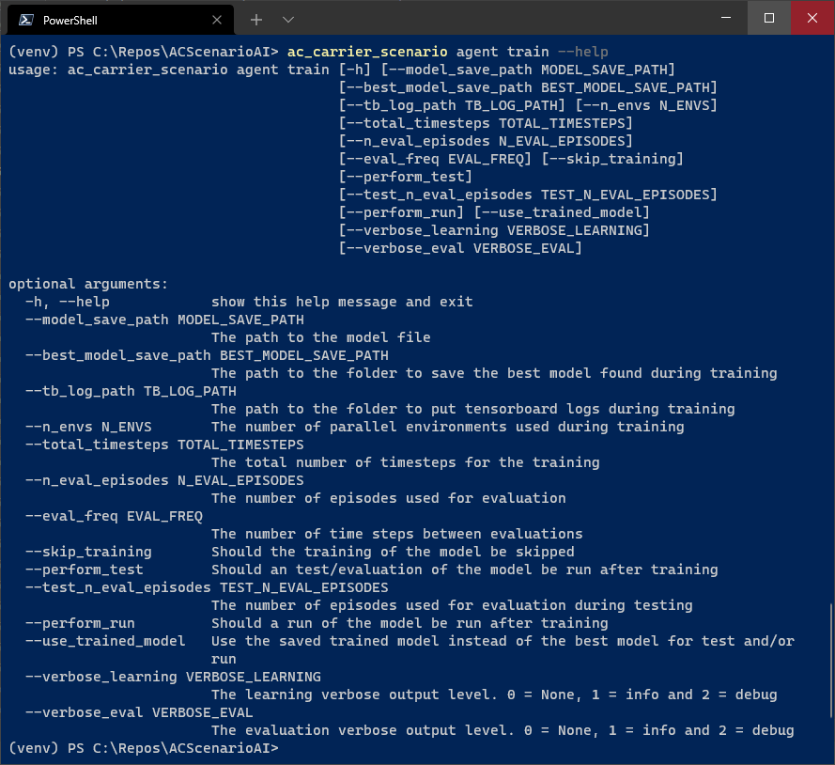
AI Agent Training
Different command line parameters that can be specified to customize the training
Training supports tensorboard logging

Slide 18
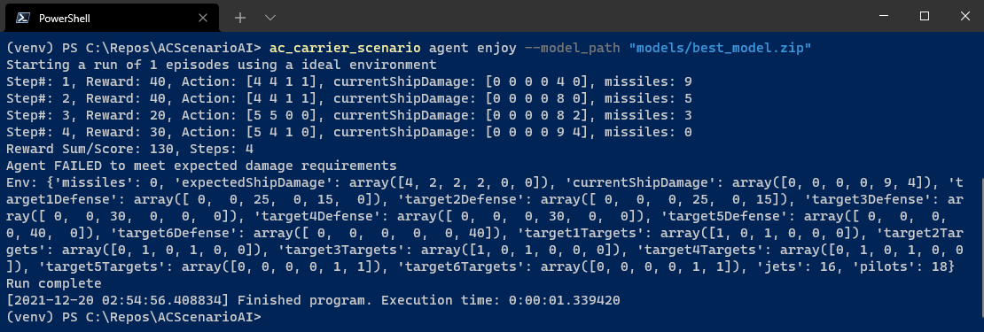
AI Agent Evaluation/Run
AI developer can run the training with ac_carrier_scenario agent enjoy command
This will run through the ideal scenario a specified number of times, default one time
If more than one run, it will display the statistics for all the runs instead of the additional info shown for one run
--use_random_env will perform the run using a random environment/scenario instead

Slide 19
Vision and future updates (The Sequel)
Integrate Flask microservice with the website
Improve the AI environment
Improve the AI training

Slide 20
The end
Thanks for inviting us!

