Slide 1

(/ɛʤ/)

Slide 2
Front-end/Back-end Design
ATO
Target 1
Target 2
…
Target n
REACT Front-end
Add/Delete Aircraft
Add/Delete Pilots
Add/Delete Weapons
DB
Mission
Add Targets through ATO
Add/Delete Targets
Add/Delete Constraints
Run Target Order Algorithm
Run Scheduling Algorithm
Schedule Modification / Updates
Inventory
Air Vehicle 1
Air Vehicle 2
Air Vehicle 3
…
Live Chat/Voice
Push Notifications
View Status / Data
Pilot 1
Pilot 2
Pilot 3
…
Weapon 1
Weapon 2
Weapon 3
…

Slide 3
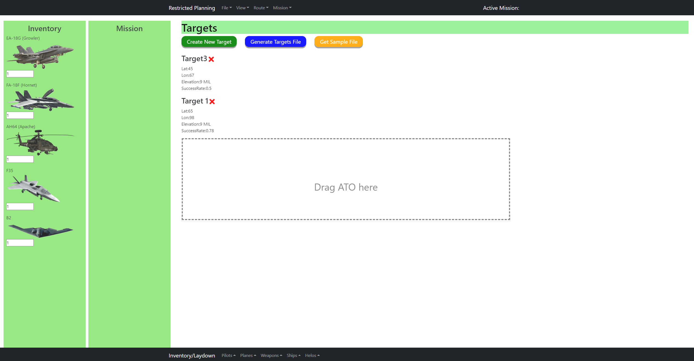
EJJ Web Page – Mission Set-Up
REACT Front-end
Add/Delete Aircraft
Add/Delete Pilots
Add/Delete Weapons
Add Targets through ATO
Add/Delete Targets
Add/Delete Constraints
Run Target Order Algorithm
Run Scheduling Algorithm
Schedule Modification / Updates
Push Notifications
Live Chat/Voice
View Status / Data

Slide 4
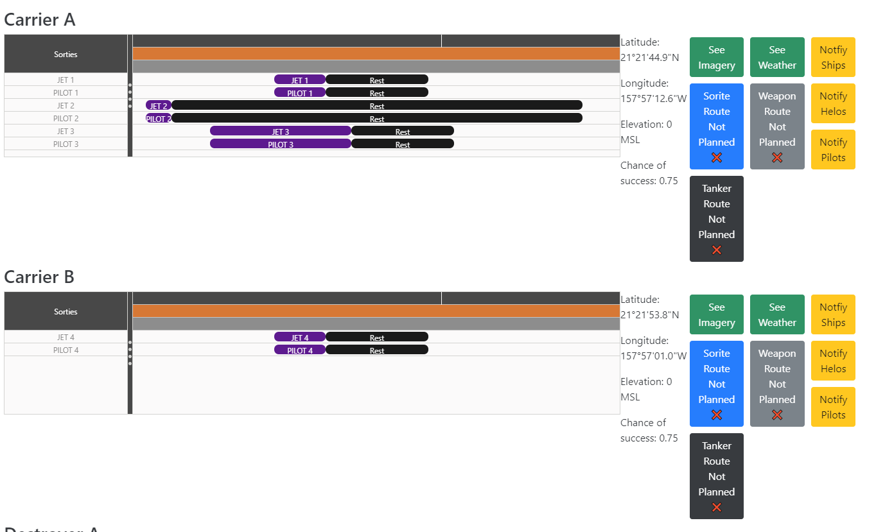
EJJ Web Page – Output Schedule
REACT Front-end
Add/Delete Aircraft
Add/Delete Pilots
Add/Delete Weapons
Add Targets through ATO
Add/Delete Targets
Add/Delete Constraints
Run Target Order Algorithm
Run Scheduling Algorithm
Schedule Modification / Updates
Push Notifications
Live Chat/Voice
View Status / Data

Slide 5
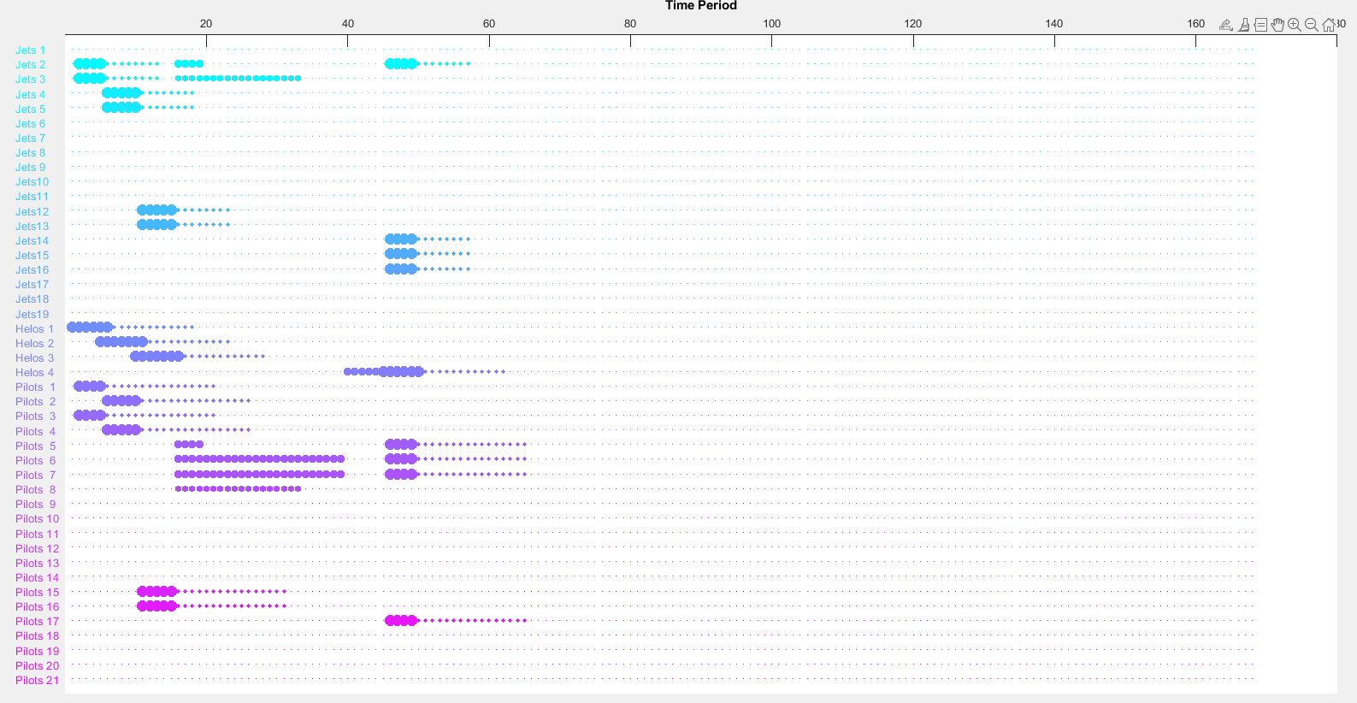

EJJ Example Initial Schedule Mission Planning With 90% probability of disabling/destroying targets (Able to Disable or Destroy Target 2, 3, 4; Unharm Targets 5, 6; Disable and Attempt to Destroy Target 1 – may not have enough missiles )
Target Strike Order: 3 4 2 1 5 6
Num Missiles Needed for 90% Success Disabling Target: 3
Num Missiles Needed for 90% Success Destroying Target: 7
Num Missiles Needed for each Target: 3 3 3 7 0 0
Sortie 1 for Target: 3
Mission Start Time (hrs): 2
Carrier Chosen: 1
Jets Chosen: 2, 3, 4
Helo Chosen: 1
Pilots Chosen: 1, 3
Number of Missiles Chosen: 3
Missiles Chosen: 1, 2, 3
Number of Missiles Needed: 3
Number of Missiles Remaining: 10
Sortie 2 for Target: 4
Mission Start Time (hrs): 6
Carrier Chosen: 1
Jets Chosen: 4, 5, 6
Helo Chosen: 2
Pilots Chosen: 2, 4
Number of Missiles Chosen: 3
Missiles Chosen: 4, 5, 6
Number of Missiles Needed: 3
Number of Missiles Remaining: 7
Sortie 3 for Target: 2
Mission Start Time (hrs): 11
Carrier Chosen: 2
Jets Chosen: 12, 13, 14
Helo Chosen: 3
Pilots Chosen: 15, 16
Number of Missiles Chosen: 3
Missiles Chosen: 9, 10, 11
Number of Missiles Needed: 3
Number of Missiles Remaining: 4
Sortie 4 for Target: 1
Mission Start Time (hrs): 46
Carrier Chosen: 2
Jets Chosen: 14, 2, 15, 16, 17, 18, 19
Helo Chosen: 4
Pilots Chosen: 17, 5, 6, 7
Number of Missiles Chosen: 4
Missiles Chosen: 12, 13, 7, 8
Number of Missiles Needed: 7
Number of Missiles Remaining: 0
Number of Targets Accounted For: 5
The results from the Target Ordering Algorithm feed the Scheduling Algorithm.
The results from the Scheduling Algorithm feed into the EJJ Web Page Output Schedule plots.

Slide 6
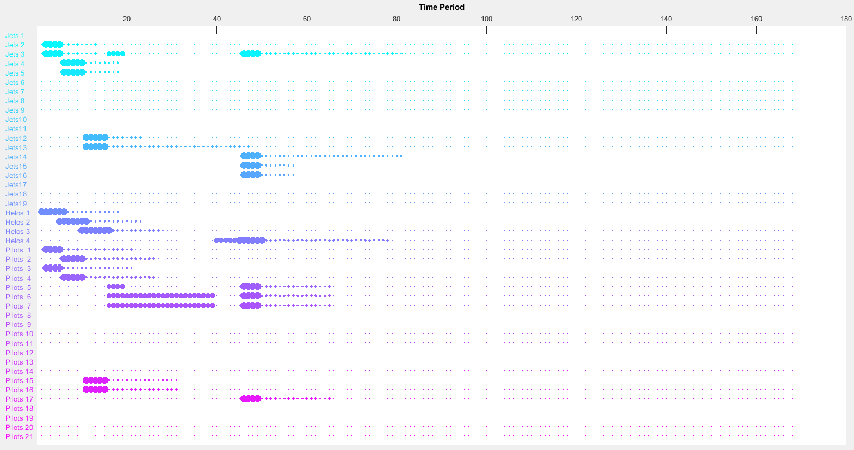
EJJ Example Updated Schedule Mission Execution With 90% probability of disabling/destroying targets (Able to Disable or Destroy Target 2, 3, 4, 5, 6; Destroy Target 1)
Target Strike Order: 3 4 2 1 5 6
Num Missiles Needed for 90% Success Disabling Target: 3
Num Missiles Needed for 90% Success Destroying Target: 7
Num Missiles Needed for each Target: 3 3 3 7 0 0
Num Missiles Actually Used for each Target: 1 2 1 3 2 1
Sortie 1 for Target: 5
Mission Start Time (hrs): 2
Carrier Chosen: 1
Jets Chosen: 2, 3
Helo Chosen: 1
Pilots Chosen: 1, 3
Number of Missiles Chosen: 1
Missiles Chosen: 1
Number of Missiles Needed: 1
Number of Missiles Remaining: 12
Jet 2 is killed!!!
Pilot 1 is killed!!!
Sortie 2 for Target: 6
Mission Start Time (hrs): 8
Carrier Chosen: 1
Jets Chosen: 4, 5
Helo Chosen: 2
Pilots Chosen: 2, 4
Number of Missiles Chosen: 2
Missiles Chosen: 2, 3
Number of Missiles Needed: 2
Number of Missiles Remaining: 10
Sortie 3 for Target: 4
Mission Start Time (hrs): 14
Carrier Chosen: 2
Jets Chosen: 12, 13
Helo Chosen: 3
Pilots Chosen: 15, 16
Number of Missiles Chosen: 1
Missiles Chosen: 9
Number of Missiles Needed: 1
Number of Missiles Remaining: 9
Jet 12 is killed!!!
Pilot 15 is killed!!!
Sortie 4 for Target: 3
Mission Start Time (hrs): 19
Carrier Chosen: 2
Jets Chosen: 14, 15, 16
Helo Chosen: 4
Pilots Chosen: 17, 18
Number of Missiles Chosen: 3
Missiles Chosen: 10, 11, 12
Number of Missiles Needed: 3
Number of Missiles Remaining: 6
Jet 14 is killed!!!
Pilot 17 is killed!!!
Sortie 5 for Target: 1
Mission Start Time (hrs): 23
Carrier Chosen: 1
Jets Chosen: 3, 4
Helo Chosen: 1
Pilots Chosen: 5, 6
Number of Missiles Chosen: 2
Missiles Chosen: 4, 5
Number of Missiles Needed: 2
Number of Missiles Remaining: 4
Number of Targets Accounted For: 6
Number of Casualties: 3
The Scheduling Algorithm updates the schedule with new information, i.e. when targets are destroyed and no more sorties are needed, when there are casualties, etc.

Slide 7
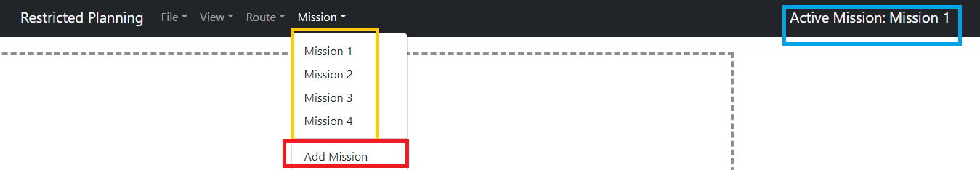
Collaboration During Mission Planning
Join or create an active mission plan session
Multiple planners across multiple platforms can work on the same mission session
Active mission displayed on the top right
Available active missions displayed in the drop down
Button to create a new mission planning session

Slide 8
Back up slides

Slide 9




(Team members)
Eileen Chang
“When there is a will, there is always a way…to screw it up”
Jonathan Guzman
“It's Halloween, everyone's entitled to one good treat or trick”
Jonathan Ong
“Wait there’s two of them?”

Slide 10
What We Accomplished
EJJ Mission Planning Tool
Optimization algorithm for the scenario
Web application

Slide 11
EJJ Auto-Scheduling Constraints/Restraints/Intent Summary
Of the 18 lines of restraints: 100% met
Of the 23 lines of constraints: 87% met (3 waived)
Algorithm does not take into account hot-seating; jets/pilots always rest
Of the other mission details: 100% covered
Of the Commander’s Intent and Desired End State: 100% covered
https://github.com/Jonathan805/RestrictedPlanning/blob/main/Matlab/AutoScheduling.m

Slide 12
Commander’s Intent and Desired End State:
Target 1 is destroyed
Targets 2, 3, and 4 are Disabled or Destroyed
Targets 5 and 6 are Disabled or Unharmed
Restraints:
Pilot 1 cannot fly with Pilot 2
Pilot 11 cannot Fly with Pilot 12
Pilot 20 cannot fly with Pilot 21
Pilot 3 can only fly with Pilot 4 or Pilot 9
Pilot 18 can only fly with Pilot 21 or Pilot 19
Pilot 5 cannot fly Jet 8
Pilot 17 cannot fly Jet 12
Jet 10 and Jet 11 cannot be in the same sortie
Pilot 15 can only fly twice during the offensive
Pilot 20 can only fly three times during the offensive
Pilot 4 cannot fly any missions on Day 5
Pilot 13 cannot fly any missions on Day 6 and Day 7
Jet 5 will need 48 hours of maintenance after it's first 10 hours of flight
Jet 7 is not available after day 5
Jet 1 is not available until 1400z on day 3
Jet 4, 8, 9 , and 17 can only carry one missile
Each Helo has a 30% chance of needing 16 hours of down-time after landing at it's home carrier for that day
Each Jet has a 20% chance of needing 24 hours of downtime after each landing at it's home carrier for that day
Targets:
Target 1 - Enemy Carrier A, no defenses, Collocated with Destroyer A, and protected by both Cruiser A and B
Target 2 - Enemy Carrier B, no defenses, Collocated with Destroyer B, and protected both Cruiser A and B
Target 3 - Enemy Destroyer A, collocated with Target 1, 25% chance to kill 50% of the aircraft that attack Target 1, and 30% chance to kill 50% of the aircraft that attack Target 3
Target 4 - Enemy Destroyer B, collocated with Target 2, 30% chance to kill 50% of the aircraft that attack it, and 30% chance to kill 50% of the aircraft that attack Target 3
Target 5 - Enemy Cruiser A, Collocated with Target 1, 15% chance to Kill 50% of the aircraft that attack Target 1 or Target 2, and 40% chance to kill 50% of the aircraft that attack Target 5
Target 6- Enemy Cruiser B, Collocated with Target 2, 15% chance to Kill 50% of the aircraft that attack Target 1 or Target 2, and 40% chance to kill 50% of the aircraft that attack Target 6
Each missile launched against an enemy vessel has a 60% Chance of hitting that ship.
Each hit has an 50% chance of Killing or Disabling that ship. Disabled ships cannot defend themselves or other vessels.

Slide 13
Constraints:
Sorties against Target 1 or 3 must be no less than 2 hours, but may not be more than 4 hours long and can attack one or both of Targets 1 and 3, and are at risk of getting shot by Target 3, 5, and 6
Sorties against Target 2 or 4 must be no less than 3 hours, but may not be more than 5 hours long and can attack one or both of Targets 2 and 4, and are at risk of getting shot by Target 4, 5, and 6
Sorties against Targets 5 or 6 must be no less than 4 hours, but may not more than 6 hours long and can attack one or both of Targets 5 or 6, and are at Risk of being shot by targets 5 and 6
Killed friendly Jets causes the loss of that Jet and its pilot.
It takes 24 hours and occupies 1 helo and helo crew to shuffle people (up to 2 jet pilots or 1 whole helo crew) between Carriers (two-way trip, the helo returns to it's home carrier and may bring passengers back on the second leg).
It takes six hours occupies 1 helo and 1 helo crew to reposition that helo between carriers
It takes 12 Hours and occupies 1 Jet and 1 Jet Pilot to move missiles between Carriers (two-way trip, may swap pilots and/or bring missile(s) back on its return leg)
It takes 4 Hours and occupies 1 Jet and 1 Pilot to reposition a jet and that pilot (one way trip, that Jet may bring missile(s))
All Jets are single seat and take 1 pilot to fly.
Jets can carry up to 2 weapons per sortie, unless some restraint says otherwise.
All sorties must have a minimum of 2 jets and 2 pilots, except reposition flights between carriers.
Each jet requires 1 pilot to fly.
Each sortie requires a Helo and crew for that carrier to be airborne during the period 1 hour before to 1 hour after launch and 1 hour before and 1 hour after recovery for man-overboard and rescue requirements (helos may cover multiple launches and lands during their period of flight)
Helos may not be airborne for more than 8 hours
Each helo requires 12 hours after land to reset for the next flight, except when doing a hotseat
Each helo crew requires 12 hours after land
Crews may hot-seat aircraft (that is, a jet or helo can land and a new pilot can take that jet for another sortie)
Each jet may fly 3 sorties per day, but may not be airborne for more than 16 hours in a day
Each jet needs 8 hours after it lands at it's home carrier for that day, unless hotseating
Each Hot Seat takes 30 minutes
Each carrier can accommodate 2x hotseats at a time in any combination of jet or helo
Each jet Pilot requires 16 hours to rest and replan before flying again
Each Jet Pilot may only fly for 16 hours in a day, but may fly more than one Jet in a day (hotseat time counts against their max duty time for the day)

Slide 14
EJJ Mission Planning Flow (1)
Open up the EJJ web page
Drag in the target information (ATO) and view target tasking details and target imagery immediately
Contains the probabilities of casualties while striking certain targets
Contains minimum/maximum sortie times against each target tasking
An algorithm runs to determines the target striking order and displays it to the user
Minimizes the chance of casualties when striking all the targets in the tasking details
The available aircraft are displayed in the Inventory
Determine the number of each aircraft needed for the friendly force laydown and drag the aircraft to carriers in the Mission
Do the same for pilots, helos, and missiles
The laydown can be saved and reloaded

Slide 15
EJJ Mission Planning Flow (2)
Drag in any constraints/restraints and the information is stored
i.e. max flight times, rest times, reposition times, missile carriage, pilot restrictions with other pilots or aircraft, jet restrictions with other jets, time restrictions, missile probabilities of hit/disabling/destroying, etc.
Does not initially assume any casualties during striking targets and jet/helo downtime chances
Make the mission the Active Mission and set mission start/end times
An algorithm runs to calculate the maximum number of sorties needed for each target tasking
90% probability to disable and/or destroy based on the target requirements

Slide 16
EJJ Mission Planning Flow (3)
An algorithm runs to schedule all the sorties within the mission time period, including repositions and rest times
The sortie data for the jets, pilots, helos, and missiles, including reposition times and rest times, are displayed on the web page
Also, display the number of successful target strikes achieved
If desired, the user can manually drag the bars in the plots to extend/shorten sortie hours, shift sorties, etc.
There are constraints for how much the bars can be dragged and extended/shortened
Sortie time will be colored RED if it’s not valid given the constraints
Chance of success updates automatically with each adjustment

Slide 17
EJJ Mission Execution Flow (1)
Mission Plan execution begins
Receive information of casualties, jet/helo down times, or successful target strikes
Casualties and jet/helo down times are stored as restraint information
Successful target strikes can reduce the actual number or sorties used
If sorties are reduced, a replan is done
The same algorithm as before runs to schedule the rest of the sorties within the mission time period starting from the current time, including repositions and rest/down times
The updates are displayed on the web page
Mission Plan execution continues, with cycles of replans when necessary

Slide 18
Improvements to Mission Planning/Mission Execution Processes
Reduced user clicks by dragging and dropping target tasking onto the web page
1 click vs. 7+ clicks when importing ATO/ACO through Task View and porting over the targets/GeoZones into JMPS
Automated task scheduling based on survivability
Automated sortie scheduling given constraints/restraints
Dynamic sortie replan capability during Mission Execution
User-friendly drag and drop capability to create a friendly force laydown
Once created, this can be saved and reloaded

Slide 19
EJJ Scheduling Algorithm Details (1)
Inputs:
Constraints/Restraints, Inventory, Maximum Sortie Length, Earliest Start Time
Start by finding a carrier with more jets and pilots to be the carrier to start the sortie from
Also try to find a carrier with available helos
The number of jets/pilots needed is determined by the number of missiles needed for 90% probability of success at striking the target depending on the requirement (i.e. disable or destroy)
Also depends on the chosen jets’ missile carriage capacity
Assuming that each jet can carry only 1 missile at first; Will have more jets/pilots to choose the final set from

Slide 20
EJJ Scheduling Algorithm Details (2)
If there aren’t enough jets, pilots, and/or helos on that carrier, store possible repositions of the least amount of jets/pilots/helos to the carrier possible
Use what we can on the carrier already
Given the available subset of the jets on a carrier (after possible repositions, if necessary), find the first set of jets that can fly together
The number of jets chosen is based on their missile carriage capacity and the number of missiles needed
Once the jets are found, then that determines the number of pilots needed
Find the first set of pilots that can fly with each other, and most importantly has a pilot that can fly with each jet
Map the pilots to the jets

Slide 21
EJJ Scheduling Algorithm Details (3)
Choose a helo for the sortie from the same carrier, if possible, otherwise, need to reposition a helo
Check the chosen pilots, jets, and helos for any flying time constraints
Max helo consecutive flying time, max jet flying time per day, max sorties per day, max pilot flying time per day, maintenance times after X amount of flight time
Choose missiles for the sortie (as many as possible without repositioning)
Determine if any missiles need to be repositioned based on the carrier to start the sortie from
No need to add extra repositioning if enough jets are already being repositioned from the same carrier
Repositioning adds extra jets/pilots to the chose jets/pilots lists

Slide 22
EJJ Scheduling Algorithm Details (4)
Set any downtime needed for jets after they reach their home carrier
Store all the data for the sortie including specific assets for each start/end time section (i.e. repositions, missile repositions, flying for the sortie intervals, rest intervals, down time intervals
Display the sortie data on the web page timeline for each jet, pilot, and helo
If at any time during this algorithm that there are not enough assets/humans to get a set of jets/pilots/helos to accomplish the sortie, then rerun the algorithm but with an incremented new sortie start time

