Slide 1
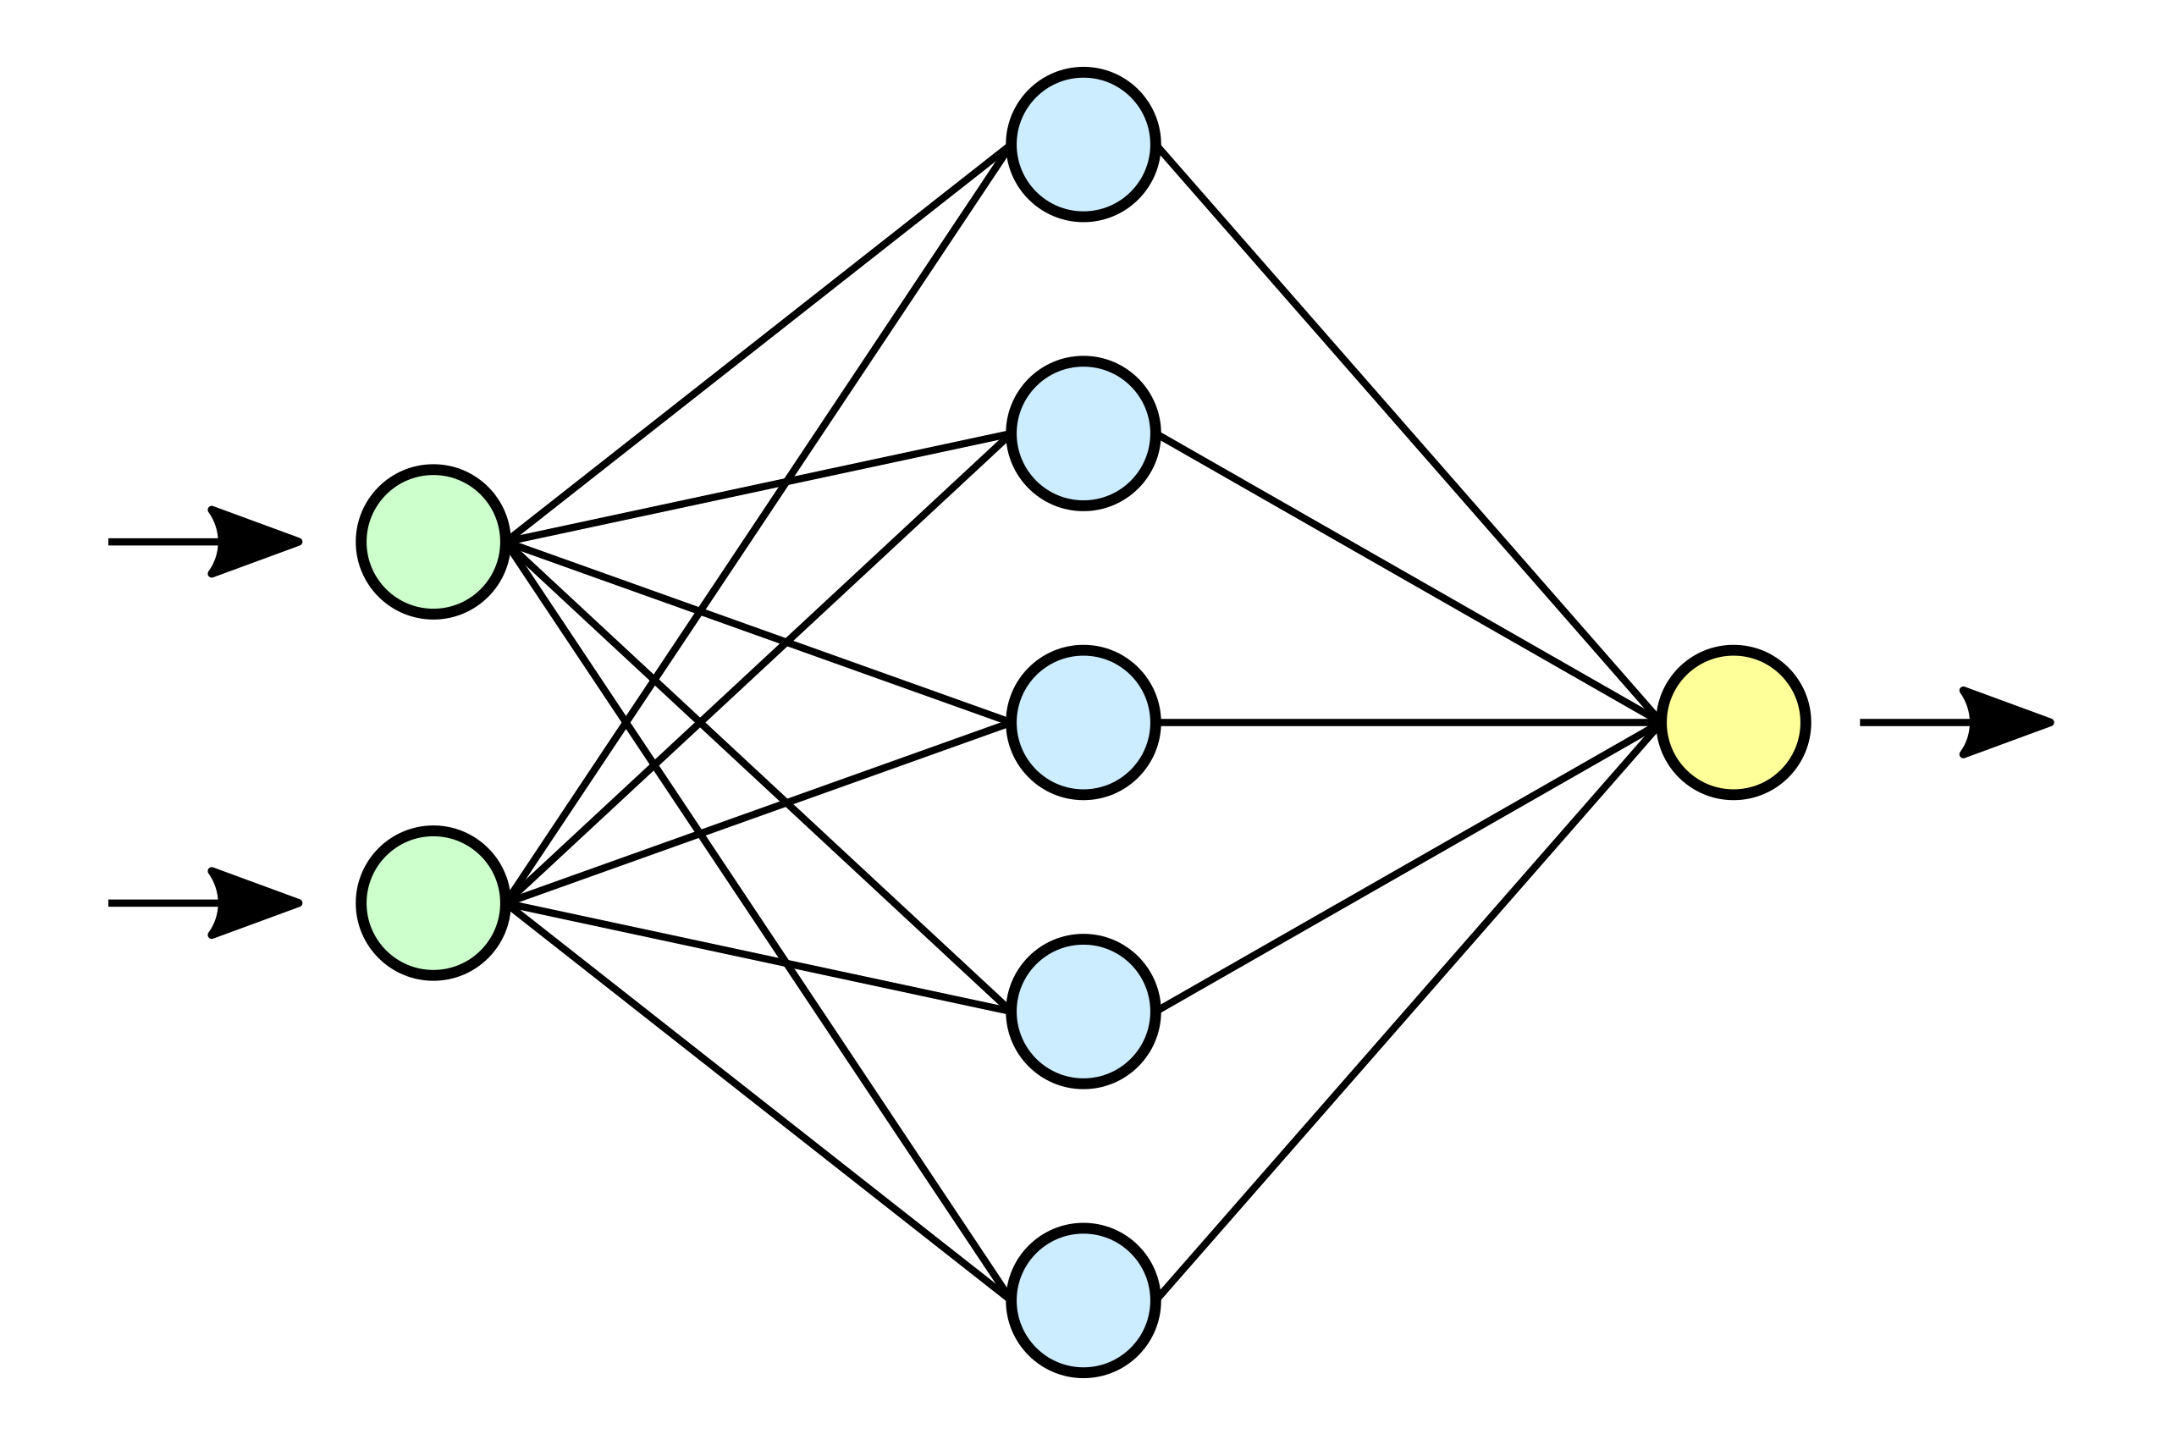
Accelerated Design of Silicon Photonic Devices with Neural Networks
Randi Wan
Jonathan Levine
Jacob Ryall
Deng Mading
Prof. Leonard MacEachern
Prof. Winnie Ye

Slide 2
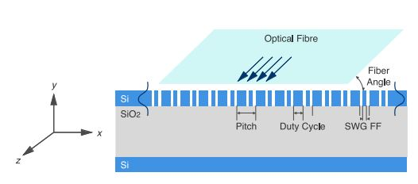
Main Motivations and Goals
SOI grating couplers are used to couple light into and out of photonic circuits
They are highly sensitive to their physical parameters
Simulated using FDTD simulations which require significant computational resources
Licensing is very expensive (order of 10k/ year)
Accelerate the design silicon photonic components with artificial neural networks
We chose SOI grating couplers because they are one of the most important devices in the SOI platform and they offer a straightforward proof of concept (are only characterized by a couple parameters)
This project was inspired by work by a former Ph.D student at Carleton, Dusan Gostimirovic
An Open-Source Artificial Neural Network Model for Polarization-Insensitive Silicon-on-Insulator Subwavelength Grating Couplers

Slide 3
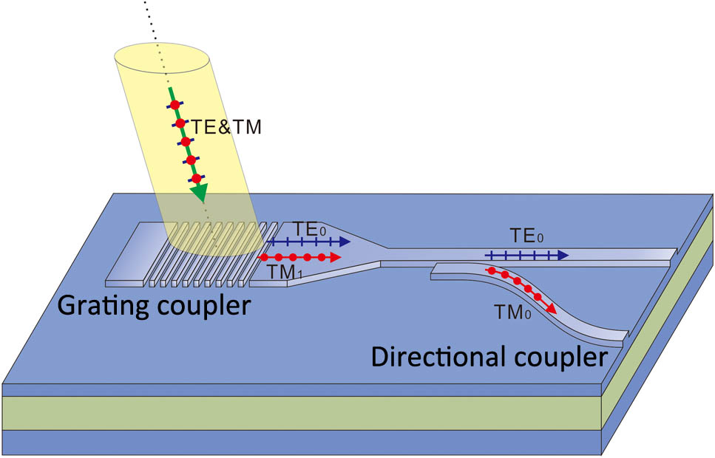
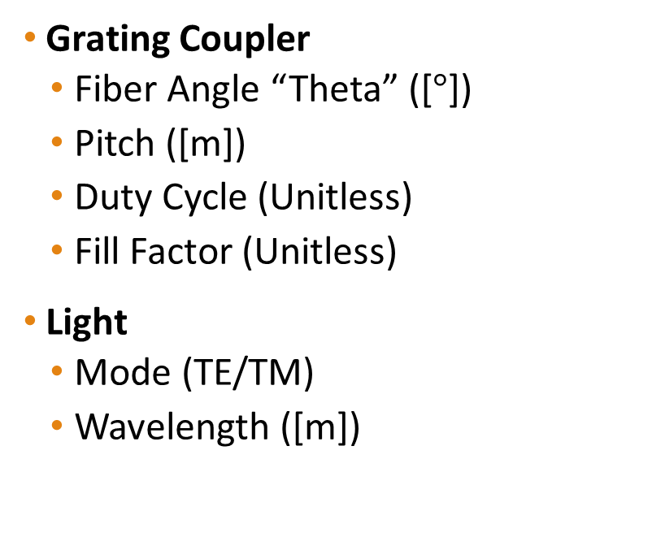
Grating Coupler Parameters
Grating Coupler
Fiber Angle “Theta” ([$°$])
Pitch ([m])
Duty Cycle (Unitless)
Fill Factor (Unitless)
Light
Mode (TE/TM)
Wavelength ([m])

Slide 4
Methodology
Generating simulation data from Lumerical and properly formatting it for processing
Manually generating the simulation data
Generating the simulation data by a script
Develop, train, test and validate a neural network
Investigate different hyperparameters
Optimizers for training

Slide 5

Job Distribution
Data Generation
Deng Mading
Randi Wan
ANN Development
Jonathan Levine
Jacob Ryall

Slide 6
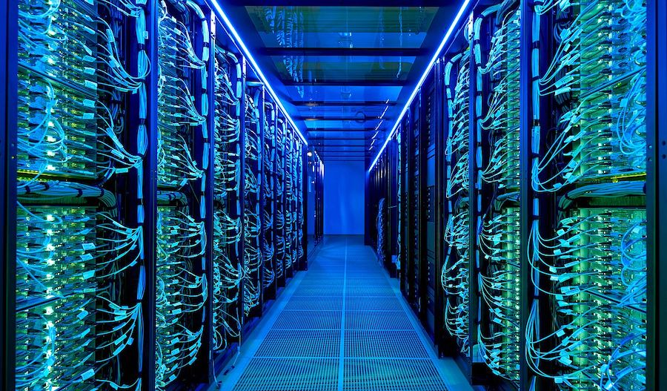
ANN Development
General Computer Specs
CPU: 6700k @ 4.0 GHz
Memory: 64 GB (DDR4) @ 2400 MHz
Develop new Grating Coupler models with the PyTorch ML Framework
Previously this was done in MATLAB
Improve the training approach
Manual changes to learning rate -> automated setting of learning rate

Slide 7
Challenges
New to SOI devices and so figuring out if data was good was also a challenge
Getting our models to converge
Python Pandas default data precision
How to handle large datasets with respect to training

Slide 8
Results

Slide 9
Future Work
Iterative approach to training the models and generating new simulation data based on training results
Automated Hyperparameter Tuning
Removing noise from the dataset

Slide 10
Reference:
INTELIGENCIA ARTIFICIAL timeline | Timetoast timelines
NT govt earmarks funds for facial recognition system | Computerworld
Premium Vector | Human face (freepik.com)
D.Gostimirovic and W.N.Ye, ”An Open-Source Artificial Neural Network Model for Polarization-Insensitive Silicon-on-Insulator Subwavelength Grating Couplers,” IEEE JOURNAL OF SELECTED TOPICS IN QUANTUM ELECTRONICS, VOL, 25, NO.3, MAY/JUNE 2019.

Slide 11
https://www.google.com/search?q=time+is+money+graphic&rlz=1C1GEWG_enCA972CA972&sxsrf=APq-WBuYoK-T9Ro-8MzwZpOi_G0e6oHSVw:1647895128262&source=lnms&tbm=isch&sa=X&ved=2ahUKEwjFivzdh9j2AhWLj4kEHewMD9oQ_AUoAXoECAEQAw&biw=1278&bih=1287&dpr=1#imgrc=LWTSkRfllJl9iM
https://m.researching.cn/articles/OJc2ecdbdc7da0bab2/figureandtable
https://www.ringcentral.com/us/en/blog/effective-teamwork/
https://www.hpcwire.com/off-the-wire/kit-supercomputer-among-the-15-fastest-in-europe/

