Slide 1
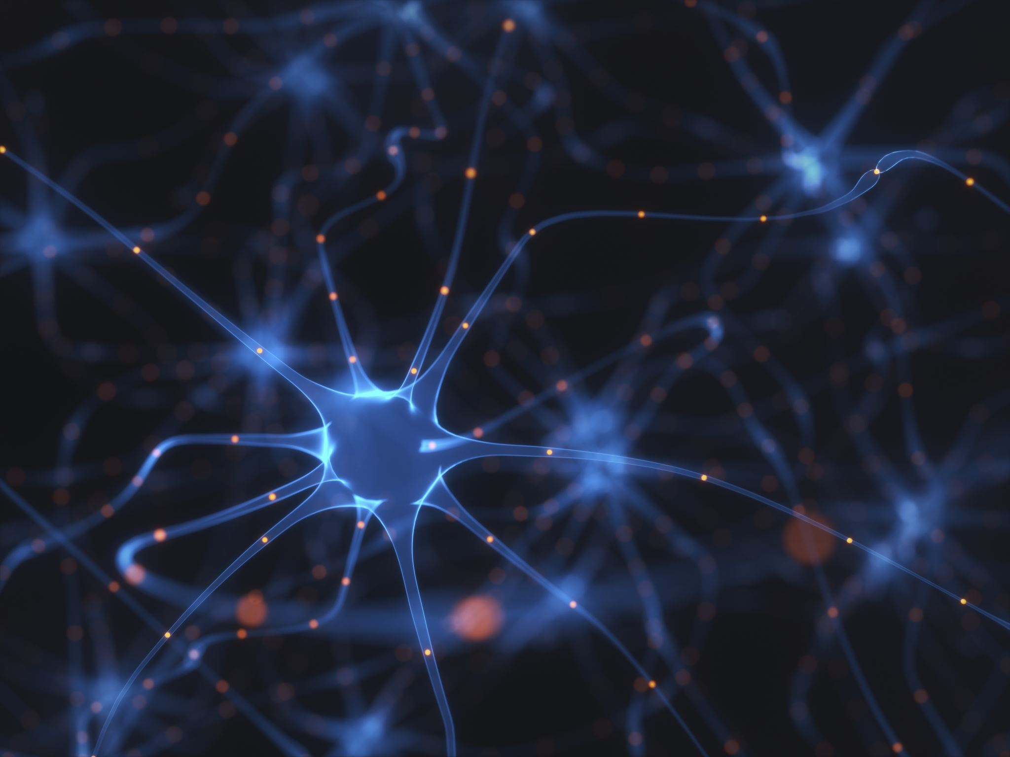
An Artificial Neural Network For Simulating Silicon Photonic Devices

Slide 2



Introduction & Background

Slide 3
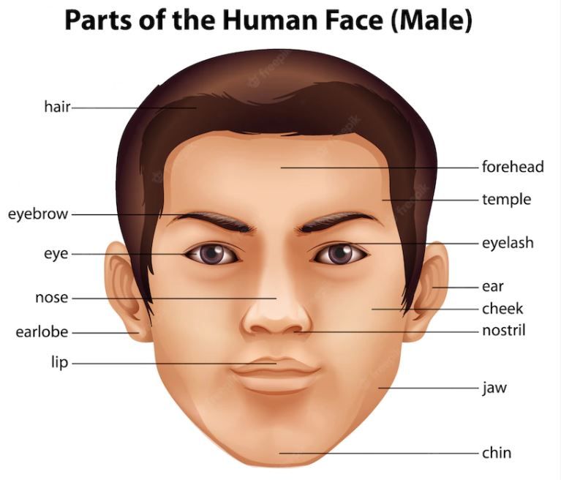
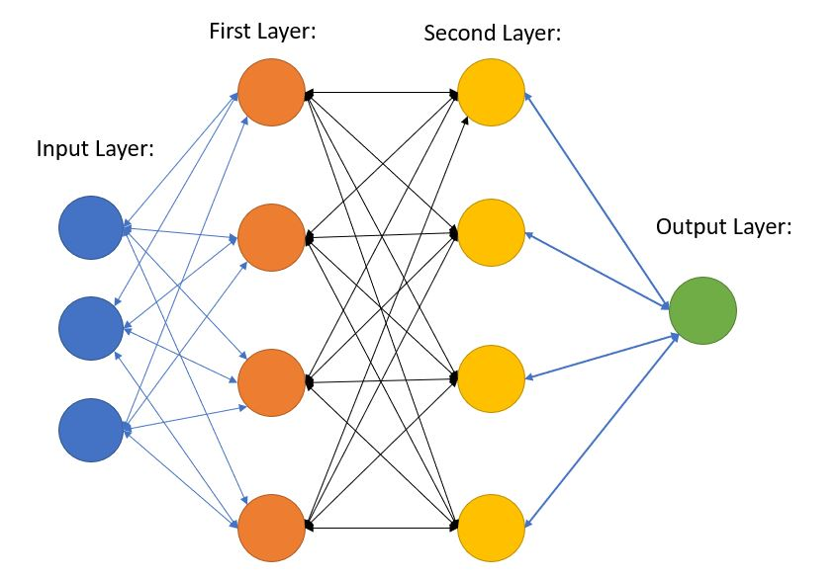
How ANN Works?

Slide 4
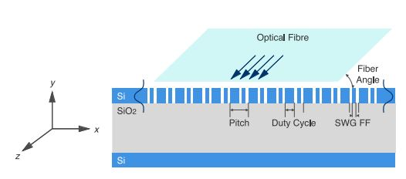
SOI Subwavelength Grating Coupler

Slide 5

Job Distribution
Data Acquisition
ANN Development

Slide 6
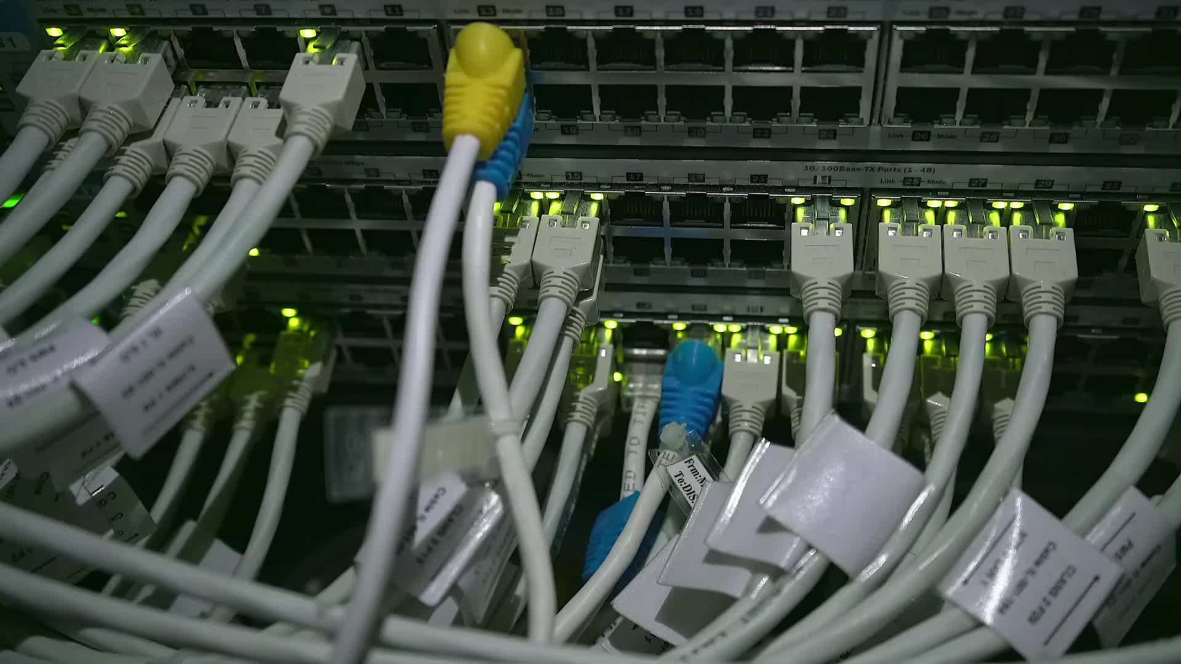
Lumerical Data Acquisition
By – Randi Wan

Slide 7
ANN Development
CPU: 6700k @ 4.0 Ghz, 64 Gb RAM @ 2400 MHz
Optimizer: Adam optimizer w\ learning rate=0.001
Log transform of the labels
Used a data loader to batch the data into a batch size of 10k

Slide 8
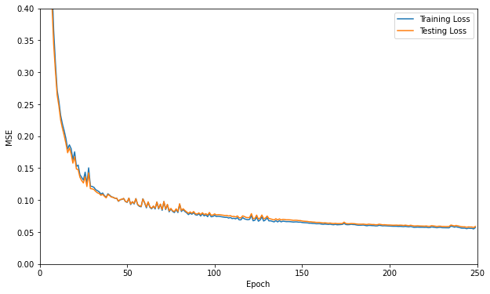
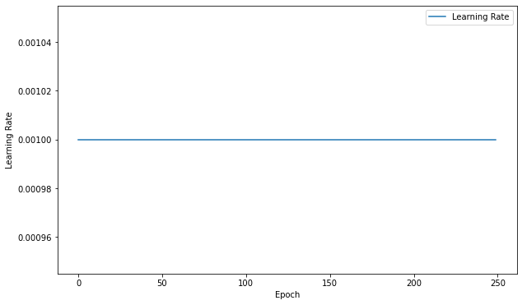
Training The ANN

Slide 9
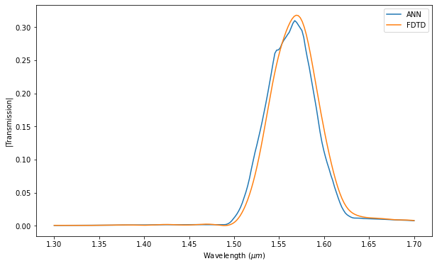
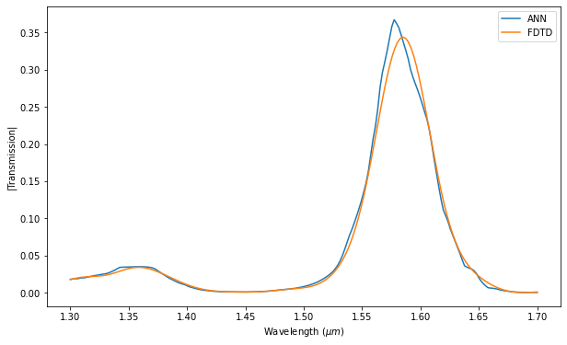

Slide 10
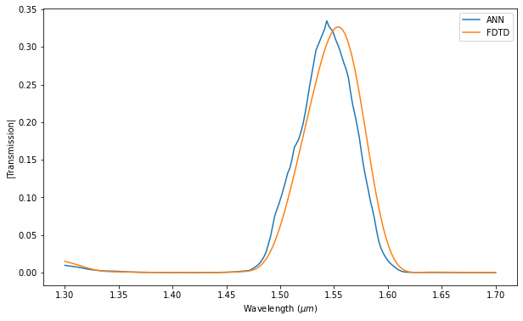
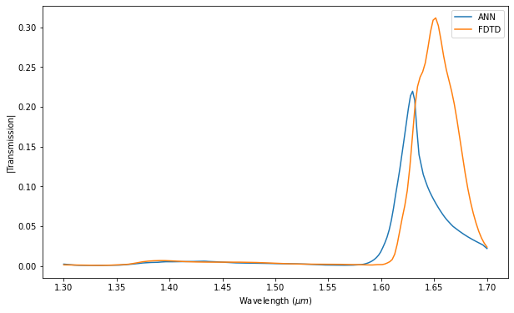
Optimized Data at 1.55 µm

Slide 11
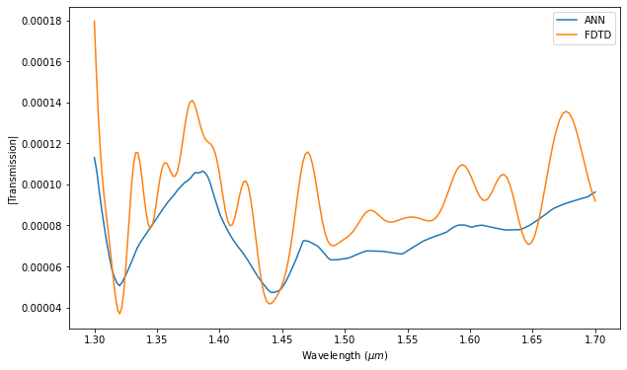
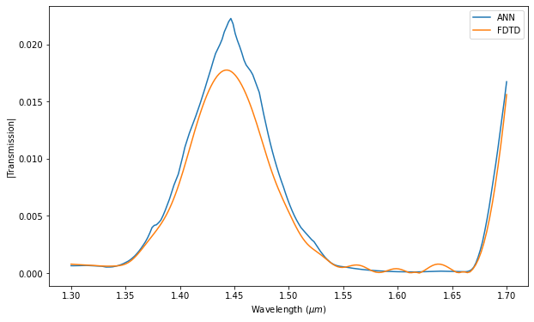

Slide 12
Getting rid of the Noisy Data

Slide 13
Reference:
INTELIGENCIA ARTIFICIAL timeline | Timetoast timelines
NT govt earmarks funds for facial recognition system | Computerworld
Premium Vector | Human face (freepik.com)
D.Gostimirovic and W.N.Ye, ”An Open-Source Artificial Neural Network Model for Polarization-Insensitive Silicon-on-Insulator Subwavelength Grating Couplers,” IEEE JOURNAL OF SELECTED TOPICS IN QUANTUM ELECTRONICS, VOL, 25, NO.3, MAY/JUNE 2019.

