Slide 1
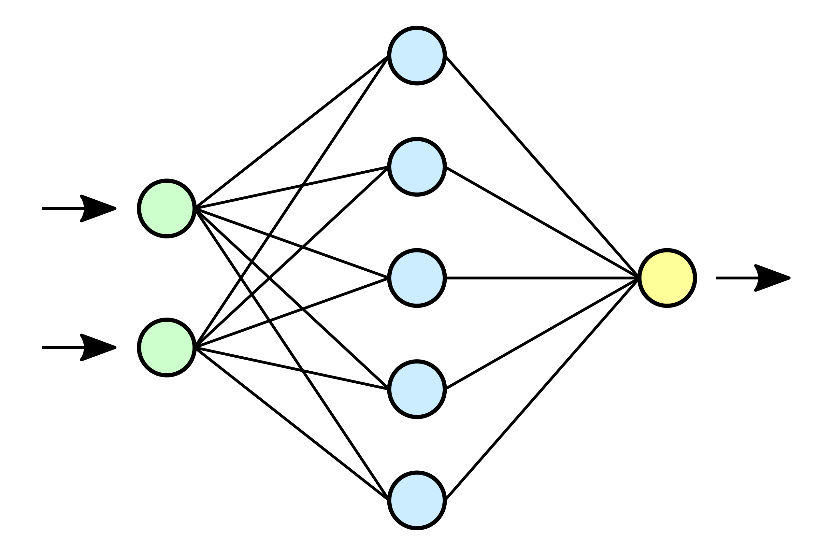
Accelerated Design of Silicon Photonic Devices with Neural Networks
Randi Wan
Jonathan Levine
Jacob Ryall
Deng Mading
Prof. Leonard MacEachern
Prof. Winnie Ye

Slide 2
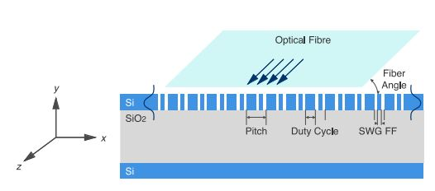
Main Motivations and Goals
SOI grating couplers are used to couple light into and out of photonic circuits
They are highly sensitive to their physical parameters
Simulated using FDTD simulations which require significant computational resources
Licensing is very expensive (order of 10k/ year)
Accelerate the design silicon photonic components with artificial neural networks
We chose SOI grating couplers because they are one of the most important devices in the SOI platform and they offer a straightforward proof of concept (are only characterized by a couple parameters)
This project was inspired by work by a former Ph.D student at Carleton, Dusan Gostimirovic
An Open-Source Artificial Neural Network Model for Polarization-Insensitive Silicon-on-Insulator Subwavelength Grating Couplers

Slide 3
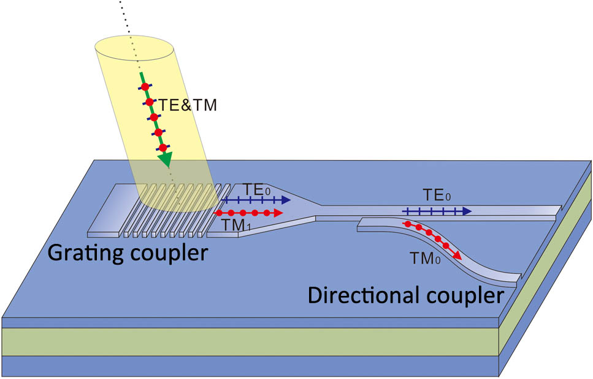
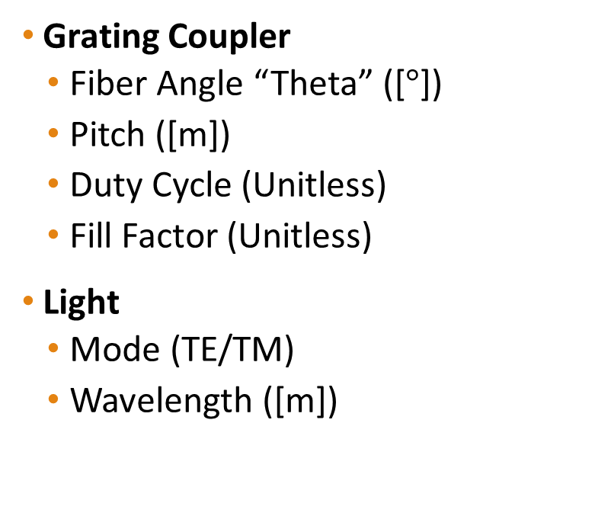
Grating Coupler Parameters
Grating Coupler
Fiber Angle “Theta” ([$°$])
Pitch ([m])
Duty Cycle (Unitless)
Fill Factor (Unitless)
Light
Mode (TE/TM)
Wavelength ([m])

Slide 4
Methodology
Generating simulation data from Lumerical and properly formatting it for processing
Manually generating the simulation data
Generating the simulation data by a script
Develop, train, test and validate a neural network
Investigate different hyperparameters
Optimizers for training

Slide 5

Job Distribution
Data Generation
Deng Mading
Randi Wan
ANN Development
Jonathan Levine
Jacob Ryall

Slide 6
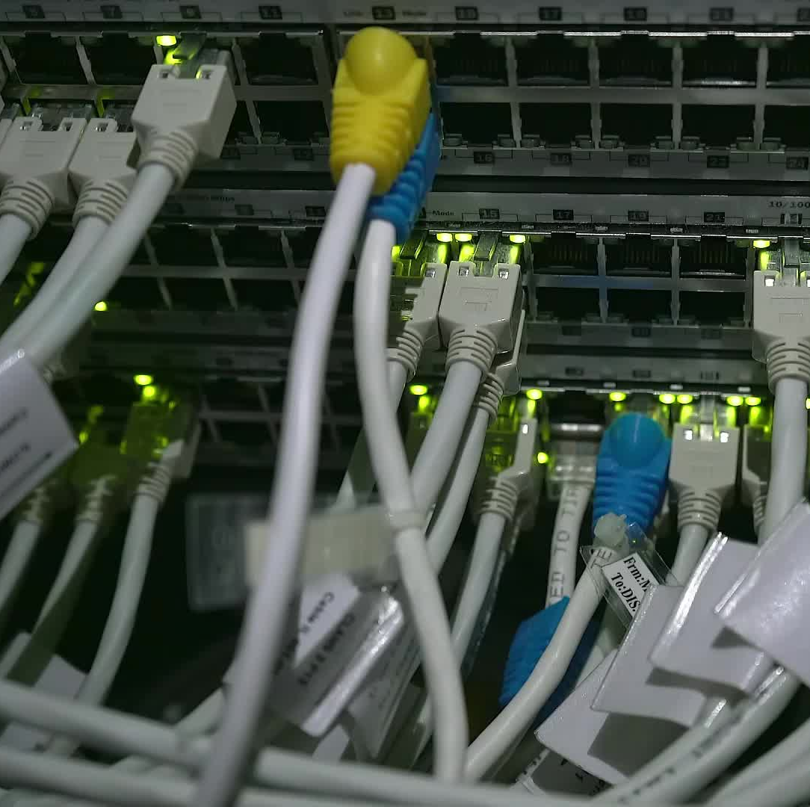
Lumerical Data Generation (Script Method)
By – Yu Wan (Randi)

Slide 7
Outline
Introduction
FDTD Settings
Challenge
Innovation
Future Plan

Slide 8

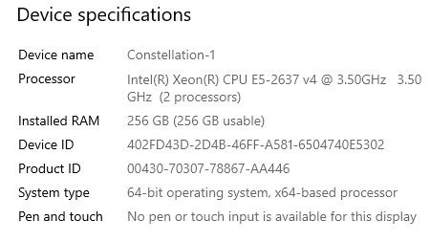
Introduction
What I did?
Data Generation
What I used?
Carleton Remote Desktop
How I did?
FDTD LUMERICAL

Slide 9

FDTD Settings

Slide 10
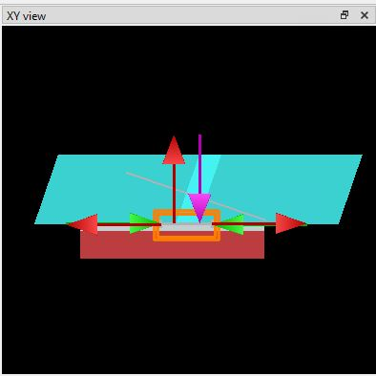
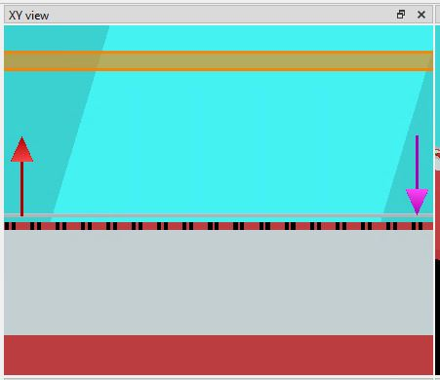
SOI Subwavelength Grating Coupler
5 Parameters
3 Materials
Fibre Angle
Optical Fibre
Core
Cladding
Pitch
Duty Cycle
^{[1]}
Oxide
SWG Fill Factor
Substrate
Modes
TE
TM

Slide 11
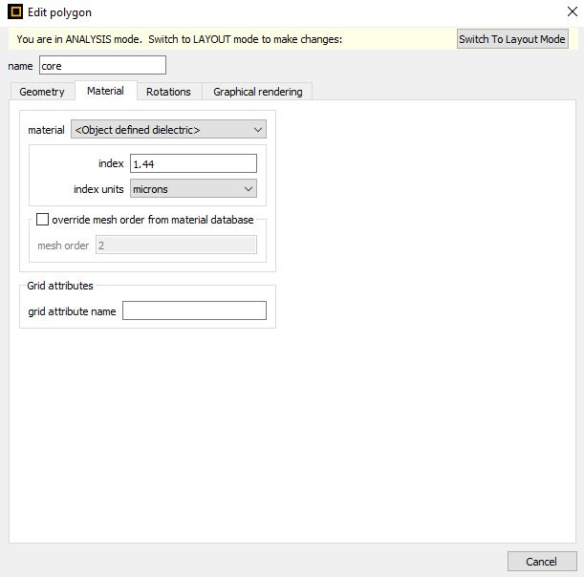
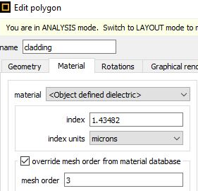
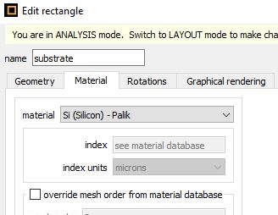
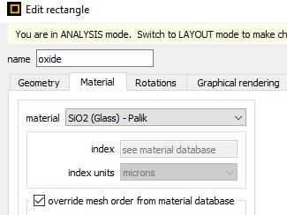
Material Settings
Core
n = 1.44
Cladding
n = 1.43482
Oxide
SiO2
Substrate
Si

Slide 12
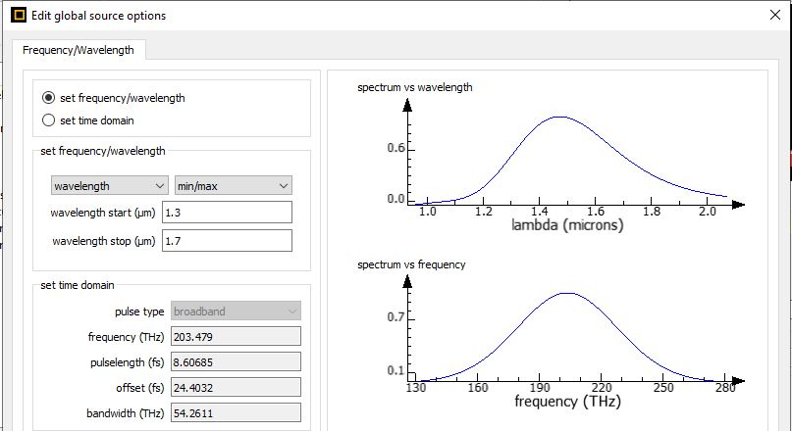
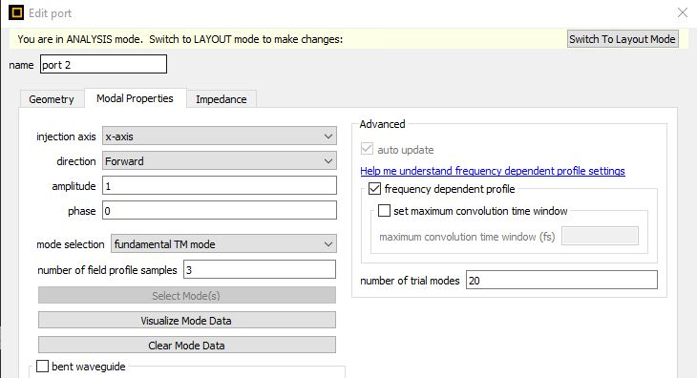
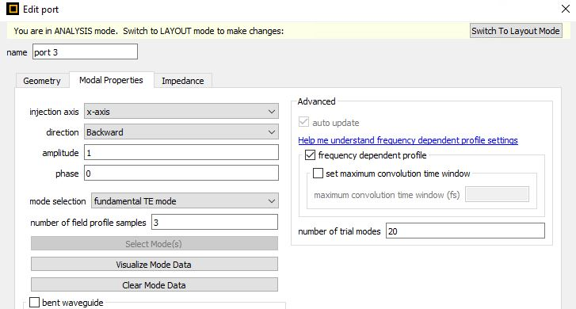
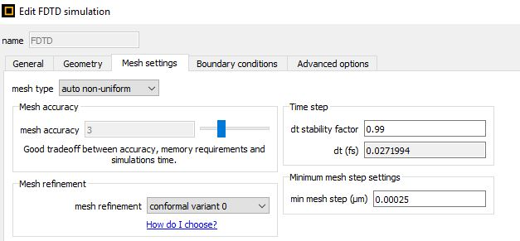
Simulation Settings
Mesh Setting
Auto non-uniform
Port 2
TM Mode
Port 3
TE Mode
Wavelength Range
1.3 – 1.7 µm

Slide 13
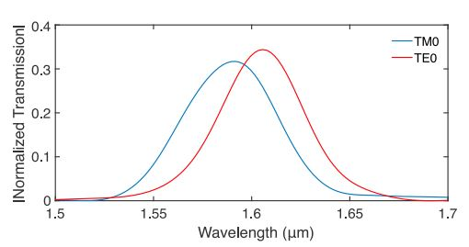
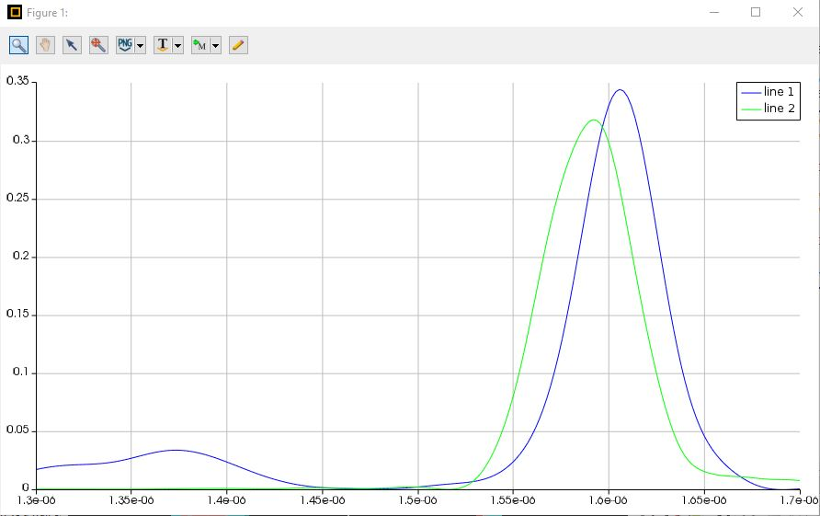
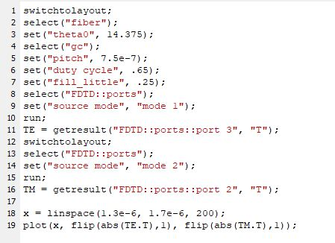
Verify the Setting
Fibre Angle = 14.375°
Pitch = 0.75 µm
Duty Cycle = 0.65
Fill Factor = 0.25
^{[1]}
T_(TE) = 0.34
λ_ (TE) = 1.61 µm
T_(TM) = -0.32
λ_ (TM) = 1.591 µm

Slide 14
Challenges

Slide 15

Challenges
Unfamiliar with the Software
Enormous Amount of Data
Undesired Format
Time Consumption

Slide 16
Innovation

Slide 17
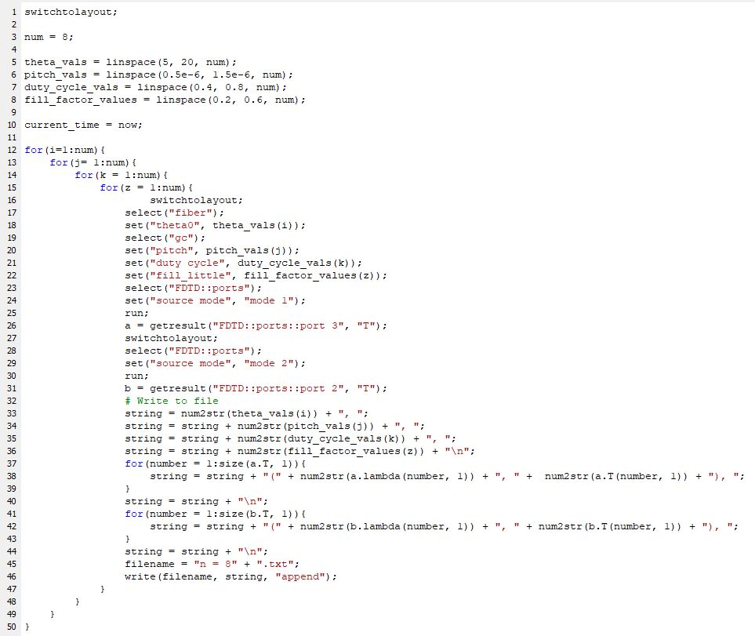
Coding Method
Setting Parameters
Fibre Angle (5 °- 20 °)
Pitch (0.5 µm – 1.5 µm)
Duty Cycle (0.4 – 0.8)
Fill Factor (0.2 – 0.6)
Iterating Parameters
8^4 = 4096 simulations
Record Results
Write it to file
Txt Format

Slide 18

Advantages
Automatic
Low Risk
Desired Format

Slide 19
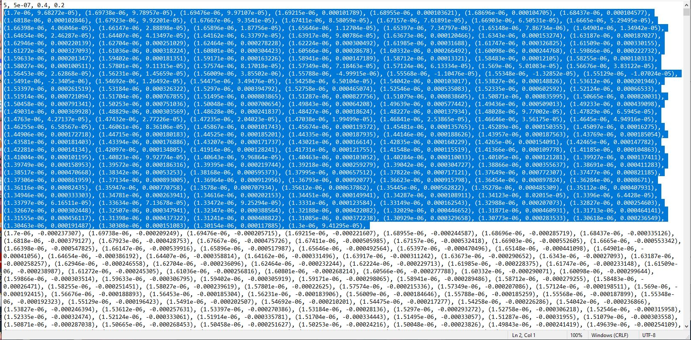
Results

Slide 20
Future Plan
Verify the Result From ANN
Measure the Energy Consumption

Slide 21

Q&A

Slide 22
Reference
[1] D.Gostimirovic and W.N.Ye, ”An Open-Source Artificial Neural Network Model for Polarization-Insensitive Silicon-on-Insulator Subwavelength Grating Couplers,” IEEE JOURNAL OF SELECTED TOPICS IN QUANTUM ELECTRONICS, VOL, 25, NO.3, MAY/JUNE 2019.

Slide 23

ANN Development
General Computer Specs
CPU: 6700k @ 4.0 GHz
Memory: 64 GB (DDR4) @ 2400 MHz
Develop new Grating Coupler models with the PyTorch ML Framework
Previously this was done in MATLAB
Improve the training approach
Manual changes to learning rate -> automated setting of learning rate
Figure 1: Supercomputer

Slide 24
Challenges
New to SOI devices and so figuring out if data was good was a challenge
Getting our models to converge
Python Pandas default data precision
Learning rate
Weight decay
How to handle large datasets with respect to training
Batching
Training Time

Slide 25
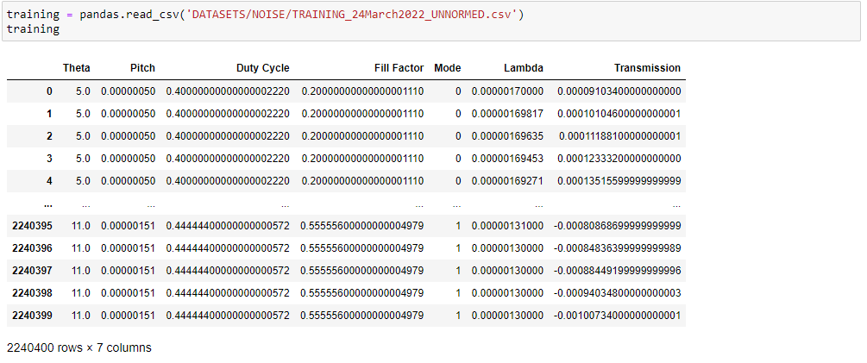
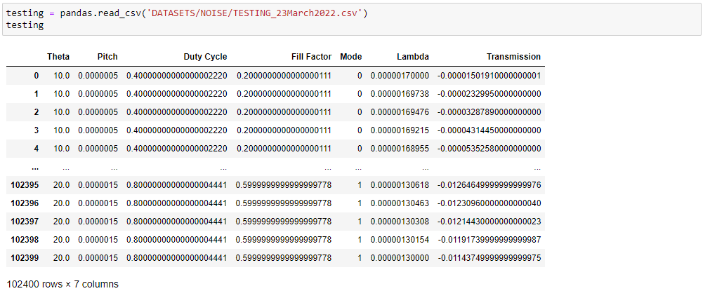
Method – Training and Testing Sets
Training Set: 11202 Examples with 200 Transmission Spectra (2,240,400 rows)
Combination of (n=6) and (n=8) datasets
Testing Set: 512 Examples with 200 Transmission Spectra (102,400 rows)
Comprised of the (n=3) dataset
Batched the Training set at 10k rows per batch
Held the learning rate at 0.001 for entire training cycle
Figure 2: Training Set
Figure 3: Testing Set

Slide 26
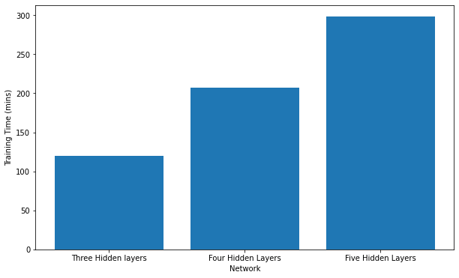
Results – Training Time
Three Hidden Layers
Input: (6, 50) -> 50, 50, 100 -> Output(100, 1)
Training Time: 119.5 mins
Four Hidden Layers
Input: (6, 50) -> 50, 100, 250, 100, 50-> Output: (50, 1)
Training Time: 207.6 mins
Five Hidden Layers
Input: (6, 100) -> 100, 250, 500, 250, 100, 50-> Output: (50, 1)
Training Time: 298.2 mins
Figure 2: Training Time For Different Network Sizes

Slide 27
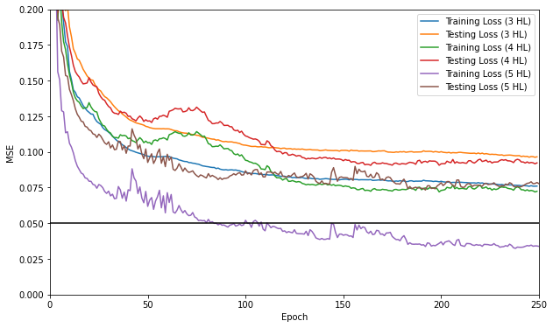
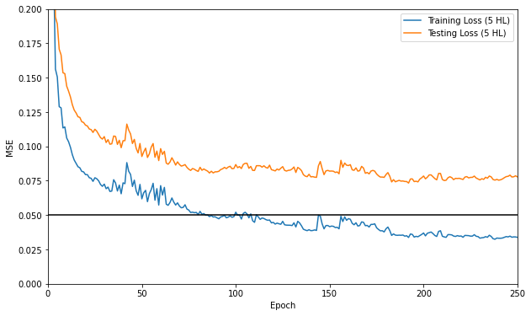
Results - Training and Testing Losses
Figure 3: Losses For All Three Networks
Figure 4: Losses For 5-Hidden Layer Network

Slide 28
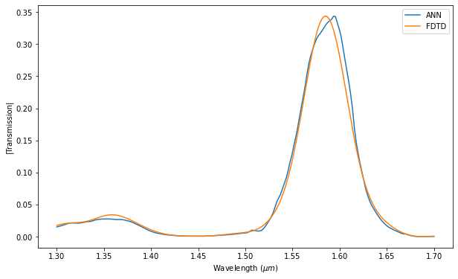
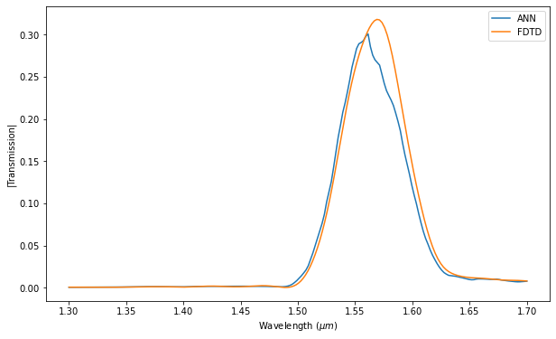
Validation Results – Example 1
Parameters:
Fiber Angle: 14.375
Pitch: 0.75x10^(-6)
Duty Cycle: 0.65
Fill Factor: 0.25
ANN Inference time: 20.25 seconds
Lumerical Simulation time: 130 seconds
Figure 5: TE Mode
Figure 6: TM Mode

Slide 29
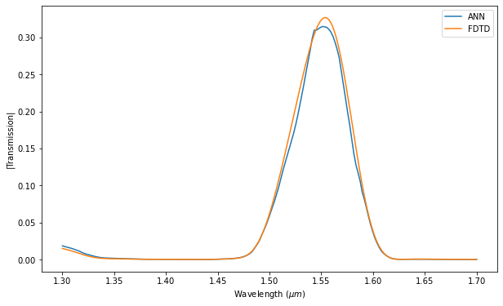
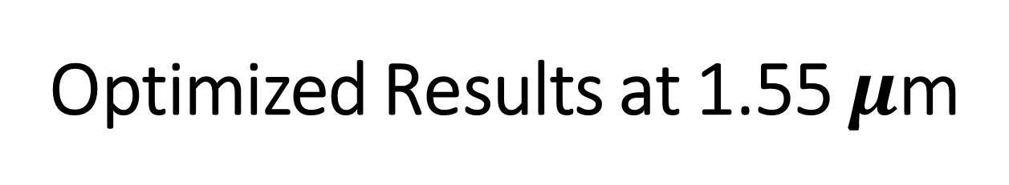
Optimized Results at 1.55 $μ$m
ANN Found The Following Parameters (0.4715):
Fiber Angle: 10
Pitch: 1.5x10^(-6)
Duty Cycle: 0.44
Fill Factor: 0.55
Figure 6: TE Mode
Figure 7: TM Mode

Slide 30
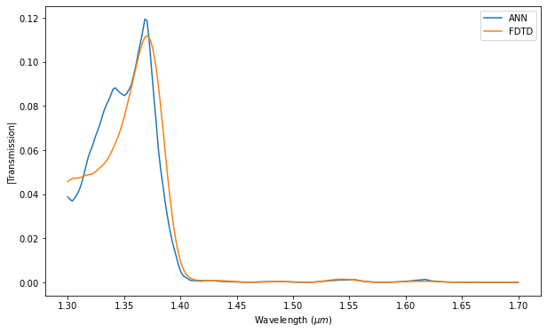
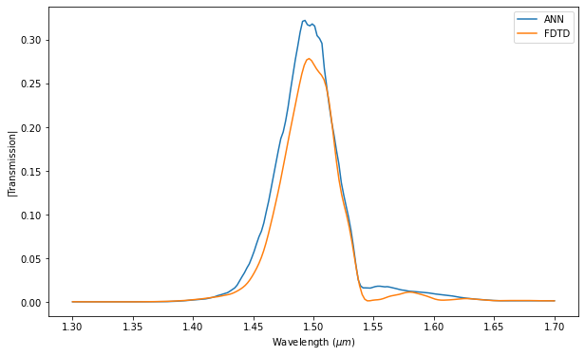
Validation Results – Example 2
Parameters:
Fiber Angle: 5
Pitch: 0.7x10^(-6)
Duty Cycle: 0.48
Fill Factor: 0.2
ANN Inference time: 20.25 seconds
Lumerical Simulation time: 130 seconds
Figure 7: TE Mode
Figure 8: TM Mode

Slide 31
Future Work
Iterative approach to training the models and generating new simulation data based on training results
Automated Hyperparameter Tuning
Removing noise from the dataset

Slide 32
Reference:
INTELIGENCIA ARTIFICIAL timeline | Timetoast timelines
NT govt earmarks funds for facial recognition system | Computerworld
Premium Vector | Human face (freepik.com)
D.Gostimirovic and W.N.Ye, ”An Open-Source Artificial Neural Network Model for Polarization-Insensitive Silicon-on-Insulator Subwavelength Grating Couplers,” IEEE JOURNAL OF SELECTED TOPICS IN QUANTUM ELECTRONICS, VOL, 25, NO.3, MAY/JUNE 2019.

Slide 33
https://www.google.com/search?q=time+is+money+graphic&rlz=1C1GEWG_enCA972CA972&sxsrf=APq-WBuYoK-T9Ro-8MzwZpOi_G0e6oHSVw:1647895128262&source=lnms&tbm=isch&sa=X&ved=2ahUKEwjFivzdh9j2AhWLj4kEHewMD9oQ_AUoAXoECAEQAw&biw=1278&bih=1287&dpr=1#imgrc=LWTSkRfllJl9iM
https://m.researching.cn/articles/OJc2ecdbdc7da0bab2/figureandtable
https://www.ringcentral.com/us/en/blog/effective-teamwork/
https://www.hpcwire.com/off-the-wire/kit-supercomputer-among-the-15-fastest-in-europe/

