Slide 1
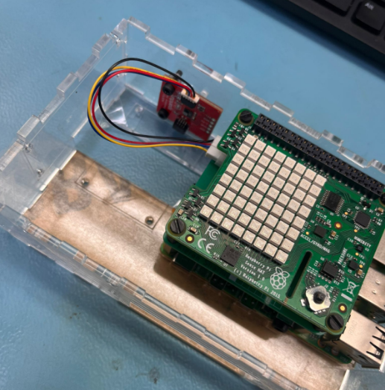
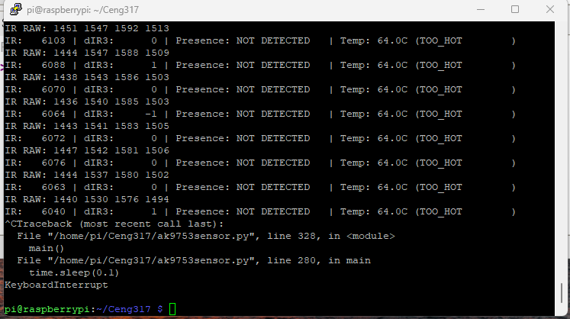
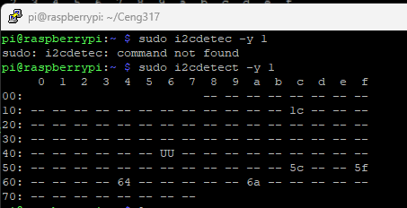
AK9753 HUMAN PRESENCE DETECTION
BY
Name: Jonathan Oluchi Akabuike
sensor mount
sensor reading
i2c detect address 0x64

