Slide 1


Changing State in the
Language
Jonathan Aldrich, Karl Naden,
Sven Stork, Joshua Sunshine
OOPSLA 2011 Demonstration
School of Computer Science

Slide 2
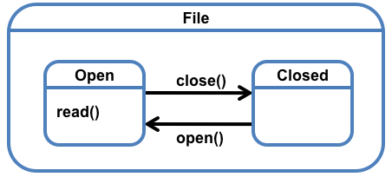
Object Protocols
An Object Protocol dictates an order on method calls:
Has a finite number of abstract states in which different method calls are valid;
Specifies transitions between abstract states that occur as a part of some method calls.
File state chart [harel 87]
2

Slide 3
File States
states

Slide 4
File States
superstate
substates

Slide 5
File States
Method available
in the Closed state
Methods available
in the Open state

Slide 6
File States
Method that keeps the
object in the same state
Methods that transition
the state of the object

Slide 7
Plaid Syntax
Need to encode:
Code from File.plaid
Notes:
7

Slide 8
Plaid Syntax
Need to encode:
States and dimensions
state File {
}
state Open case of File {
}
state Closed case of File {
}
Code from File.plaid
Notes:
8

Slide 9
Plaid Syntax
Need to encode:
States and dimensions
Actions and supporting representation
state File {
val filename;
}
state Open case of File {
val filePtr;
method read() {…}
method close() {…}
}
state Closed case of File {
method open() {
…
}
}
Code from File.plaid
Notes:
9

Slide 10
Plaid Syntax
Need to encode:
States and dimensions
Actions and supporting representation
Transitions
state File {
val filename;
}
state Open case of File {
val filePtr;
method read() {…}
method close() { this ⬅ Closed; }
}
state Closed case of File {
method open() {
this ⬅ Open { val filePtr = … };
}
}
Code from File.plaid
Notes:
10

Slide 11
Using Files
Instantiation:
val fs = new Closed { val filename = “path.to.file”; };
Code from File.plaid

Slide 12
Using Files
Matching:
method readAndCloseFile(theFile) {
}
Code from File.plaid

Slide 13
Using Files
Matching:
method readAndCloseFile(theFile) {
match (theFile) { /* make sure the file is Open */
case Closed { theFile.open() }
case Open { /* no op – already Open */ }
};
}
Code from File.plaid

Slide 14
Using Files
Matching:
method readAndCloseFile(theFile) {
match (theFile) { /* make sure the file is Open */
case Closed { theFile.open() }
case Open { /* no op – already Open */ }
};
val ret = theFile.read();
}
Code from File.plaid

Slide 15
Using Files
Matching:
method readAndCloseFile(theFile) {
match (theFile) { /* make sure the file is Open */
case Closed { theFile.open() }
case Open { /* no op – already Open */ }
};
val ret = theFile.read();
theFile.close();
}
Code from File.plaid

Slide 16
Using Files
Matching:
method readAndCloseFile(theFile) {
match (theFile) { /* make sure the file is Open */
case Closed { theFile.open() }
case Open { /* no op – already Open */ }
};
val ret = theFile.read();
theFile.close();
ret
}
Code from File.plaid

Slide 17
Conditionals
If functions: (
method readTwiceAndAdd(openFile) {
var result = openFile.read();
val second = openFile.read();
if (second != -1) { //only add if not EOF symbol
result = result + second;
};
result
}
Code from File.plaid

Slide 18
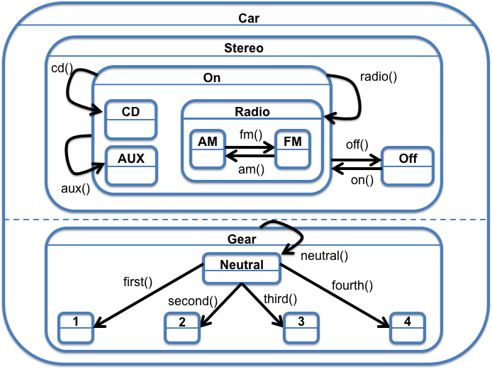
And-states and Composition
A Car has a more complicated state chart

Slide 19
And-states and Composition
A Car has a more complicated state chart
Two
independent
dimensions
within Car
Changing a
Gear does not
impact the
stereo state

Slide 20
And-states and Composition
A Car has a more complicated state chart
radio() method
available
in all substates
of On. Always
ends in the
Radio state.

Slide 21
Plaid Car
Code from Car.plaid

Slide 22
Plaid Car
state Gear {
method neutral() { this ⬅ Neutral }
}
Code from Car.plaid

Slide 23
Plaid Car
state Gear {
method neutral() { this ⬅ Neutral }
}
state 1 case of Gear { }
state 2 case of Gear { }
…
Code from Car.plaid

Slide 24
Plaid Car
state Gear {
method neutral() { this ⬅ Neutral }
}
state 1 case of Gear { }
state 2 case of Gear { }
…
state Neutral case of Gear {
method first() { this ⬅ 1 } …
}
Code from Car.plaid

Slide 25
Plaid Car
state Gear {
method neutral() { this ⬅ Neutral }
}
state 1 case of Gear { }
state 2 case of Gear { }
…
state Neutral case of Gear {
method first() { this ⬅ 1 } …
}
state Car = Stereo with Gear;
state Car = Stereo with Gear;
Code from Car.plaid

Slide 26
Plaid Car
state Gear {
method neutral() { this ⬅ Neutral }
}
state 1 case of Gear { }
state 2 case of Gear { }
…
state Neutral case of Gear {
method first() { this ⬅ 1 } …
}
state Car = Stereo with Gear;
Composition
Code from Car.plaid

Slide 27
Questions?
Let’s write some code!

Slide 28
Game Of Life Rules
For each step, iterate over each cell and
If the cell is alive and
Has 0 or 1 Alive neighbors, it dies from Loneliness
Has 2 or 3 Alive neighbors, it is Happy and stays alive
Has 4 or more Alive neighbors, it dies from Overcrowding
If the cell is dead and
Has 2 or fewer Alive neighbors, it remains Dead
Has 3 or more Alive neighbors, it is Fertile and becomes Alive

Slide 29
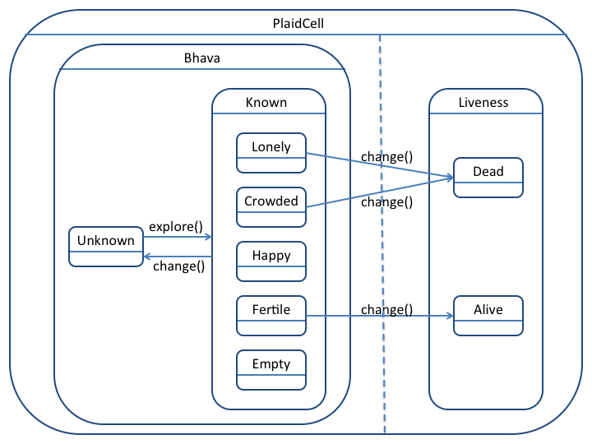
Game Of Life State Chart

Slide 30
Setup
To set up Java and Ant:
Windows: Double-click on /path/to/usb/DEMO/windows.bat
Linux/OSX: in Terminal, go to /path/to/usb/DEMO/
Linux – source linux.sh
OSX – source OSX.sh
Run ant in the examples/gameoflife and confirm it works
Edit files in
/path/to/usb/DEMO/examples/gameoflife/pld/plaid/demo/plugin
Edit in your favorite text editor!

