Slide 1
Estimation

Slide 2

how
to
estimate
anything

Slide 3
manager /
customer
rights

Slide 4
knowledge worker rights

Slide 5
points

Slide 6

points

Slide 7
From: Jon Aquino
Subject: RE: http://home.ninginc.com/display
16 points - Main Navigation Tabs sub-project
12 points - Add As Friend dialog, with custom message
16 points - Inbox
8 points - Sent
8 points - Archive
12 points - Message Detail
8 points - Reply
8 points - Compose New Message
8 points - Search Friends section (for Compose New
8 points - Search Friends page (Facebook-like page)

Slide 8
8 points - Prompt to import address book
1 point - Link in email to the reply page
4 points - Customize message to someone you decline for
2 points - Broadcast messages should show up in Inbox,
8 points - NC can set up automatic message to new
8 points - Friend requests received
8 points - Friend requests sent
12 points - People You May Know
2 points - Limit total friends on a network to 5,000
2 points - Remove selected Ningbar functionality
Total: 138 points, or 4.2 person-weeks

Slide 9
From: Jay Parikh
Subject: RE: http://home.ninginc.com/display
Thanks Jon. Very helpful.
----------
From: Jon Aquino
Subject: RE: http://home.ninginc.com/display
16 points - Main Navigation Tabs sub-project
12 points - Add As Friend dialog, with custom message
16 points - Inbox

Slide 10
16 points - Main Navigation Tabs sub-project
12 points - Add As Friend dialog, with custom message
16 points - Inbox
8 points - Sent
8 points - Archive
12 points - Message Detail
8 points - Reply
8 points - Compose New Message
8 points - Search Friends section (for Compose New Message)
8 points - Friend requests sent
8 points - People You May Know
? points - Roll out LDAP to production
2 points - Remove selected Ningbar functionality

Slide 11

16 points - Main Navigation Tabs sub-project
12 points - Add As Friend dialog, with custom message
16 points - Inbox
8 points - Sent
8 points - Archive
12 points - Message Detail
8 points - Reply
8 points - Compose New Message
8 points - Search Friends section (for Compose New Message)
8 points - Friend requests sent
12 points - People You May Know
points - Roll out LDAP to production
2 points - Remove selected Ningbar functionality
?

Slide 12
spike solution

Slide 13
psychic spam
filter

Slide 14
Block spammers before they send spam
2) Monitor spam levels in the future
3) Send alerts a week in advance

Slide 15
tips

Slide 16
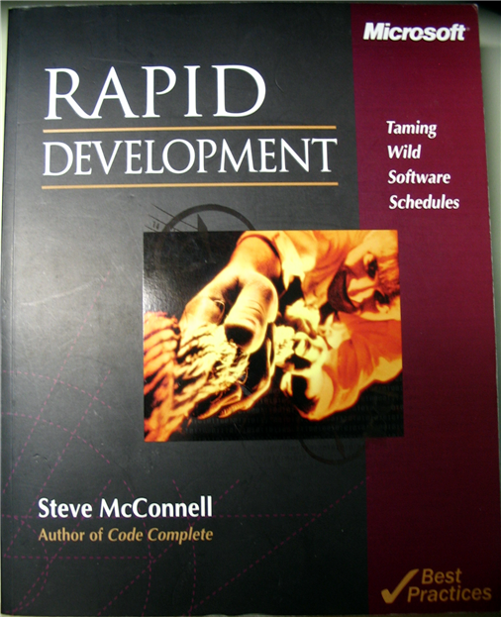
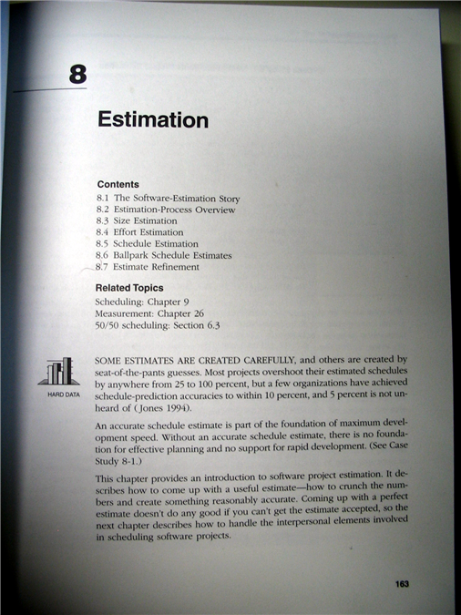

Slide 17

