Slide 1
Use a robot to help fix Kubernetes issues and apps.
Jonathan Arrance
Notes:
Allison
We’ve expanded beyond OpenStack. Each of these projects makes OpenStack more successful, because they provide critical components and functions to openstack clouds, taking openstack to new markets… integrating with kubernetes, optimizing for edge environments, securing containers

Slide 2


NAME SECTION
Jonathan Arrance
I am a technology professional with over 20 years of experience. He has done everything from help build datacenters, architect early cloud solutions and built a company. Recently he has worked in the observability industry and is now in the freelance market exploring opportunities in AI and ML. In his spare time he enjoys rock climbing, BJJ, and building things with Python.
LinkedIn: https://www.linkedin.com/in/jonathanarrance/
GitHub: https://github.com/JonathanArrance
Twitter: @JonathanArrance
Instagram: Jonathan.arrance
Email: jonathan.arrance@gmail.com

Slide 3

TOPICS TO TALK ABOUT
Kubernetes
Robusta
Why are organizations building club native apps in Kubernetes? What makes it so complex?
How does Robusta help make Kubernetes Observability easier?
Observability
Robusta with OpenAI
Why would we use an Observability platform to watch over Kubernetes?
Make Robusta an LLM powered troubleshooting assistant.
Prometheus
Demo
Why use prometheus for observability and what are the challenges?
Let’s see this in action with a simple POC.
Notes:
We build open source communities around infrastructure software

Slide 4
Kubernetes
What is so attractive about Kubernetes?
It is a cloud native container orchestration layer.
If done correctly, apps are portable from one provider to another.
Faster deployment, testing and updating.
Scalability
Streamlining of infrastructure - a.k.a cost efficiency
So what’s the issue? All of this sounds great!
Notes:
We build open source communities around infrastructure software

Slide 5
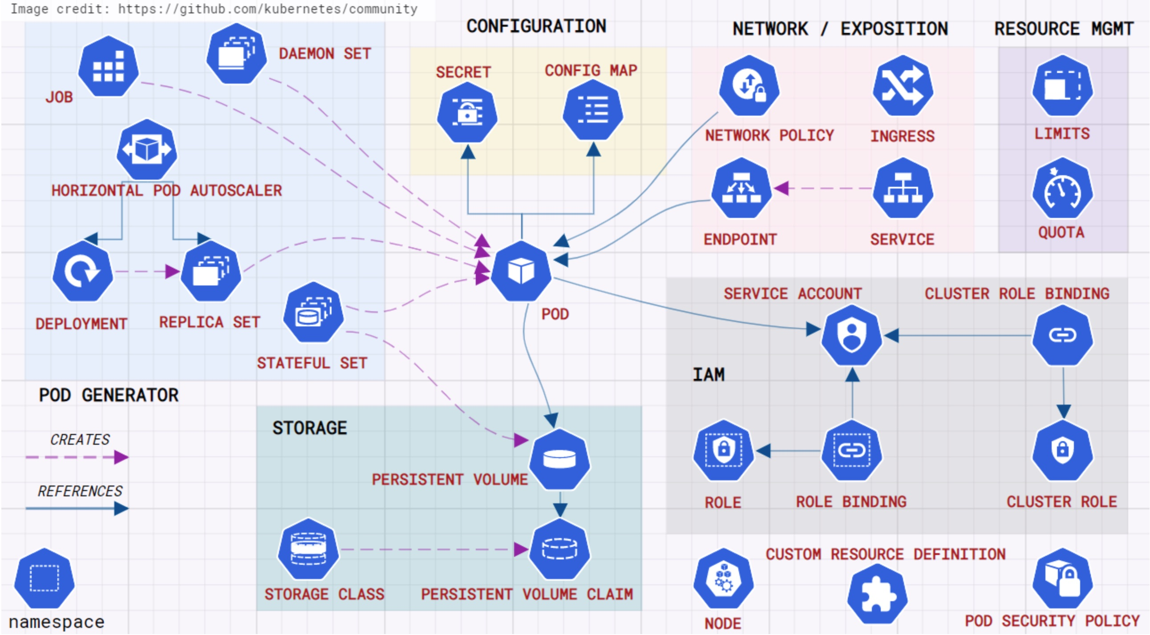
Kubernetes
Why is Kubernetes so complicated?
A lot of moving parts
Networking is complex
Tracking down all parts of an app is difficult for the uninitiated.
Configuring the app for deployment can be confusing if you do not understand the environment.
A good illustration of an app running Kubernetes.
Notes:
We build open source communities around infrastructure software

Slide 6
Observability is key!
Because of the inherent complexity of Kubernetes we need to be able to look under the hood to find out what is going on.
A good observability metrics platform should gather quantitative readings used to identify issues, find performance issues, and troubleshoot problems.
We need to see how both applications and the infrastructure operates and reacts to changes made in the development process.
Notes:
We build open source communities around infrastructure software

Slide 7
Prometheus to the rescue!
Kubernetes requires observability and Prometheus is the standard for observability.
Kubernetes works with Prometheus “out of the box”.
Prometheus has a native, flexible, query language; PromQL.
Applications can be built to natively work with Prometheus. Ex. GoLang, Python
Simplified data collection by using a scrape based model.
Prometheus is not the end all.
We can only get metrics, no logging or tracing. So it is not a one stop solution.
Query language has a high learning learning curve.
Reliant on external dashboard solutions
Notes:
We build open source communities around infrastructure software

Slide 8
Robusta
Simplify two complex systems and get the info you need.
Simplify your Prometheus journey with prebuilt dashboards and improved alerting.
Simplified runbook
Open source.
“On prem” installation in your Kubernetes environment.
Added features and integrations when using the Robusta SaaS platform.
Robusta Resources:
https://home.robusta.dev
https://github.com/robusta-dev/robusta
Notes:
We build open source communities around infrastructure software

Slide 9
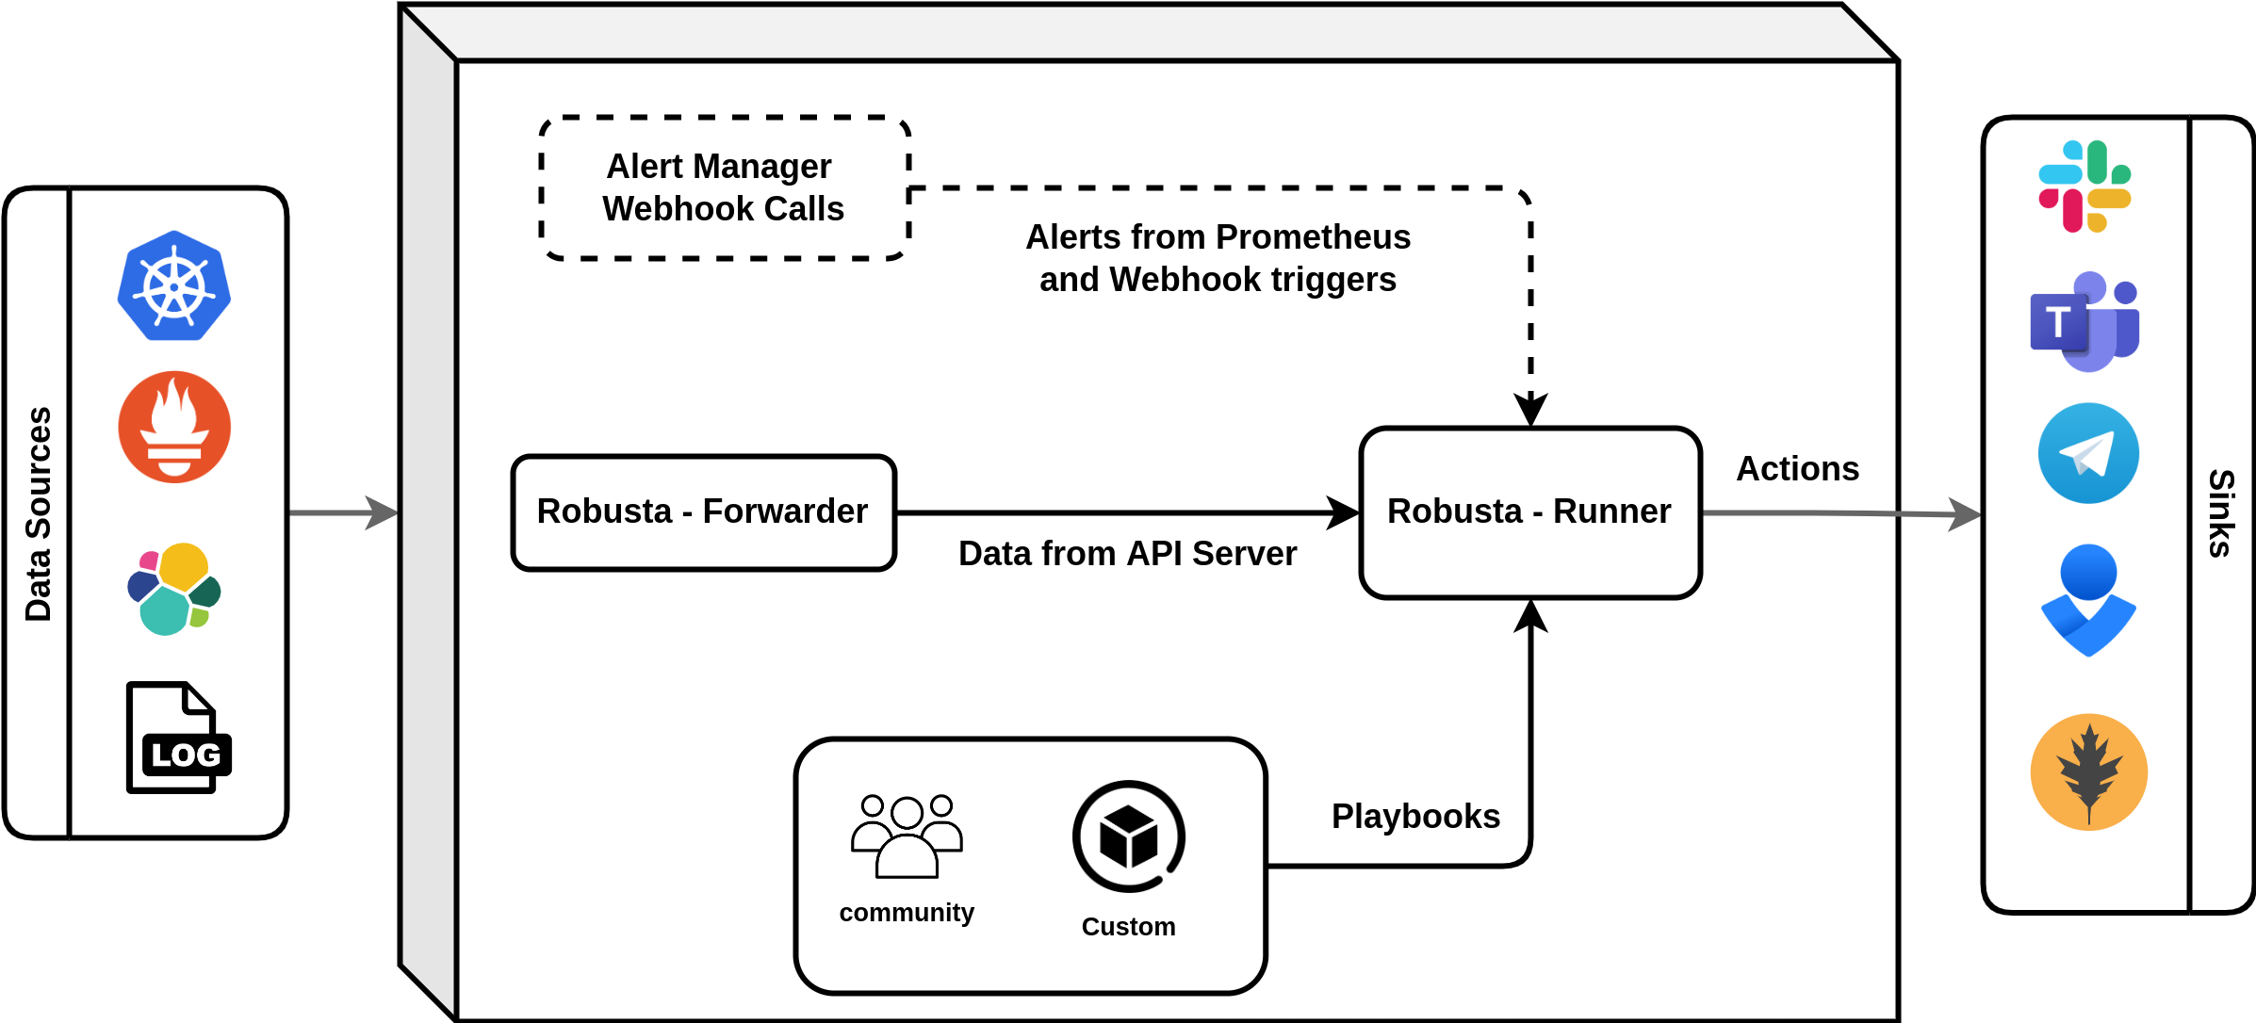
Robusta Under the Hood
Robusta-Forwarder - Monitors for Kubernetes changes, forwards to the runner.
Robusta-Runner - Receives events, evaluates which playbook to run and forwards notifications.
OpenAI Plugin - Extends the Robusta runner, communicates with the OpenAI API to prompt the LLM.
Resource: https://docs.robusta.dev/master/how-it-works/architecture.html
Notes:
We build open source communities around infrastructure software

Slide 10
Robusta OpenAI Integration
Lets get some assistance with our troubleshooting:
OpenAI LLM integration - ChatGPT assistance
Forwards Prometheus alerts to the OpenAI API
Results posted to a predetermined Slack channel
Great for level 1 support
Things needed to make it work:
Slack channel
OpenAI API Key - $
Resources:
https://github.com/robusta-dev/kubernetes-chatgpt-bot
Notes:
We build open source communities around infrastructure software

Slide 11
Demo Time!
Lets see how all of this works
Notes:
We build open source communities around infrastructure software

