Slide 1
Continuous Integration
Git

Slide 2

Presentation contents:
Git Basics
Git and GitHub setup
Using Git

Slide 3
Course objectives
Be able to describe what Git is, what we mean by it and why we want to use it
Configure Git and Create a GitHub account
Practice using Git with your new GitHub account

Slide 4
Activity: What do you think?
Directions:
In pairs (without Internet) take 5 minutes to discuss what you think Git is and why we would want to use it
Debrief:
Discuss your thoughts with the rest of the class

Slide 5
What is Git?
Distributed version control system (VCS)
Handles source code on any sized project
Works with local and remote repositories
Used for sharing source code and as a tool for collaborative work on projects
A couple of programs that are similar to Git are Mercurial and Apache Subversion.

Slide 6
Software & Version Control
When developing software, especially in an enterprise environment when the software is going to be a product for a client, it is almost unthinkable to not have the source code in some form of Version Control System
Version Control Systems keep track of every single change that has been made to the code base
Usually with an indication of the time that change was made or “committed”
Should be a comment from the developer who made that change

Slide 7
Online Services that use Git
Git is the underlying tool for quite a few very popular services
GitHub
GitLab
BitBucket
These services add more features for managing project source code, such as:
Security & Access control
Pull requests
Other project documentation and planning tools, depending on the service

Slide 8
Installing Git
Windows
Navigate to the Git download for Windows in your preferred web browser (the download should automatically start when you go to the link below): https://git-scm.com/download/win
Click on next for every option and finally click install
The installer adds the Git program to your PATH environment variable, so it can accessed either in the Windows command prompt or by using the Git Bash terminal that was also installed.

Slide 9
Installing Git
Linux
Because of how popular the Git tool is, it can be installed by using almost any package manager that is included with the operating system, below are examples for RHEL/CentOS and Ubuntu.
RHEL/CentOS
sudo yum install –y git
Ubuntu
sudo apt install –y git
Open a command prompt and enter ‘git --version’ to verify your install!

Slide 10
Activity: Create GitHub account
Directions:
Go to https://github.com/join
Create a GitHub account
Debrief:
We will now learn more about Git and our GitHub account

Slide 11
Git – Basic Workflow
The basic workflow for using Git includes staging, committing and pushing changes
Staging (git add) – An area where files can be stored, ready for commit
Committing (git commit) – Records changes to local repository
Pushing (git push) – Pushes changes to remote repository (like GitHub)
Why would we want to push to a remote repo?

Slide 12
Git – Basic Workflow
Git Config
Before you can commit changes to a repository you need to have your username and email configured
This can either be set in the scope of the repository you downloaded or set globally, so that it does not need to be configured for any other repository that you clone
git config user.name “[USERNAME]”
git config user.name “bob”
git config user.email “[EMAIL]”
git config user.email “bob”
git config --global user.name “[USERNAME]”
git config --global user.name “bob”
git config --global user.email “[EMAIL]”
git config --global user.email “bob”

Slide 13
Git - Cloning
Used to target an existing repository and create a clone, or copy of it
Most common way to obtain a development copy of the project
Cloning automatically creates a remote connection called "origin" pointing back to the original repository
Makes it very easy to interact with a central repository
Main usage:
Make sure you are in the righty directory (where you want the project on your system)
git clone [link to repo]

Slide 14
Git - Forking
A fork is a copy of a repository
Allows you to freely experiment with a project, without affecting the original project!
Most commonly used to propose changes, or use as a good starting point for your own project
You could:
Fork the repository (using the GitHub GUI or git clone & then git fork)
Make a change/fix
Submit a pull request to the product owner – they may decide to include your change/fix!
Notes:
More about pulling coming in the next few slides

Slide 15
Git – Pull
Git Pull
Because Git is a collaborative tool, other people could have made changes to code in the remote repository
These changes will need to be pulled down to avoid conflicts in the code:
git pull [REMOTE] [REMOTE BRANCH]
git pull origin master

Slide 16
Activity: Practice with Git
Directions:
Go to lab on GitHub
Complete the Basics module task
Complete Cloning and Forking tasks
Debrief:
Any comments/problems?

Slide 17
Git - Branching
Branching in Git helps us to define workflows that make sure the code that is being delivered is in the best state possible
Minimises risks for any errors or crashes
With version control systems like Git, we can separate the codebase on to many different branches
Useful for cases such as isolating the development and testing of new features from working code that is running on a production environment
The two main branches that exist are the develop and master branches

Slide 18
Git – The Master Branch
By default, the master branch is the only branch created in a Git repo
This could be named anything in reality, but master is a simple naming convention
After cloning a repository from a remote repository, the local repository will have the master branch present
From here, we can create multiple branches for different features

Slide 19
Git – The Develop Branch
New Features
Created in feature branches from the develop branch
Once the feature has been developed, the code can be reviewed by a peer in a Pull Request and deployed to a test environment for Integration or User Acceptance Testing
If all testing and reviews pass then the Pull Request can be approved and merged into the develop branch

Slide 20
Git - Merging
Merging is a common practice within Git when working with branches
We’ve created what we need to create within a branch, now let’s put it all together!
The git merge command allows you to take all of the individual workflows of branches and integrate them
Focal part of the continuous integration process!
Git merge allows us to work with the tip of the feature and the master and combine them

Slide 21
Git – New Branches
To create a new branch, use the git branch command
As with most other commands, git branch has a number of options
To begin working on this branch, use the git checkout command
This allows us to navigate between branches and start working on a branch
Adding the –b option simultaneously creates a new branch

Slide 22
Git - Releases
Releases
When there is a release approaching, a release candidate branch can be made
On this new branch, further testing can take place, and more candidates can be made on this branch to amend any issues
Once testing has passed and the release has been signed off, the release candidate branch can be merged into master for the release to be deployed to a production environment
Once merged into the master branch, the code can be tagged or marked as a release
Changes must also be merged back into the develop branch, so that any changes that were made to the release candidate will also be included in future releases

Slide 23
Git – Deleting Branches
Deleting branches is typical within Git
Once work on an issue has been completed and successfully merged into the master, we can delete the branch
We wouldn’t need a branch called ‘login_feature’ if the login feature is complete! Rather, we would re-create the branch as and when we need it, not to further complicate the workflows
To delete a branch, use the git branch –d command
If there is work on the branch, Git will stop you from deleting the branch. To override this, use the –D flag!

Slide 24
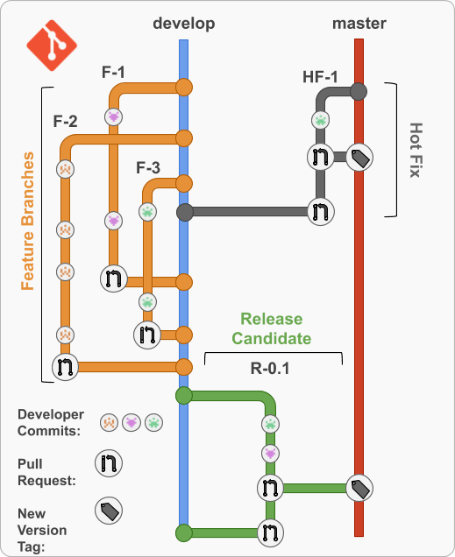
Git – Hotfixes
Hotfixes
Preventing hotfixes is one of the main reasons for designing a workflow such as the one here
Hotfixes should be prevented where possible, but this isn’t always possible
A hotfix can be conducted by creating a hotfix branch from the master branch and applying the changes on that branch
Before merging back into the master branch all the changes should, of course, be tested and reviewed to avoid even more hotfixes!

Slide 25
Activity: Practice with Git Branching
Directions:
Go to lab on GitHub
Complete the Branching module
Debrief:
Any comments/problems?

Slide 26
Git – Merge Conflicts
Not everything will go to plan at times…
As a project grows in the amount of developers and files, there’s every chance redundant work is done
If two people are working on the same file, we may run into merge conflicts
Git can typically figure out how to merge two files, but we can run into merge conflicts
If 2 developers have changed the same line in a file, this could bring up a merge conflict

Slide 27
Git merge Conflicts
Developer 1
package com.qa.tracker.constants;
public interface Constants {
static final String GET_TRAINER_BY_ID = "/getTrainer/{trainerId}";
static final String GET_ALL_TRAINERS = "/getAllTrainers";
static final String SAVE_TRAINER = "/saveTrainer";
static final String TRAINER = "/trainer";
static final String HOME = "/home";
static final String INDEX = "index";
}
Both developers have been working on this file at the same time - how does Git know which file is correct?
Simply speaking, it doesn’t as the same lines have been edited differently in the same file
Git cannot take a wild guess as to which is correct!
We will need to resolve the conflict ourselves by editing the file
Developer 2
package com.qa.tracker.constants;
public interface Constants {
static final String GET_TRAINER_BY_ID = "/getTrainer/{trainerId}";
static final String GET_ALL_TRAINERS = "/getTrainers";
static final String SAVE_TRAINER = "/saveTrainers";
static final String TRAINER = "/trainers";
static final String HOME = "/home";
static final String INDEX = "index";
}

Slide 28
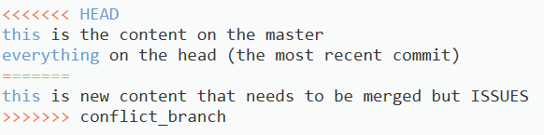
Git - Resolving a merge conflict
The easiest way to resolve a conflict is to directly edit the file in question
The HEAD (most recent commit) will have its content between HEAD and the content divider ( ==== )
Comparatively, the conflict in question will be between the content divider ( ==== ) and the branch name

Slide 29
Activity: Practice with Git Merge & Conflicts
Directions:
Go to lab on GitHub
Complete the Merging module
Debrief:
Any comments/problems?

Slide 30
Git – Ignoring Files
Git sees all files in your working repo as tracked, untracked or ignored
There are files that we don’t want pushed onto our repo
This could be logs, artefacts, system files, key files and more
To ensure these types of files aren’t committed and/or pushed to our repository, we use the .gitignore file
This file must be edited and configured by the user in the same way any text document would be
Works with verbose file names as well as with file globbing

Slide 31
GitHub - Reviewing
Reviews allow collaborators to:
comment on the changes proposed in pull requests
approve the changes
request further changes before the pull request is merged
Repository administrators can require that all pull requests are approved before being merged
Reviews allow for discussion of proposed changes and help ensure that the changes meet the repository's contributing guidelines and other quality standards
Reviews take place using the GitHub GUI

Slide 32
Activity: Practice Reviewing
Directions:
Go to lab on GitHub
Complete the Reviewing module
Debrief:
Any comments/problems?

Slide 33
Course Summary
We have learnt about Git and why it is a really useful tool for developers
We’ve looked at many aspects of Git, including staging, committing, pushing, pulling and branching
We’ve set up a GitHub account and pushed to it
We looked at a workflow design and discussed why these are necessary

Slide 34
Thank you for listening
Any Questions?

