Slide 1
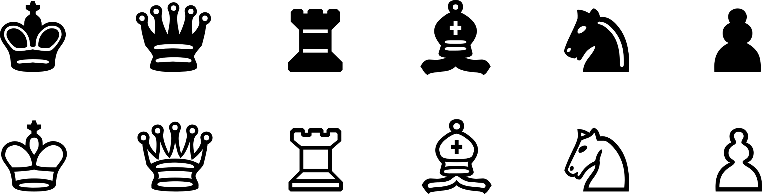
Chess Opening Website
Solo Project

Slide 2
The Brief
A Trello board
An application with a functioning front-end website and integrated APIs.
Automated tests for validation of the application.
Code fully integrated into a VCS which will subsequently be built through a CI server and deployed to a cloud-based virtual machine
Notes:
A Trello board with full expansion on user stories and tasks needed to complete the project. A relational database used to store data persistently for the project
An application created in the OOP language, that meets the requirements set on your Trello Board with a functioning front-end website and integrated APIs.
Automated tests for validation of the application. You must also meet 80% test coverage in your backend.
Code fully integrated into a Version Control System which will subsequently be built through a CI server and deployed to a cloud-based virtual machine

Slide 3
My Solution
Kanban Board: Trello
Databases: h2
Programming language: Java
Front-end: HTML, CSS and JavaScript
Unit Tests: JUnit and Mockito
Integration Tests: Selenium
Version Control: Git
CI Server: Jenkins
Cloud server: GCP

Slide 4
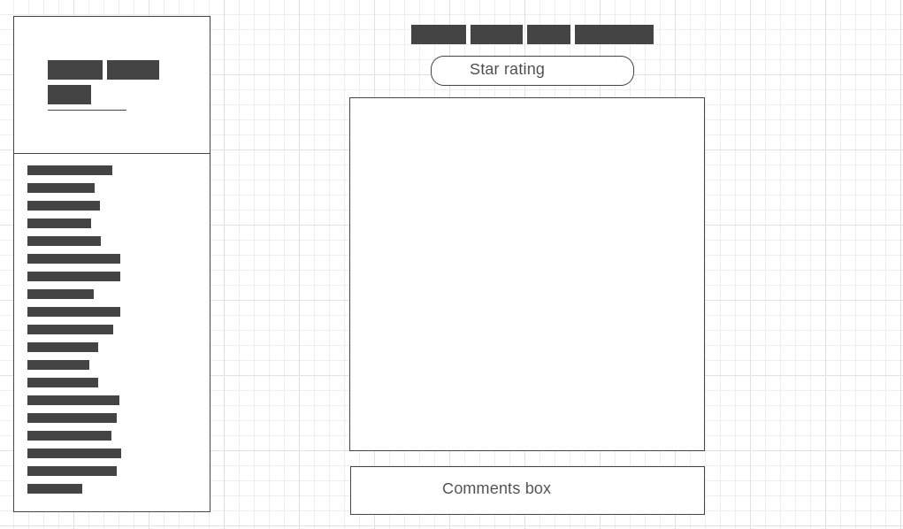
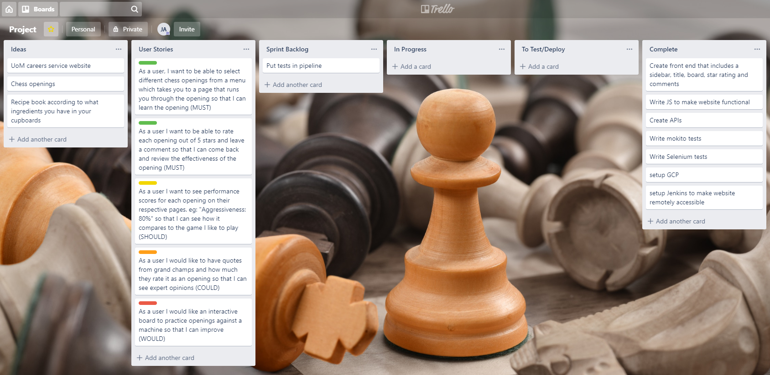
Trello and Wireframe

Slide 5
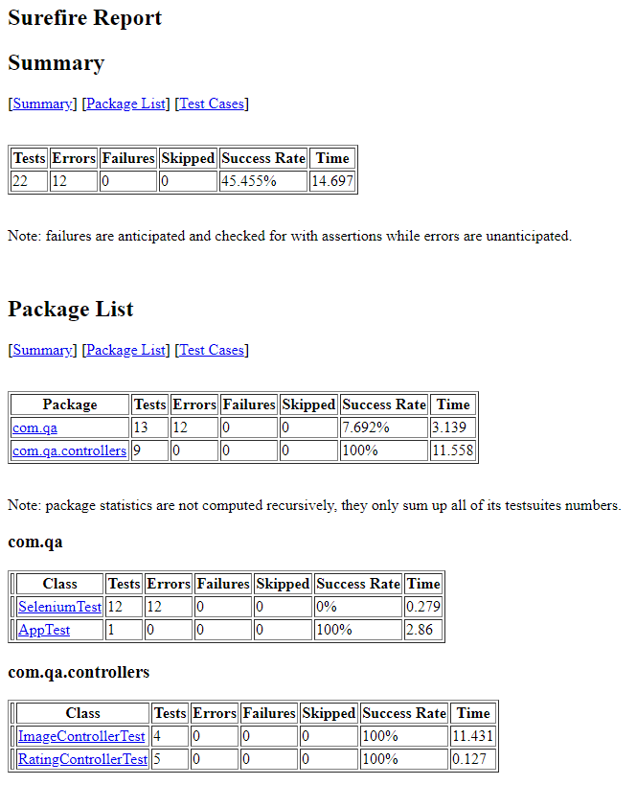

Testing: Unit

Slide 6
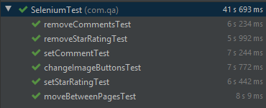
Testing: Selenium

Slide 7
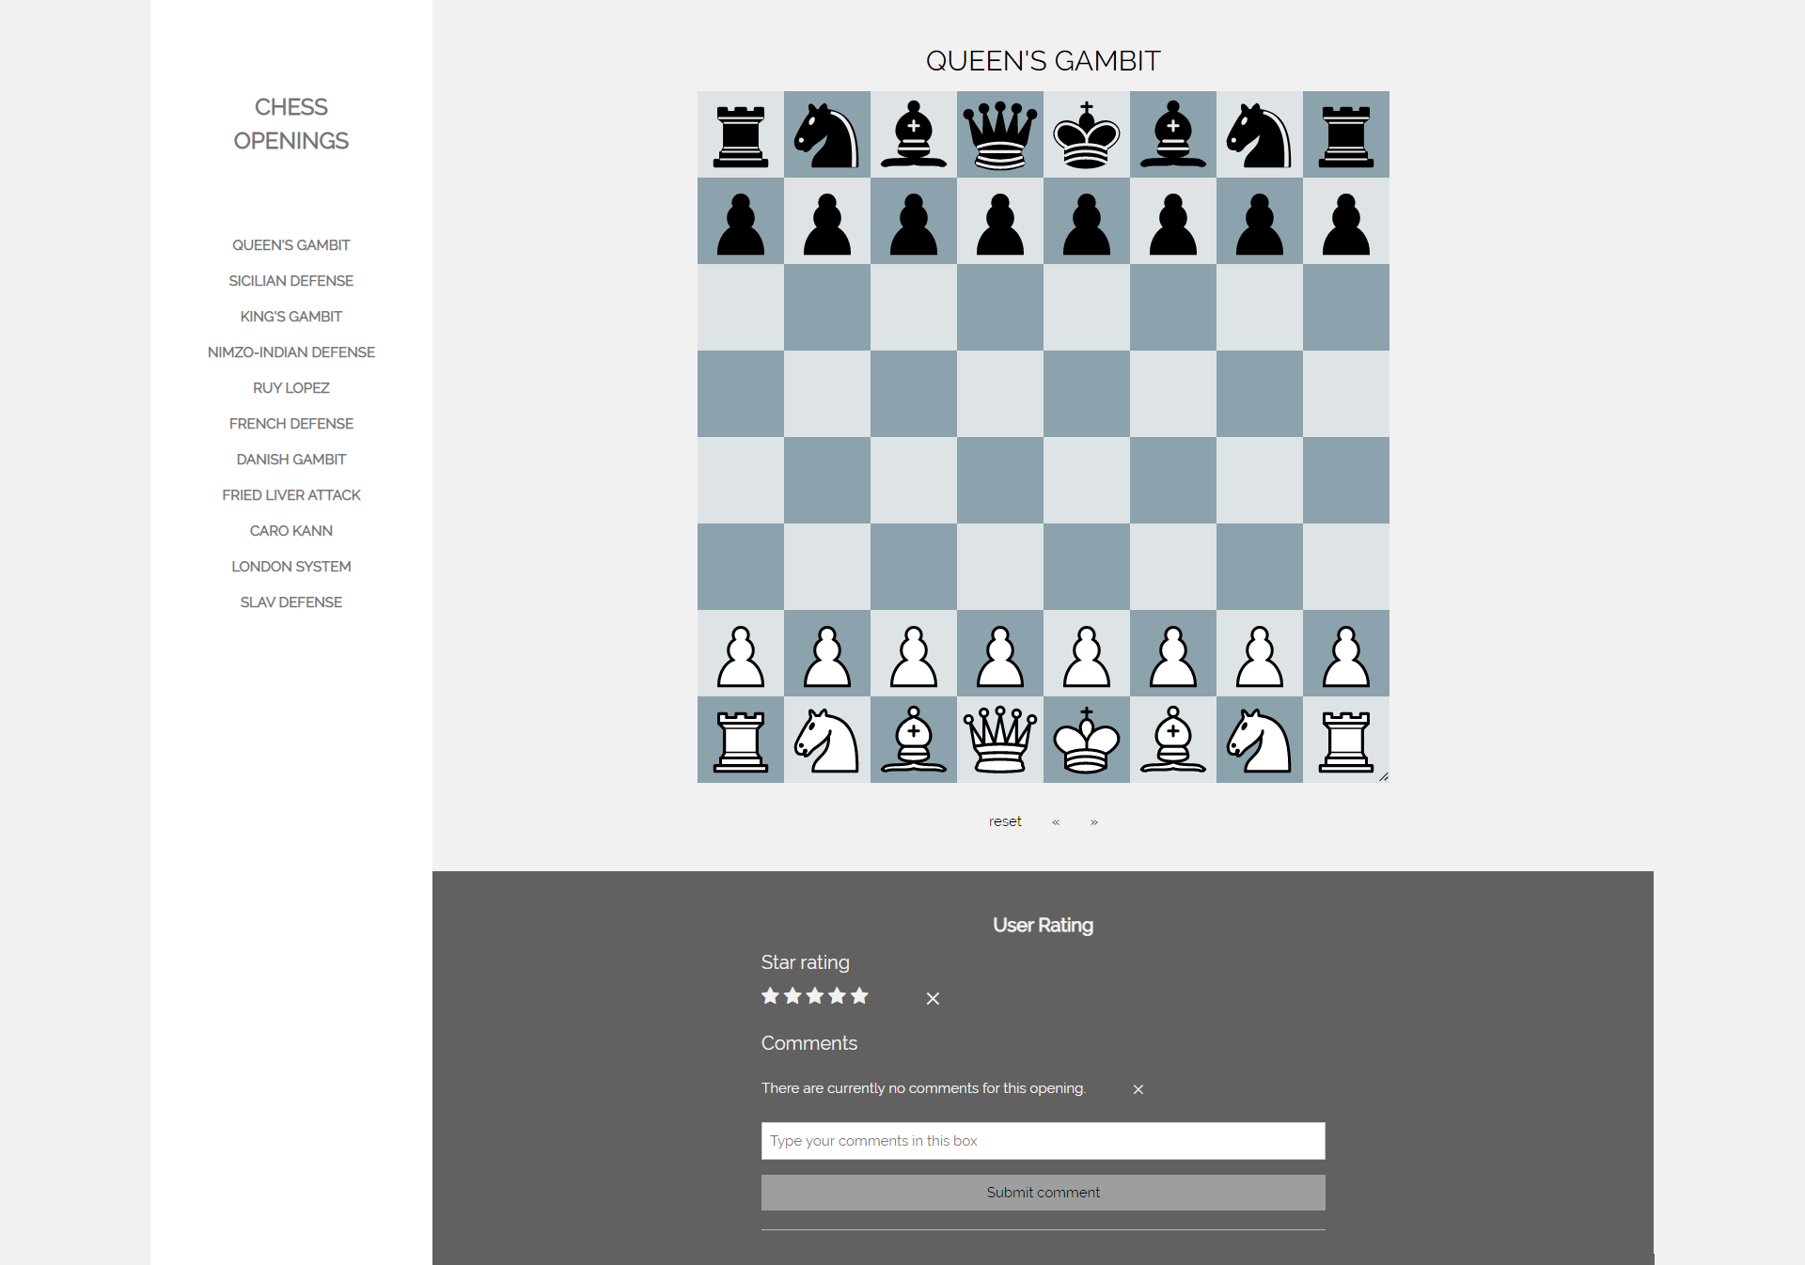
Front End

Slide 8
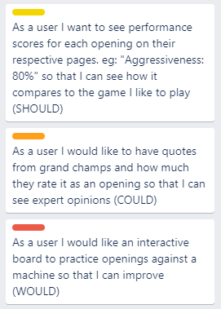

Future developments
Notes:
For this I refer back to my trello board

Slide 9
Summary
What went well
Fulfilled the brief
Test coverage
Evidence of CI
Improvements for the future
Take a more TDD approach
Provide a report for selenium tests

Slide 10

Questions

