Slide 1
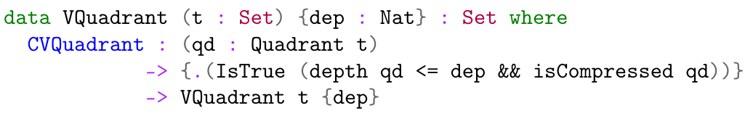
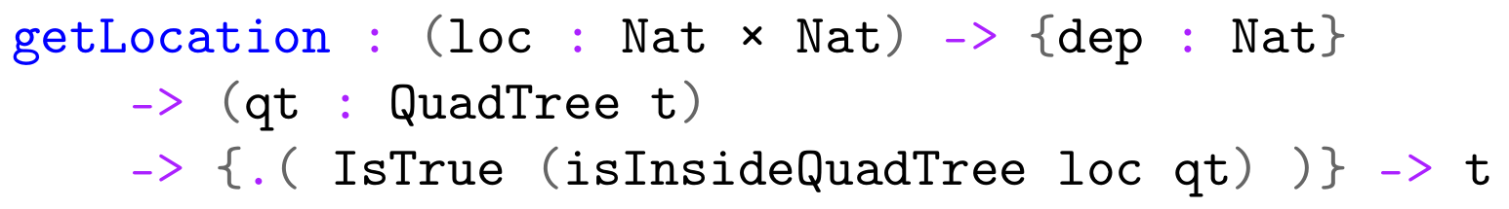
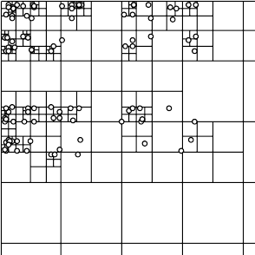
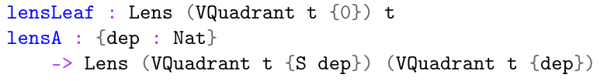
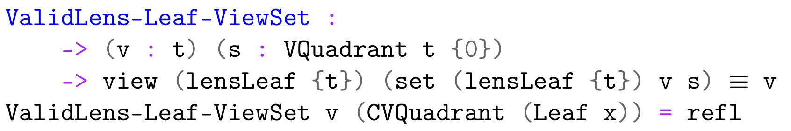
Practical Verification of QuadTrees
Jonathan Brouwer (jtbrouwer@student.tudelft.nl)
Delft University of Technology
1. Introduction
3. Invariants
QuadTree is a Haskell library. This paper aims to rewrite this in Agda, so it can be formally verified using Curry Howard. It can then be compiled back to Haskell using Agda2hs.
How do you prove invariants, preconditions, and postconditions in a way that works with Agda2hs?
Invariants are proven by adding the proof as an implicit constructor argument. To verify that a quadrant is compressed (no identical leafs) and has a certain depth, we can use:
2. QuadTrees
4. Preconditions
QuadTrees are used for storing two-dimensional information in a functional style.
They consist of a size and a root quadrant. Each quadrant is either a Leaf, or a Node consisting of 4 sub-quadrants.
The library makes use of lenses, which are composable functional references. So, `Lens a b` means that given an object `a`, we can view or modify an inner object `b`.
Preconditions are proven by adding the proofs as implicit arguments to the function. To verify that the location given to getLocation is in the QuadTree, one can use:
Alternatively, we can pass in a datatype with an invariant. This verifies that the input of lensLeaf is depth 0 and that the depth of the input of lensA is greater than 0.
5. Postconditions
Postconditions are proven as separate functions. For example, this is the proof that one of the lens laws holds for lensLeaf:

