Slide 1
Processes
Dr Alessio Magro

Slide 2
Some fundamental os Concepts
Thread
Single sequence of execution
Program Counter, Registers, Stack
Process
An instance of a program in execution (may have a single or multiple threads of execution)
Has its own address space
Address Space
Memory allocated to a specific process
Programs believe they have their own memory available to themselves
Translation: Translate a program’s memory from where it thinks it is, to where it actually is
Dual mode operation
Only kernel can access all resources (User applications need to be restricted)
Notes:
2

Slide 3


OS and Programs
Executable
Memory
Source
Instructions
Compiler
Loader
Data
Heap
main.c
a.out
(or main.exe)
Stack

Slide 4
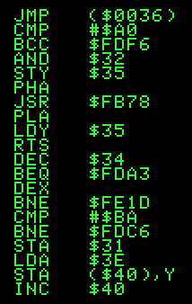
Key Architecture Concept
Processor
Memory
Fetch
Retrieves the next instruction and operands
Decode
- Figures out which operation it is
- Might retrieve values from registers
or memory
Execute
- Performs the operation
- Store result in registers
(or perhaps memory)

Slide 5
Thread of execution
Thread: a single unique execution context
Program Counter, Registers, Stack
A thread is executing on the processor when it is resident in the processor’s registers
Program Counter: contains the address of the current instruction being executed
Stack pointer: Pointer to the top of the stack for the current thread
Registers hold the root state of the thread
Other thread state can be stored in memory

Slide 6
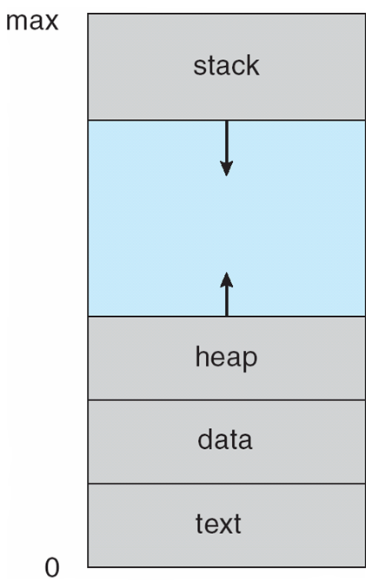
A Process’ Address Space
What is the address space?
Set of all accessible addresses (and associated state/value)
For a 32-bit architecture:
2³²: > 4 billion addresses
Actual address space made available to a process will be less

Slide 7
A Process’ Address Space
Text: Program code
Data: Global variables
Heap: Dynamically allocated memory
The Stack: Temporary Data:
Function parameters
Return addresses
Local variables

Slide 8
Concurrency
What is Parallelism?
They run at the same time
What is Concurrency
They could run at the same time
Focusing on concurrency
Helps to assume “things” are parallel to ensure they can operate concurrently

Slide 9
Some Terminology
‘Thread’ of execution:
Independent Fetch/Decode/Execute loop
Operating in some address space (could be shared with other threads)
Uni-programming: one thread at a time:
MS-DOS, early Macintosh, …
Multiprogramming/Multitasking
Appears to have more than one thread at a time

Slide 10
What happens during execution
Addr 0
Instr 0
Instr 1
Instr 2
…
Instr83
…
Instr237
Data0
Data1
…
CPU
Memory
R0
R1
…
R31
PC
SP
Fetch
Decode
Execute
Fetch Instruction at PC
Decode
Execute
Write results to registers/memory
Update PC
Repeat
Addr 2³² - 1

Slide 11
Processor state
Each process has its own processor state
State for Process1
State for Process2
State for Process3
PC: 0x1000
R1: 12
R2: 66
…..
R32: 95
SP: 0x2023
PC: 0x3000
R1: 56
R2: 34
…..
R32: 95
SP: 0x4175
PC: 0x5000
R1: 96
R2: 55
…..
R32: 78
SP: 0x6690
Illusion that there are multiple processors

Slide 12
The illusion
CPU1
CPU2
CPUN
…
Shared Memory
Assuming a single processor, how can we provide illusion of multiple ‘virtual’ processors?

Slide 13
The illusion
Multiplex in time
CPU1
CPU2
CPUN
…
Shared Memory
Each ‘virtual CPU’ or thread, needs a structure to hold:
Program Counter (PC)
Stack Pointer (SP)
Registers
How to switch from one thread to the next?
Save PC, SP and registers of active thread
Load PC, SP and registers of new thread
What triggers the switch?
- Timer, voluntary yield (cooperative threading), I/O, interrupt

Slide 14
Basic problem of concurrency
Single CPU, Memory and set of devices
Users and applications think they have exclusive access to resources
Actually shared
Give illusion that multiple processes/threads are running at the same time
OS needs to coordinate access to resources whilst avoiding chaos

Slide 15
We can now multiplex CPU in time
Now we can share CPU amongst different processes in time…
But processes still share all resources (given the techniques we’ve covered)
Processes share non-CPU resources
Memory
I/O devices
Consequence of sharing: Each thread can access other’s data and instructions
This unprotected mode common in:
Some embedded OS/applications (that have multiple threads)
Early Windows and Macs (cooperative threading)

Slide 16
process
Process: A program in execution that:
Has one or more threads of execution
Has its own address space
Why own address space?
Each process is protected from other processes
OS is protected from them
The Process abstraction introduces memory protection
(threads are more efficient than processes… we’ll see later)

Slide 17
How to protect processes
Need to protect access to:
Memory
Processes should only access their own memory address space
I/O Devices
Processes should only access devices they have acquired
Processor
Processes should not be able to hog the processor
Use of timer, which cannot be disabled from user level

Slide 18
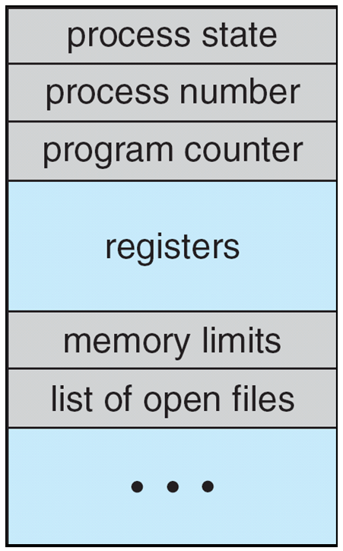
How to keep track of processes
Current state of a process in the Process Control Block (PCB):
Snapshot of the execution and protection environment
Only one PCB active at a time
Give out the CPU to difference processes (Scheduling)
Give resources to different processes:
Protection
Controlling access to non-CPU resources

Slide 19
scheduler
if isAProcessReadyToRun {
nextProcess = selectNextProcess();
run( nextProcess );
} else {
run_idle_process();
}

Slide 20
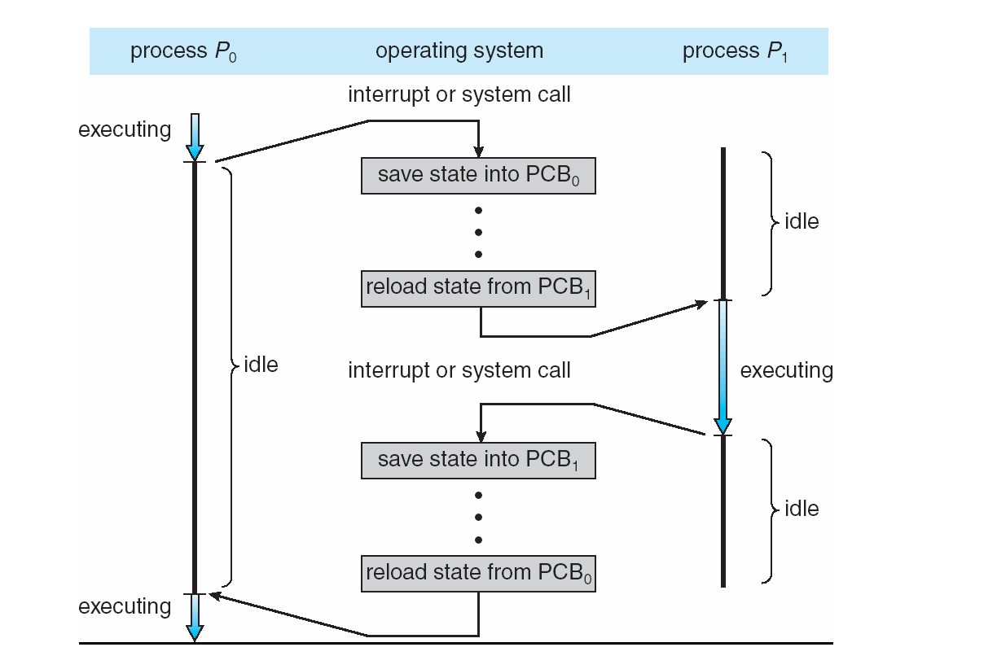
Switching from process to process
Context Switch

Slide 21
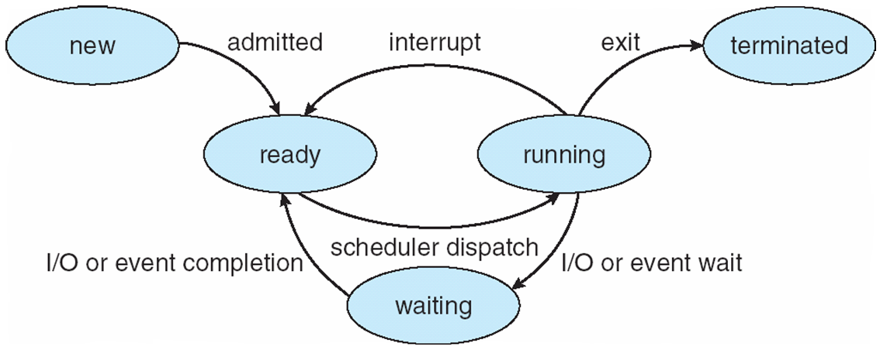
Process state
As a process executes it changes state:
A process may use more I/O than you think (file system etc…)

Slide 22
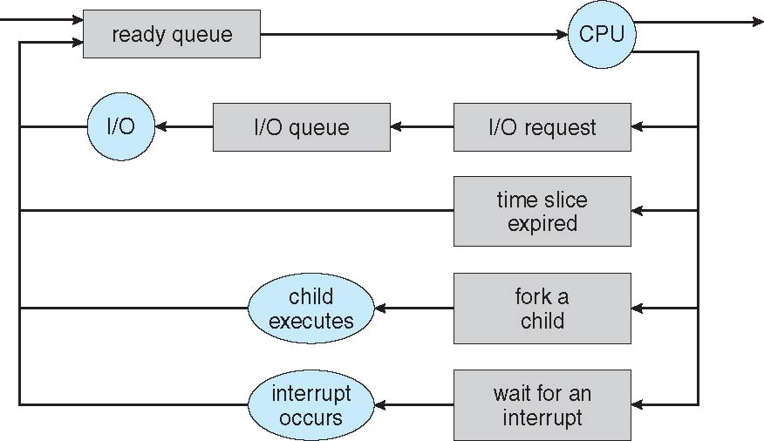
Process scheduling

Slide 23
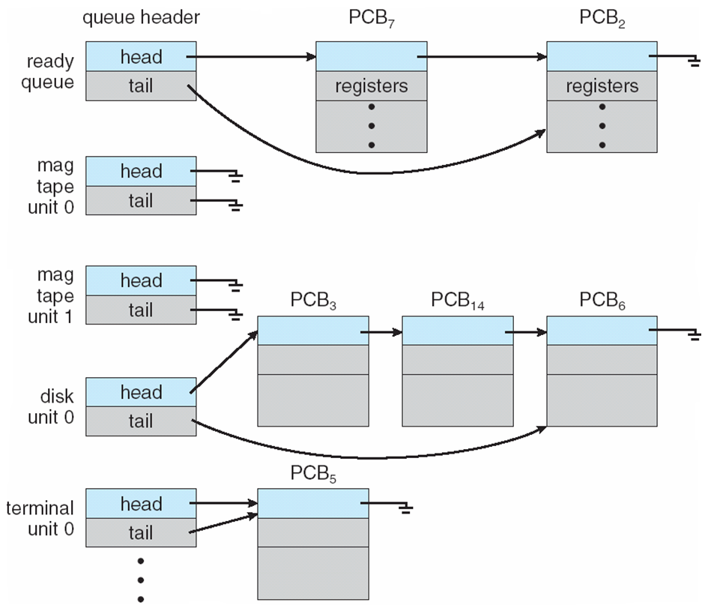
Ready and Device Queues

Slide 24
I/O and CPU Bound
Processes can be described as:
I/O bound: spends more time doing I/O
Many short CPU bursts
CPU bound: spends more time doing computation
Few very long CPU bursts

Slide 25
How to create a process
Make a PCB
Assign an address space
Copy data from parent process?
Unix fork(): child process gets copy of parent process’ memory
Linux’s vfork(): does not copy parent’s memory

Slide 26
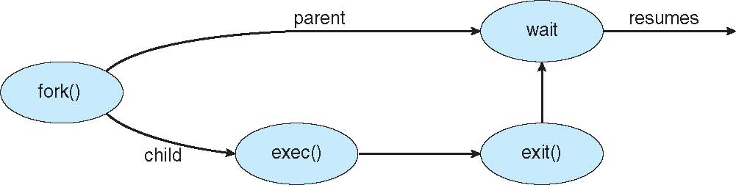
Process creation

Slide 27
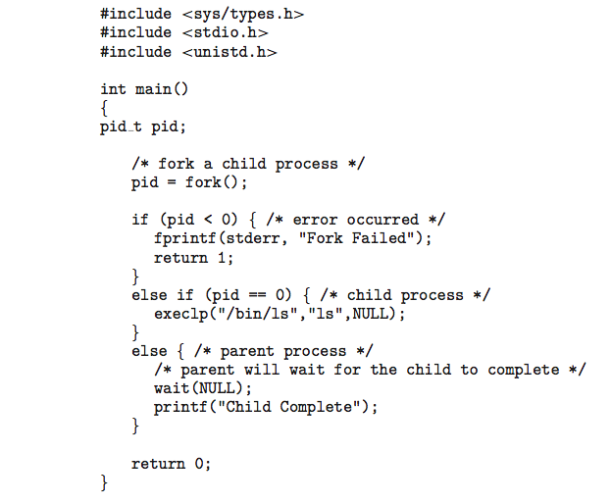
Process creation

Slide 28
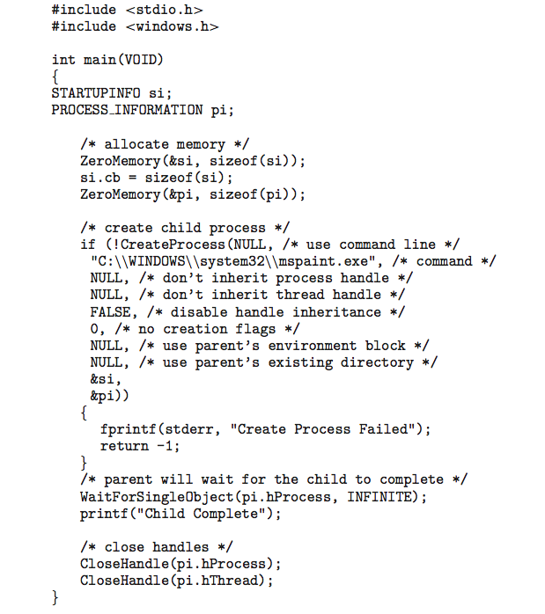
Process creation

Slide 29
Process creation

Slide 30
Process termination
A process should as their last statement:
Invoke the exit() system call
A status value can be passed back to the parent
Resources acquired will be deallocated
Parent can also terminate a child process using the abort() system call
Some OSes do not allow child processes to exist without parents
Cascading termination: all children, grandchildren etc… are terminated (by OS)
A parent process can wait for a child process to terminate using the wait() system call

Slide 31

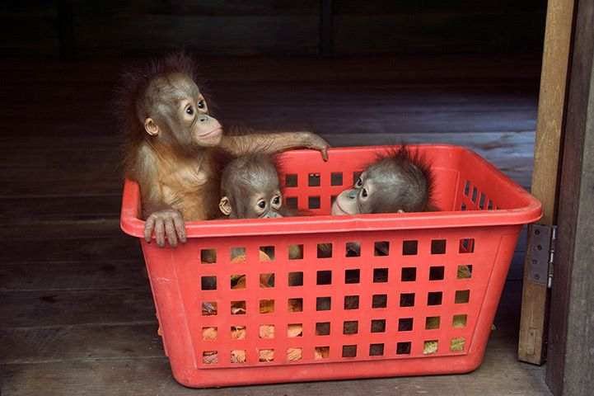
Process termination
Zombie: a child process that terminated but still exists in the process list:
Needed so that parent process can read the child’s exit status
Once the exit status is read the Zombie is removed
Orphan: parent process terminates without calling wait
Orphan is then adopted by the init process

Slide 32
Process == Program?
main ()
{
call func();
}
func()
{
… }
main ()
{
call func();
}
func()
{
… }
Heap
Stack
func
main
Program
Process

Slide 33
Collaborative processes
Process 1
Process 2
Process 3
If a program has multiple processes in it
Processes need to communicate with each other
If collaborative: requires synchronisation
Each process has a different memory address space
Shared memory functionality via OS services
Message passing

Slide 34
Inter-process communication (IPC)
Cooperative processes
Can affect or be affected by other processes
Cooperation requires IPC

Slide 35
SHARED MEMORY
Data 2
Code
Code
Stack 1
Data
Data
Heap 1
Heap
Heap
Code 1
Stack
Stack
Stack 2
Shared
Shared
Data 1
Process 1
Virtual Address
Space
Process 2
Virtual Address
Space
Heap 2
Code 2
Shared
Memory
Communication by standard reading/writing to memory
Low overhead
Requires synchronisation code

Slide 36
MULTI-PROCESS ARCHITECTURE
Many web browsers used a single process for different browsing tabs
If one site causes problems, all tabs could hang or crash
Chrome and other browsers now use multiple processes, one for each tab (among other processes)

Slide 37
Process with threads
A single process: single address space
Thread: A sequential execution stream within a process
No protection between threads
Multithreading: a single process made up of a number of different threads
Sharing the same address space

Slide 38
Context switch
When CPU is switched to another process:
State of old process saved: state save
State of new processes loaded: state restore
State of a process is in the PCB
Context switch time is overhead

Slide 39
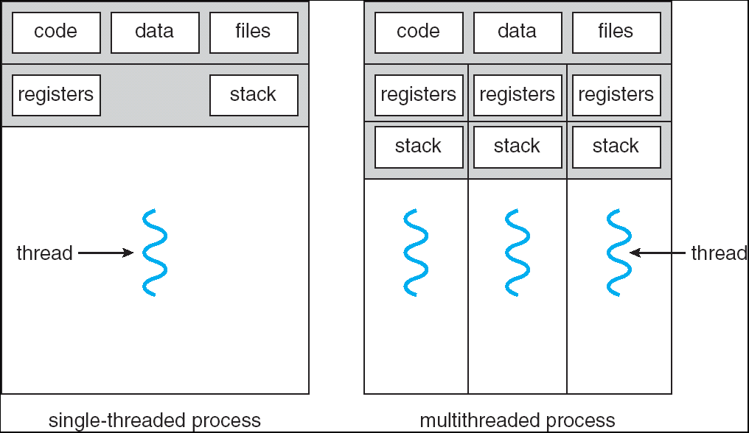
Single vs Multithreaded process

Slide 40
Thread state
State shared by all threads in a process:
Contents of memory (global variables, heap)
I/O state (file system, network connections, …)
State “private” to this thread
Thread Control Block (PC, SP, Registers…)

Slide 41
classification
Address Space Threads of Execution | One | Many
One | MS/DOS, Early Macintosh | Traditional UNIX
Many | Embedded Systems | Mach, OS X, Windows NT+, Linux

Slide 42
Producer consumer problem
Popular problem for cooperating processes
Producer: produces information
Consumer: consumer the information
Shared memory often used for this

Slide 43
buffers
Unbounded buffer
“No” limit on size of buffer
Consumer: has to wait for new items
Producer: never waits
Bounded buffer:
Has a fixed size
Consumer: has to wait for new items
Producer: has to wait when buffer is full

Slide 44
buffer
Producer adds ‘a’
Producer adds ‘b’
Producer adds ‘c’
Producer adds ‘d’
Consumer take an item
Consumer take an item
Consumer take an item
Consumer take an item
Buffer
a
b
c
d

Slide 45
Keeping track of a buffer
Producer adds ‘a’
Producer adds ‘b’
Producer adds ‘c’
Producer adds ‘d’
Consumer take an item
Consumer take an item
Consumer take an item
Consumer take an item
Buffer
a
b
c
d
0
1
2
3
4
Now what?
in
out

Slide 46
Circular buffer
Producer adds ‘a’
Producer adds ‘b’
Producer adds ‘c’
Producer adds ‘d’
Consumer take an item
Consumer take an item
Consumer take an item
Consumer take an item
Producer adds ‘e’
Producer adds ‘f’
Producer adds ‘g’
Producer adds ‘h’
Buffer
a
b
c
d
0
1
2
3
4
in
out

Slide 47
Circular buffer
Producer adds ‘a’
Producer adds ‘b’
Producer adds ‘c’
Producer adds ‘d’
Consumer take an item
Consumer take an item
Consumer take an item
Consumer take an item
Producer adds ‘e’
Producer adds ‘f’
Producer adds ‘g’
Producer adds ‘h’
Buffer
f
g
h
e
0
1
2
3
4
in
out

Slide 48
Example
Producer-Consumer with a Bounded-Buffer in Shared Memory
#define BUFFER_SIZE 10
char buffer[BUFFER_SIZE];
int in = 0;
int out = 0;
In shared memory
The Producer:
char nextProduced;
while(true) {
nextProduced = <some new char>;
while( ((in+1) % BUFFER_SIZE) == out);
buffer[in] = nextProduced;
in = (in+1) % BUFFER_SIZE;
}

Slide 49
Example
Producer-Consumer with a Bounded-Buffer in Shared Memory
#define BUFFER_SIZE 10
char buffer[BUFFER_SIZE];
int in = 0;
int out = 0;
In shared memory
The Consumer:
char nextConsumed;
while(true) {
while( in == out );
nextConsumed = buffer[out];
out = (out + 1) % BUFFER_SIZE;
OutputToScreen( nextConsumed );
}

Slide 50
Message Passing
Useful for passing smaller amounts of data than shared memory
Each message passed requires system calls
Two main operations:
Send (message)
Receive (message)
When two processes require to communicate, they need to:
Establish a link
Exchange message via send/receive

Slide 51
blocking
SendMessage (in this example) is non-blocking, it does not wait for the operation to finish
void SendAndWaitB()
{
SendMessage();
bool sent = false;
while(!sent) {
sent = IsMessageSent();
}
}
void SendAndWaitA()
{
SendMessage();
WaitTillMessageSent();
}
Blocking call
Busy waiting / spinning
SendAndWaitA and SendAndWaitB are blocking functions

Slide 52
Message Passing Blocking?
Blocking send
Sending process is blocked until message is received by receiving process or mailbox
Non-blocking send
Sends message and continues operation
Block receive
Receive blocks until a message is available
Non-blocking receive
Receive retrieves either a valid message or a null

