Slide 1
Version Control Systems
Mark Micallef
mark.micallef@um.edu.mt
JOSEPH MASINI
joseph.M.masini@gmail.com

Slide 2



Motivation
Product
v2
Buy
Buy
Buy
Change
Bug Report
Create
Buy
Create
Product
v1
?????
Change
Create
Product
V1.1
Buy

Slide 3
Motivation
File Server
?????

Slide 4
Motivation
Calculator.java
Who made Change 4? Why? How?
Change 2
Change 4
Change 1
Change 3
Change 5

Slide 5
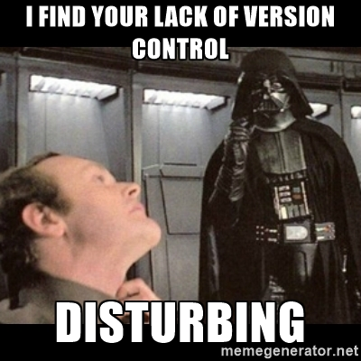

Slide 6
The Problem
Things go wrong
Deleted code
Overwritten code
How can we recover from such situations?
Developers work in teams
They work on the same codebase
How can they work on the same files without conflicting with each other?
How can we know what has changed in a source file and who changed it?
Customers require customisation
Multiple customer can buy the same product
They later require customisations
How can developers manage multiple versions of the same product?

Slide 7
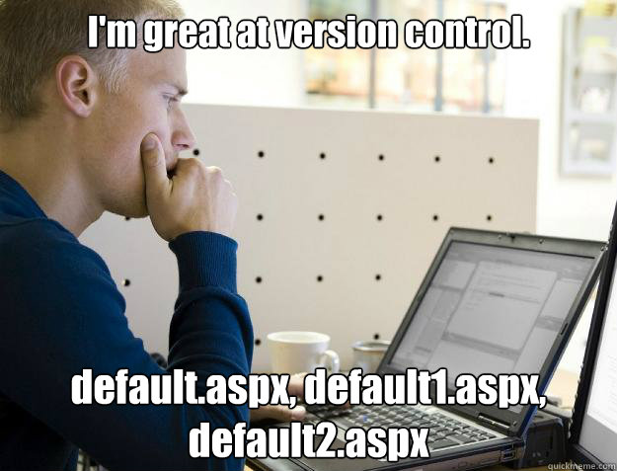
Your already do VC
This is a rudimentary form of version control
Sophisticated tools exist: Version Control Systems

Slide 8
Version Control Systems (VCS)
Many exist
CVS
Subversion (SVN)
Perforce
Git
Mercurial
…
Concepts are similar in all tools
In this course, we will use git for practical work

Slide 9
Uses of a VCS
Backup and restore source code
Synchronisation
Short-term undo
Long-term undo
Track changes
Track ownership
Branching and merging

Slide 10
Terminology
Repository – The database which stores files
Server – The computer that hosts the repository
Client – The computer that connects to the repository
Working set – Your local version of files.
Master – The primary location for code in the repository. This is explained later on.

Slide 11
Basic Actions
Add – Add new files to the repository for versioning
Revision – Check the version of a particular file
Head – The latest version of a file
Clone– Download a file from the repository
Commit – Commit a file to the working copy. File gets a new revision number.
Commit message – A message describing the change being committed
Push – Upload a number of commits to the repository.
Pull – Synchronise your file with the latest version on the repository.
Revert – Discard your local changes and get the latest version from the repository
Changelog / History – See the history of changes for a particular file

Slide 12


Slide 13
INIT / CLONE
Master file (on repo)
Working copy/set
v1
git init
v1
Clone
v1
Master
git clone https://host.com/user/my-project.git

Slide 14
Basic Commit + Push
diffs
+Milk
+Eggs
+Juice
-Juice
README.md
+Soup
Master
Milk
Milk
Eggs
Milk
Eggs
Juice
Milk
Eggs
Soup
v1
v2
v3
v4
echo README > README.md
git add README.md
git commit // don’t forget to save the message
git push

Slide 15
Clone, Revert, Commit + Push
Master
Milk
Eggs
Juice
Milk
Eggs
Soup
Clone
Milk
Eggs
Fish
Milk
Eggs
Juice
Milk
Eggs
Soup
Push
Milk
Eggs
Juice
Revert

Slide 16
Clone, Revert, Commit + Push
echo README > README.md
git add README.md
git commit
git revert [commit] // will revert the specified commit
echo README > README.mdx
git add README.mdx
git commit
======================================================================
echo README > README.md
git add README.md
git commit
git reset [mode] [commit] // reset the branch HEAD to that // specified commit

Slide 17


Conflict Resolution
Milk
Sugar
Milk
Coffee
Sugar
Peter
Clone
Commit + Push
Master
Milk
Sugar
Milk
Coffee
Sugar
Milk
Coffee
Sugar
Tea
CONFLICTED
Resolve Conflict
Commit + Push
Clone
Commit + Pull
Milk
Sugar
Milk
Sugar
Tea
Milk
Coffee
Sugar
Tea
Jane

Slide 18
Tagging
Master
Soup
Lasagne
Turkey
Xmas Pie
Soup
Lasagne
Beef
Trout
Icecream
Garlic Bread
Penne
Beef
Custard
menu.txt
v1
v56
v113
Tag: xmas_lunch_2012
Tag: easter_lunch_2013
Tag: cassar_wedding_menu
git tag thistag
echo test >> test.txt
git add test.txt
git commit
git checkout thistag // checks out the branch at the specific tag

Slide 19
The Source Tree
IOS 5
Released
IOS 4
Angry Birds
Master
Branching: Creates a copy of a code into a ‘branch’ for separate editing.
Merging: Migrating (merging) changes from one branch into another branch.
IOS 6
Released
IOS 5
iPad 3
Released
iPad 3 Optimisations
git branch ios4
git checkout ios4
... // do some changes and commit them
git checkout master
git merge ios4 // might need to resolve conflicts

Slide 20


Slide 21
Exercises (Setup)
Exercise setup to be completed on your own machine:
1. Clone the repository at
https://github.com/josephmasini/softwareengineering
2. Project structure in folder softwareeningeering is composed of:
src/main/java/PatternRepeater.java – Class we are testing.
src/test/java/PatternRepeaterTest.java – Test class.
pom.xml – (Maven) package management configuration
3. Check that everything runs well by opening a command line window in softwareeningeering and running the command:
mvn clean install
4. For simplicity, you are going to be working on your own machine, editing the project you just downloaded – no pushes are necessary for the time being.

Slide 22
Exercises
Task at hand is to create – drum roll - an array sorter!
The array sorter should have two features (methods), one to sort an array of integers, and the other to sort an array of strings (by the first character).
Tips:
Use TDD to first write tests to verify your behavior, then write the actual logic!
Code one feature at a time:
Create a new branch for each feature
One finished, merge back to master

Slide 23
For more information
1. Typing git in your console should bring up the commands available.
2. Typing git [command] --help will get you the help for that command.
Ex. git branch --help
3. And my latest tip…

Slide 24

… but until that day
Google is your friend!
So Google any questions away!

