Slide 1
Code Learning Lab: SMART® Authorization
Matt Randall
Principal Architect
July 25-26, 2017
Notes:
© Cerner 2017

Slide 2
Introduction
This is an overview of Cerner’s authorization guide to help you get started. The full authorization guide, along with further security background information, may be found at:
http://fhir.cerner.com/authorization/

Slide 3
SMART® on FHIR® Recap

Slide 4
Introduction
SMART® provides:
A framework to launch client applications from either an EHR or a patient portal workflow.
A framework to let client applications obtain access to FHIR resources on behalf of the user.
A framework to share the user’s context in the EHR or patient portal.
Notes:
SMART defines a security and integration framework for applications, whereas FHIR defines API resources for an EHR.

Slide 5
Introduction
How does it accomplish this?
Extends OAuth2 Framework (IETF RFC 6749)
Utilizes OpenID Connect identity tokens for conveying user identity.
Defines additional extensions and mechanisms outside of the core OAuth 2 framework to handle healthcare use cases.
Notes:
The OAuth2 framework was made popular by service providers such as Google, Twitter, and Facebook and has further been adopted by other SaaS providers such as SalesForce, Microsoft, and Oracle for enabling third-party applications to participate in “app ecosystems”.
OpenID Connect is an authentication framework built on top of OAuth 2, and is considered by some in the software industry as a successor to SAML.

Slide 6
Why utilize the OAuth 2 framework?

Slide 7
Introduction
Reason: It abstracts authentication away from client applications.
Benefit: Organizations can choose any mechanism(s) of authentication that are appropriate for its user population without affecting apps.
Benefit: Users can have an “single sign-on” experience, and don’t have to update apps if they change their credentials.

Slide 8
Introduction
Benefit: Apps aren’t directly handling user credentials; this is beneficial to all parties from a security perspective.
Benefit: As a framework based on trust-exchange, the EHR does not have to extend the entirety of authorization rights of a given user to your app – only those needed to function.
This, in turn, can lower risk to organizations, patients, and your application.
Notes:
Your app doesn’t have to manage credentials, the user doesn’t have to deal with issues associated with putting their credentials in individual apps, and there’s less opportunity for risk of credentials being leaked.

Slide 9
Introduction
Reason: As a security framework, OAuth has a tremendous amount of investment from the security community.
Benefit: The SMART® on FHIR® ecosystem can benefit from further security research and improvements being added to OAuth in the future.
Benefit: Tools, education, articles, etc., covering the OAuth framework are commonly available.
Notes:
Your app doesn’t have to manage credentials, the user doesn’t have to deal with issues associated with putting their credentials in individual apps, and there’s less opportunity for risk of credentials being leaked.

Slide 10
Overview: Working with the OAuth 2 Framework
Notes:
To understand SMART on FHIR, you’ll need a base understanding of how the OAuth 2 framework functions. The following is a high-level overview of how systems based on OAuth 2 function, and how app developers generally interact with them. These steps aren’t specific to Cerner, and aren’t even necessarily specific to SMART.

Slide 11
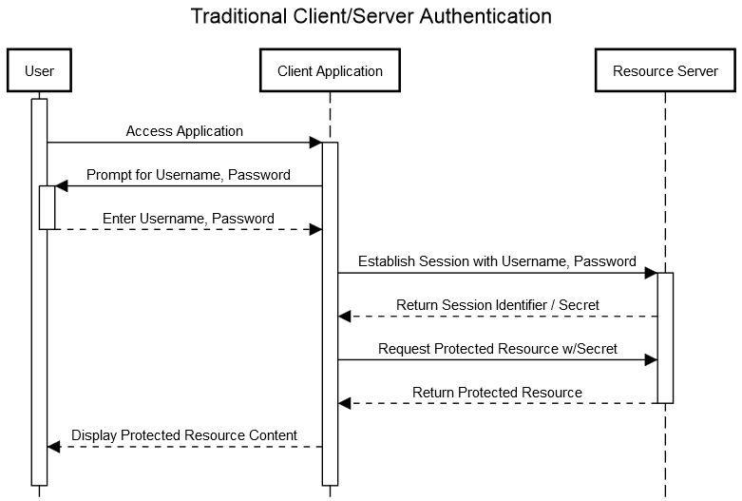
Notes:
In traditional authentication schemes, the user supplies a username and password to their client application. This application, in turn, supplies it to the server as proof of the user’s identity; in turn, the server issues a time-bound secret (a user’s “session”) such that it does not have to continue to re-verify credentials. In some architectures, the “secret” is effectively those used in the underlying communication protocol (the connection itself is proof), in web applications, a cookie is traditionally sent to track a user’s session.
Presenter Note:
UML Content
title Traditional Client/Server Authentication
participant User
participant Client Application
participant Resource Server
activate User
User->Client Application: Access Application
activate Client Application
Client Application->User: Prompt for Username, Password
activate User
User-->Client Application: Enter Username, Password
deactivate User
Client Application->Resource Server: Establish Session with Username, Password
activate Resource Server
Resource Server-->Client Application: Return Session Identifier / Secret
Client Application->Resource Server: Request Protected Resource w/Secret
Resource Server-->Client Application: Return Protected Resource
deactivate Resource Server
Client Application-->User: Display Protected Resource Content

Slide 12
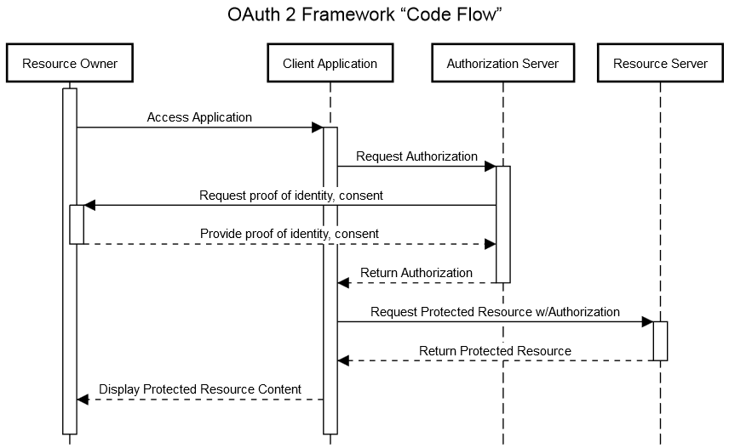
Notes:
The OAuth 2 framework adds an additional actor (Authorization Server); interactions involving authentication and consent are brokered directly between it and the user (referred to in OAuth 2 as the “resource owner”).
In this manner, neither the client application or services need to be aware of how the user is authenticated.
title OAuth 2 Framework “Code Flow”
participant Resource Owner
participant Client Application
participant Authorization Server
participant Resource Server
activate Resource Owner
Resource Owner->Client Application: Access Application
activate Client Application
Client Application->Authorization Server: Request Authorization
activate Authorization Server
Authorization Server->Resource Owner: Request proof of identity, consent
activate Resource Owner
Resource Owner-->Authorization Server: Provide proof of identity, consent
deactivate Resource Owner
Authorization Server-->Client Application: Return Authorization
deactivate Authorization Server
Client Application->Resource Server: Request Protected Resource w/Authorization
activate Resource Server
Resource Server-->Client Application: Return Protected Resource
deactivate Resource Server
Client Application-->Resource Owner: Display Protected Resource Content

Slide 13
What does my application need to get started?

Slide 14
Getting Started
client identifier: A unique* identifier, assigned to your client application.
authorization endpoint: Used to interact with the resource owner and obtain an authorization grant. The authorization server MUST first verify the identity of the resource owner.
token endpoint: Used by the client to obtain an access token by presenting its authorization grant or refresh token.
Notes:
As part of the registration process with the service provider, you’ll receive a client identifier.
*it is unique within context of the service provider you’ve registered with.
The authorization endpoint is the URI in which authorization grant request protocol messages are sent in the authorization code flow. This interaction is also what allows the authorization server to authenticate the end user (or determine the user’s identity based on an existing session.)

Slide 15
Getting Started
redirection endpoint: A URI to which the authorization server will send the user-agent back once access is granted (or denied).
scope: The extent of access being requested by an application during grant and token requests.
client credentials: secret material “used for authenticating with the authorization server (e.g., password, public/private key pair).” (optional based on workflow)
Notes:
Also known as “redirection URI”. Used in the “authorization grant” flow, authorization grant response protocol messages are sent via a URI, which for security purposes, must be registered with the service provider.
You also need to know what scope your application needs to function. Scopes are defined by the service provider; in the case of SMART on FHIR, the specification defines a standard set of scopes that your application can request, which will be covered in this presentation.

Slide 16
“Authorization Code” Flow
+----------+
| Resource |
| Owner |
| |
+----------+
^
|
(B)
+----|-----+ Client Identifier +---------------+
| -+----(A)-- & Redirection URI ---->| |
| User- | | Authorization |
| Agent -+----(B)-- User authenticates --->| Server |
| | | |
| -+----(C)-- Authorization Code ---<| |
+-|----|---+ +---------------+
| | ^ v
(A) (C) | |
| | | |
^ v | |
+---------+ | |
| |>---(D)-- Authorization Code ---------' |
| Client | & Redirection URI |
| | |
| |<---(E)----- Access Token -------------------'
+---------+ (w/ Optional Refresh Token)
Notes:
This diagram, from the OAuth 2 framework specification, depicts the specifics of how authorization is delivered to the client application.
https://tools.ietf.org/html/rfc6749#section-4.1
Essentially, protocol interactions are driven via invocation of URIs, and such URIs may be hypertext (https) URLs, or locally-registered schemes (to allow for interaction between native apps). The client application invokes an authorization request via opening a URI in the user agent, and receives responses at its “Redirection URI” after user interaction at the authorization server completes. The “authorization grant” (authorization code) is then exchanged via back-channels between the client and authorization server.

Slide 17
Lab 1: Authorization Code Flow
These labs use Cerner’s “Authorization Demo”. This web site allows developers to experiment with SMART® on FHIR® authorization servers and see the OAuth protocol interactions in action.
http://bit.ly/2uV5OlQ

Slide 18
Authorization Code Flow Recap

Slide 19
Authorization Code Flow Recap
Steps:
Construct the authorization request URL.
Open the URL in an appropriate user-agent.
Parse and validate the grant response.
Request a token using the code from the grant response.
Parse the token response.
Utilize the token to access a protected resource.

Slide 20
Authorization Code Flow Recap
The authorization grant requests and responses are passed using an x-www-form-urlencoded query string, appended to the authorization endpoint and redirection URIs, respectively.

Slide 21
Authorization Code Flow Recap
Query parameters in the authorization request:
client_id: The identifier of your client application.
state: The “state” parameter, sent by your application, used to verify that the code did not originate from another device (cross-site attacks.)
scope: The space-delimited scopes your application is requesting.
aud: The base FHIR URL
grant_type: constant value of “authorization_code”

Slide 22
Authorization Code Flow Recap
Query parameters returned in the grant response:
code: A one-time use code that may be exchanged by your application for an access token.
state: The “state” parameter, sent by your application, used to verify that the code did not originate from another device (cross-site attacks.)

Slide 23
Authorization Code Flow Recap
Other parameters may appear in the case of an error:
error: An OAuth2 error code, indicating why the grant request was rejected.
error_uri: A URI to be displayed to the user as a link, providing the user (or developer or support personnel) with more information as to why the request failed.

Slide 24
Authorization Code Flow Recap
Validate the state parameter matches the value originally chosen when the request was initiated. If the value does not match, or you receive a grant code unexpectedly, this could be an attempted “cross-site request forgery” or a “session-fixation”-style attack.

Slide 25
Authorization Code Flow Recap
Token requests are encoded as an x-www-form-urlencoded string, sent via HTTP POST to the “token” URL.
grant_type: constant value of “authorization_code”.
client_id: the client identifier of your app.
code: the code received in the authorization grant response.

Slide 26
Authorization Code Flow Recap
Token responses are encoded as application/json, and contain the following name/values:
access_token: A “bearer” token that is used to access FHIR® services.
scope: The list of scopes that were approved by the authorization server and/or end user.
expires_in: The duration (in seconds) that the token will last.

Slide 27
Authorization Code Flow Recap
A single token generally does not last more than 10 minutes; if longer access is required, you will need a “refresh token”, obtained via the scope of “online_access” or “offline_access”
(more information later in this presentation.)

Slide 28
Authorization Code Flow Recap
Error responses may also be returned, with the following values present in the JSON response:
error: An OAuth2 error code, useful for troubleshooting.
error_uri: Similar to the error_uri in the authorization grant response, a value to link to the user for further assistance, and useful for developers and support personnel for troubleshooting.

Slide 29
Authorization Code Flow Recap
Add an authorization header to your HTTP requests, including the access_token value as a “Bearer” token:

Slide 30
Authorization Code Flow Recap
If the token is invalid, or otherwise not authorized for the resource/method being invoked, you will receive a corresponding 401/403 response with a “WWW-Authenticate” header.

Slide 31
Lab 2: Utilizing an Access Token
Let’s repeat the series of steps again from the first lab, but this time, we will access a protected resource using the resulting bearer token.
http://bit.ly/2tA7KMT

Slide 32
Scopes

Slide 33
Scopes
Scopes provide a means for a client application to:
“Ask” for specific permissions
Negotiate permissions between client, server, and resource owner.
Request tokens with fewer permissions for use with other (possibly third-party) microservices.

Slide 34
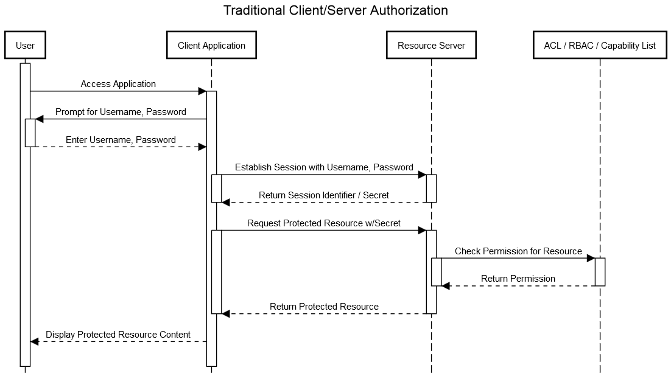
Notes:
Scopes are another concept that differentiates OAuth from a traditional authentication and authorization scheme. Depicted here, in a traditional client/server app, the client application possessed the user’s credentials and resulting time-bound secret, and can act in any capacity on behalf of the user.

Slide 35
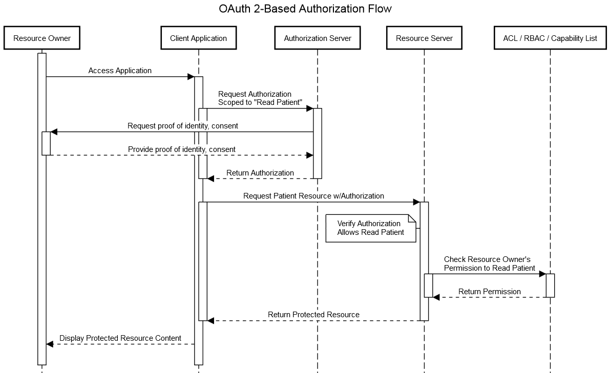
Notes:
With OAuth, the interaction can be “scoped” to a subset of rights possessed by the user. This provides a level of control over what specific client applications are capable of performing on behalf of the user. In security terms, this is known as the “principle of least privilege” – the client application is being constrained to only what it needs to provide value.

Slide 36
Scopes
The structure of scopes, as defined by FHIR:
scope-name = resource-context "/" resource-type "." modification-rights
resource-context = ("user" / "patient")
resource-type = (Name / "*")
modification-rights = ("read" / "write" / "*" );

Slide 37
Scopes
Example Scope: patient/Observation.write
Allows your application to modify or create records in the Observation resource, constrained to a single patient currently in context, subject to the limits of the authenticated user.

Slide 38
Scopes
Example Scope: user/MedicationHistory.read
Allows your application to read from the MedicationHistory resource from any record the authenticated user has access to.

Slide 39
Scopes
Example Scope: user/Immunizations.*
Allows your application to read, modify, or create records in the Immunization resource, subject to the limits of the authenticated user.

Slide 40
Scopes
Scopes are combined using spaces. Example:
user/Observation.read user/MedicationHistory.read online_access
Notes:
If your application needs to “authenticate” the user, this provides an authentication mechanism.

Slide 41
Scopes
Your application may not always receive full access to the scopes requested in the original grant – make sure to validate you received the scopes you need to function.

Slide 42
Lab 3: Scopes
In this lab, we’ll attempt to access a different resource and request the scope necessary for access.
http://bit.ly/2tA9KEY

Slide 43
Special Scopes
Other “special” scopes offered in SMART on FHIR:
openid: Returns an identity token containing the authenticated “principal” identifier for the user.
profile: Used in conjunction with openid, provides access to the authenticated user’s demographics through a specific FHIR resource. (not supported yet in Cerner’s implementation)
launch: Requests access to information associated with a SMART on FHIR launch received by your application.

Slide 44
Special Scopes
Other “special” scopes offered in SMART on FHIR:
online_access: Allows your application to obtain a “refresh token”, such that your application can continue to operate as long as the user possesses an active session with the EHR.
offline_access: Allows your application to obtain a “refresh token”, such that your application can operate even when a user is not authenticated.

Slide 45
Special Scopes
Other special scopes not currently supported:
launch/patient*
launch/encounter
launch/location
Notes:
*Patient identifiers are returned with authorization requests involving users that are patients and/or their authorized representative, when requesting a single patient scope.

Slide 46
Discovery
SMART® on FHIR® provides a mechanism to determine the authorization and token endpoints associated with the FHIR® service via a conformance resource / capability statement.

Slide 47
Example Conformance Content
"extension": [
{
"url": "http://fhir-registry.smarthealthit.org/StructureDefinition/oauth-uris",
"extension": [
{
"url": "token",
"valueUri": "https://authorization.sandboxcerner.com/tenants/0b8a0111-e8e6-4c26-a91c-5069cbc6b1ca/protocols/oauth2/profiles/smart-v1/token"
},
{
"url": "authorize",
"valueUri": "https://authorization.sandboxcerner.com/tenants/0b8a0111-e8e6-4c26-a91c-5069cbc6b1ca/protocols/oauth2/profiles/smart-v1/personas/patient/authorize"
},
{
"url": "manage",
"valueUri": "https://authorization.sandboxcerner.com/tenants/0b8a0111-e8e6-4c26-a91c-5069cbc6b1ca/personas/patient/my-authorizations"
}
]
}
],
Notes:
Three important URLs are used in the process of obtaining authorization on behalf of a person:
The authorization endpoint, that the end user interacts with via their browser.
The token endpoint, where the result of the authorization interaction is used to obtain an access token.
The end user management endpoint, where the user can manage their authorization decisions in the future.
These are located at the FHIR® conformance endpoint, advertised as a security extension with URI “http://fhir-registry.smarthealthit.org/StructureDefinition/oauth-uris”

Slide 48
Lab 4: Discovery
In this lab, we’ll fetch the conformance document and see how the endpoints are used by a SMART® application.
http://bit.ly/2h0L4DG

Slide 49
Launch
The SMART® framework provides a mechanism for applications to be “launched”. A “launch” passes two pieces of information to your application’s pre-registered launch endpoint:
iss: The FHIR® base URL of the EHR performing the “launch” (or “issuer”).
launch: A “launch” identifier, used by the EHR to associate the subsequent authorization request with context in the EHR.

Slide 50
Launch
Additional information may be returned in the JSON of a token response upon completion of the authorization flow:
patient: The FHIR® identifier of a Patient resource of the current patient in context. Present during “launch”.
need_patient_banner: a boolean, present during launch, indicating whether a patient banner should be displayed.

Slide 51
Lab 5: Launch
In this lab, we’ll observe how launch is leveraged by the demo application and how launch effects contextual (“patient/…”) scopes.
http://bit.ly/2h0L72k

Slide 52
OpenID and User Identity
Many applications have a need to determine the identity of the user the application is acting on behalf of. Example reasons:
Display of username in application
Auditing / logging
Protecting non-FHIR resources

Slide 53
OpenID and User Identity
The openid scope allows an application to request an identity token (defined as part of the OpenID Connect specification*).
The profile scope requests additional demographic data to be included in the identity token.
Notes:
* SMART does not technically require authorization servers to be fully-compliant OpenID Connect implementations – it only leverages certain aspects of OpenID Connect for user identity.

Slide 54
OpenID and User Identity
OpenID repsonses come in the form of an id_token that is returned in the access token response.
id_token(s) are JSON Web Tokens and are generally signed using the JSON Web Signature specification (more details provided in the lab.)

Slide 55
OpenID and User Identity
Tokens contain an issuer (“iss”) and a subject (“sub”). The combination of these represents a globally-unique identifier for a user.
Subject values are only unique within the context of the issuer of the token (two different issuers might assert the same subject values.)
The subject is not guaranteed by all implementations to be an actual username, nor does FHIR® offer a standard mechanism to obtain a “username” via a resource.

Slide 56
OpenID and User Identity
Some authorization server implementations may choose not to sign such tokens.
In such cases, the “issuer” value MUST match the URL of the token endpoint from which you are receiving the id_token.

Slide 57
Lab 6: OpenID
In this lab, we’ll observe how the openid scope is used.
http://bit.ly/2uWqmKi

Slide 58
Refresh Tokens
Access tokens are valid for short durations.
If your application needs access for a longer duration (> 10 minutes), your application needs the ability to automatically obtain new tokens.

Slide 59
Refresh Tokens
With the scopes of online_access or offline_access, you can obtain additional tokens.
A “refresh_token” is returned in the token response when this scope is granted. This token can be used to obtain new tokens from the authorization server.

Slide 60
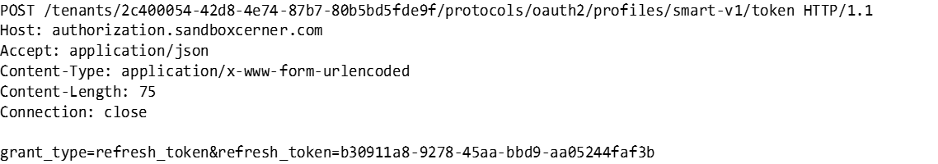
Example Refresh Token Request
Notes:
A refresh token request is also a x-www-form-urlencoded request, consisting of the refresh token, and identifying that the request is for a refresh token.

Slide 61
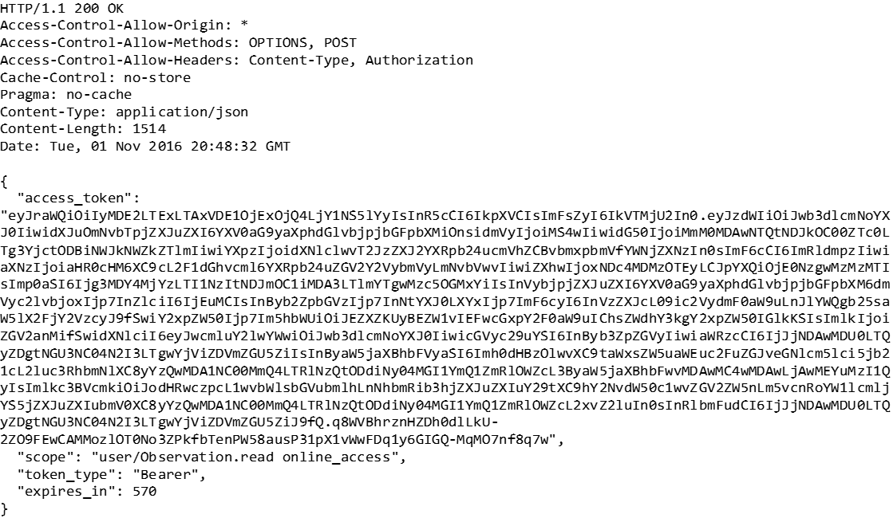
Example Refresh Token Response
Notes:
A refresh token response is also JSON.

Slide 62
Refresh Tokens
Refresh token responses may not contain the additional response parameters that were included in the original grant, such as the “patient” value seen during a launch.

Slide 63
Refresh Tokens
“offline_access” refresh tokens may require “client credentials” to utilize.
In Cerner’s ecosystem, Cerner Central system account credentials are required for use with such refresh tokens, sent via HTTP Basic authentication.

Slide 64
Refresh Tokens
Refresh tokens will continue to function until either:
The user’s session (“online_access”) is terminated or risk-based re-authentication is required (logging out, expiration, other security events).
The user or their administrator terminates the persistent grant (“offline_access”) via “manage authorizations”.
The organization terminates all access for your application to their FHIR® services.

Slide 65
Lab 7: Refresh Tokens
In this lab, we’ll observe how the online_access scope is used, and how refresh tokens are utilized.
http://bit.ly/2uuj7Zy

Slide 66
Handling Errors
All workflows in the OAuth 2 framework allow for an error_uri parameter to be returned to the client application.
If your application receives an error, at minimum provide a link to the user using the value of error_uri – this will help in diagnosing the cause and guiding the user to support.

Slide 67
Common Error Cases
Forgetting to send the “aud” (audience) parameter. This parameter is not part of the core OAuth 2 framework, but is unique to the security requirements of the SMART® ecosystem.
Authorization grant codes are one-time use codes. Submitting a token request twice using the same authorization grant code will result in an error.
If you include a redirect_uri in your authorization request, it must match the scheme, host, port, and path (including trailing slashes) that was registered with the authorization server.

Slide 68
Lab 8: Exception Cases
In this lab, we’ll observe how these common errors manifest themselves, as well as the error page provided by the authorization server.
http://bit.ly/2v5Kv1o

Slide 69
UX Considerations
For applications that “stand-alone” (Applications that are not embedded within the EHR via web view technology):
Use a separate browser tab / window for authorization flows.
Close this tab upon completion of the authorization flow.
The separate tab isolates the authorization and authentication workflow, preventing issues that would interfere with the use of browser and/or device navigation mechanisms (the “back” button problem.)
Provide a “Manage Authorizations” link to the user, linked to the “manage” endpoint advertised in the conformance document.

Slide 70
Troubleshooting
It is critical to obtain the calls being made by the user agent (browser) itself when obtaining assistance in diagnosing problems. This can be obtained using the “net” tab of most browser developer tools:

Slide 71
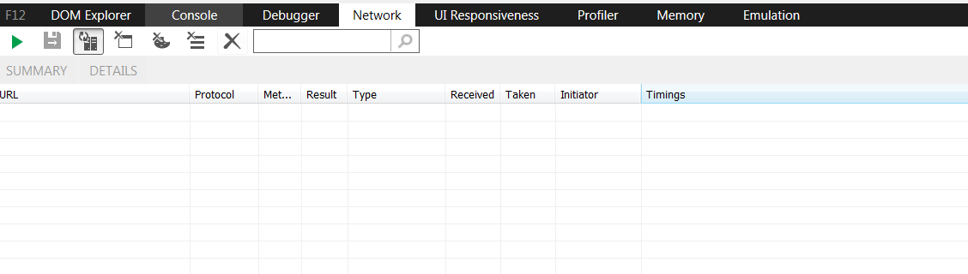
Internet Explorer

Slide 72
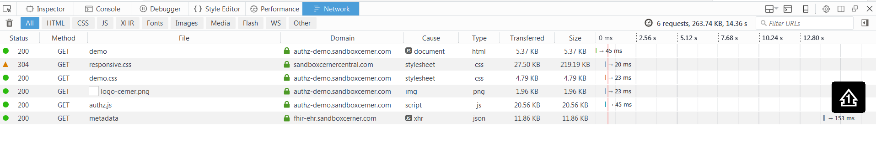
Firefox

Slide 73
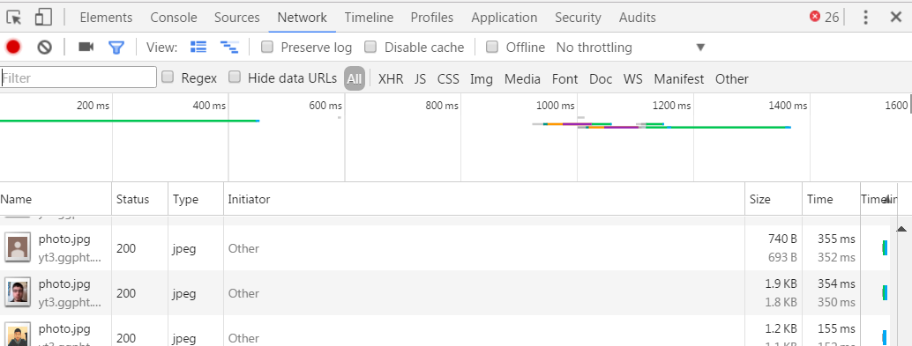
Chrome

Slide 74
Native Applications
For “native” applications, an in-app browser is recommended.
Chrome Custom Tab (Android)
SFAuthenticationSession (iOS 11 beta 3)
Safari View Controller (iOS 10)
Windows Authentication Broker (UWP)
Older platforms (including legacy Windows apps): Use the system browser.
Notes:
For more information, see “OAuth 2.0 for Native Apps”:
https://tools.ietf.org/html/draft-ietf-oauth-native-apps-05

Slide 75
Native Applications
Why this approach for native?
Enables sharing of persistent state between all instances of the browser, both in apps and the system browser.
In turn, this enables single sign-on and single log-out experiences to be offered.
Use of actual browser ensures compatibility with anti-phishing protection mechanisms and device authentication schemes (MDM).
Notes:
For more information, see “OAuth 2.0 for Native Apps”:
https://tools.ietf.org/html/draft-ietf-oauth-native-apps-05

Slide 76
Other Recommendations

Slide 77
Other Recommendations
Read the specifications and our comprehensive authorization guide @ fhir.cerner.com
Create a Threat Model for your Application
Stay Up to Date With Industry Changes
https://groups.google.com/d/forum/smart-on-fhir
https://tools.ietf.org/wg/oauth/
Notes:
Our authorization guide has more comprehensive guidance on many topics, including many of the special use cases we briefly touched on today, such as OpenID Connect. We encourage you to read these guides, as well as the underlying specifications to become more acquainted with the security models in use.

Slide 78
Q&A

Slide 79
“System” Access
SMART® on FHIR® also describes a methodology for direct system-to-system security interactions.
For “system” actors, the “Client Credentials” flow is utilized. This is sometimes referred to as “B2B” or “Backend Services”.
Notes:
A system is something that runs as a dedicated process, such as a scheduled script, or an interface.

Slide 80
“Client Credentials” Flow
+---------+ +---------------+
| | | |
| |>--(A)- Client Authentication --->| Authorization |
| Client | | Server |
| |<--(B)---- Access Token ---------<| |
| | | |
+---------+ +---------------+
Figure 6: Client Credentials Flow
Notes:
Also known as “system access” or “B2B”, the client credentials flow allows an application to directly interact with the authorization server to obtain access tokens. In this manner, the application’s credentials are not being exposed directly to resource servers, and allows for client applications to delegate access tokens to other parts of its architecture.

Slide 81
“System” Access
Steps:
Discover the “token” endpoint via the FHIR® Conformance document.
Make a token request, including your client credentials.
Notes:
Similar to the user authorization workflow, fetch the FHIR Conformance document and retrieve the “token” endpoint.

Slide 82
“System” Access
Client credentials are sent using the HTTP Basic Authentication scheme.
For Cerner FHIR® services, credentials are issued via Cerner Central System Accounts.

Slide 83
“System” Access
Scopes for system access:
FHIR® scopes are prefixed with “system” to denote that access is on behalf of a system, not a user. They cannot be mixed with “user” or “patient” scopes.
You may request fewer scopes than your system is authorized to access – this is useful if you want to pass such tokens off to other components in your architecture that are “less trusted”.

Slide 84
“System” Access
Note: Few Cerner FHIR® services currently support direct access via client credentials grant. Refer to the documentation of the individual service.

