Slide 1

Matt Randall
Principal Architect, Distinguished Engineer
November 15-17, 2016
Notes:
© Cerner 2016

Slide 2
What you’ll need to get started:
A browser of your choice:
Internet Explorer (11)
Edge
Chrome
Firefox
Access to built-in “Developer Tools” (Javascript console)
A copy of this presentation (bitly link)

Slide 3
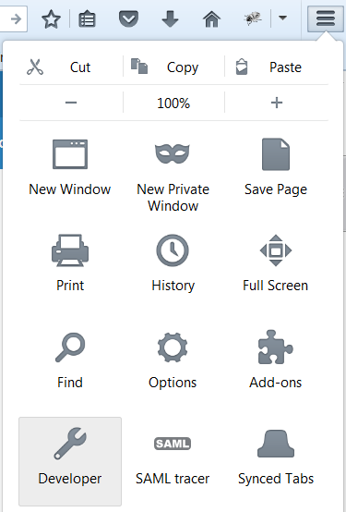

Slide 4
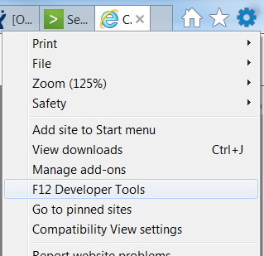

Slide 5
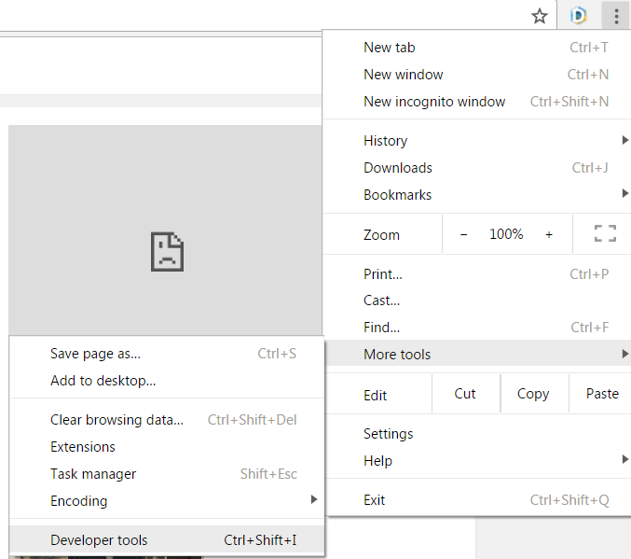

Slide 6
Bookmark our demo application: http://bit.ly/2eZKmRw

Slide 7
Lab 1: SMART Launch Breakdown

Slide 8
Note the URL:
iss: The FHIR Base URL of the EHR that is launching your app.
launch: A limited-time use code used to maintain state about user context.

Slide 9
Step 1: Discovery via FHIR Conformance
Open the console from your developer tools.
Click “Discover Authorization URLs”
See the resulting FHIR conformance document.
Note the items “discovered” in the Javascript console.
The discovered URLs automatically data for step #2 and #3.

Slide 10
Step 2: Prepare an Authorization Request
Enter client_id:
94bbd90d-482a-4a10-b7df-b40edb278da2
Enter scope:
patient/Patient.read patient/Encounter.read launch

Slide 11
Step 2 (continued): Prepare an Authorization Request
Switch presentation mode to “Mobile Sized Popup”
Click “Get Authorization Code”
Note in the console the fully-constructed authorization grant request URL.
You may be presented with an authentication screen. Log In.

Slide 12
Step 3: Examining the Authorization Response
Note in the JS console the query string that was received as the grant response.
This query string was communicated from the child window to the parent window in this example.
What is the value of the authorization code you received?

Slide 13
Step 3: Examining the Authorization Response
Say hello to the developer next to you.
Compare the code and state values in your respective responses, they should be different.
Authorization codes are time-bound, one-time use secrets.
Note the “state” matches what was sent in your original request.

Slide 14
Step 4: Preparing a Token Request
Note the token URL was pre-populated from discovery.
We’ll use the same client_id from the grant request (it should be prepopulated)
The grant type is “authorization_code”
The code from step 3 is populated.
Click “Get Access Token”
If the grant expired, repeat step 3.

Slide 15
Step 5: Examining the Token Response
The token response contains:
An access token.
The ID for the patient in context at time of launch.
The time (in seconds) the token is valid for.
Other launch context information, such as whether to display a patient banner.
Cut and paste this token response for a later lab into a text editor.

Slide 16
Step 6: Using the token in a FHIR request.
In section “4”, enter the URL of the discovered patient (/Patient/1316024), relative to the FHIR base URL.
Click “Access Protected Resource”.
Note the header that was sent using the access token.

Slide 17
Step 7: Using the token in a FHIR request with a resource not in context.
In section “4”, enter the URL of a different patient (/Patient/4342008), relative to the FHIR base URL.
Click “Access Protected Resource”.
What happened?
Why did we get a 401 response?

Slide 18
Lab 2: User Scopes

Slide 19
Step 1: Prepare an authorization request with user scopes
In section 2, change the scopes to the following:
user/Patient.read user/Encounter.read launch

Slide 20
Step 2: Obtain authorization grant, access token
Click “Get Authorization Code”
Click “Get Access Token”

Slide 21
Step 3: Access protected FHIR® resources.
In section “4”, enter the URL of a different patient than launched (/Patient/4342008), relative to the FHIR base URL.
Click “Access Protected Resource”.
What happened?
Why were we able to retrieve the resource?

Slide 22
Lab 3: Client Apps that Start from Outside the EHR (or Patient Portal)

Slide 23
Step 1: Prepare an authorization request without launch
In section 2, change the scopes to the following (remove “launch”):
user/Patient.read user/Encounter.read
Clear the field “launch code”

Slide 24
Step 2: Obtain authorization grant, access token
Click “Get Authorization Code”
Click “Get Access Token”
Examine the token response
The response no longer contains other context, such as the patient ID.

Slide 25
Step 3: Confirm you can access protected FHIR® resources.
In section “4”, enter the URL of a different patient than launched (/Patient/4342008), relative to the FHIR base URL.
Click “Access Protected Resource”.

Slide 26
Lab 4: Obtaining an OpenID Connect Identity Token

Slide 27
Step 1: Prepare an authorization request with the “openid” scope
In section 2, change the scopes to the following:
user/Patient.read openid

Slide 28
Step 2: Obtain authorization grant, access token
Click “Get Authorization Code”
Click “Get Access Token”

Slide 29
Step 3: Evaluating the Token Response
Note the token response contains an element with name “id_token”.

Slide 30
Steps to Validate OpenID Connect Tokens:
Parse the JWT contents.
Identify the “issuer”.
Fetch the openid-configuration document for the issuer.
Locate the JSON web keys (jwks_uri) from the configuration document.
Obtain the key used to sign the id_token from the jwk endpoint.
Validate the token signature.

Slide 31
Step 4: Parsing the id_token
Open the website http://jwt.io
Paste the contents of the id_token into the website.
Examine the decoded contents
Note: The subject + issuer combined are considered the globally unique “identifier” for a given user.

Slide 32
Step 5: Fetch the openid-configuration document
Append “/.well-known/openid-configuration” to the issuer value:
https://authorization.sandboxcerner.com/tenants/0b8a0111-e8e6-4c26-a91c-5069cbc6b1ca/oidc/idsps/0b8a0111-e8e6-4c26-a91c-5069cbc6b1ca/.well-known/openid-configuration

Slide 33
Step 6: Fetch the JSON Web Keys
Examine the value of “jwks_uri” in the configuration document.
Fetch the document.
Find the key whose key id (“kid”) matches and algorithm (RSA256) that of the original id_token.
This key is used to validate the signature of the signed JWT.

Slide 34
Other Considerations
The “aud” parameter is the “audience”, which must match your application’s client_id.
If your application is in itself a client/server application, these validation steps must be performed by your server tier to trust the id_token.
Major applications have missed the above steps, resulting in billions of vulnerable client installations in apps worldwide.

Slide 35
Other Considerations
SMART® also allows for a scope named “profile”.
This scope instructs the authorization server to return the URL of the authenticated user’s FHIR® resource.
This capability is not yet available in Cerner’s implementation – coming soon.

Slide 36
Lab 5: Online Access and Refresh Tokens

Slide 37
Step 1: Prepare an authorization request with the “online_access” scope
In section 2, change the scopes to the following:
user/Patient.read user/Encounter.read online_access

Slide 38
Step 2: Obtain authorization grant, access token
Click “Get Authorization Code”
Click “Get Access Token”

Slide 39
Step 3: Evaluating the Token Response
Note the token response contains an element with name “refresh_token”.

Slide 40
Step 4: Using a Refresh Token
Click the “Refresh Token” button that appears.
Note in the Javascript console that the content sent to the token endpoint is different.
The grant_type parameter changed from “code” to “refresh_token”.
The token response containers fewer elements.

Slide 41
What happen when refresh tokens expire?
In a separate tab, enter the following URL:
https://authorization.sandboxcerner.com/session-api/log-out
(This is a private mechanism, used by the authorization server to end a session; it is linked to by other user interfaces that are part of the EHR.)

Slide 42
Refreshing an Expired token
Click “Refresh Token”
Note that the refresh fails.
Existing access_tokens are still valid, however, until they expire.

Slide 43
Corner Cases and Exception Handling

Slide 44
Lab 6: Handling Error Responses

Slide 45
Step 1: Make an authorization request without required parameters.
In section 2, remove the “audience” parameter.
Click “Get Authorization Code”

Slide 46
Step 2: Examine the Authorization Grant Response.
The x-www-form-urlencoded query parameters returned in response contain an error and error_uri.
Extract these parameters; URI-decode the error_uri value.
https://www.bing.com/search?q=url+decoder
Visit the URL in a separate tab.

Slide 47
Components of Cerner’s Error Pages
User-facing error message with support contact information.
Error message for developers.
A “correlation ID” for assisting troubleshooting / diagnosis.

Slide 48
Lab 7: Exchanging the Authorization Code Twice

Slide 49
Step 1: Make the authorization request.
In section 2, add the “audience” parameter:
https://fhir-ehr.sandboxcerner.com/dstu2/0b8a0111-e8e6-4c26-a91c-5069cbc6b1ca
Click “Get Authorization Code”

Slide 50
Step 2: Exchange the code, twice
Click “Get Access Token”
Click “Get Access Token”
Result should be an error (“invalid_grant”)

Slide 51
Lab 8: Scopes Redacted by the Authorization Server

Slide 52
Step 1: Make the authorization request.
In section 2, change the scopes to:
user/Patient.read user/Imaginary.read
Click “Get Authorization Code”

Slide 53
Step 2: Exchange the code, twice
Click “Get Access Token”
Note the list of scopes in the token response does not contain “user/Imaginary.read”

Slide 54
Step 3: Make another authorization request.
In section 2, change the scopes to:
user/Imaginary.read
Click “Get Authorization Code”
Note an error is immediately returned.

Slide 55
Lab 9: Invalid Redirect URIs

Slide 56
Step 1: Make the authorization request.
In section 2, change the scopes to:
user/Patient.read
Enter the redirect URI:
http://www.cerner.com
Click “Get Authorization Code”
Note the error returned

Slide 57
Step 2: Make a second authorization request.
Enter the redirect URI:
https://authz-demo.sandboxcerner.com/client/demo/cb
Click “Get Authorization Code”
Note this succeeds (it matches the redirection URI registered with the authorization server).

Slide 58
Step 3: Make a third authorization request.
Enter the redirect URI:
https://authz-demo.sandboxcerner.com/client/demo/cb/
Click “Get Authorization Code”
Note this fails (it contains a trailing slash, which does not match the URI path registered with the authorization server).
Trailing slashes matter:
https://www.searchenginejournal.com/linking-issues-why-a-trailing-slash-in-the-url-does-matter/13021/

Slide 59
Lab 10: Insufficient Scopes Accessing a Resource

Slide 60
Step 1: Make the authorization request.
In section 2, change the scopes to:
user/Encounter.read
Click “Get Authorization Code”

Slide 61
Step 2: Obtain an Access Token
Click “Get Access Token”

Slide 62
Step 3: Attempt to Access a Patient Resource.
In section 4, change the resource to:
https://fhir-ehr.sandboxcerner.com/dstu2/0b8a0111-e8e6-4c26-a91c-5069cbc6b1ca/Patient/1316024
Click “Access Protected Resource”
Note the 401 response

Slide 63
Step 4: Repeat Steps with Valid Scopes
In section 2, change the scope to:
user/Encounter.read user/Patient.read
Click “Get Authorization Code”
Click “Get Access Token”
Click “Access Protected Resource”
You should receive a 200 response.

Slide 64
Lab 11: Utilizing an Invalid Token

Slide 65
Step 1: Use a Modified Access Token.
In section 4, add, remove, or change a character in the access token.
Click “Access Protected Resource”
You should receive a “401” response.

Slide 66
Lab 12: Utilizing an Expired Token

Slide 67
Step 1: Use an Expired Access Token.
Paste the token response you saved from Lab 1 into section 4.
Click “Access Protected Resource”
You should receive a 401 response indicating the token is invalid/expired.

Slide 68
Lab 13: Tracing Browser Calls

Slide 69
Often times, it is important to obtain the calls being made by the user agent itself for diagnosis. This can be obtained using the “net” tab of most browser developer tools:

Slide 70
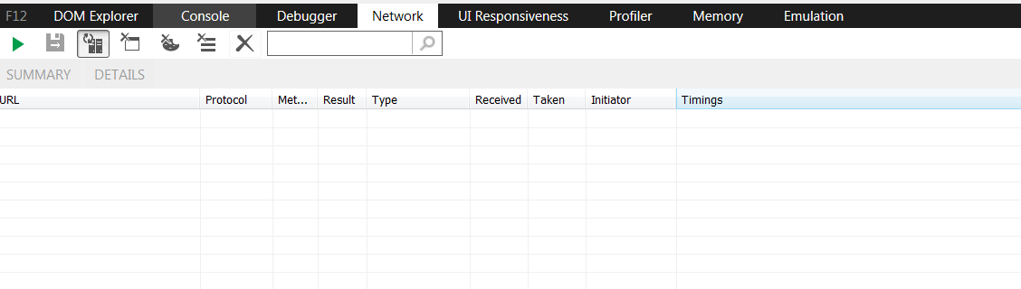
Internet Explorer

Slide 71
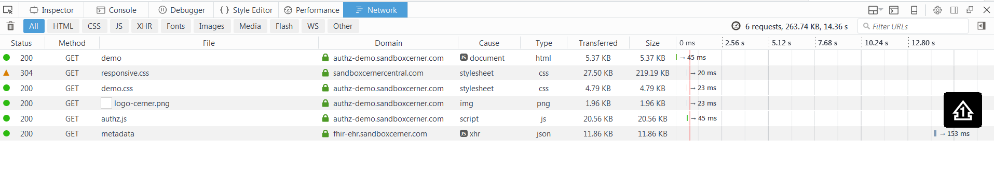
Firefox

Slide 72
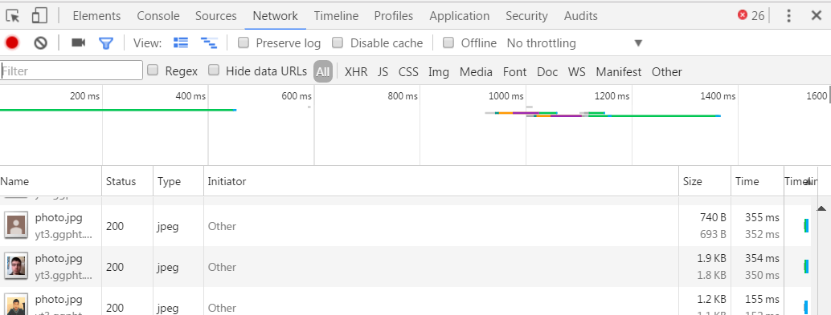
Chrome

Slide 73
To capture all information, ensure that “preserve log” is enabled, or that “clear entries on navigate” is disabled.
Repeat Lab 1 and investigate the resulting browser trace.

Slide 74
Lab 14: Modifying Your SMART Tutorial App

Slide 75
In a previous lab, you cloned a tutorial project on GitHub and registered it with Cerner’s Sandbox environment. In this lab, we’ll demonstrate the inner workings of the SMART Javascript library, and highlight its limitations.

Slide 76
Step 1: Update “launch.html” in your GitHub pages branch: Add no-cache meta tags to make prototyping easier: <meta http-equiv="cache-control" content="max-age=0" /> <meta http-equiv="cache-control" content="no-cache" /> <meta http-equiv="expires" content="0" /> <meta http-equiv="expires" content="Tue, 01 Jan 1980 1:00:00 GMT" /> <meta http-equiv="pragma" content="no-cache" /> Modify 'scope': user/Patient.read user/MedicationStatement.read user/MedicationStatement.write

Slide 77
Step 2: Update “index.html” in your GitHub pages branch: We’ll be modifying the example code to fetch a resource directly, using the Javascript API provided by the SMART® on FHIR® Javascript library. Use the following link, or copy and paste from the next slide: http://bit.ly/2fSCc0Q This script checks if authorization is complete, and if so, fetches a FHIR patient resource. The raw JSON of the resulting resource is then displayed in markup.

Slide 78
<!DOCTYPE html> <html> <head> <meta http-equiv='X-UA-Compatible' content='IE=edge' /> <meta http-equiv='Content-Type' content='text/html; charset=utf-8' /> <meta http-equiv="cache-control" content="max-age=0" /> <meta http-equiv="cache-control" content="no-cache" /> <meta http-equiv="expires" content="0" /> <meta http-equiv="expires" content="Tue, 01 Jan 1980 1:00:00 GMT" /> <meta http-equiv="pragma" content="no-cache" /> <title>Example-SMART-App</title> <link rel='stylesheet' type='text/css' href='./src/css/example-smart-app.css'> </head> <body> <h2>Example-SMART-App</h2> <div id='errors'> </div> <div id="loading">Loading...</div> <script src='./lib/fhir-client.min.js'></script> <script> function ready(smart) { var patient = smart.api.read({type: 'Patient', id: '711924'}).then(function(response) { document.body.innerText = JSON.stringify(response); }); } function notReady() { if (window.location.href.indexOf('error') < 0) { document.body.innerText = "Launch first."; } } FHIR.oauth2.ready(ready, notReady); </script> </body> </html>

Slide 79
Step 3: Invoking the Authorization Request https://[yourname].github.io/smart-tutorial/example-smart-app/launch.html?iss=https://fhir-ehr.sandboxcerner.com/dstu2/0b8a0111-e8e6-4c26-a91c-5069cbc6b1ca The SMART library is triggers an authorization request based on this API call. Note: The issuer is populated, which the SMART® on FHIR® JS library uses to determine the endpoints; unlike your previous examples, we are not including a launch code.

Slide 80
Additional Exercises
Try to create a MedicationStatement:
{
"resourceType": "MedicationStatement",
"patient": {
"reference": "Patient/1316024"
},
"status": "active",
"medicationCodeableConcept": {
"coding": [
{
"system": "http://www.nlm.nih.gov/research/umls/rxnorm",
"code": "2551",
"display": "Ciprofloxacin",
"userSelected": false
}
],
"text": "ciprofloxacin"
},
"dosage": [
{
"timing": {
"code": {
"coding": [
{
"system": "http://hl7.org/fhir/v3/vs/GTSAbbreviation",
"code": "BID"
}
],
"text": "BID"
}
},
"quantityQuantity": {
"value": 500.0,
"units": "mg",
"system": "http://unitsofmeasure.org",
"code": "mg"
}
}
]
}

