Slide 1
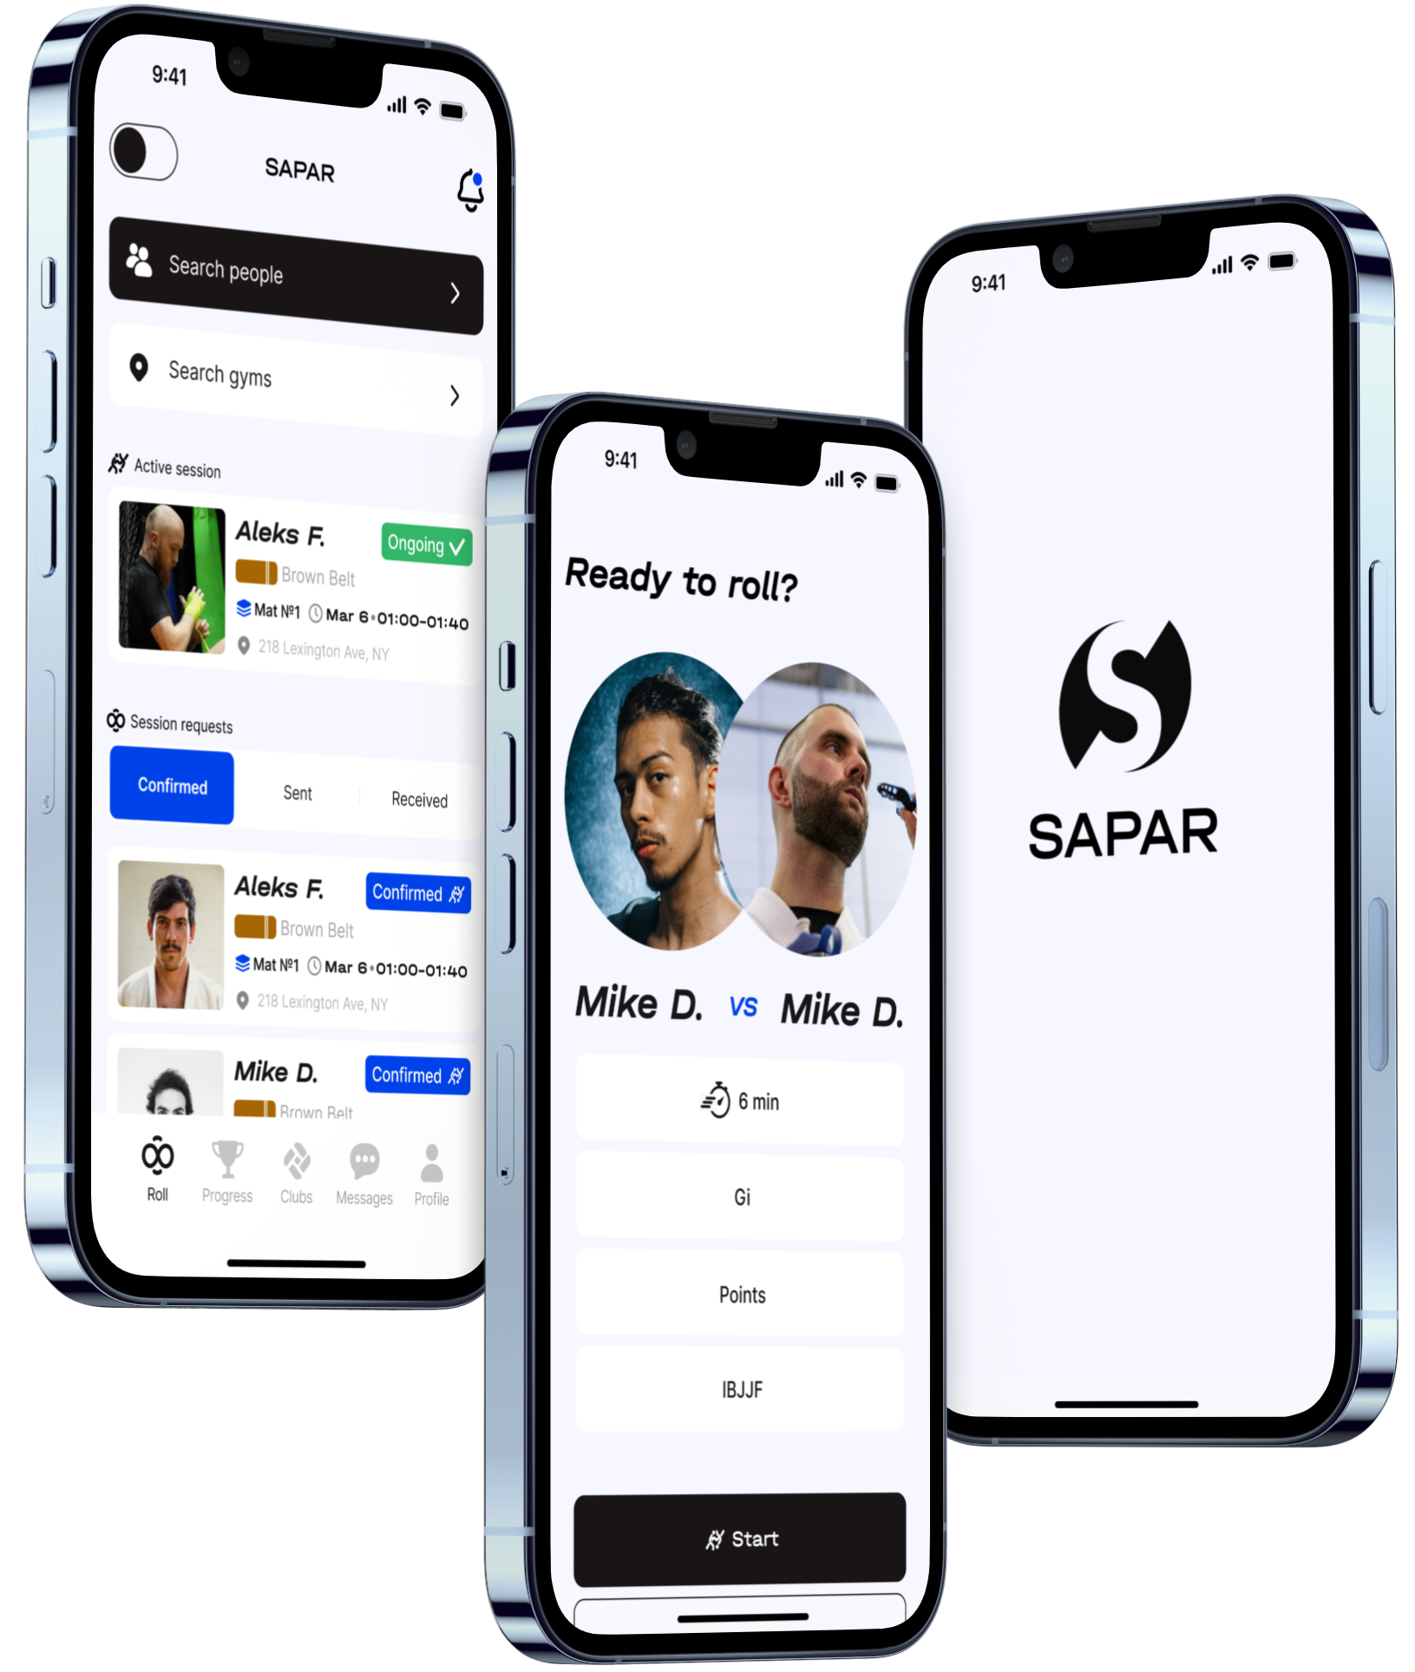
SAPAR
STRATEGIC PARTNER BRIEFING
TRAIN.
CONNECT.
COMPETE.
A connected Jiu-Jitsu platform with a proof-first path to intelligent competition.
CORE PLATFORM: FEASIBLE
BODY TRACKING: STAGED VALIDATION
AUTONOMOUS SCORING: NOT AN EARLY PROMISE
Notes:
Open with the platform vision, then establish that SAPAR advances through proof gates rather than AI promises.
[Sources]
- https://saparsport.com/ - public SAPAR positioning: mobile-first platform for Jiu-Jitsu practitioners, gyms, referees, and coaches.
- https://saparsport.com/assets/sapar-logo-blue-small.svg - SAPAR logo asset.
- https://saparsport.com/assets/top-image-cropped.png - public SAPAR app composition.
- Internal feasibility dossier: docs/EXECUTIVE_DECISION.md and docs/AI_ENGINE_DOSSIERS.md.

Slide 2
THE OPPORTUNITY
Jiu-Jitsu still lives across disconnected systems
Training, identity, gyms, competition, media, and reputation rarely share one trusted record.
TRAIN
CONNECT
COMPETE
PROVE
//
//
//
Partners
coaches
sessions
Profiles
media
community
Events
rules
results
Ratings
record
progress
THE COST OF FRAGMENTATION
Every disconnected workflow loses context, trust, and the evidence needed to improve the sport.
SAPAR
STRATEGIC PARTNER BRIEF / THE OPPORTUNITY
02 / 14
Notes:
Frame the opportunity as connected infrastructure for the sport, not another isolated social feed.
[Sources]
- https://saparsport.com/ - public SAPAR product positioning and Fighter/Gym paths.
- Internal feasibility dossier: docs/PRODUCT_TRUTH.md - product analogy map and primary user jobs.
- Internal feasibility dossier: data/domain-entities.json and data/domain-relationships.json - proposed connected domain model.

Slide 3
SAPAR ECOSYSTEM
One network can make every interaction compound
A shared identity, event, result, and media layer connects the people and places that already make the sport work.
EVENTS + OFFICIALS
rules / results / corrections
FIGHTERS
GYMS
identity / progress / media
sessions / hosting / community
ONE TRUSTED
SPORTS GRAPH
COACHES + PARTNERS
instruction / discovery / growth
The network grows useful before advanced AI arrives.
SAPAR
STRATEGIC PARTNER BRIEF / SAPAR ECOSYSTEM
03 / 14
Notes:
Show that the product has a strong non-AI value proposition: connect the sport, create trusted records, and improve discovery.
[Sources]
- https://saparsport.com/ - public Fighter and Gym ecosystem positioning.
- Internal feasibility dossier: docs/PRODUCT_TRUTH.md - athlete, coach, organizer, referee, scorekeeper, and gym operator jobs.
- Internal feasibility dossier: docs/TARGET_ARCHITECTURE.md - domain modules and authority boundaries.

Slide 4
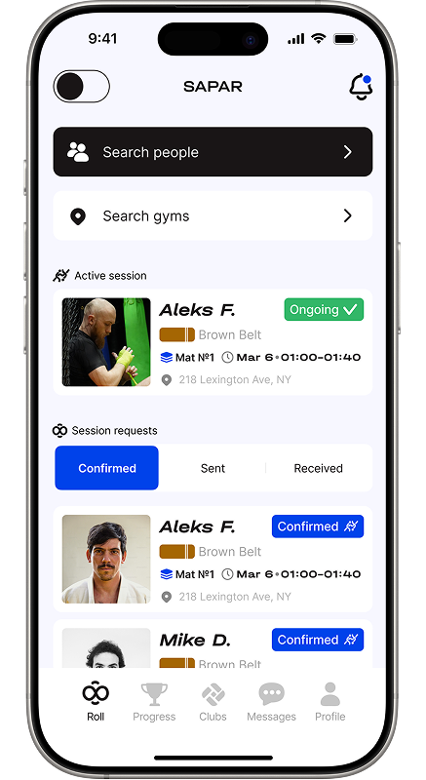
FIGHTER EXPERIENCE
For fighters, SAPAR turns mat time into momentum
Find the right session, build a credible record, share the journey, and understand progress in one place.
01
DISCOVER
People, gyms, sessions, and opportunities to roll.
02
PROVE
Verified results and explainable ratings, distinct from XP.
03
BELONG
A combat-sports community built around real participation.
Product concept - experience details require pilot validation.
SAPAR
STRATEGIC PARTNER BRIEF / FIGHTER EXPERIENCE
04 / 14
Notes:
Keep ratings, XP, belt rank, official record, and community status separate. The value proposition is clarity, not one magic score.
[Sources]
- https://saparsport.com/assets/how-it-works/image.png - public SAPAR fighter discovery screen.
- https://saparsport.com/ - public product positioning.
- Internal feasibility dossier: docs/PRODUCT_TRUTH.md - athlete jobs and first-wedge workflow.
- Internal feasibility dossier: docs/RATING_XP_AND_LEADERBOARDS.md - rating, XP, record, and leaderboard boundaries.

Slide 5
GYM EXPERIENCE
For gyms, the network becomes an operating advantage
Discovery and scheduling can lead into verified participation, hosted competition, and a stronger local community.
1
2
3
4
5
DISCOVER
SCHEDULE
HOST
VERIFY
RETAIN
Be found by the right athletes
Coordinate sessions and mat time
Run bounded events and open mats
Confirm participation and results
Turn activity into community
Prove repeatable operations with one-to-three partner gyms before scaling.
SAPAR
STRATEGIC PARTNER BRIEF / GYM EXPERIENCE
05 / 14
Notes:
Emphasize a focused gym pilot: operational proof and retention before nationwide expansion.
[Sources]
- https://saparsport.com/ - public Sapar for Gym positioning and gym benefit claims.
- Internal feasibility dossier: docs/PRODUCT_TRUTH.md - gym operator jobs and smart-gym hypothesis.
- Internal feasibility dossier: docs/MILESTONES.md - bounded community and one-to-three gym pilot exit criteria.

Slide 6
FEASIBILITY VERDICT
Build the platform.
Earn the intelligence.
FEASIBLE NOW
PROVE FIRST
CONNECTED CORE
PERCEPTION + SCORING
Identity, profiles, gyms, events, result ledger, ratings, media workflows, and bounded community.
Tracking, positions, technique understanding, live analysis, and any scoring suggestion require staged evidence and human authority.
AUTONOMOUS OFFICIAL SCORING IS NOT AN EARLY PRODUCT PROMISE
Notes:
Give the answer plainly: the product core is buildable; the hardest AI is a research program with stop gates.
[Sources]
- Internal feasibility dossier: docs/EXECUTIVE_DECISION.md - conventional core feasible and ambitious AI conditional.
- Internal feasibility dossier: docs/AI_ENGINE_DOSSIERS.md - portfolio sequencing and human-authority boundary.
- Internal feasibility dossier: data/claims.json - claim-conventional-core-feasible, claim-ledger-first, and claim-autonomous-scoring-not-credible.

Slide 7
CORRECT BUILD ORDER
The order is the strategy
Each stage earns the evidence, data, and operational confidence required by the next.
6
5
4
RESEARCH
3
PERCEIVE
2
ASSIST
Technique / shadow scoring
1
PILOT
Tracking / coarse states
LEDGER
Search / summaries / review
AUTHORITY
Adult users / partner gyms
Events / results / replay
Rules / rights / roles
Exit: decisions signed
Exit: deterministic truth
Exit: repeat use
Exit: measured value
Exit: hard strata pass
Exit: safe utility
No phase advances because the calendar moved. It advances because the exit evidence exists.
SAPAR
STRATEGIC PARTNER BRIEF / CORRECT BUILD ORDER
07 / 14
Notes:
Walk left to right. The deterministic ledger and pilot create the evidence required for bounded AI; perception stays later.
[Sources]
- Internal feasibility dossier: docs/BUILD_ORDER.md - dependency-aware stages 0 through 6.
- Internal feasibility dossier: docs/MILESTONES.md and data/milestones.json - entry criteria, exit evidence, owners, and funding decisions.
- IBJJF rules and referee materials: https://ibjjf.com/books-videos.
- Association of Boxing Commissions rules: https://www.abcboxing.com/unified-rules/.

Slide 8
DATA FLYWHEEL
The data flywheel starts with rights, not volume
Product value creates governed evidence. Governed evidence earns bounded automation. Human corrections shape the next experiment.
2
CAPTURE
1
RIGHTS
context / provenance
3
LABEL
purpose / consent
expert / unknown
EVERY CORRECTION
IMPROVES EVIDENCE
NOT AUTHORITY
model proposals remain derived and reviewable
6
CORRECT
4
EVALUATE
feedback / deletion
holdouts / severe errors
5
ASSIST
shadow / review
SAPAR
STRATEGIC PARTNER BRIEF / DATA FLYWHEEL
08 / 14
Notes:
Make the governance point explicit: upload permission is not training consent, and model output never becomes official authority by default.
[Sources]
- Internal feasibility dossier: docs/DATA_FLYWHEEL.md - rights, provenance, ontology, labeling, evaluation, correction, and deletion loop.
- Internal feasibility dossier: docs/DATA_AUTHORITY_AND_LIFECYCLE.md - authoritative, derived, and user-declared data.
- Internal feasibility dossier: data/data-lifecycle.json and data/data-authority.json.

Slide 9
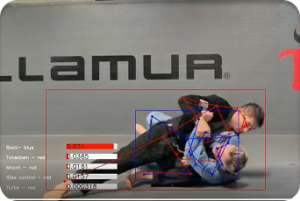
AI VALIDATION
Body tracking is a validation ladder, not a launch feature
Close contact, occlusion, changing cameras, rulesets, and identity swaps make grappling harder than generic sports tracking.
E
D
SHADOW
SAPAR / BODY TRACKING RESEARCH
LABELS
C
B
STATES
A
TRACK
CAPTURE
EXISTING CONCEPT IMAGE - VALIDATION REQUIRED
fixed + phone views
identity continuity
coarse + abstain
small ontology + holdouts
human decision remains official
A visual concept does not establish tracking, technique, or scoring accuracy.
STOP: AUTONOMOUS OFFICIAL SCORING UNTIL SAFETY, GENERALIZATION, AND AUTHORITY GATES PASS
SAPAR
STRATEGIC PARTNER BRIEF / AI VALIDATION
09 / 14
Notes:
Use the ladder to show disciplined ambition: a controlled proof can be valuable even if autonomous scoring remains stopped.
[Sources]
- https://saparsport.com/assets/why-it-matters/screen-ai-1.png - public SAPAR vision concept image; concept only, not performance evidence.
- Internal feasibility dossier: docs/EVALUATION_STRATEGY.md - Protocol D controlled tracking and Protocol E small technique ontology.
- Internal feasibility dossier: docs/AI_ENGINE_DOSSIERS.md - tracking, pose, coarse state, technique, and scoring boundaries.
- ByteTrack: https://arxiv.org/abs/2110.06864; SportsMOT: https://openaccess.thecvf.com/content/ICCV2023/papers/Cui_SportsMOT_A_Large_Multi-Object_Tracking_Dataset_in_Multiple_Sports_Scenes_ICCV_2023_paper.pdf.
- Harmony4D: https://proceedings.neurips.cc/paper_files/paper/2024/file/c20b843d0c6b1b40a8e6eb9a44e719c9-Paper-Datasets_and_Benchmarks_Track.pdf; MMPose: https://github.com/open-mmlab/mmpose.
- ViCoS dataset: https://www2.vicos.si/resources/jiujitsu/ - too narrow and noncommercial for a production foundation.

Slide 10
CANDIDATE ACCELERATOR
Inference stability can help - after a transfer test
A team-reported capability could help evaluation discipline, but language-model stability and vision-model drift are different problems.
TEAM-REPORTED CAPABILITY
SAPAR-SPECIFIC PROOF REQUIRED
Inference-stability
control
Temporal + domain
stability
Potential reuse: versioning, deterministic harnesses, regression detection, rollback, and reproducible evaluation.
Body tracking can drift across athletes, gyms, cameras, lighting, occlusion, uniforms, rulesets, venues, and time.
1
2
3
4
REPEAT
TRANSFER
COMPARE
ROLL BACK
SAPAR
STRATEGIC PARTNER BRIEF / CANDIDATE ACCELERATOR
10 / 14
Notes:
Treat the capability as an option to verify, not as proof that SAPAR body tracking is solved. Distinguish deterministic LLM behavior from computer-vision generalization.
[Sources]
- User brief - team-reported reusable inference-stability capability; no reproducible artifact supplied to this deck.
- Internal feasibility dossier: docs/EVALUATION_STRATEGY.md - frozen tests, versioning, baselines, hard strata, abstention, and release packets.
- Internal feasibility dossier: data/failure-modes.json and docs/DATA_FLYWHEEL.md - drift detection, representation, and rollback requirements.
- Harmony4D: https://proceedings.neurips.cc/paper_files/paper/2024/file/c20b843d0c6b1b40a8e6eb9a44e719c9-Paper-Datasets_and_Benchmarks_Track.pdf - close-contact domain adaptation pressure.

Slide 11
SCALE-SAFE ARCHITECTURE
Scale around one source of truth
Start coherent. Split systems only when measured workload, reliability, or ownership pressure justifies the move.
FIGHTER
GYM
EVENT OPS
PARTNERS
MODULAR PRODUCT CORE
identity / rules / events / results / ratings / consent / audit
POSTGRESQL AUTHORITY
OBJECT STORAGE
WORKERS + PROJECTIONS
transactions / ledger / outbox
media bytes / policy in DB
feeds / search / media / AI
MEASURE FIRST: contention / queue lag / media throughput / recovery / cost
SAPAR
STRATEGIC PARTNER BRIEF / SCALE-SAFE ARCHITECTURE
11 / 14
Notes:
Present the architecture as deliberately scale-safe, not prematurely distributed: one authority, asynchronous work, and evidence-triggered evolution.
[Sources]
- Internal feasibility dossier: docs/TARGET_ARCHITECTURE.md - pilot topology, domain modules, outbox, projections, and AI boundary.
- Internal feasibility dossier: docs/RELATIONAL_DATABASE_ARCHITECTURE.md - one authoritative PostgreSQL system and independently scalable workers.
- Internal feasibility dossier: data/scale-breakpoints.json and data/architecture-transitions.json - evidence-triggered transitions and rollback.

Slide 12
RISK AND UNKNOWNS
Make every material unknown testable
SAPAR should convert each material uncertainty into an owner, a test, and a stop condition.
RIGHTS + PRIVACY
MODEL + DATA
Footage can include opponents, referees, crowds, voices, minors, and biometric signals.
Aggregate accuracy can hide failure by athlete, gym, camera, occlusion, style, or time.
Gate: explicit purpose, consent, withdrawal, deletion, and counsel review.
Gate: hard-strata reporting, holdouts, calibration, and abstention.
RULES + TRUST
OPERATIONS + SCALE
Wrong rules, self-approval, disputes, collusion, or rating manipulation can corrupt credibility.
Media cost, review queues, incident response, and recovery can fail before traffic does.
Gate: versioned rules, separation of duties, replay, corrections, and appeals.
Gate: workload budgets, service objectives, drills, and measured breakpoints.
SAPAR
STRATEGIC PARTNER BRIEF / RISK AND UNKNOWNS
12 / 14
Notes:
Avoid presenting governance as friction. It is how SAPAR protects participants, partners, and the credibility of every result.
[Sources]
- Internal feasibility dossier: docs/RISKS_AND_GOVERNANCE.md and data/risks.json - risk register and proposed decision rights.
- Internal feasibility dossier: data/trust-safety-gates.json - staged launch boundaries.
- Internal feasibility dossier: docs/DATA_FLYWHEEL.md - rights, provenance, representation, poisoning, withdrawal, and deletion.
- Internal feasibility dossier: docs/PERFORMANCE_AND_RESILIENCE_TEST_PLAN.md - workload, recovery, and failure drills.

Slide 13
STAGED PROGRAM
Fund completed evidence, not elapsed time
The program advances through four decision gates. Later AI options remain visible without becoming premature commitments.
GATE 1
GATE 2
GATE 3
GATE 4
PROVE AUTHORITY
PROVE VALUE
PROVE ASSISTANCE
PROVE PERCEPTION
Locate source
Sign rules + roles
Approve rights boundaries
Replay results
Explain ratings
Show repeat pilot use
Beat baseline
No access leakage
Reduce review burden
Pass hard strata
Calibrate + abstain
Fit camera + cost
UNLOCKS TRUSTED CORE
UNLOCKS COMMUNITY
UNLOCKS BOUNDED AI
UNLOCKS RESEARCH OPTION
PHASES 0-6 / TIMING FOLLOWS EVIDENCE / RESEARCH CAN NARROW OR STOP
SAPAR
STRATEGIC PARTNER BRIEF / STAGED PROGRAM
13 / 14
Notes:
Use the staged program to set expectations: early investment proves authority and product value; later AI gates can narrow, pause, or stop.
[Sources]
- Internal feasibility dossier: docs/MILESTONES.md and data/milestones.json - phases 0 through 6, exit evidence, owners, and funding decisions.
- Internal feasibility dossier: docs/BUILD_ORDER.md - promotion method and non-parallelizable dependencies.
- Internal feasibility dossier: docs/HANDOFF.md - first 30/60/90-day evidence objectives.
- No calendar or capital commitment is made on this slide; exact commercial structure requires owner approval.

Slide 14
SAPAR
THE NEXT MOVE
01
PILOT ACCESS
Start with one
closed, adult-only pilot.
Selected gyms, events, operators, and representative capture conditions.
02
DOMAIN AUTHORITY
Rules-qualified officials, privacy review, and explicit data rights.
Prove the trusted competition core. Create the data flywheel. Advance body tracking only when the evidence earns it.
03
STRATEGIC SUPPORT
Product, operating, and capital partnership shaped around proof gates.
BUILD THE TRUSTED NETWORK.
EARN THE DATA. THEN AUTOMATE.
Commercial structure and investment terms to be defined with SAPAR leadership.
Notes:
Close with the concrete decision: authorize a bounded pilot and strategic working session. Do not negotiate terms from the deck.
[Sources]
- Internal feasibility dossier: docs/EXECUTIVE_DECISION.md - recommended proof-first funding posture.
- Internal feasibility dossier: docs/HANDOFF.md - evidence-recovery and pilot-definition sequence.
- https://saparsport.com/ - public SAPAR brand and product vision.
- Partner type, investment amount, economics, and legal terms remain owner-approved decisions and are intentionally not invented.

