Slide 1

IRIS – Enterprise Security
Pitch Deck November 2017
Notes:
https://www.bizzbeesolutions.com/wp-content/uploads/2017/04/037-sample-business-plan-home-automation-and-security-solution.pdf
https://pitchdeck.improvepresentation.com/what-is-a-pitch-deck

Slide 2

Disclaimer
All of the slides in our final have been reviewed by the entire team. Each slide has a primary author. The primary author wrote the bulk of the content. All team members reviewed the content for accuracy and the team agreed to the final presentation.
The final version is not permitted to be distributed outside of class without prior permission from the team.
David Burrill
David Burrill

Slide 3
Project IRIS - Overlooking eye to see everything
Our Vision is to disrupt the “Smart Building” industry with a product that differentiates itself from the other leaders by focusing on technology and safety using the data gathered from IoT sensors to help people that can not help themselves.
Our team will build a system that gathers and analyzes data from IoT sensors within the buildings, and use that data to prevent safety issues. This system will be scalable so that it can be incorporated in private homes as well as large scale buildings.
David Burrill
David Burrill

Slide 4





Team
David Burrill
David Burrill
Jonathan Cheng
Northrop Grumman
chonathan.jeng@gmail.com
Arnold Benitez
Northrop Grumman
arnoldbenitez@gmail.com
David Burrill
Qualcomm
dburrill@eng.ucsd.edu
Amin Karbasi
Qualcomm
mkarbasi@eng.ucsd.edu
Kathirvelavan Ramakrishnan
Qualcomm
rkathir0808@gmail.com

Slide 5
Problem
There is no smart building product that focuses on Safety and Security
Smart Home automation solutions such as Google Home and Amazon Alexa focus mainly on interacting with sensors and home entertainment.
Home security solutions such as “ADT” and “Front Point” only focus on passive security solutions such as security cameras and motion detectors.
Customers require a comprehensive solutions that not only interacts with all the supported sensors installed, but also intelligently detect all the potential threats.
David Burrill
David Burrill

Slide 6
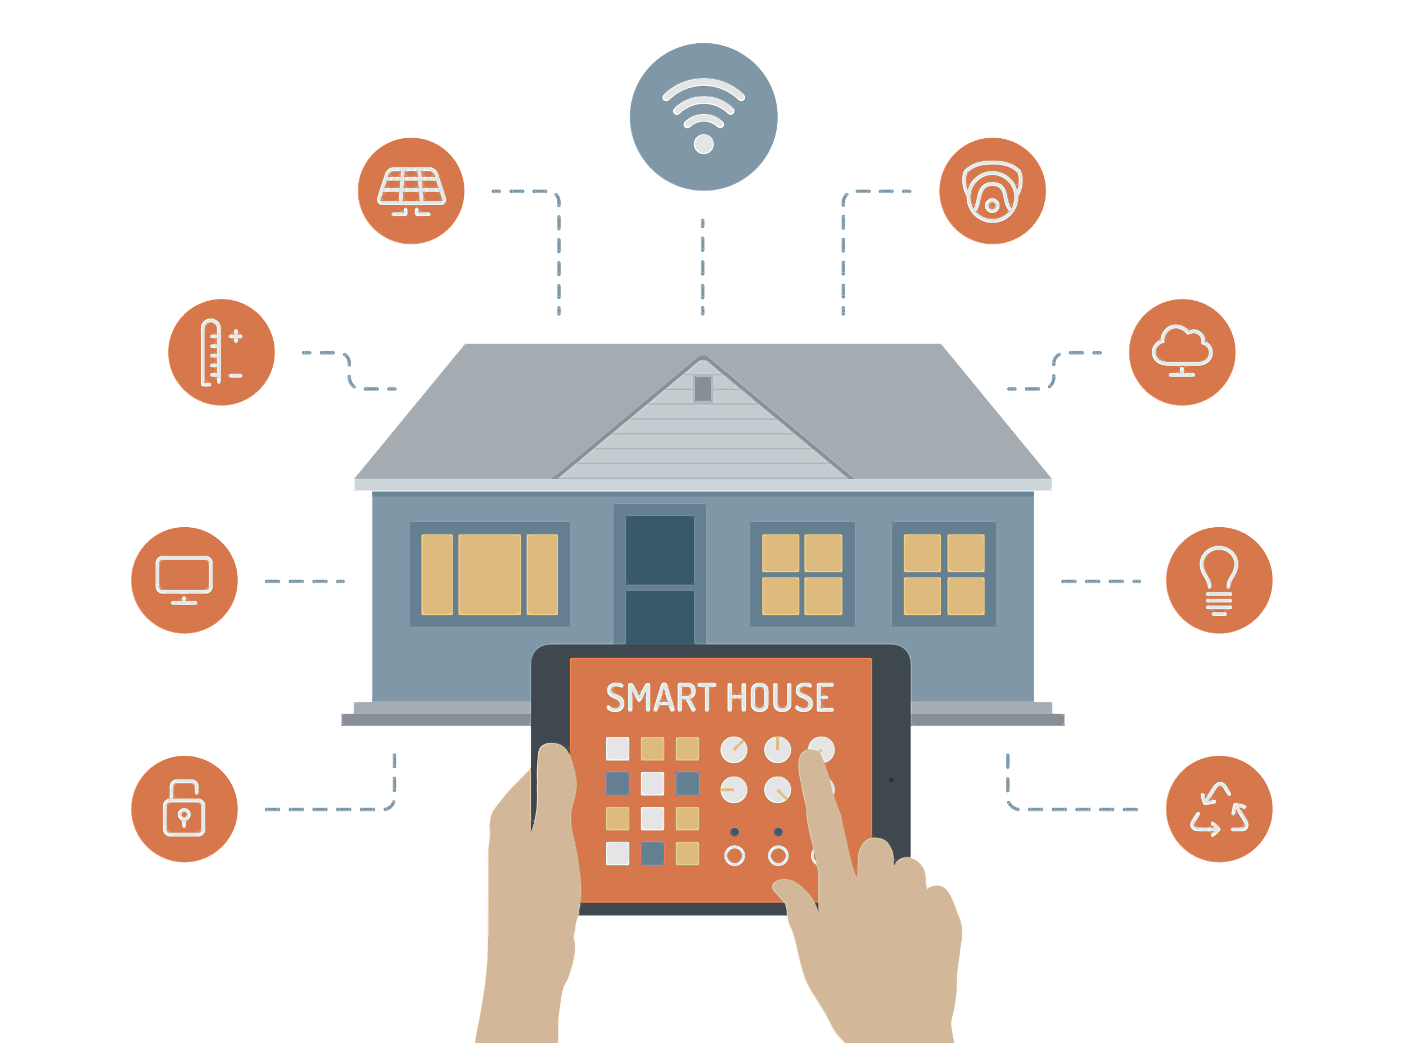
IRIS Solution
IRIS is a low cost, building security solutions that integrates all the supported sensors with the central hub with which customers can control all sensors with voice as well as smart handhelds.
IRIS is a Qualcomm snapdragon 835 based hub, which is using AI and Machine-Learning techniques that can provide smart secure personalized environment.
David Burrill
David Burrill

Slide 7
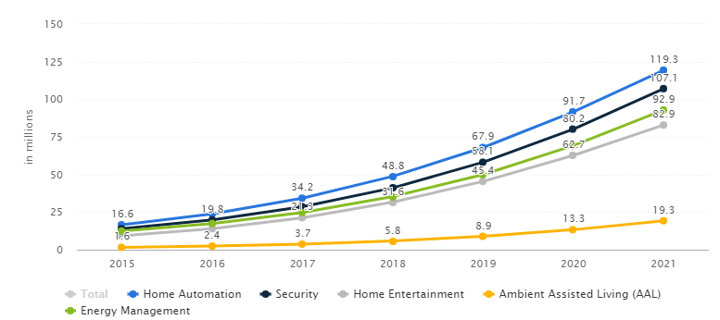
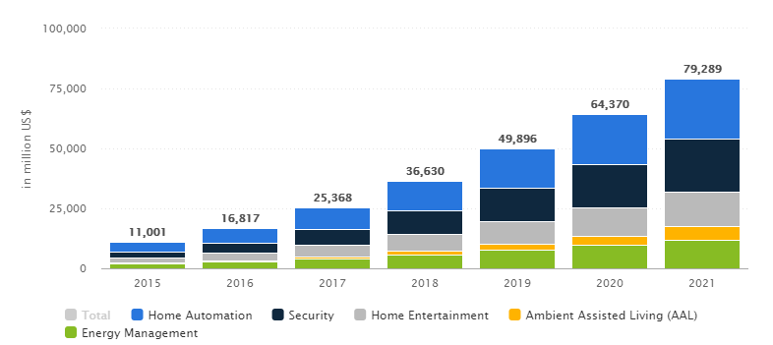
Market
In the “Smart Building" segment, the number of active households is expected to amount to 119.3m by 2021
Revenue in the "Smart Home" market amounts to US$25,368m in 2017
David Burrill
David Burrill

Slide 8
Competition
Smart Building Automation Solutions
Google Home: 5 million unit sold. Price $79.
Amazon Alexa: 15 million unit sold. Price $79.
Miscellaneous Home Automation Solutions
Home Security Solutions
ADT: 14 million houses. Price $27/month
Front Point: 4 million houses. Price $34/month
Protect America: Price $19/month
IRIS Solution
IRIS is the one to combine smart building automation solutions with security features and represents an end to end solution that covers all customers needs from smartness to security.
It uses Machine-Learning and AI techniques to intelligently detect any safety threats.
David Burrill
David Burrill
Notes:
Where do you exist in the larger overall Market Space?
What are your Advantages?
How is your place in the market unique to you, and the right one for your company growth and customers?
Who are the competitors, why have they succeeded, and how do you truly differentiate from them?

Slide 9
Industry Analysis- Porter’s Five Forces Framework
Barriers to Entry
Capital requirement to build servers that store and process data | Start by using Cloud services
Lack of Financial Resources | We will look towards Venture Capitalist to get started
Security/Privacy Concerns | We will convince users that our analytical tool is more valuable than security of the data
No one knows about our product/company | We can advertise our company on every “Smart Building” that we are attached to by using a sign with our company name.
Industry Competitors and Rivalry among Incumbents
Right now, Google Home and Amazon are well known for their Smart Home systems. Larger companies can drive the price down to put us out of business | We will depend on product differentiator to separate us from the incumbents.
Bargaining Power of Suppliers
There are limited suppliers for Servers to collect and process data. Intel is the largest supplier of the ASICs that support the Server systems. They would prioritize larger companies | We will work with Qualcomm as they are currently entering into the Server market. They are anxious to work with new customers with superior technology, like our team. We will also be working with a variety of suppliers for IoT sensors.
Bargaining Power of Buyers
Our customers could choose other providers with similar services at lower costs. | With our product differentiation, buyers would incur high switching costs if they choose to change to a competitor.
Threat of Substitutes
It is conceivable that Google or Amazon will have advanced technology and knowhow to provide faster more reliable analytics. | We will be the first to market and patent our technology
Threat of Compliments
Our system will rely on the cooperation with law enforcement or other agencies to react to the alerts from our system. | We will demonstrate the reliability of our system and ensure no false alarms.
David Burrill
David Burrill

Slide 10
SWOT Analysis
Strengths | Weaknesses
Team Education and Skillset - Use our wide backgrounds, network, expertise, and knowledge to our advantage Driven for Success - Determined to create a scalable architecture Key stakeholders already identified Large target customer audience Benefits through data analytics | Existing similar products (Google Home, Amazon) Big companies can drive prices down w/volume Brand recognition, new to market - Will have to depend on product differentiator Security/Privacy Concerns - Will have to show how benefits outweigh concerns No Artificial Intelligence (AI) Subject Matter Expert (SME), gap in data analysis knowledge
Opportunities | Threats
Expansion into Wider Application - Our architecture will allow for easy expansion into other business areas such as elderly home communities and hospitals Possibilities for Strategic Alliances Customized Benefits Through Data Analytics | Competition - Features of AI and architecture have to be superior Lack of Financial Resources - Will leverage proof of concept and have sound architecture in place
David Burrill
David Burrill

