Slide 1

Final Project– Digital Level
Jonathan Ely

Slide 2
Concept Inspiration
Gyros are neat and interactive
To work towards making more complicated designs like a digital Etch a Sketch using a gyro to reset the screen, an OLED display, and two rotary encoders
A digital level would allow me to practice with the gyro as well as a rotary encoder (for added features)

Slide 3
General System Description
When running, the gyro’s x and y output is used to light the board’s four LEDs that increase in brightness depending on how tilted the gyro is in each respective direction (forward/back, left/right).
A rotary encoder controls the maximum brightness the LEDs can display
The button of the rotary encoder “zeros” the gyro

Slide 4

Problem Solving
The LEDs are controlled with the output of a clock divider, like the blinker lab, but the counter of the divider is controlled by the value of the rotary encoder and the x or y axis outputs from the gyro.
There is an internal register which holds values that the gyro axis output values are compared with. The greater the difference in value, the brighter the respective LED gets. (Two LEDs per axis, so one LED lights for positive difference, the other lights for negative difference).
The switch on the rotary encoder controls whether the button on the rotary encoder sets the internal position registers to the current position or to zero. This either ‘zeros’ the level or ‘resets’ the level.

Slide 5
Application Space
Construction and carpentry, mainly
A level is useful in any application that would require something to be precisely oriented
Room to expand this design to other application

Slide 6
Market / End User
Targeted for general consumers
Can be used for many home improvement projects as well as crafts

Slide 7
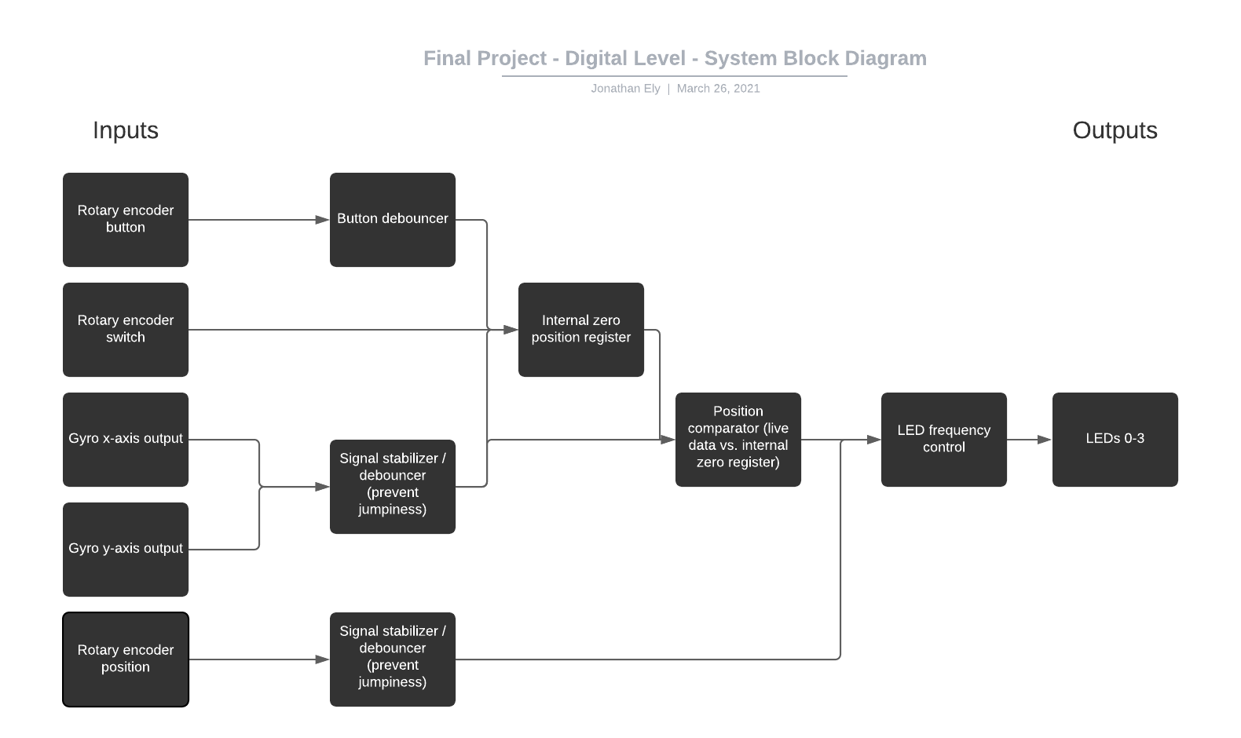
System Block Diagram

Slide 8
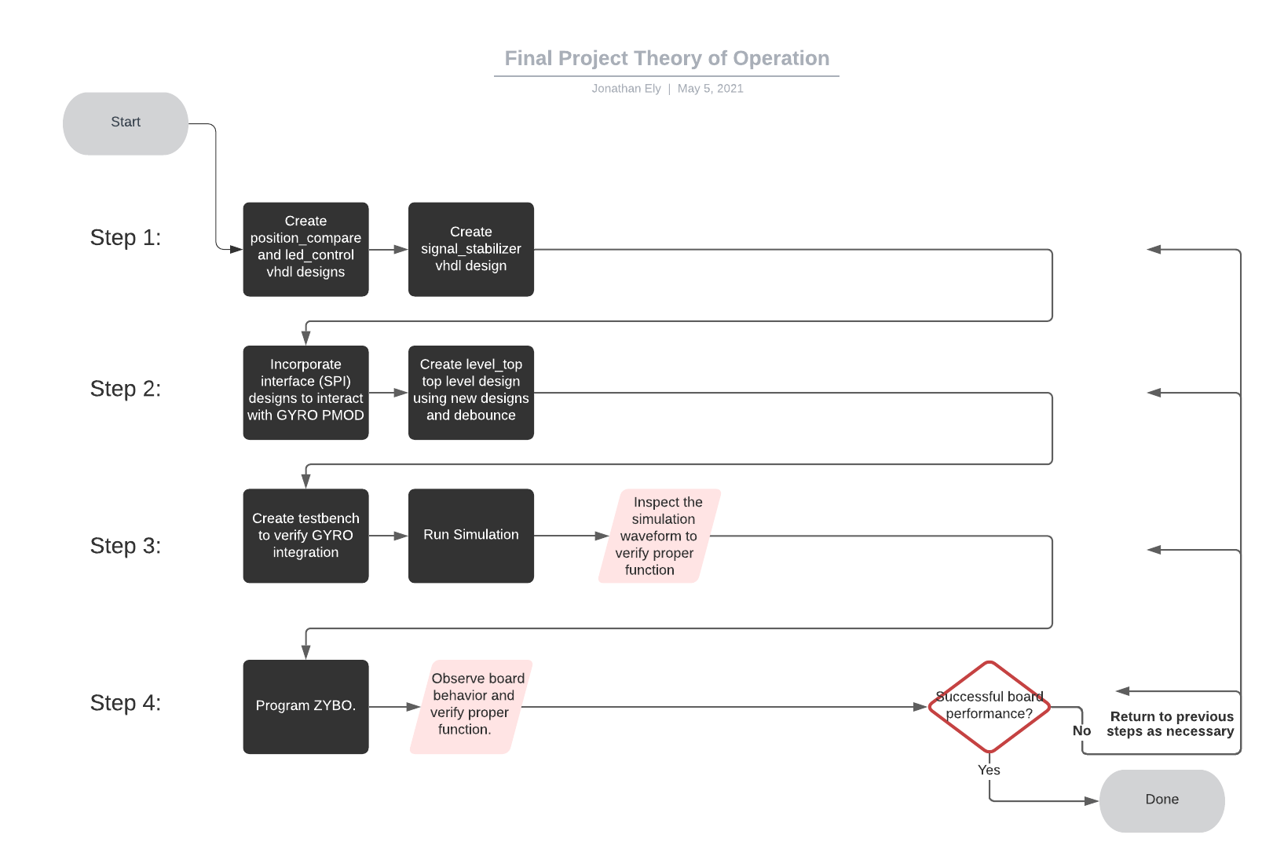
System Theory of Operation

Slide 9
Progress and Complications
Background research into understanding different busses used to interface with PMODs (SPI, I2C, GPIO)
Planned out and coded most of the underlying designs
Practice with different type of rotary encoder
Ultimately ran out of time

Slide 10
Implementation Challenges and Choices
Could be implemented with a single purpose processor efficiently because it’s a simple design concept; applying outputs from sensors to display outputs on LEDs
No need for custom processors or hardware so long as we can interface with a gyro and a rotary encoder

Slide 11
Summary and Moving Forward
Unable to successfully complete this project for this semester, but plans to continue working post-semester; redesign as necessary
Expand on planned design by extending the project to the digital Etch-a-Sketch design previously mentioned

Slide 12
References
Digilent documentation and user manuals
Digilent reference pages, https://reference.digilentinc.com/reference/
Xilinx forums related to SPI interfacing

