Slide 1
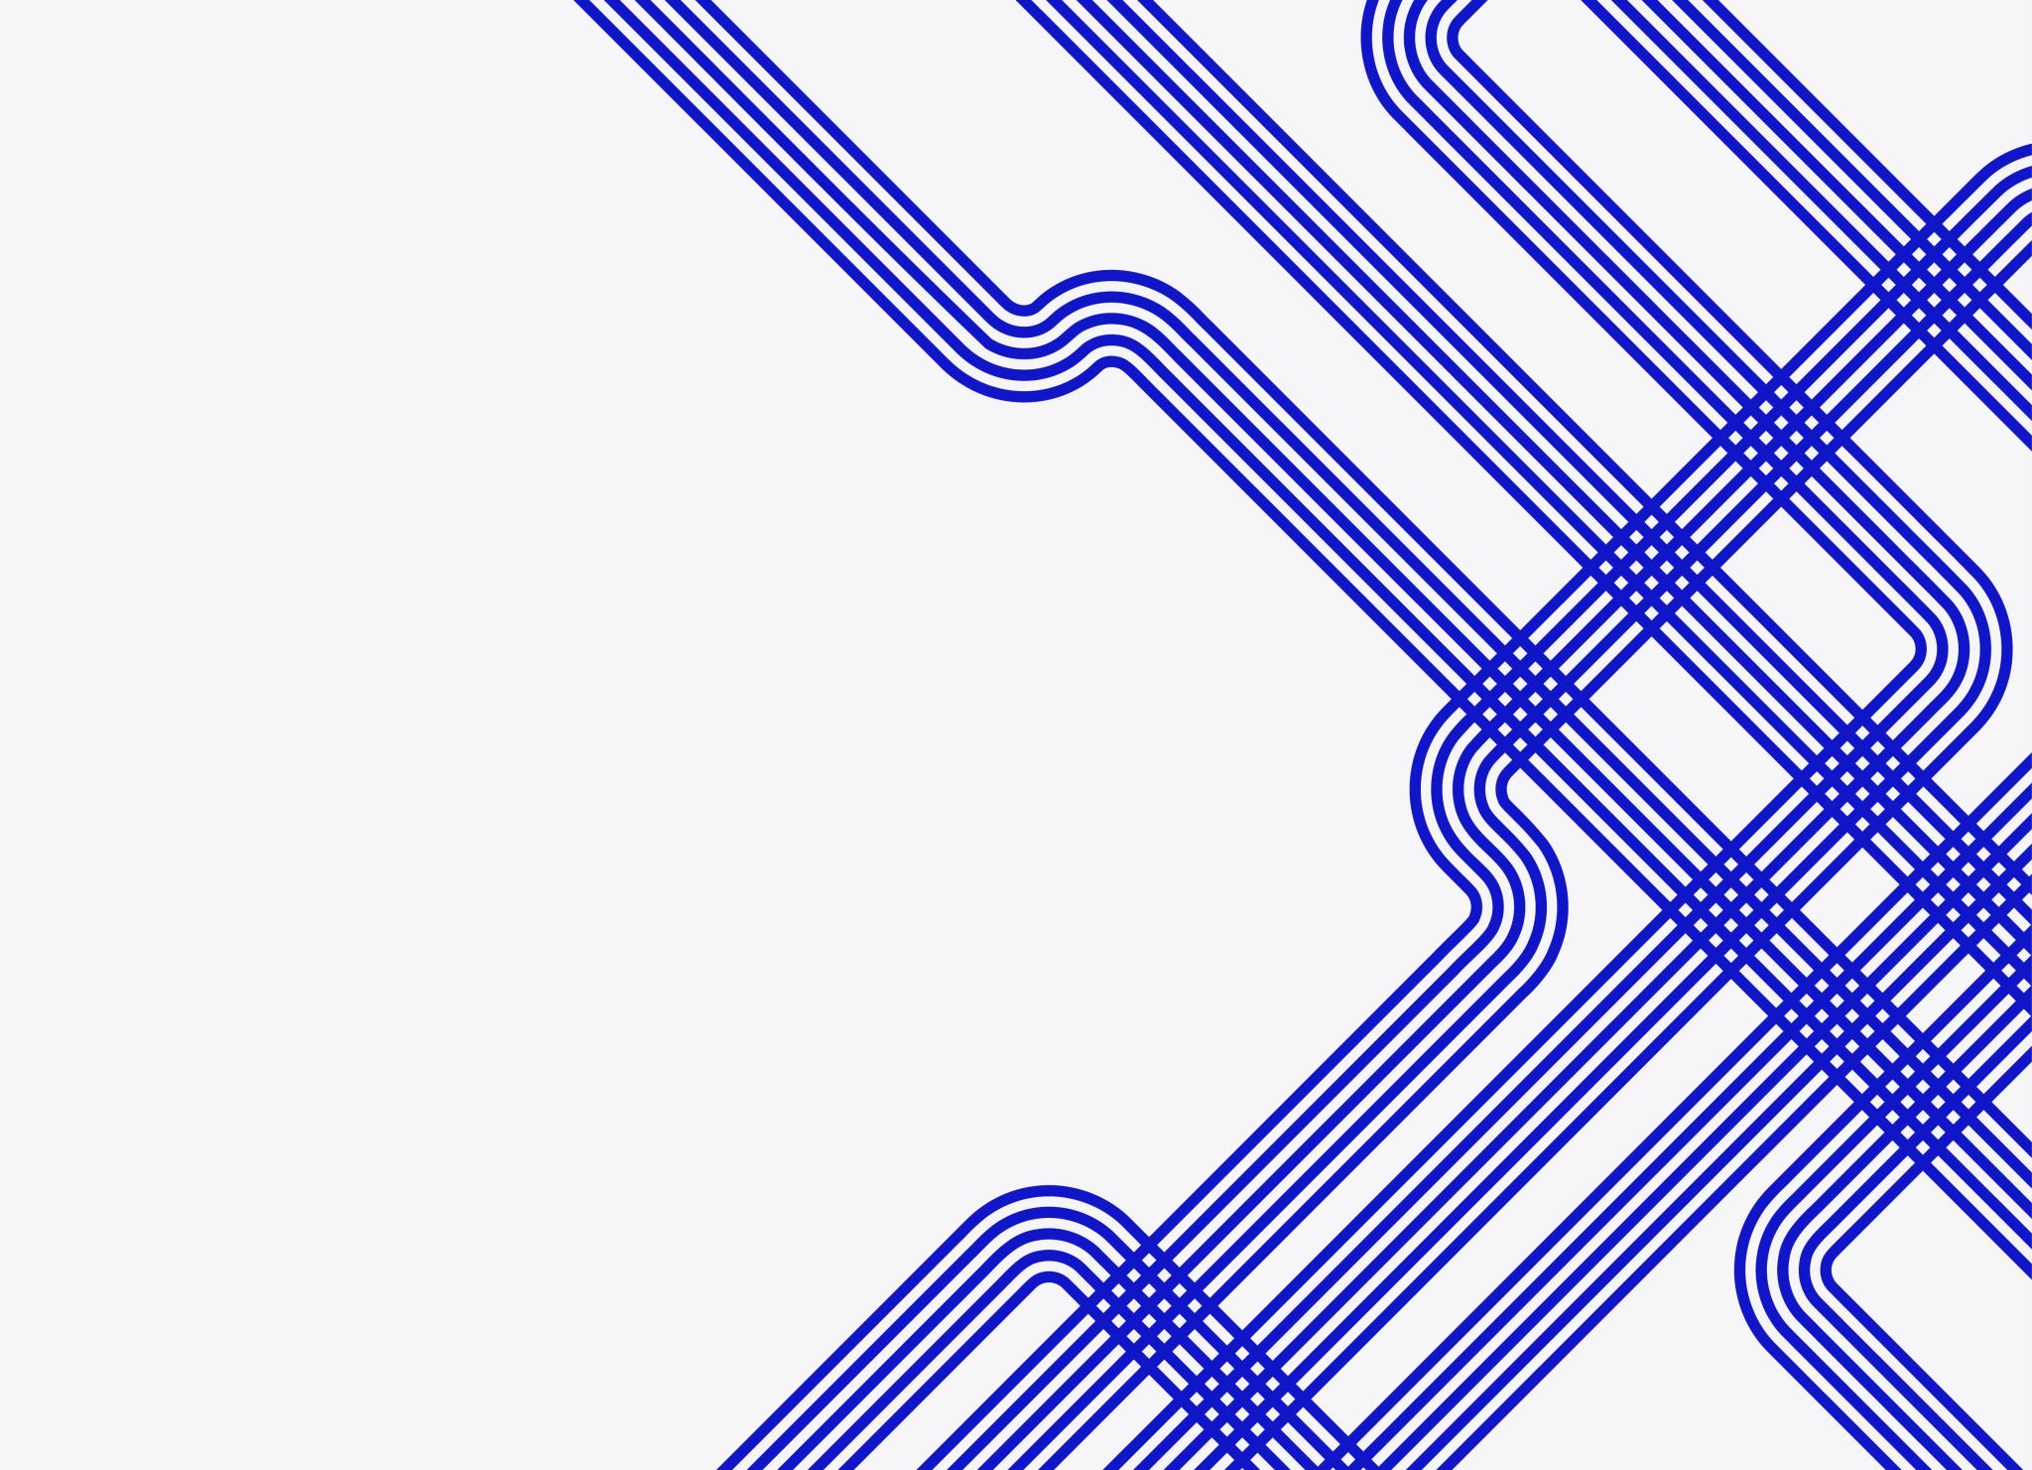
Final Project Proposal – Digital Level
Jonathan Ely

Slide 2
Concept Inspiration
Gyros are neat and interactive
I want to work towards making more complicated designs like a digital Etch a Sketch using a gyro to reset the screen, an OLED display, and two rotary encoders
A digital level would allow me to practice with the gyro as well as a rotary encoder (for added features)
(I have my own board and PMODs, so I can work with the project physically.)

Slide 3
General System Description
When running, the gyro’s x and y output will be used to light the board’s four LEDs that increase in brightness depending on how tilted the gyro is in each respective direction (forward/back, left/right).
A rotary encoder will control the maximum brightness the LEDs can display
The button of the rotary encoder will “zero” the gyro

Slide 4

Problem Solving
The LEDs will be controlled with the output of a clock divider, like the blinker lab, but the counter of the divider will be controlled by the value of the rotary encoder and the x or y axis outputs from the gyro (likely a product of the two, but specifics can be worked through).
There will be an internal register which holds values that the gyro axis output values will be compared with. The greater the difference in value, the brighter the respective LED gets. (Two LEDs per axis, so one LED lights for positive difference, the other lights for negative difference).
The switch on the rotary encoder will control whether the button on the rotary encoder sets the internal position registers to the current position or to zero. This either ‘zeros’ the level or ‘resets’ the level.

Slide 5
Application Space
Construction and carpentry, mainly
A level is useful in any application that would require something to be precisely oriented.

Slide 6
Market / End User
Targeted for general consumers
Can be used for many home improvement projects as well as crafts

Slide 7
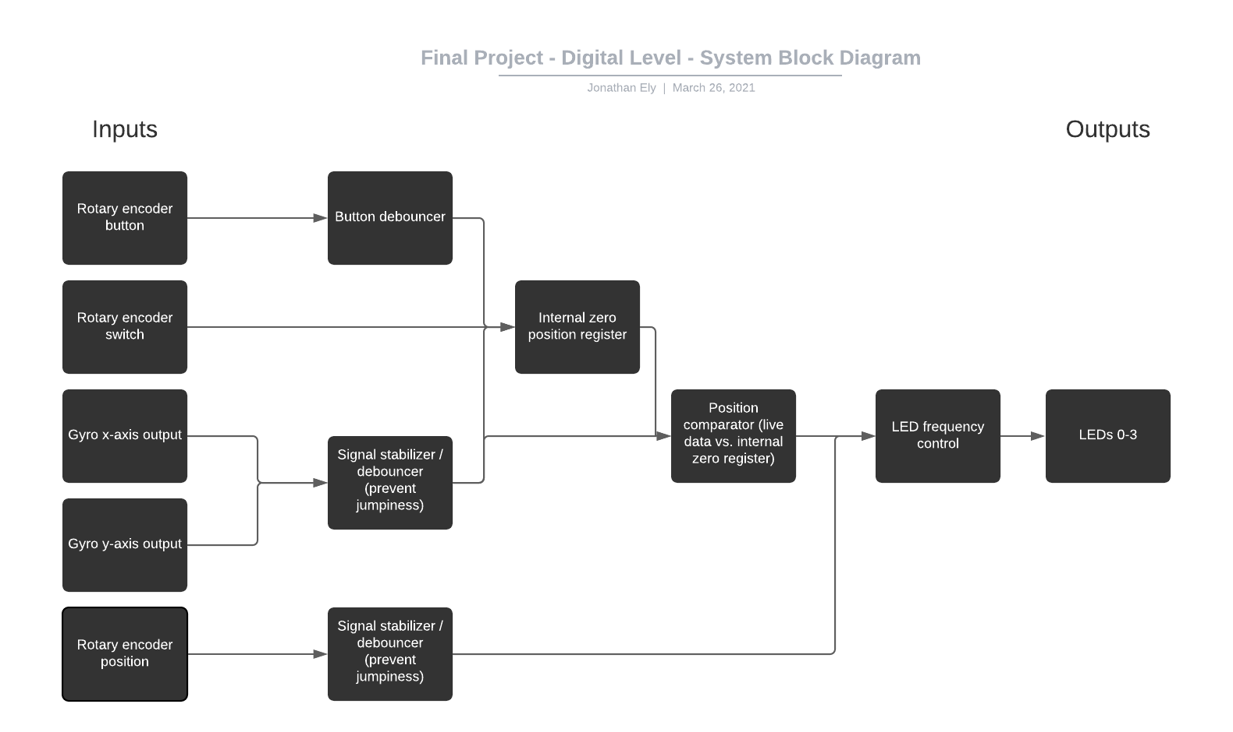
System Block Diagram

