Slide 1
microads
Name : Jonathan Mburu
Registration Number : Sc211/0875/2016
Supervisor: Dr. Geoffrey Mariga

Slide 2
Background of the study
Content Marketing is a form of marketinG focused on creating, publishing, and distributing content for a targeted audience online(“Content marketing,”n.d.,para. 1)
. The 2018 B2B content marketing statistics from the Content Marketing Institute (CMI) show that 91% of B2B marketers use content marketing to reach customers. And the CMI’s 2018 B2C content marketing stats reveal that 86% of B2C marketers think content marketing is a key strategy. (Hall, 2018, Statistics on Content Marketing Usage, para.4)
The use of digital content in marketing has brought along a surge in the number of advertisements per page over the years with small businesses taking advantage of the flexible terms offered by Facebook and Google to advertise their services to consumers on social media websites through targeted advertising.
But with the ever growing number of advertisements, annoying/irrelevant ads and inappropriately intrusive ads, coupled with unethical advertising practices such as advertorials, kick-through ads and in-text advertising, the effectiveness of online advertising could soon take a turn for the worse as 41% of internet users globally use an adblocker in 2019 (Malik, 2019) and 48% in 2020(Baum, 2020) if this number continues to rise, online advertising may become ineffective.
My research question is whether there is a way to deliver advertisements to consumers without them necessarily being online.
Assuming the availability of a reliable internet connection, I hypothesize that a digital content delivery system , coupled with low cost computational devices such as the Arduino Zero W can be used to decentralize the advertising market from websites to brick and mortar stores.
In this paper however due to the financial constraints I will be demonstrating the Digital Content Delivery System only.

Slide 3
Problem Statement
The online advertising industry has seen a surge in uptake and application of digital content in marketing campaigns and strategies, however with the information overload on users together with unethical advertising practices such as advertorials,kick-through ads and in-text advertising,users are turning to adblockers, a trend which puts the effectiveness of online advertising to question, if it continues to rise. There is therefore need to undertake a research on how to go about circumventing the negative effects adblockers would have on the online advertising industry.

Slide 4
General Objectives
Objectives
To develop a digital content delivery system
specific Objectives
To analyze the requirements for a system to deliver digital content
To design a digital content delivery system
To develop core components of the system
To implement the digital content delivery system

Slide 5
RELATED WORKS
S/No | Authors | Contribution | Gaps
1 | D Shen-Orr, Eli Hibshoosh, Steve Epstein, Stephanie Wald, Yaakov Belenky, Yigal Shapiro | Introduced an automatic payment mechanism for purchasing Digital Content | No relevance Metrics for Digital Content
2 | Colins Jeavons | The system includes a computer program product for determining relevance of the advertising content with regard to a selected item of editorial content | No prularity of communication devices neither data intereaction capabilities
3 | Binzhen Zhang, Kum Shiong Chong | Comprises of a plurality of communication devices and a content server is provided. Each of the plurality of communication devices has a display panel for enabling haptic interaction with data displayed thereon | No billing system
4 | Rick Kay, Gregory B Temmkin, Mathew L Olson, David J Hendrickson | A billing system tracks the bill for each unit in the multiple unit environment, based on the accessed digital content | No relevance metrics for digital content

Slide 6
Methodology
The following fact finding twechniques were employed observation,interviews and websurfing
I applied the agile development model to develop the system
In my project I utilize a Php framework called Codeigniter to develop the user login,signup and advertisement scheduling interface.
I test the web application using an apache local server installed through the wamp suite.
To simulate the working of the Arduino Zero W as a display tool for content over a network, I develop a simple GUI in python that accesses the database and retrieves scheduled advertisments to display.

Slide 7
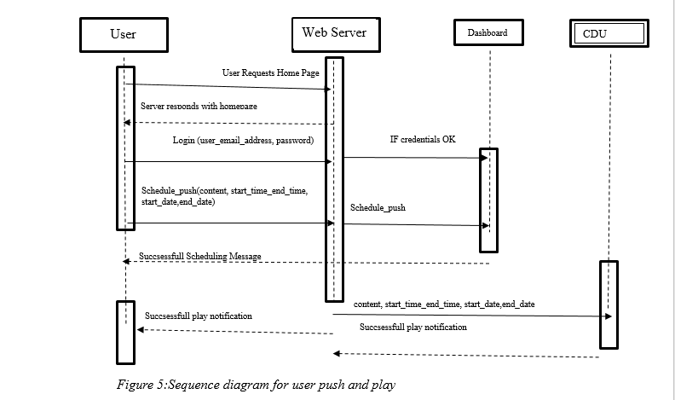
ANalysis
Sequence Diagram

Slide 8
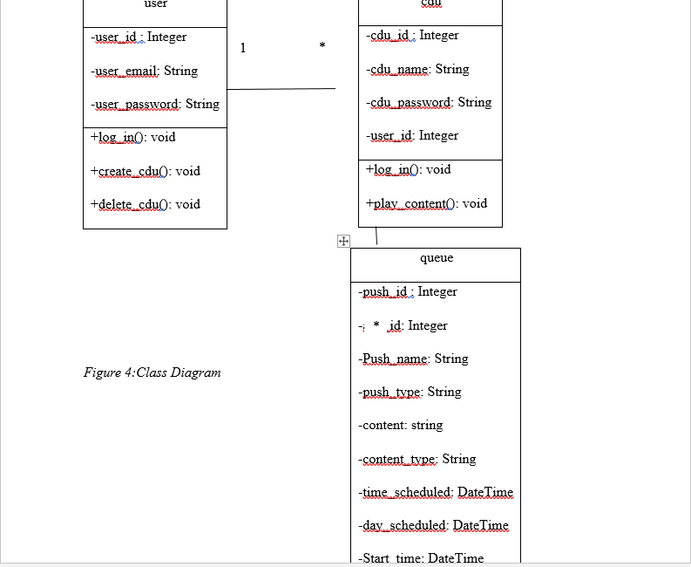
Class Diagram

Slide 9
SYSTem flowchart
ADU login Prompt first time use
Retrieves scheduled object from databases
Systems checks for new advertisements in the database
Displays Image

Slide 10
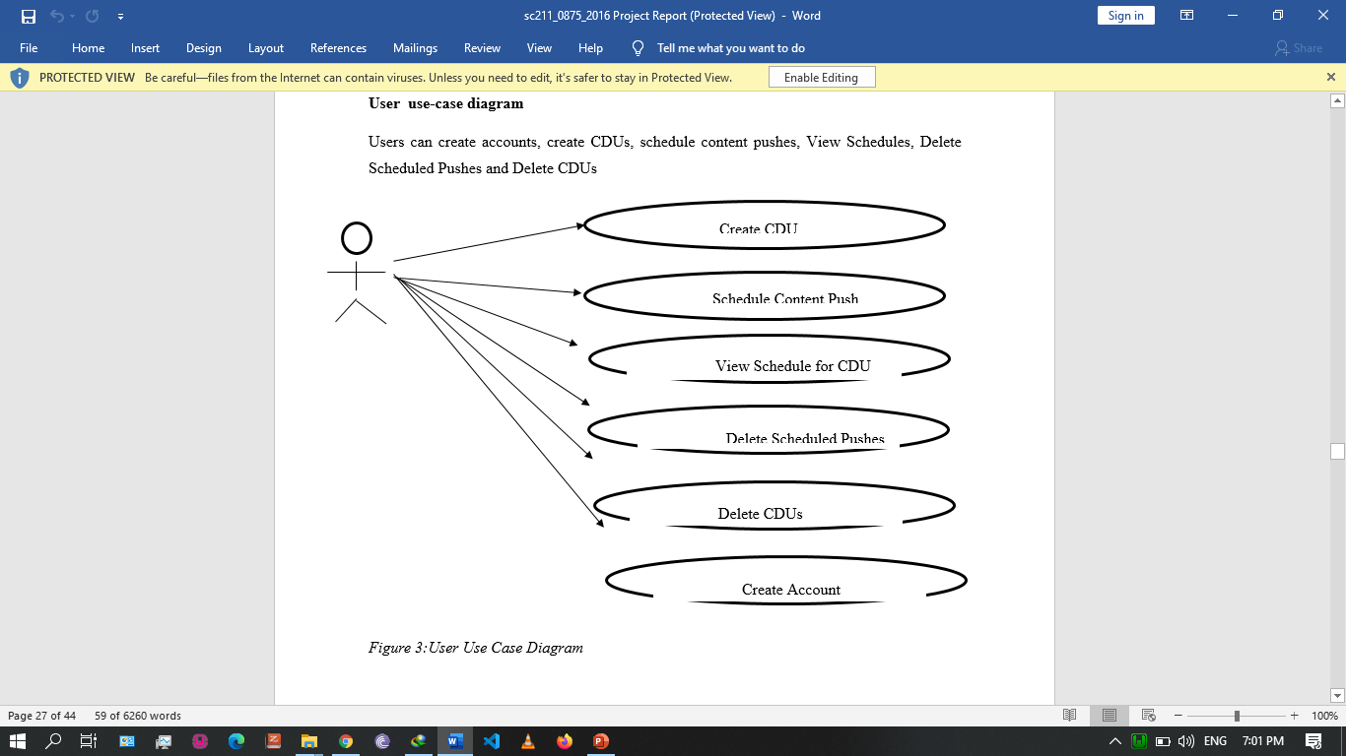
Design

Slide 11
Conclusion and future works
Having achieved my general objective of developing a digital content delivery system, developing a full solution where Arduino Zero W would be used as the display component is now halfway done as the system can receive and deliver digital content over a network.
In future works, I aim to incorporate a billing system that would allow owners of the full solution to receive payments from advertisers whenever they display their advertisments on their premises, as well as evolve the system to accept video formats as well.

Slide 12
References
Susan Perschke (23 April 2012).”WampServer delivers a smart, windows-friendly platform for Apache,MySQL and PHP-based apps”.Network World. Retrieved 20 January 2015.
https://en.m.wikipedia.org/wiki/Digital_content retrieved on May 2015.
D Shen-Orr,Eli Hibshoosh, Steve Epstein, Stephanie Wald, Yaakov Belenky, Yigal Shapiro, (2002) Digital content delivery system and method .
Colin Jeavons. (2012) Content management and delivery system.
Binzhen Zhang, Kum Shiong Chong. (2010) Content management and delivery system.
Rick Kay, Gregory B Temmkin, Mathew L Olson, David J Hendrickson. (2007) Digital content delivery system transaction engine.
Tuhina Chattopadhyay (2019, October 23). Digital Media Consumption and Trends. https://www.mantralabsglobal.com/blog/digital-media-consumption/

Slide 13
end

