Slide 1
STUDENT ATTENDACE TRACKING SYSTEM
Name : Henry Mutua
Registration Number : Sc211/1163/2016
Supervisor: Dr. Geoffrey Mariga

Slide 2
Background of the study

Slide 3
Problem Statement
The online advertising industry has seen a surge in uptake and application of digital content in marketing campaigns and strategies, however with the information overload on users together with unethical advertising practices such as advertorials,kick-through ads and in-text advertising,users are turning to adblockers, a trend which puts the effectiveness of online advertising to question, if it continues to rise. There is therefore need to undertake a research on how to go about circumventing the negative effects adblockers would have on the online advertising industry.

Slide 4
General Objectives
Objectives
To develop a digital content delivery system
specific Objectives
To analyze the requirements for a system to deliver digital content
To design a digital content delivery system
To develop core components of the system
To implement the digital content delivery system

Slide 5
RELATED WORKS
S/No | Authors | Contribution | Gaps
1 | D Shen-Orr, Eli Hibshoosh, Steve Epstein, Stephanie Wald, Yaakov Belenky, Yigal Shapiro | Introduced an automatic payment mechanism for purchasing Digital Content | N/A
2 | Colins Jeavons | The system includes a computer program product for determining relevance of the advertising content with regard to a selected item of editorial content | N/A
3 | Binzhen Zhang, Kum Shiong Chong | Comprises of a plurality of communication devices and a content server is provided. Each of the plurality of communication devices has a display panel for enabling haptic interaction with data displayed thereon | N/A
4 | Rick Kay, Gregory B Temmkin, Mathew L Olson, David J Hendrickson | A billing system tracks the bill for each unit in the multiple unit environment, based on the accessed digital content | N/A

Slide 6
Methodology
In my project I utilize a Php framework called Codeigniter to develop the user login,signup and advertisement scheduling interface.
I test the web application using an apache local server installed through the wamp suite.
To simulate the working of the Arduino Zero W as a display tool for content over a network, I develop a simple GU in python that accesses the database and retrieves scheduled advertisments to display.

Slide 7
ANalysis
Flowchart
User Login
User creates ADU
User schedules a Push
User logs out
User signs up

Slide 8
SYSTem flowchart
ADU login Prompt first time use
Retrieves scheduled object from databases
Systems checks for new advertisements in the database
Displays Image

Slide 9
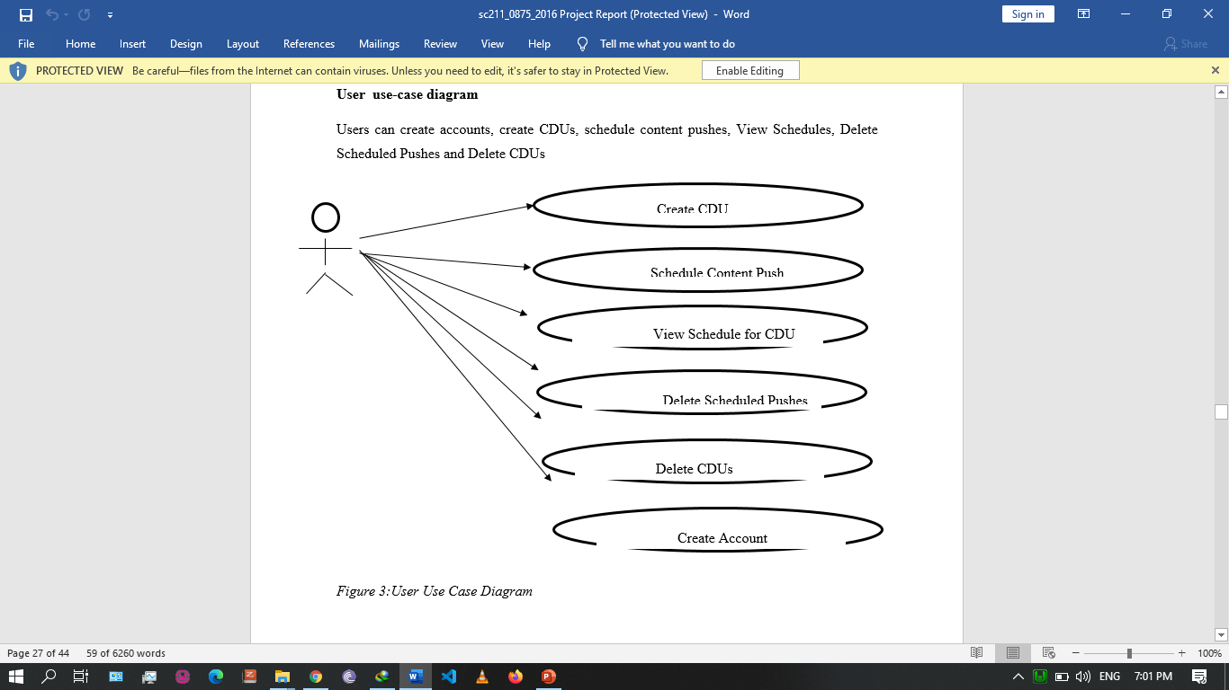
Design

Slide 10
Conclusion and future works
Having achieved my general objective of developing a digital content delivery system, developing a full solution where Arduino Zero W would be used as the display component is now halfway done as the system can receive and deliver digital content over a network.
In future works, I aim to incorporate a billing system that would allow owners of the full solution to receive payments from advertisers whenever they display their advertisments on their premises, as well as evolve the system to accept video formats as well.

Slide 11
end

