Slide 1

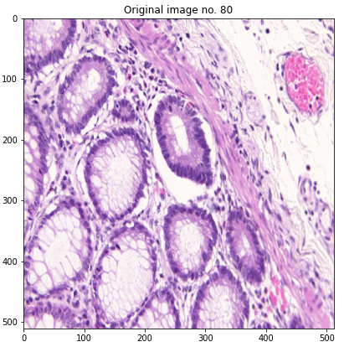
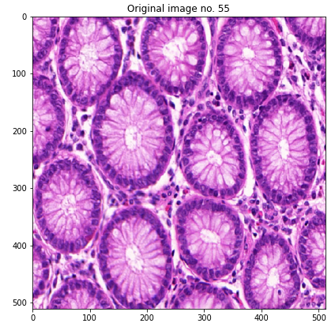
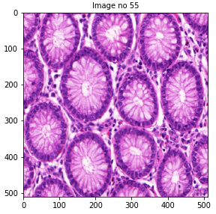
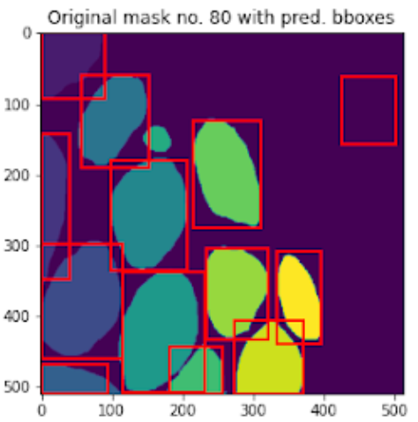
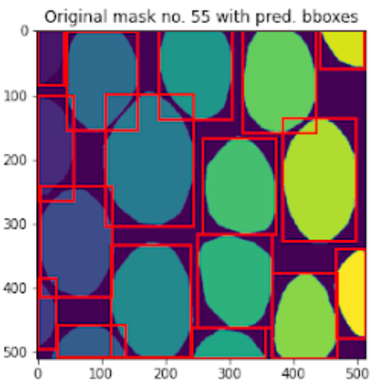
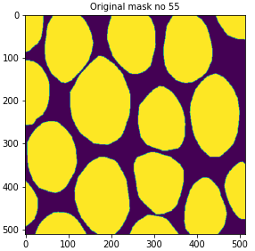
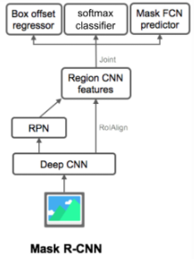
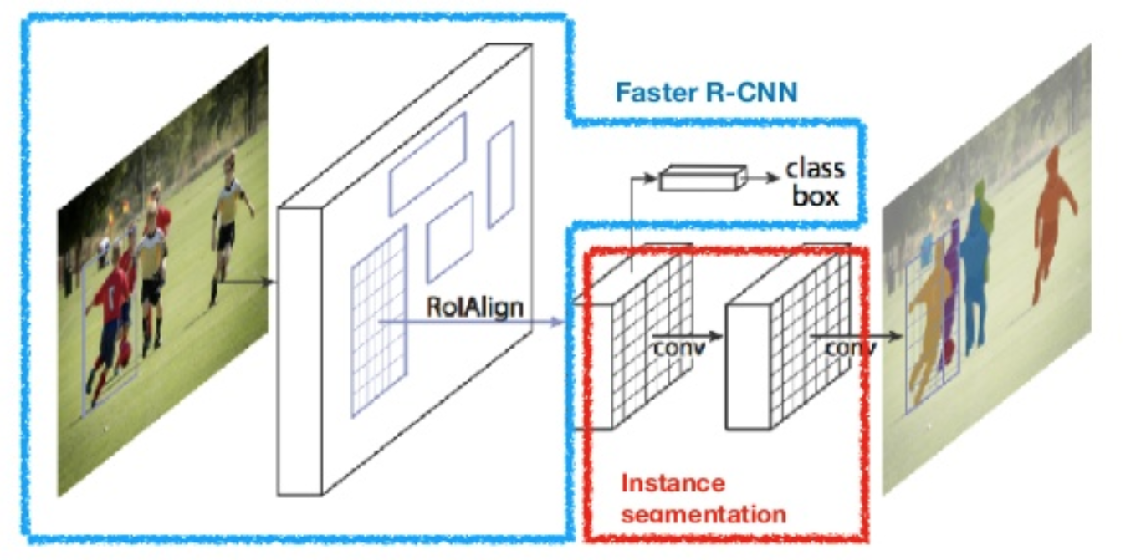
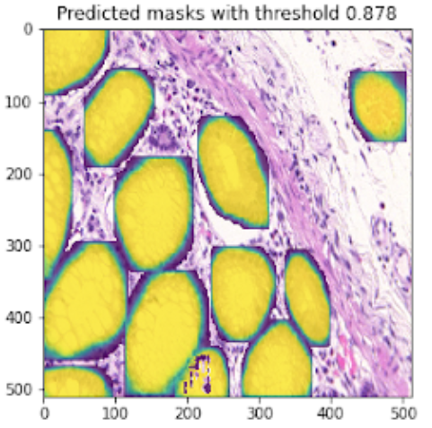
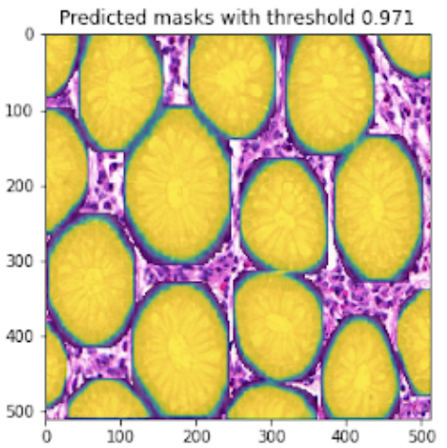
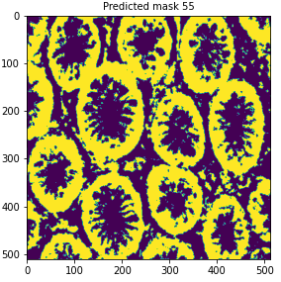
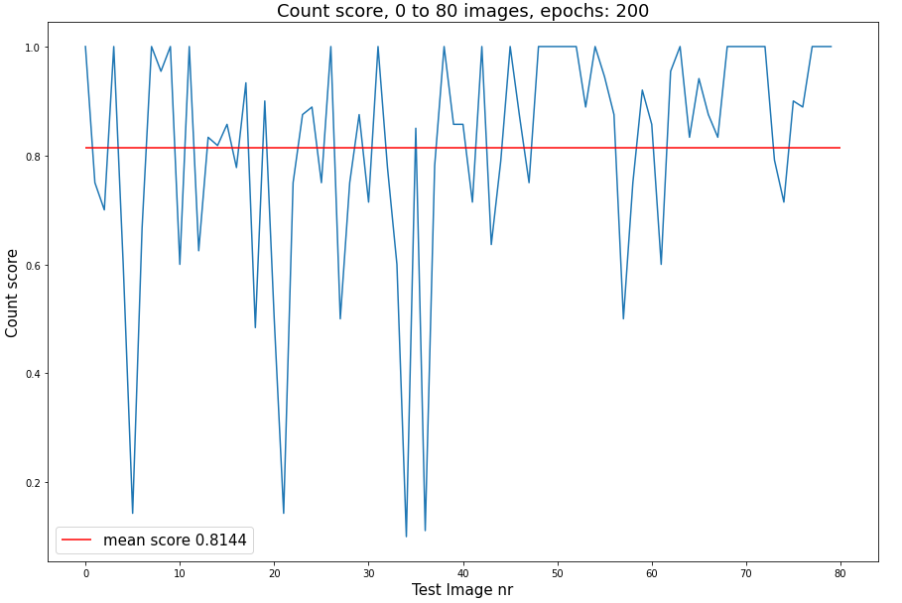
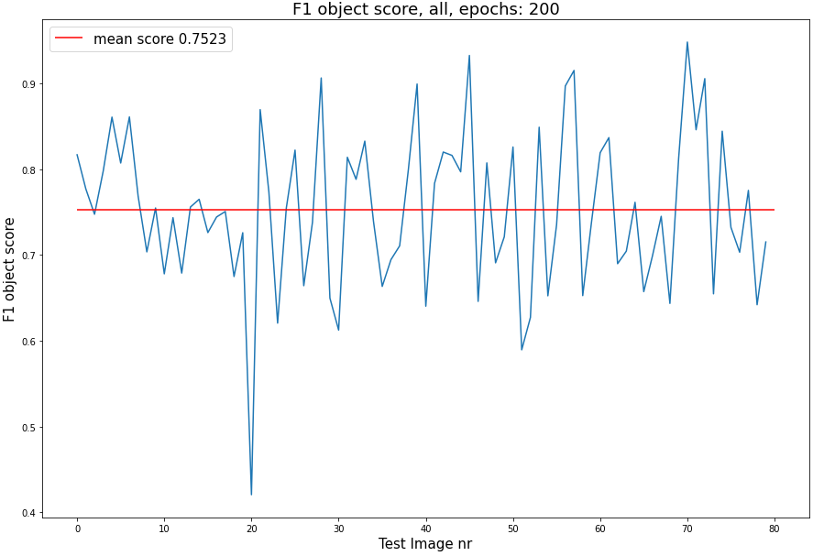
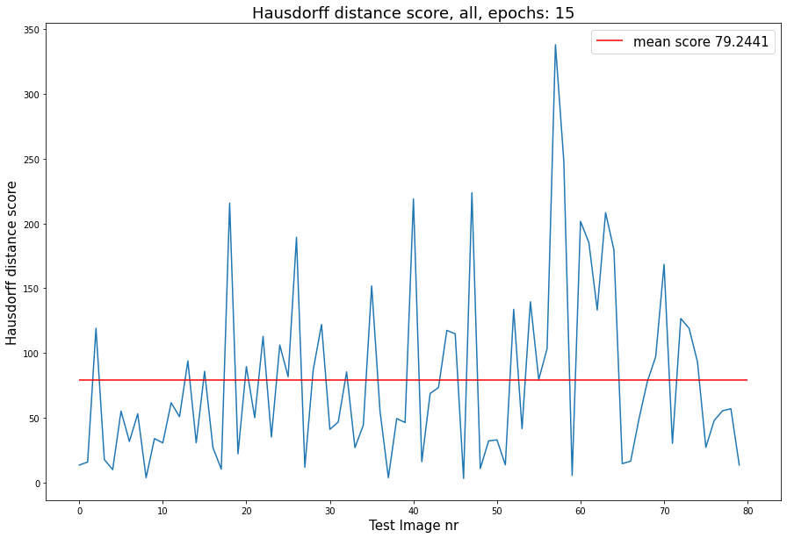
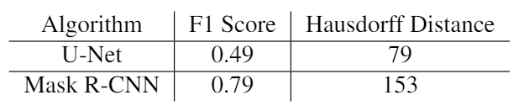
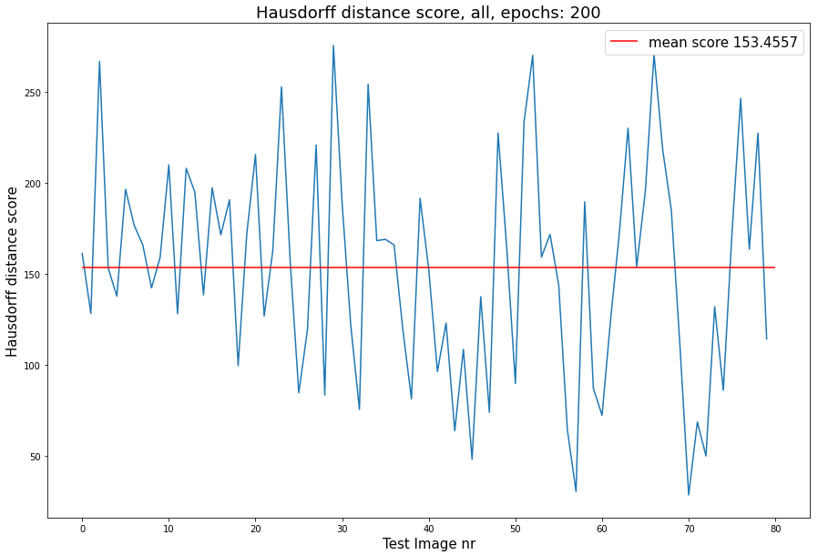
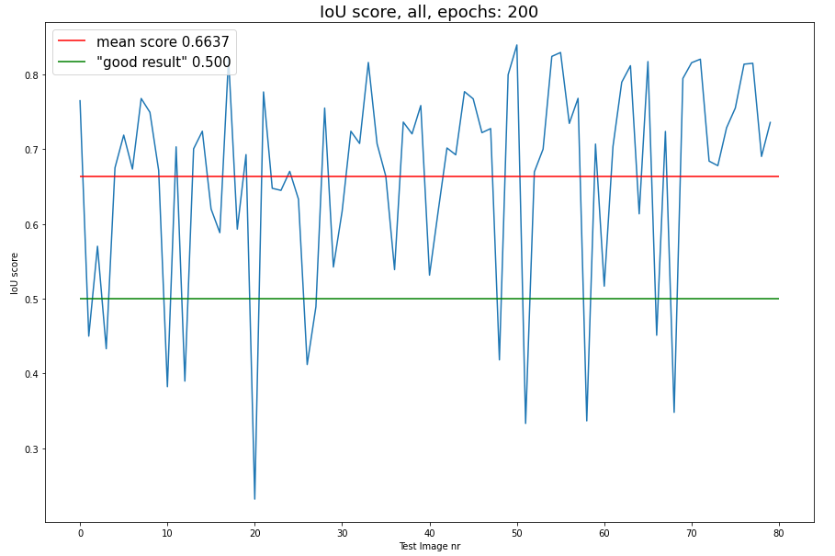
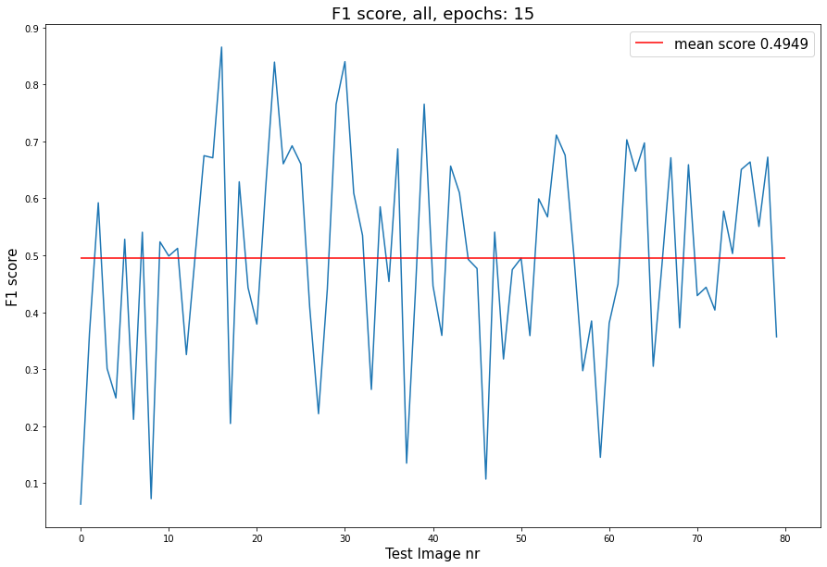
Segmentation of cells using Mask-RCNN and U-Net
:
[By Jonathan Gundorph and Johanne Thorkilsdatter] Technical University of Denmark
Mask R-CNN Results
(Object detection and semantic segmentation)
U-Net Results
(Semantic segmentation)
Introduction
Clinicians and researchers spend an enormous amount of time and resources on repetitive, manual tasks, such as identifying and counting objects in images. The process of identifying objects can be highly subjective, which induces reproducibility issues. Segmentation of gland is challenging due to the great variation of glandular morphology.
By using deep learning to aid clinicians and researchers in identifying objects in images, the repetitive and complex tasks can be reduced, while minimizing scientific reproducibility issues.
The GLAND (Warwick-QU) Dataset
The dataset was used in a competition in 2015 about gland segmentation on images of Hematoxylin and Eosin (H&E) stained slides, together with ground truth annotations by expert pathologists
Image 80 Image 55 Image 55
Model specifications:
Model:
ResNet-50 Convolutional Neural Network
Optimizer:
Stochastic Gradient Descent (SGD)
Hyperparameters:
Initial learning rate: 0.005
Momentum: 0.9
Weight decay: 0.0005
Learning rate decay: Staircase, 10x every 3 epochs
Batch size: 2
Epochs: 200
Architecture of Mask R-CNN
Loss function of Mask R-CNN
Mask R-CNN metrics (all images)
U-Net Metrics (15 epochs)
Count-score (mean: 0.81)
F1-obj score (mean: 0.75)
Hausdorff-Score (mean: 79)
Future work
More data augmentation
Look more into alt. optimizers (such as AdamW)
Use a deeper architecture, such as ResNet-101
Improve metrics
Different batch sizes
Hausdorff-Score (Mean: 153)
IoU-Score (Mean: 0.66)
F1 score (mean: 0.49)
References
[1] HE, Kaiming, et al. Mask r-cnn. In: Proceedings of the IEEE international conference on computer vision. 2017. p. 2961-2969.
[2] REN, Shaoqing, et al. Faster r-cnn: Towards real-time object detection with region proposal networks. In: Advances in neural information processing systems. 2015. p. 91-99.
[3]Torchvision Object Detection Finetuning Tutorial, [URL: https://pytorch.org/tutorials/intermediate/torchvision_tutorial.html]
Notes:
‹#›
To do: mark chosen image example in the metrics plots
Mask R-CNN extends Faster R-CNN, which uses bounding box detection. The extension is an added branch for predicting an object mask / pixel-level image segmentation, along with the existing branch for bounding box detection in Faster R-CNN. Image segmentation involves drawing the boundaries of the objects within an input image at the pixel level.
Bounding box: Created from object detection
Masks: Segmantic segmentation
Pretrained on MS COCO
ROI Align: Region of interest
Metrics explanation:
Img3: Argmax: Pixel values, avoid cells with low confidence and noise in image
Mask R-CNN kilde: https://arxiv.org/pdf/1703.06870.pdf / (with boxes) https://lilianweng.github.io/lil-log/2017/12/31/object-recognition-for-dummies-part-3.html

