Slide 1
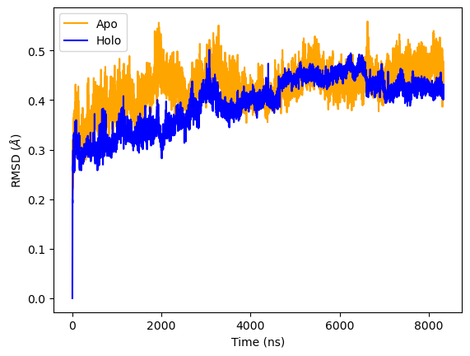
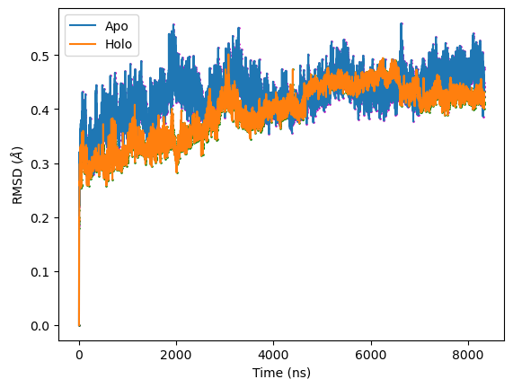
Change in RMSD with ligand binding
RMSD computed with respect to first frame of trajectory
Overall smaller magnitude RMSD in ligand-bound trajectory, but doesn’t look decisive

Slide 2
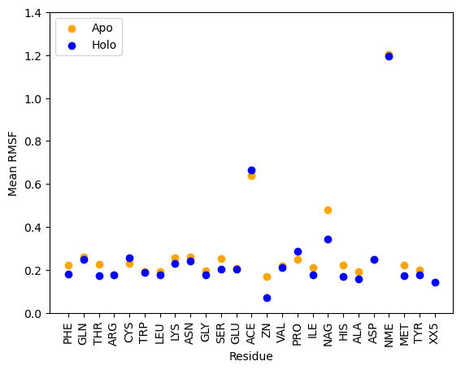
RMSF per residue
Non-amino acid residues have highest RMSF
Overall decrease in residue’s RMSF after binding of ligand

Slide 3
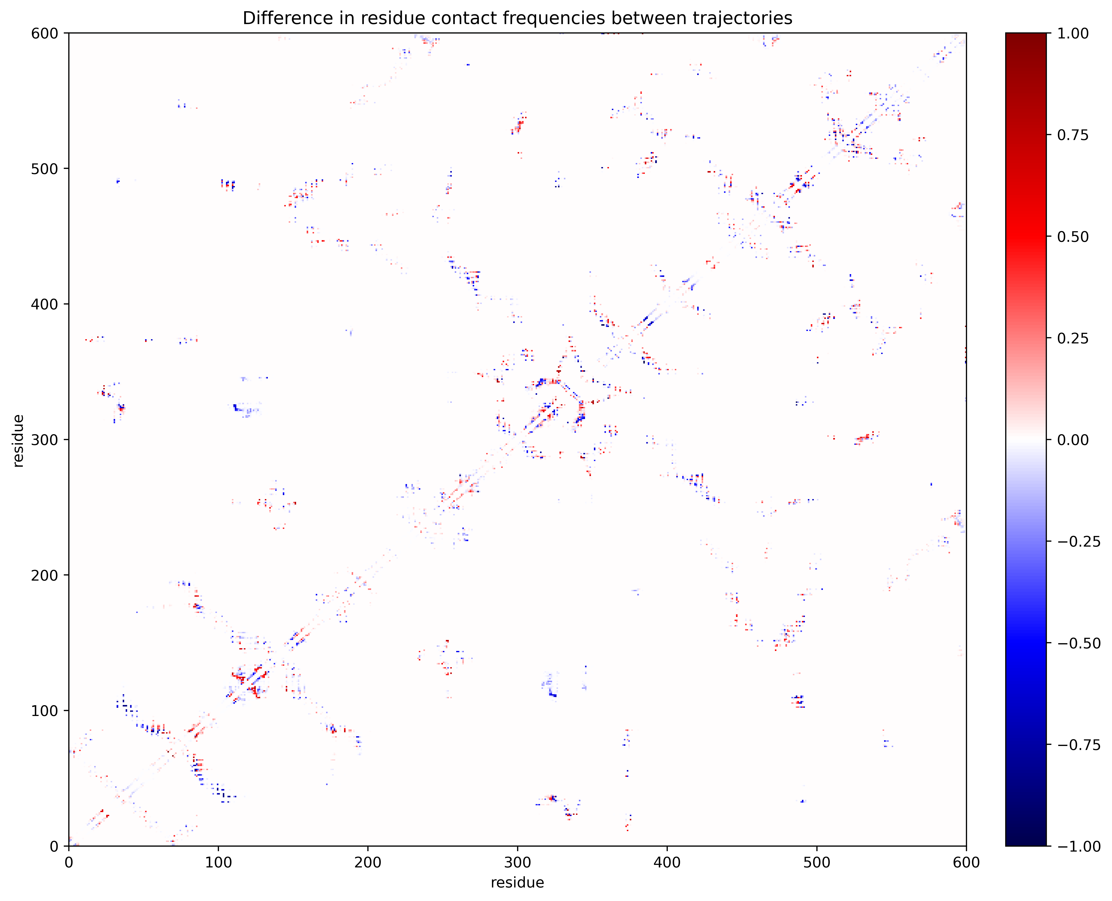
Change in contact frequencies

Slide 4
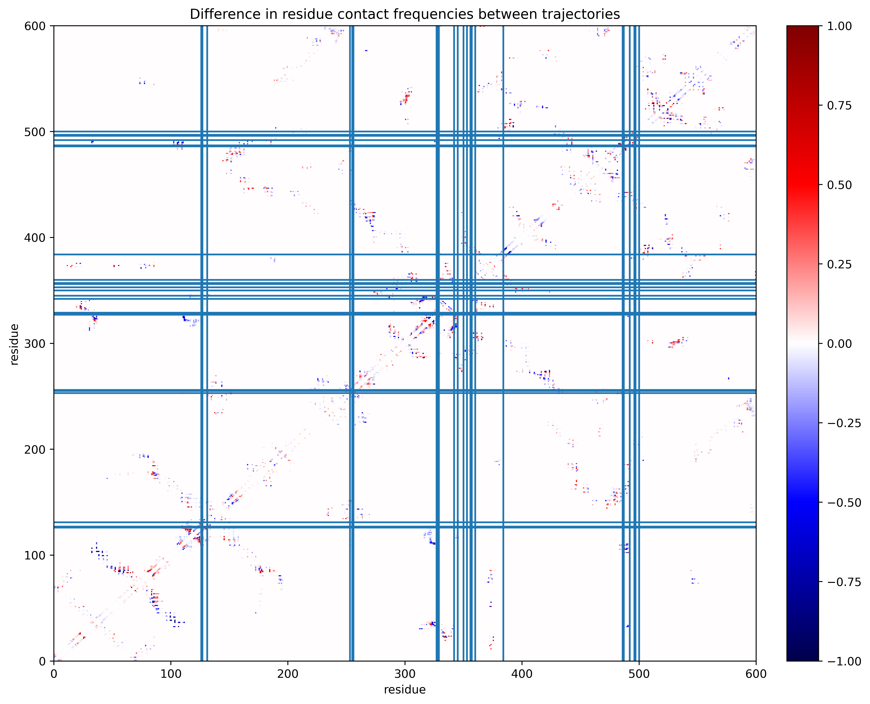
Change in contact frequencies
Ligand binding residues

Slide 5
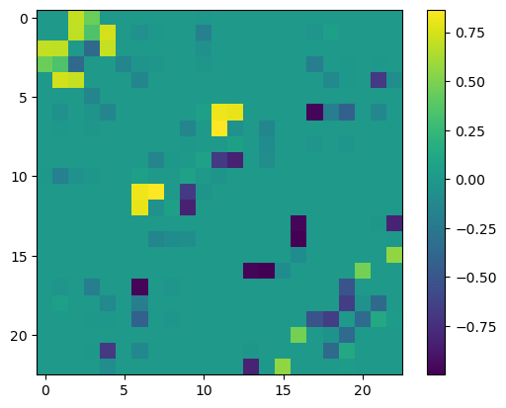
Change in contact frequency after ligand binding

Slide 6
Change in contact frequency after ligand binding
HIS <-> ASP
HIS <-> THR
PRO <-> ASP
HIS <-> GLU
GLU <-> GLU
(+) charged amino acids
(-) charged amino acids
Polar uncharged

