Slide 1
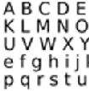
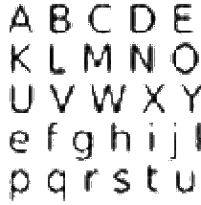
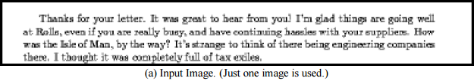
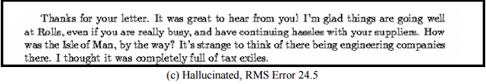
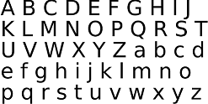
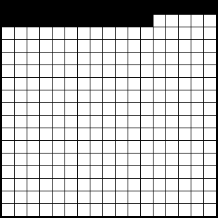

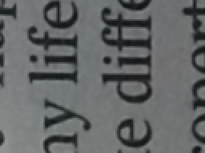
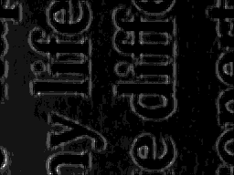
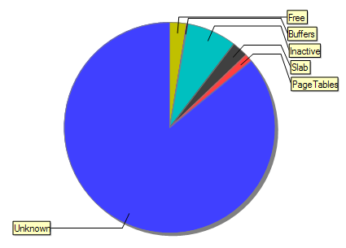
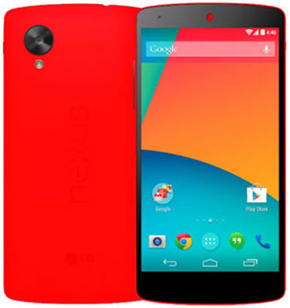
ISee++ - An Image Hallucination Android Application
Jonathan Holland, supervised by Surya Singh
THE PROBLEM
Brief
Design, implement and evaluate a mobile application to up-sample images (increase the resolution) of printed text.
Goals
High final image quality with readable text.
No internet usage
Low power usage
High Speed
Heavy code abstraction to easily allow further work
Assumptions
Image from average android camera
Image content is printed text from the Latin/Roman alphabet (not necessarily English)
Image content assumed to be monochrome (black & white)
THE SOLUTION
Hallucination
The chosen super-resolution algorithm is known as ‘Hallucination’:
Allows single or multi-image super-resolution
Uses a high-resolution library of ‘ideal’ images
Application highly dependent upon this library.
Test Platform
Nexus 5 with Android 5.1.1
Images at 1280x960, then sub-sampled.
Newspaper text & deliberately blurred images of the library image
RESULTS
Ideally the HR library should be composed of the exact objects desired in the final hallucinations. The below newspaper section used the same library image (pure monochrome alphabet):
Similar results were obtained for 8x resolution, also with dark artifacts.
ANALYSIS
The library should always contain only the exact desired images (including ratio of colours and shades)
An allowance of higher differences in weighted PS scores results in a less robust solution, decreased computation and increased speed
If a comparison only has to be made to the first 1/10th elements then the speed is essentially 10x.
If the image is large, memory can also be an issue. For the full 8MP of the Nexus 5, the limit of 500mb is reached:
4x resolution. Pre-processed scaled image (left) and final hallucinated image (right).
Baker, S., & Kanade, T. (2002). Limits on super-resolution and how to break them.
Visual representation of pixels having to be checked
Library image chosen based on assumptions.
4x resolution. Pre-processed scaled image (left) and final hallucinated image (right).
Memory graph during processing. Blue is the memory currently under use.

