Slide 1

Infectious Disease Tracking with AWS
(Near) Real-Time Analysis of Streaming Twitter Data
By Jonathan Hourany

Slide 2
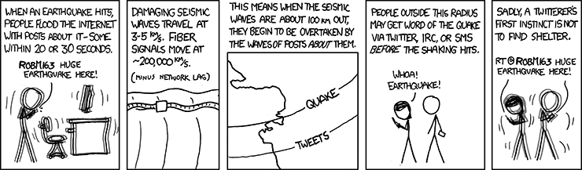
Motivation
Can we do that same for infectious diseases?

Slide 3
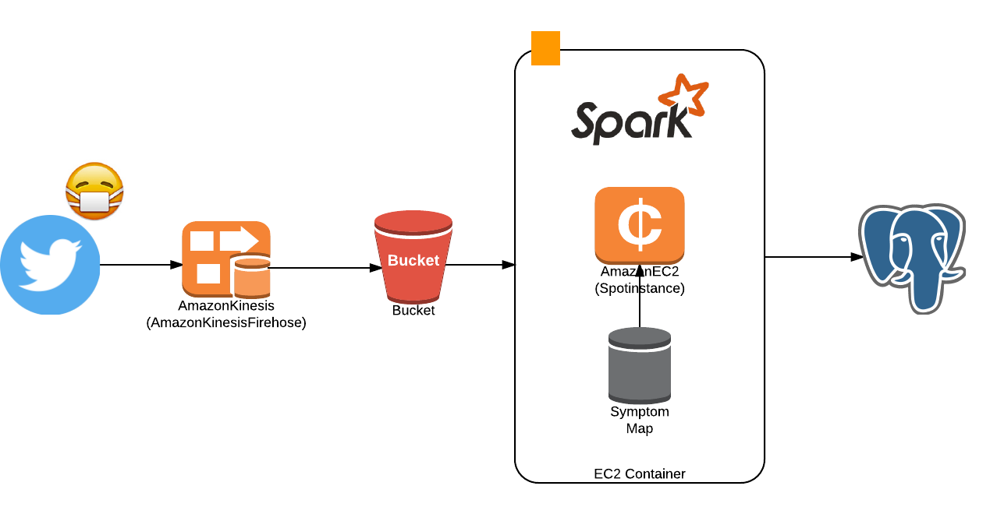

Slide 4
Tracking has limited options
Can search by words or location, but not both
Can’t search by # alone
JSON Object is variable in shape
Many fields, no explanation
Size disproportionate to Tweet
Twitter data is a f*@#%ing mess

Slide 5
u'contributors': None, u'coordinates': None, u'created_at': u'Tue Jul 12 07:21:15 +0000 2016', u'entities': {u'hashtags': [{u'indices': [12, 21], u'text': u'TillNoon'}, {u'indices': [60, 72], u'text': u'DoctorsRoom'}, {u'indices': [84, 98], u'text': u'DoctorMhlongo'}], u'symbols': [], u'urls': [], u'user_mentions': [{u'id': 847073700, u'id_str': u'847073700', u'indices': [3, 10], u'name': u'Vuma FM', u'screen_name': u'VumaFM'}, {u'id': 98630335, u'id_str': u'98630335', u'indices': [27, 41], u'name': u'Vanessa Marawa', u'screen_name': u'VanessaMarawa'}]}, u'favorite_count': 0, u'favorited': False, u'filter_level': u'low',
u'created_at': u'Tue Jul 12 07:20:11 +0000 2016', u'entities': {u'hashtags': [{u'indices': [0, 9], u'text': u'TillNoon'}, {u'indices': [48, 60], u'text': u'DoctorsRoom'}, {u'indices': [72, 86], u'text': u'DoctorMhlongo'}], u'symbols': [], u'urls': [], u'user_mentions': [{u'id': 98630335, u'id_str': u'98630335', u'indices': [15, 29], u'name': u'Vanessa Marawa', u'screen_name': u'VanessaMarawa'}]}, u'favorite_count': 1, u'favorited': False, u'filter_level': u'low', u'geo': None, u'id': 752764478152970240, u'id_str': u'752764478152970240', u'user': {u'contributors_enabled': False, u'created_at': u'Wed Sep 26 09:25:58 +0000 2012', u'default_profile': False, u'default_profile_image': False, u'description': u'Welcome to Vuma 103 FM - KZN Be Inspi

Slide 7

Message Queue
Streams Directly to S3
Every 5 minutes or 5 MB

Slide 9

Cron job pull from S3
PySpark!
Extremely fast
Unprecedented network bandwidth

Slide 10
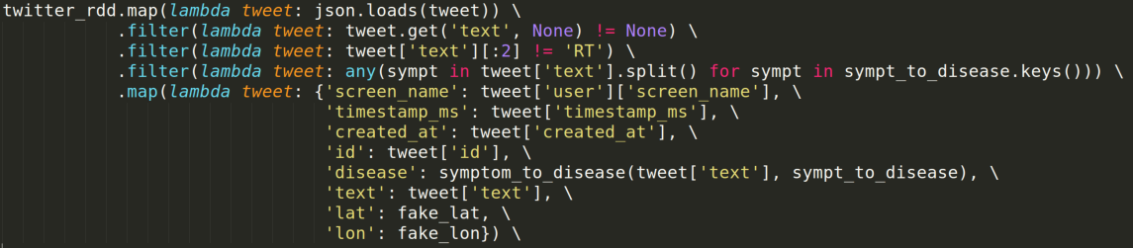

Slide 12
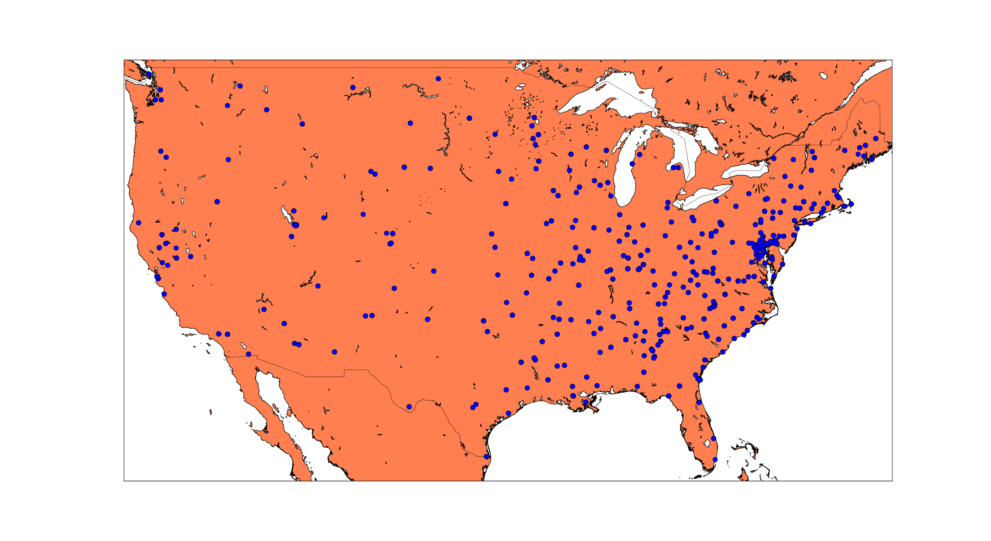

Slide 13
v2.0
Spark Clusters
Dynamic Mapping

