Slide 1

Rockbuster stealth: customer Strategy for online launch
Data-Driven Market Prioritization and Loyalty Program
Presented by: Jonathan Howell

Slide 2
Baseline: our customer snapshot
Total Customer Count: 599
Core Film Rating: PG-13
Operations: Two Store Locations
Story Point: Establish the starting point – a small, concentrated customer base that needs a global growth strategy

Slide 3
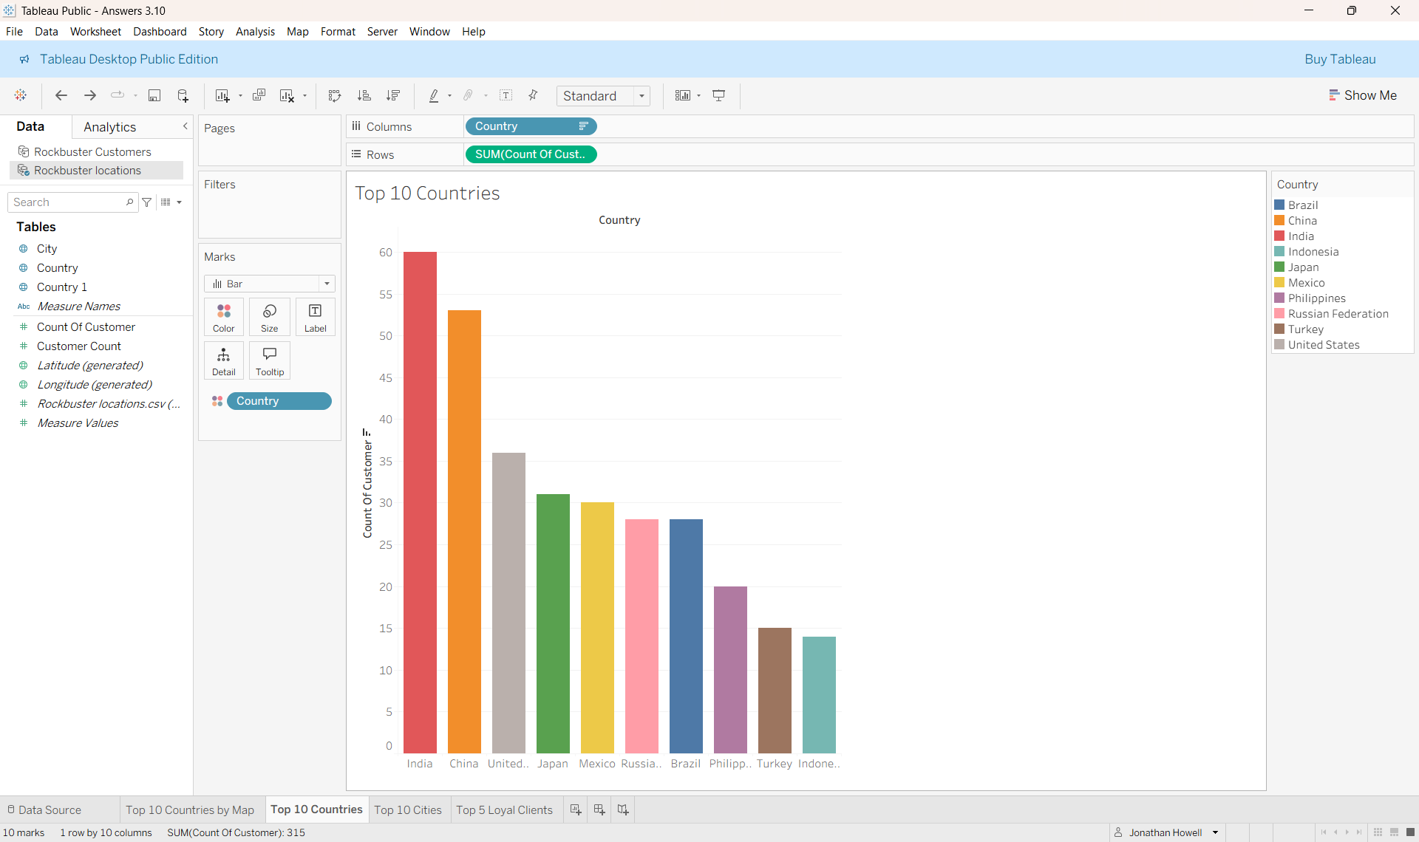
Priority market 1: global customer density
India is our clear priority with 60 customers. The top 10 countries represent 67% of our current customer base.
Source: Tableau Public

Slide 4

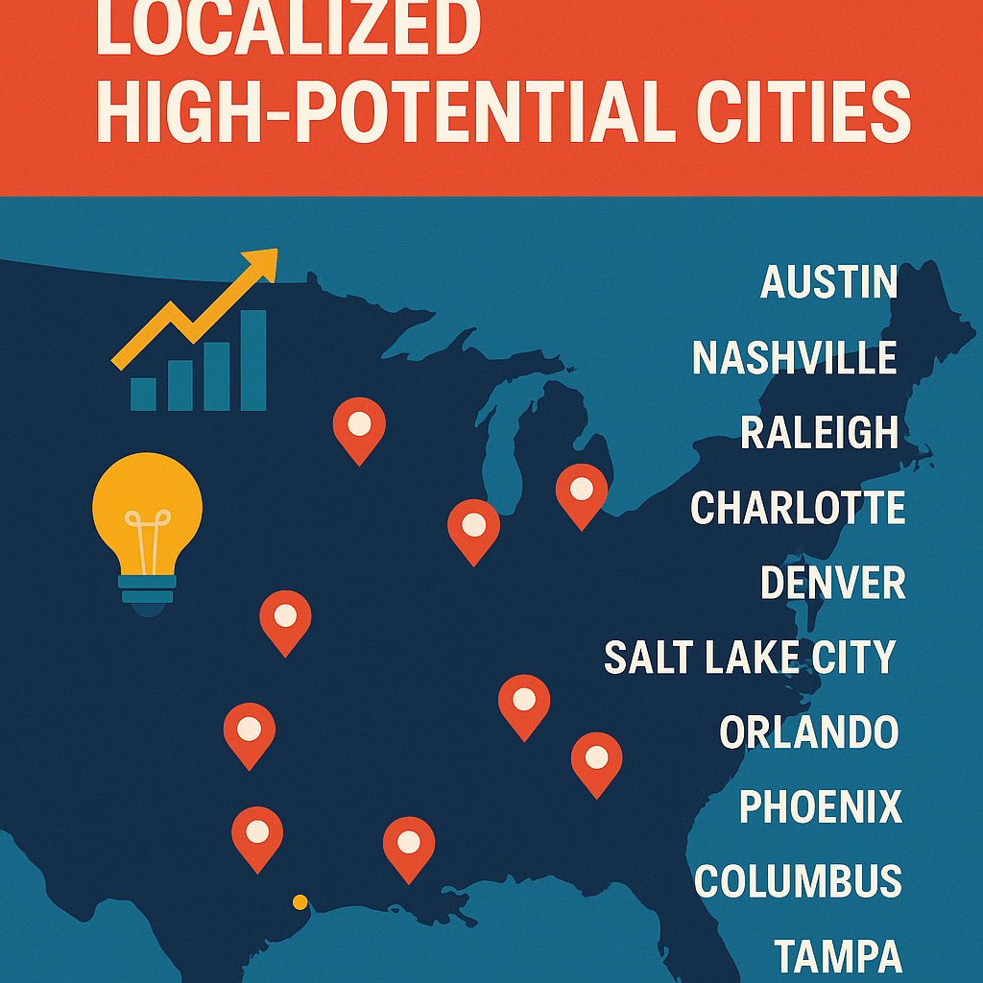
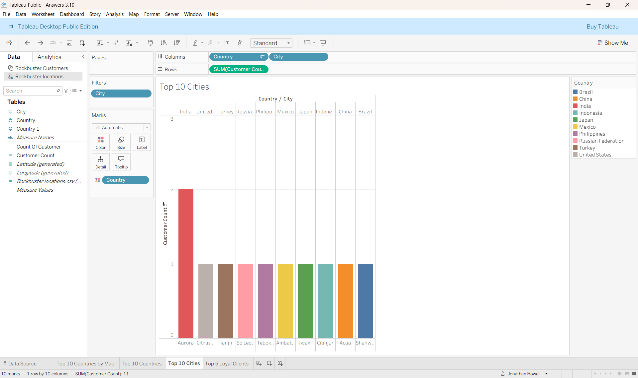
Overcoming nervousness
PRIORITY MARKET 2: LOCALIZED HIGH-POTENTIAL CITIES
Within the top countries, customer count is highly fragmented. We must focus marketing on these 10 cities to drive new sign-ups.
The top city, Aurora (US), has only 2 customers, highlighting the low density and high growth opportunity in all regions.

Slide 5
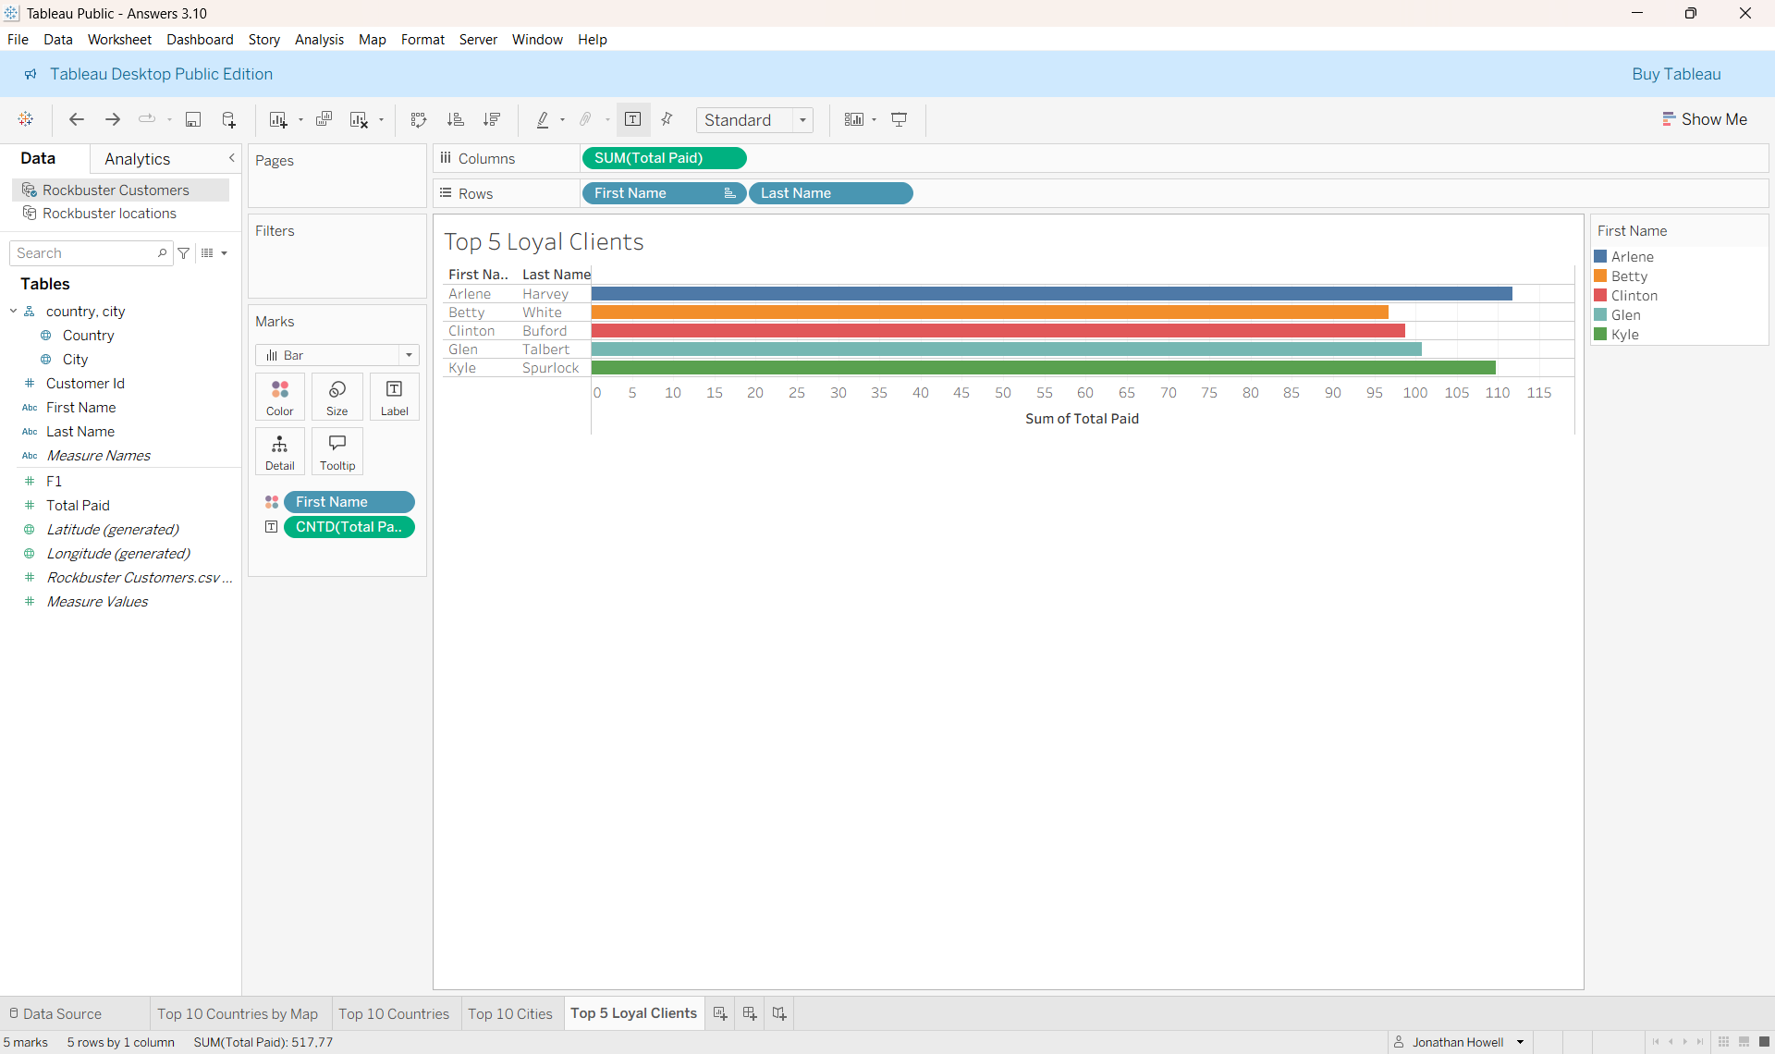
The Top 5 Most Loyal Customers
  We have identified the 5 highest-spending customers in our target cities. They are the ideal candidates for a pre-launch rewards program.
  Arlene Harvey (India) is the highest value customer with $111.76 total spend.

Slide 6
Strategy recommendation: next steps
  Geographic Focus: Concentrate 80% of launch marketing budget on the Top 10 Countries/Cities identified
  Loyalty Program: Initiate a “Founders Club” rewards tier for the Top 5 customers to generate early positive buzz
  Data Accessibilty: The full analysis, data outputs, and SQL queries are available in the accompanying technical Excel file
Tableau Public URL: https://public.tableau.com/app/profile/jonathan.howell/LoyalClients

