Slide 1

KYLE HOBSON / NAVA DESIGN & RESEARCH TALENT POOL
Show what happened.
Make the next step clear.
UX research, operational product design
and accessible learning experiences
Future opportunities · Remote (US)
01
Notes:
Prepared for Nava Design & Research Resume Drop Off, https://job-boards.greenhouse.io/navapbc/jobs/4140877009 . This is an explicit talent pool for future roles, not a current vacancy. The packet presents operational software, research and education work. No government-contract delivery is claimed. Existing paper-path art is decorative.

Slide 2
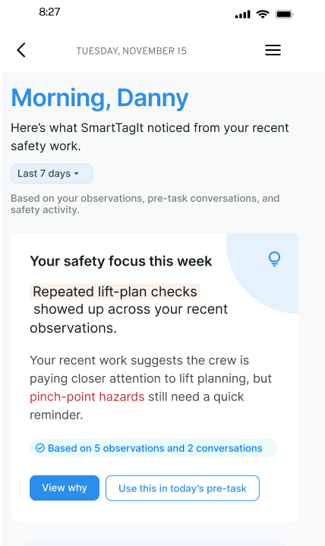
FACTORLAB / SMARTTAGIT ABOUT ME
A summary connected
to its evidence
I explored feedback layouts, widget families and content density so people could inspect the basis of a summary and find a useful next action.
Original design iteration. About Me web/server changes released September 2, 2026; this pictured variant is not claimed as the final released layout.
02
Notes:
Kyle explored About Me information models and widget families in original April–May 2026 design walkthroughs. Source: reviewed portfolio-suite design About Me case and original about-me-widget-system.png. Numbers and named content inside the design are interface example data, not measured outcomes. September 2 release evidence supports web/server feature release, not this exact variant or mobile rollout. Public case: https://jonathankhobson.github.io/portfolio/design/case/about-me/ .

Slide 3
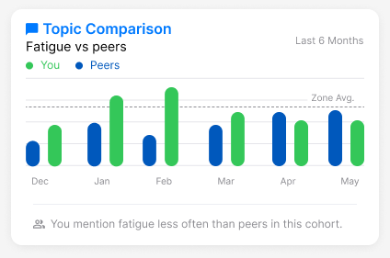
FACTORLAB / ABOUT ME COMPARISON DESIGN
A comparison needs
a careful explanation
The caption describes how often a topic appears in a cohort. It avoids turning a difference into an unsupported performance judgment.
Original interface design with example data. No measured performance result is shown.
03
Notes:
Original FactorLab About Me design variant. Source about-me-comparison.png and reviewed design source map. Chart is retained as a source screenshot to show the actual interface design; it is not an editable analytic chart or report of real user performance. Kyle’s contribution was comparison language and interface reasoning; no measured user outcome or public-service delivery is inferred.

Slide 4


FACTORLAB / FLINT CONVERSATIONAL PRODUCT DESIGN
Recovery depends
on what happened
An interrupted answer and a lost connection leave different information available. I designed their messages and actions, then annotated the behavior for engineering.
Original mobile designs and handoff. No claim that the pictured states are shipped.
04
Notes:
FactorLab UX Designer & Researcher (Contract), October 2025–Present. Original Kyle-authored Figma designs and March 27 error-state walkthrough. Entry, waiting, saved questions and response actions are organized with engineering annotations. These are design and handoff artifacts; the exact states are not verified as shipped. Public case: https://jonathankhobson.github.io/portfolio/design/case/flint/ .

Slide 5

OAK AI / LEAD UX RESEARCHER, 2023–2025
A finding becomes
a visible recommendation
The audit identified vague login feedback. I recommended locating the error beside the relevant field so people could see what to correct.
Original proposed interface. This is evaluation and design guidance, not a measured conversion improvement.
05
Notes:
Oak original DesignRecOak findings and recommendations, reviewed September 2026. Kyle led UX research and developed navigation/error-feedback recommendations with the lead UX designer. The public crop preserves the original proposed treatment; no production deployment, conversion gain or ownership of every design element is inferred. Public case: https://jonathankhobson.github.io/portfolio/design/case/oak/ .

Slide 6
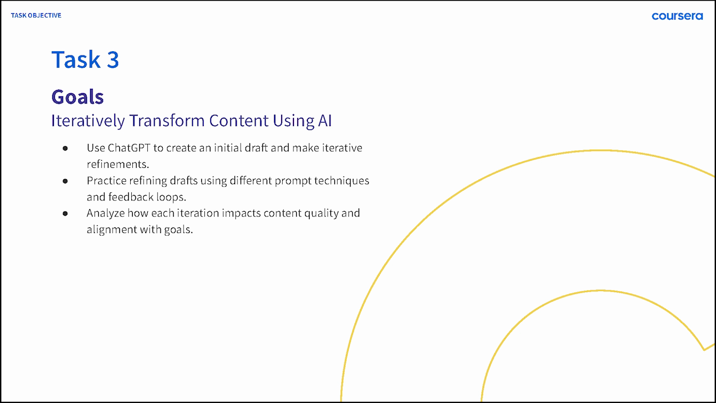
ASU · OPPIA · COURSERA / LEARNING AND EXPLANATION
Learning experience informs the interface
At ASU, I developed learning materials and proposed AI workflows with mentor review.
At Oppia, I questioned autosave and save-on-exit before finalizing dialog guidance.
My Coursera lesson makes iteration a practice activity.
Original 2024 Coursera lesson slide. ASU workflow was proposed; Oppia example is a design review.
06
Notes:
Career claim map C06/C08/C14/C18: ASU Knowledge Enterprise instructional design, ASU Learning Innovations proposed prompt architecture, current Oppia volunteer exit-dialog review. Coursera original ai-course-goals.png is approved published-course evidence; no raw private correspondence is displayed. These are education and design contributions, not government-contract delivery.

Slide 7
NAVA PBC / PROPOSED APPROACH FOR A FUTURE PROJECT
Follow one task across the service
Nava’s caseworker toolkit pairs cited answers with staff review. For a future project, I would begin by understanding that task and its constraints.
Map the task, decisions and handoffs with the team.
Find where a rule or system state becomes confusing.
Prototype a manageable change and check comprehension.
Document the behavior, review implementation and learn from use.
Proposed approach for future opportunities; not a Nava project or prior government-contract work.
07
Notes:
This is a proposed starting approach for a future Nava project, not delivered work, a product audit or an invented government contract. The official future design/research pool is https://job-boards.greenhouse.io/navapbc/jobs/4140877009 . Company context: Nava Labs Caseworker Empowerment Toolkit, April 30, 2026, https://www.navapbc.com/news/ai-caseworker-tools . The toolkit source explains policy citations and caseworker review before form submission.

Slide 8
KYLE HOBSON / NAVA DESIGN & RESEARCH TALENT POOL
Design & Research
Mesa, Arizona · Available for U.S. remote work
Future opportunities · Research, design and learning
JonathanKyleHobson@gmail.com
View the Nava design and research portfolio
08
Notes:
Candidate confirmed Mesa location, U.S. work authorization without sponsorship and ASAP start. Portfolio links to an isolated introduction for the Nava talent pool. No current vacancy, government-contract delivery or prior Nava employment is claimed.

