Slide 1

KYLE HOBSON / ASG · INSTRUCTIONAL DESIGNER (TEMPORARY)
Build practice.
Learn from the revision.
ASU learning design, original Coursera lessons
and Figma workflow design.
Instructional Designer (Temporary) application · September 2026
01
Notes:
Prepared for ASG Instructional Designer (Temporary), https://www.asgllc.com/careers/instructional-designer-temporary/ . Displayed work belongs to prior ASU, Coursera, FactorLab and independent tool projects. Decorative cover is existing canonical art, not evidence.

Slide 2
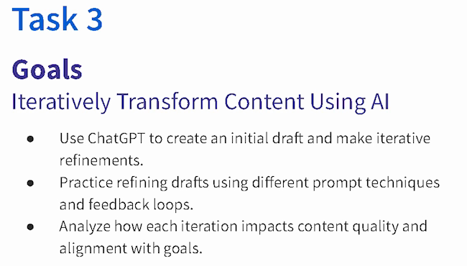
COURSERA · GUIDED PROJECT / ORIGINAL TEACHING, 2024
Make revision
something the
learner can see
I created a beginner project around drafting, reviewing and refining content against a goal.
Published teaching activity. Learner improvement is not measured here.
Original 2024 lesson material · goals excerpt
02
Notes:
Source: canonical ai.json teaching-ai case, original 2024 lesson material and https://www.coursera.org/projects/chatgpt-beginners . Kyle created and taught the published project ChatGPT 4o for Beginners: Create Social Media Content. The crop preserves all original Task 3 goal text without changing source pixels: ai-course-goals.png x80 y85 w650 h370. Learning sequence and teaching materials are direct evidence; enrollment is not a learning-gain measure.

Slide 3
COURSERA / ASSESSMENT REVIEW, OCTOBER 2024
Make the review change the material
Review finding | My documented revision
Choices were easy to eliminate | Reworked distractors, especially Questions 7, 8 and 10.
Question 7 tested only a definition | Added application of the concept alongside the definition.
Retry feedback revealed answers | Made feedback more neutral and referred learners to the lesson task.
Task references were incorrect | Corrected references across the assessment.
Paraphrased original review and instructor-response notes · revisions, not final QA signoff
03
Notes:
Source: original October 1,2024 Course Shell Feedback rows16,19,20,22 and instructor-response notes. Four rows summarize actual concerns and recorded revisions. Completed appears in instructor-response status; separate QA ID Approval remains false. No final row-level signoff or measured learner gain claimed. Native editable two-column table.

Slide 4

COURSERA / RECORDED PRACTICE SEQUENCE
Review added detail
before accepting it
The lesson made an instruction visible beside the result it changed. That gave learners something concrete to inspect.
The revised answer added detail. In my retrospective, I would make factual checks and length limits more explicit.
Original 2024 recording, Task 3 · 03:35
Fictional practice brand · unchanged source excerpt
04
Notes:
Source: canonical teaching-ai case and original recorded revision instruction at 03:35. The screenshot preserves the historical interface and original text, including typos. Brew Bliss is fictional practice material. This slide shows teaching judgment, not a school deployment, controlled experiment or measured learner result. The retrospective check is a later reflection, not an assessment reported as run.

Slide 5
ASU LEARNING INNOVATIONS / 2024 WORKFLOW PROPOSAL
Human review before learner-facing tasks
A staged prompt workflow for personalized learner tasks.
01
02
03
Condense learner context
→
Mentor validates context
→
Personalize task template
Prepare context for review.
Check the interpretation.
Use the reviewed context.
↓
06
05
04
Prepare learner-facing output
←
Mentor confirms tasks
←
Generate and refine tasks
Structured output and feedback.
Approve or revise the tasks.
Prepare candidate tasks.
Simplified reconstruction · Documented proposal; no deployment or measured efficiency claimed.
05
Notes:
Source: reviewed 2024 ASU Learning Innovations proposal and accompanying source brief. Kyle proposed a prompt workflow that condensed learner context, included mentor validation of context, personalized a task template, generated and refined tasks, included mentor confirmation or revision, and prepared structured learner-facing output and feedback. This editable reconstruction groups the original steps into six stages while retaining both mentor review gates. It is a proposal, not a deployed clinical system or a measured efficiency or learning outcome. The human review pattern is adjacent evidence for discussing learning workflows at ASG; no prior ASG engagement is claimed.

Slide 6


FLINT / INTERRUPTED AND OFFLINE STATES
Incomplete answer
Connection lost
Recovery follows
the failure
An incomplete answer and a lost connection need different next actions.
I assembled the flows and their next actions into an annotated handoff for engineering.
06
Notes:
Source: selected original Flint interrupted-response and offline design variants, including the March 27, 2026 error-state handoff. Distinct recovery actions follow the state: Ask again or Continue for a partial response, and retry after connection loss with the question preserved. Deliverable: connected flows, interaction states and engineering annotations.

Slide 7
ASU · FACTORLAB · COURSERA / RELATED EXPERIENCE
Use research to find
the learning need
Learning design
Objectives, demonstrations and practice
Research
At ASU, I developed learning materials and workshops and evaluated voice and chat flows. Product research adds practice clarifying the task before proposing support.
Questions about context and friction
Workflow design
Actions and recovery explained to engineering
Evaluation to propose
My next step would be to test a teaching approach with staff doing real work and measure what changes.
Completion, correction and repeat use
07
Notes:
Experience synthesis, not a new case study. ASU Instructional Designer Apr2022–Oct2024 and AI Analyst Feb–Oct2024 overlap. Coursera2024 also overlaps; no inflated elapsed training tenure. Last row is a proposed measure, not an observed enterprise adoption result.

Slide 8
PROPOSED APPROACH / ASG LEARNING PRODUCTS
Connect the action to the decision
Choose one learner task
Build a focused learning path
Work with an expert to choose a useful task.
Define what the learner needs to recognize
and which result they should inspect.
Outline the goal, prerequisites and practice.
Use a short demonstration and a safe example
that the product team has verified.
Review accuracy and usability
Publish through the team workflow
Check the content with domain experts.
Watch a learner try the task and note
where the explanation leaves them uncertain.
Learn the authoring tools and review process.
Document content and version dependencies
and revisit content when behavior changes.
08
Notes:
Proposed approach for ASG Instructional Designer (Temporary), https://www.asgllc.com/careers/instructional-designer-temporary/ . Not prior ASG delivery, a diagnosed product issue, a security investigation or a measured learner outcome. ASG authoring tools and subject matter require onboarding and expert review.

Slide 9
KYLE HOBSON / ASG · INSTRUCTIONAL DESIGNER (TEMPORARY)
Let’s make technical work
easier to learn
Mesa, Arizona. Applying for the listed 100% remote U.S. arrangement.
JonathanKyleHobson@gmail.com
jonathankhobson.github.io/application-portfolios/asg-instructional-designer-temporary
09
Notes:
Tailored Instructional Designer (Temporary) packet. Related experience spans ASU learning design, Coursera teaching and assessment revisions, the ASU workflow proposal and product research. Course-authoring and product-documentation evidence are distinct from LMS administration or independent publishing-control ownership. Advanced Evolve or Articulate 360 experience is not claimed. Mesa is disclosed.

