Slide 1

KYLE HOBSON / Juniper Square · AI ENABLEMENT LEAD
Teach the workflow.
Make judgment part of it.
Practical AI teaching, prompt checks
and research-informed workflow design.
AI Enablement Lead application · September 2026
01
Notes:
Prepared for Juniper Square AI Enablement Lead, https://jobs.ashbyhq.com/junipersquare/7fb4a94f-7098-4a5f-a205-6772649f8da6 . Displayed work belongs to prior Coursera, FactorLab and Oak experience. Decorative cover is existing canonical art, not evidence.

Slide 2
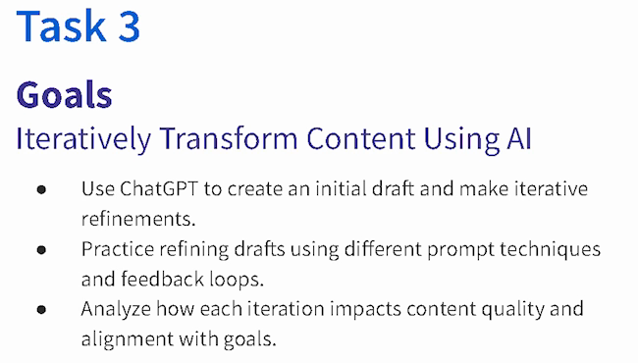
COURSERA · GUIDED PROJECT / ORIGINAL TEACHING, 2024
Make revision
something the
learner can see
I created a beginner project around drafting, reviewing and refining content against a goal.
Published teaching activity. Learner improvement is not measured here.
Original 2024 lesson material · goals excerpt
02
Notes:
Source: canonical ai.json teaching-ai case, original 2024 lesson material and https://www.coursera.org/projects/chatgpt-beginners . Kyle created and taught the published project ChatGPT 4o for Beginners: Create Social Media Content. The crop preserves all original Task 3 goal text without changing source pixels: ai-course-goals.png x80 y85 w650 h370. Learning sequence and teaching materials are direct evidence; enrollment is not a learning-gain measure.

Slide 3
COURSERA / ASSESSMENT REVIEW, OCTOBER 2024
Make the review change the material
Review finding | My documented revision
Choices were easy to eliminate | Reworked distractors, especially Questions 7, 8 and 10.
Question 7 tested only a definition | Added application of the concept alongside the definition.
Retry feedback revealed answers | Made feedback more neutral and referred learners to the lesson task.
Task references were incorrect | Corrected references across the assessment.
Paraphrased original review and instructor-response notes · revisions, not final QA signoff
03
Notes:
Source: original October 1,2024 Course Shell Feedback rows16,19,20,22 and instructor-response notes. Four rows summarize actual concerns and recorded revisions. Completed appears in instructor-response status; separate QA ID Approval remains false. No final row-level signoff or measured learner gain claimed. Native editable two-column table.

Slide 4

COURSERA / RECORDED PRACTICE SEQUENCE
Review added detail
before accepting it
The lesson made an instruction visible beside the result it changed. That gave learners something concrete to inspect.
The revised answer added detail. In my retrospective, I would make factual checks and length limits more explicit.
Original 2024 recording, Task 3 · 03:35
Fictional practice brand · unchanged source excerpt
04
Notes:
Source: canonical teaching-ai case and original recorded revision instruction at 03:35. The screenshot preserves the historical interface and original text, including typos. Brew Bliss is fictional practice material. This slide shows teaching judgment, not a school deployment, controlled experiment or measured learner result. The retrospective check is a later reflection, not an assessment reported as run.

Slide 5
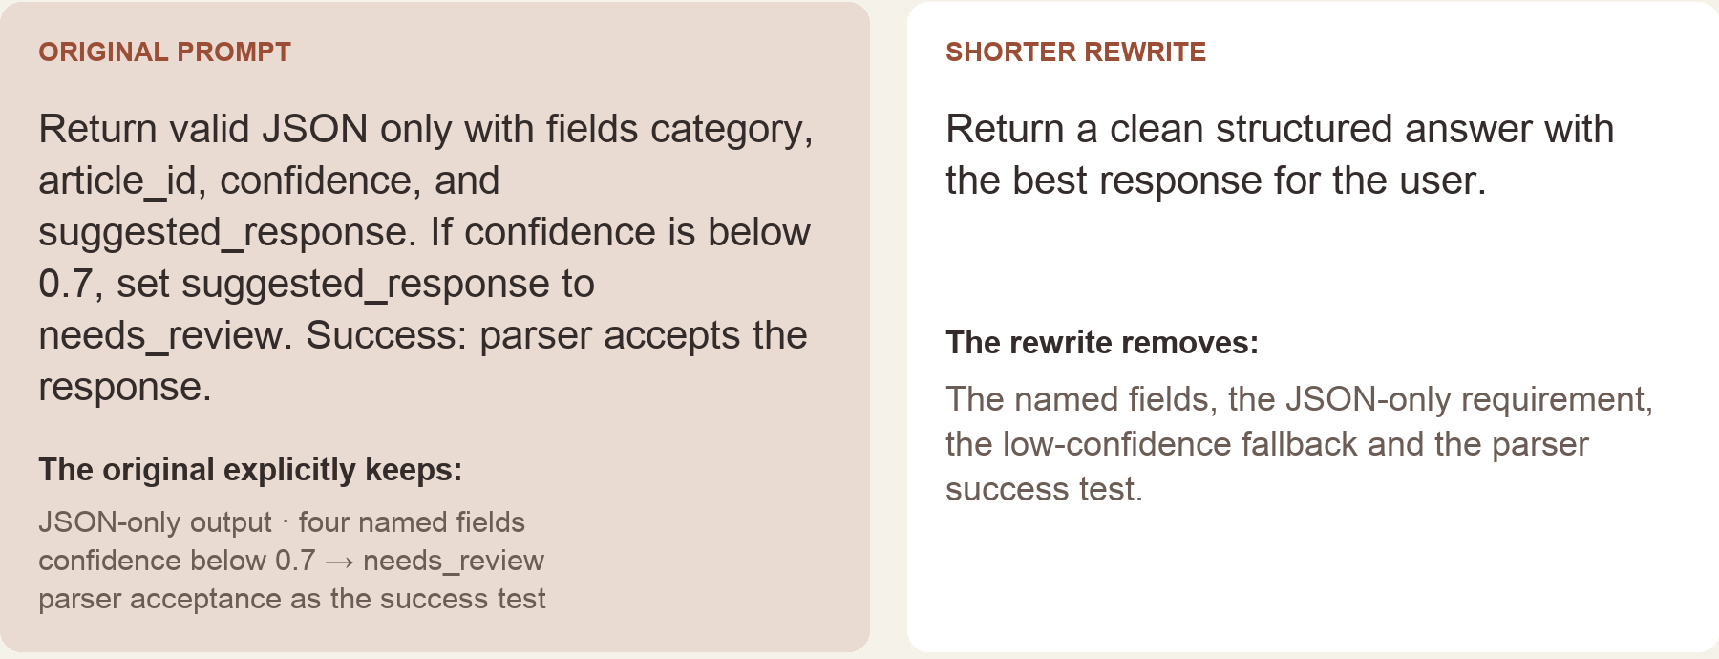
PROMPT COMPASS / LOCAL REGRESSION EXAMPLE, MAY 2026
A cleaner rewrite can lose the task
Original test inputs, excerpted from the portfolio rendering · expected winner: original prompt
05
Notes:
Canonical ai.json prompt-compass case. Original developer-authored regression fixture, reformatted for the portfolio. May2026 local work is separate from the April27 public beta. Deterministic literal-term checks report missing fields in the rewrite; they do not execute an LLM, parse its output or establish model accuracy. The low-confidence threshold is a test instruction, not a deployed enterprise policy.

Slide 6


FLINT / INTERRUPTED AND OFFLINE STATES
Incomplete answer
Connection lost
Recovery follows
the failure
An incomplete answer and a lost connection need different next actions.
I assembled the flows and their next actions into an annotated handoff for engineering.
06
Notes:
Source: selected original Flint interrupted-response and offline design variants, including the March 27, 2026 error-state handoff. Distinct recovery actions follow the state: Ask again or Continue for a partial response, and retry after connection loss with the question preserved. Deliverable: connected flows, interaction states and engineering annotations.

Slide 7
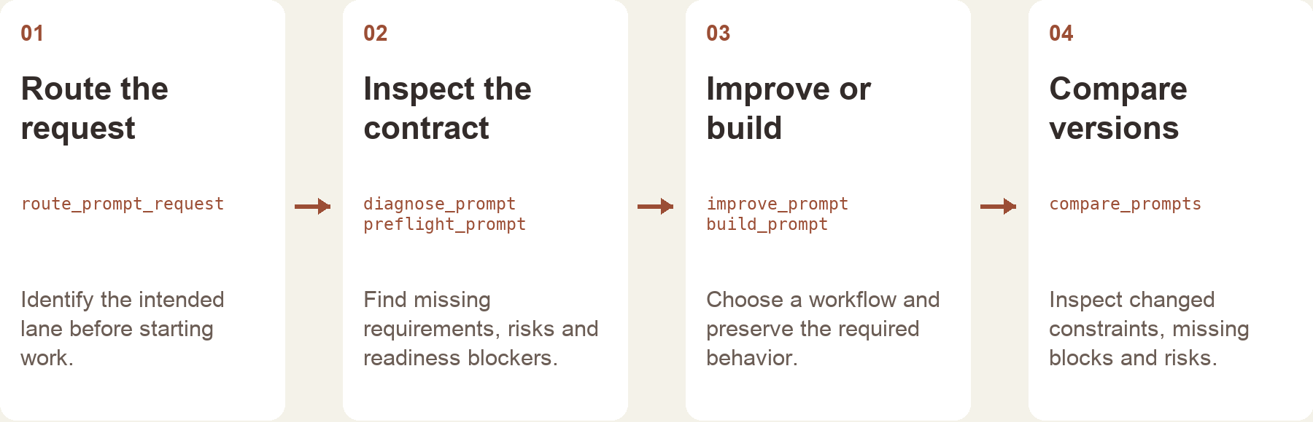
PROMPT COMPASS / RELEASED TOOL AND WORKFLOW DESIGN
Give the tool a clear role
The local tool returns structured checks and routing.
The host assistant handles the conversation and final wording.
Implementation-based portfolio diagram · public beta release, April 2026
07
Notes:
Source: canonical prompt-compass case and public beta3 release. Kyle built and released the tool with installable packages and source downloads. Diagram is reconstructed from implementation, not an original product screenshot. Does not establish customer adoption, employee use, or daily mastery of every Claude product.

Slide 8
ASU · FACTORLAB · COURSERA / RELATED EXPERIENCE
Use research to find
the learning need
Learning design
Objectives, demonstrations and practice
Research
At ASU, I developed learning materials and workshops and evaluated voice and chat flows. Product research adds practice clarifying the task before proposing support.
Questions about context and friction
Workflow design
Actions and recovery explained to engineering
Evaluation to propose
My next step would be to test a teaching approach with staff doing real work and measure what changes.
Completion, correction and repeat use
08
Notes:
Experience synthesis, not a new case study. ASU Instructional Designer Apr2022–Oct2024 and AI Analyst Feb–Oct2024 overlap. Coursera2024 also overlaps; no inflated elapsed training tenure. Last row is a proposed measure, not an observed enterprise adoption result.

Slide 9
PROPOSED APPROACH / JUNIPER SQUARE AI GUILD
Start with a task staff already need to do
Understand one workflow
Teach through practice
Ask about the task, data and current effort.
Agree on a safe practice example and what
a useful result must preserve.
Demonstrate the workflow, then let staff try.
Make source checks, output review and
escalation part of the exercise.
Support the next attempt
Check what changed
Use office hours to inspect stuck points.
Turn recurring questions into brief guidance
and improve the practice material.
Compare completion and correction effort.
Ask whether people use the workflow again.
Keep self-reports separate from observed use.
09
Notes:
Proposed approach for discussion, informed by Juniper Square AI Enablement Lead requirements. Not prior Juniper work, an agreed rollout, a time-savings guarantee or reported adoption result. Work within company data, permissions and tool-use rules; validate task-specific methods with the AI Guild.

Slide 10
KYLE HOBSON / Juniper Square · AI ENABLEMENT LEAD
Let’s make AI use easier
to learn and evaluate
Mesa, Arizona. Full U.S. work authorization. Available to start as soon as possible.
JonathanKyleHobson@gmail.com
jonathankhobson.github.io/application-portfolios/juniper-square-ai-enablement
10
Notes:
Tailored AI Enablement Lead packet. Related experience spans ASU learning design, Coursera teaching and assessment revisions, Prompt Compass and product research. No enterprise adoption metrics, company-wide training ownership, financial-domain expertise or mastery of each Claude product asserted. Mesa disclosed; Arizona payroll remains unconfirmed.

