Slide 1

KYLE HOBSON / WHITE CIRCLE · PRODUCT DESIGN
Technical tools.
Clear decisions.
Selected work in conversational interfaces,
prompt requirements and actionable feedback.
Product Designer application · September 2026
01
Notes:
Prepared for White Circle Product Designer, https://jobs.ashbyhq.com/whitecircle/ca1228ee-92e8-4eaa-9d67-cc4d3e3240ce . White Circle is a prospective employer. Work examples are reviewed prior FactorLab, Oak AI and independent Prompt Compass artifacts. Decorative cover from the canonical portfolio; not project evidence.

Slide 2
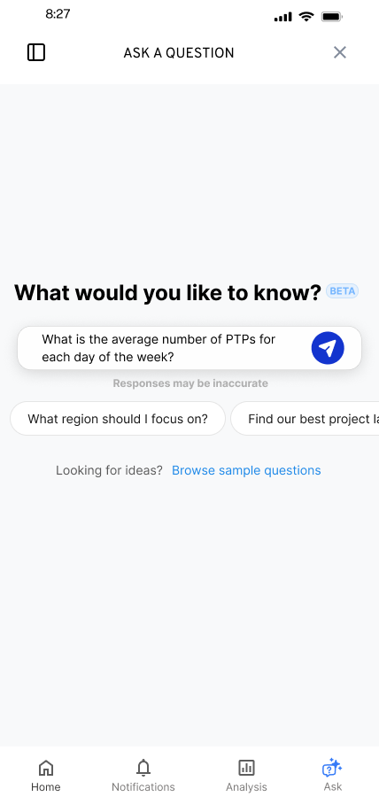
FACTORLAB · FLINT / INTERACTION DESIGN, 2025–2026
Make the first question
easier to ask
Suggested questions offered a starting point while leaving the person free to edit or ask something else.
I worked within the existing product, keeping the answer layout and agreed phase scope in view.
02
Notes:
Source: original Flint suggested-question state and project walkthroughs in canonical design.json. Selecting a suggestion was intended to populate the input for review or editing. Design variant and engineering handoff; release of each variant is unverified.

Slide 3


FLINT / INTERRUPTED AND OFFLINE STATES
Incomplete answer
Connection lost
Recovery follows
the failure
An incomplete answer and a lost connection need different next actions.
I assembled the flows and their next actions into an annotated handoff for engineering.
03
Notes:
Source: selected original Flint interrupted-response and offline design variants, including the March 27, 2026 error-state handoff. Distinct recovery actions follow the state: Ask again or Continue for a partial response, and retry after connection loss with the question preserved. Deliverable: connected flows, interaction states and engineering annotations.

Slide 4


OAK AI / LOGIN FEEDBACK
Error feedback
beside the field
Original
Proposed
I made the problem field visible where a person could act on it.
The recommendation gave the team a specific behavior to discuss and prioritize.
Original error at the page footer
Proposed feedback beside the field
04
Notes:
Source: original Oak error-message recommendation artifact containing Before and After panels. Displayed interface panels retain source pixels and are labeled Original and Proposed to clarify the work state. Kyle connected an evaluation finding to visual alternatives and implementation recommendations. No conversion or task-success percentage is asserted.

Slide 5
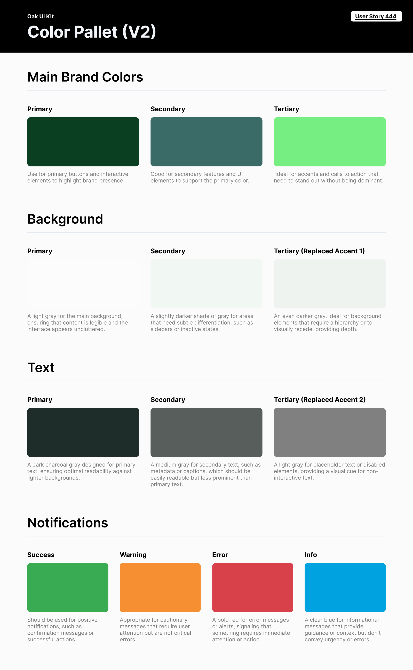
OAK AI / VISUAL GUIDANCE
Give color
a defined job
Brand, backgrounds, text and feedback needed consistent roles across the interface.
I documented those roles for the next design iteration. This focused guide did not establish a complete component library.
05
Notes:
Source: original Oak UI Kit V2 export tied to User Story 444 and canonical design.json. Focused color specification; no complete design-system coverage or accessibility-compliance claim.

Slide 6
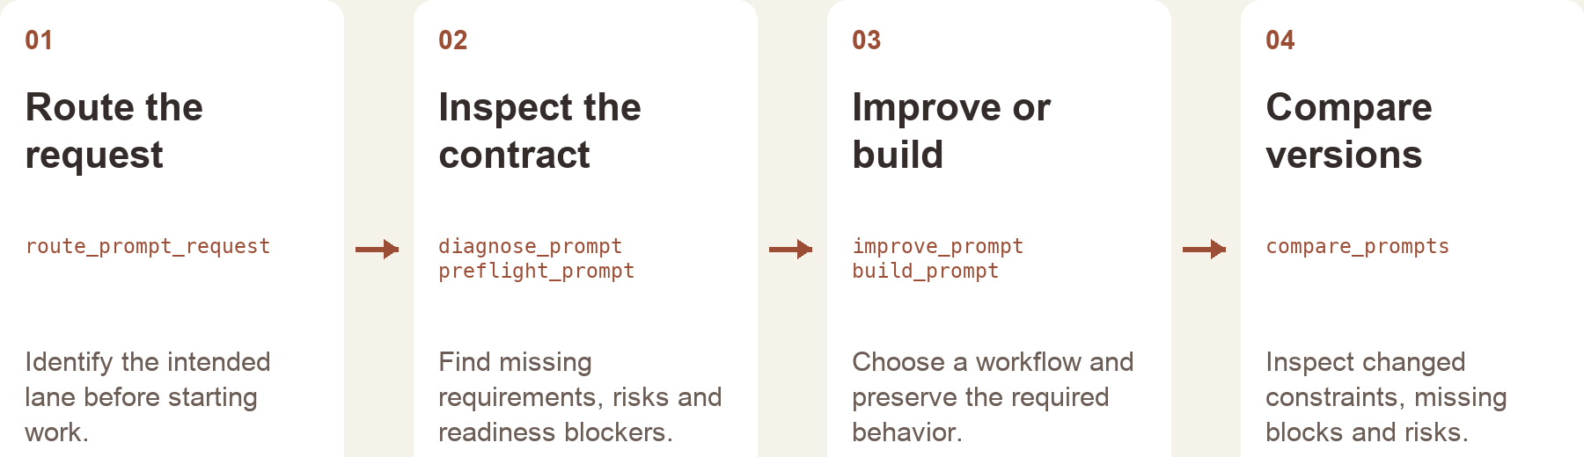
PROMPT COMPASS / INDEPENDENT PROJECT, 2026
A useful prompt preserves the job
I built Prompt Compass to turn rough requests into inspectable workflows, with clear requirements and comparison points.
Public beta available · reconstruction includes later local development
06
Notes:
Independent project. Sources: actual Prompt Compass README, server.py and service.py. The public v0.1.0-beta.3 prerelease was published April 27, 2026 and its assets refreshed May 18; local development includes later work. Public release: https://github.com/JonathanKHobson/prompt-compass/releases/tag/v0.1.0-beta.3 . This workflow plate is reconstructed from implementation, not a product screenshot. The host AI handles conversation and final wording; the tool provides structured diagnosis, contracts, routing and comparison.

Slide 7
PROMPT COMPASS / DESIGNED LOCAL REGRESSION CASE
Cleaner language can lose the task
ORIGINAL FIXTURE PROMPT
SHORTER REWRITE
Return valid JSON only with fields category, article_id, confidence, and suggested_response. If confidence is below 0.7, set suggested_response to needs_review. Success: parser accepts the response.
Return a clean structured answer with the best response for the user.
Expected winner: the original
The rewrite loses named fields, JSON-only output and the low-confidence fallback.
07
Notes:
Source: actual May 2026 developer-authored Prompt Compass Eval Studio fixture phase2t-schema-regression-cleaner-but-worse. The two displayed prompts are exact fixture values. The expected winner is the original because the shorter rewrite removes the output contract. This is a designed regression case, not a customer incident or a production-model benchmark. Human-review metadata in the fixture is unreviewed. No new runtime test is claimed in this deck.

Slide 8
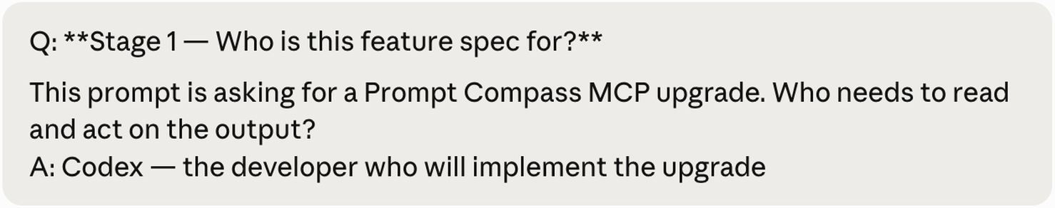
PROMPT COMPASS / HOST AND TOOL RESPONSIBILITIES
Structured checks support the conversation
The host AI handles the dialogue and final language. My tool makes task requirements and tradeoffs available for review.
Original public example session · proposed feature specification
Next test: compare realistic prompt revisions against an agreed task rubric and human review.
08
Notes:
Source: the original packaged public Prompt Compass real-session snapshot. This is a selected example conversation about an autopilot feature proposal. It does not establish that the proposed feature shipped. Implementation sources show prompt contracts, missing-block checks, anti-pattern checks and comparison deltas. Existing local May 9 evaluation reports document deterministic fixture checks; these do not measure user effectiveness, and this deck does not claim a new test run. A prospective human-reviewed comparison is stated as the next test.

Slide 9
PROPOSED APPROACH / WHITE CIRCLE
A review flow for
a technical user
Understand the decision
Map the states
Observe how a user investigates a flagged interaction. Identify what they need before choosing a next action.
Work with product and research on available evidence, uncertain results and incomplete data.
Prototype the alternatives
Test the next action
Use the existing Figma system to compare the flow, hierarchy and feedback with engineering.
Check whether users can explain the result and choose an appropriate action. Document what needs revision.
09
Notes:
Proposed approach for discussion, informed by the current White Circle role description: https://jobs.ashbyhq.com/whitecircle/ca1228ee-92e8-4eaa-9d67-cc4d3e3240ce . Not prior White Circle work, a completed research study or a production AI-safety implementation. Exact user responsibilities, safety policies and backend signals would be established with the team.

Slide 10
KYLE HOBSON / WHITE CIRCLE · PRODUCT DESIGN
Let’s make technical
tools easier to use
Mesa, Arizona. Full U.S. work authorization. Available to start as soon as possible.
JonathanKyleHobson@gmail.com
jonathankhobson.github.io/application-portfolios/white-circle-product-designer
10
Notes:
The tailored portfolio contains complete selected case studies and all six application materials. The current employer listing states fully remote within the United States and an EST preference, while its location header mentions San Francisco or New York. Kyle is based in Mesa; specific overlap and employer location approval remain for discussion. No relocation, East Coast schedule or compensation acceptance is made.

