Slide 1

KYLE HOBSON / TRIPSUITE · PRODUCT DESIGN
Make the next step clear.
Keep the work moving.
Operational workflows, reusable patterns
and research-informed interface decisions.
Founding Product Designer application · September 2026
01
Notes:
Prepared for Founding Product Designer (TripSuite), https://job-boards.greenhouse.io/applytotripsuite/jobs/4625794004 . TripSuite is a prospective employer; the displayed projects are prior FactorLab and Oak work. Decorative cover uses existing canonical artwork and is not evidence.

Slide 2
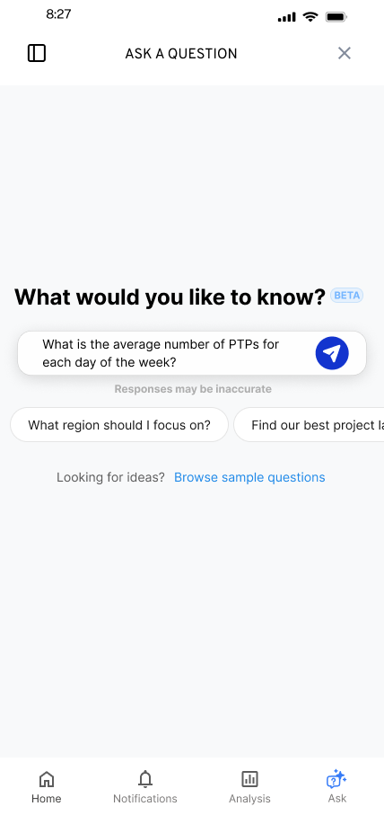
FACTORLAB · FLINT / INTERACTION DESIGN, 2025–2026
Make the first question
easier to ask
Suggested questions offered a starting point while leaving the person free to edit or ask something else.
I worked within the existing product, keeping the answer layout and agreed phase scope in view.
02
Notes:
Source: original Flint suggested-question state and project walkthroughs in canonical design.json. Selecting a suggestion was intended to populate the input for review or editing. Design variant and engineering handoff; release of each variant is unverified.

Slide 3
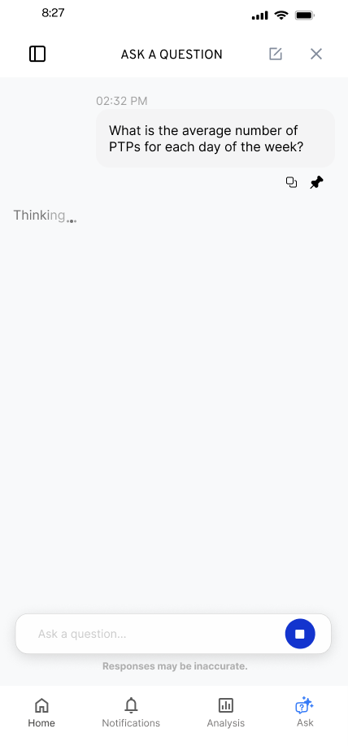
FACTORLAB · FLINT / RESPONSE IN PROGRESS
Keep the request visible
while it runs
The conversation needed to show that a request was still in progress, without making a new result appear before it existed.
I explored waiting feedback within the existing conversation and worked through animation constraints with the product lead.
03
Notes:
Source: Flint original loading state and canonical design case waiting decision. This is a design exploration and discussion of constraints, not a measured wait-time reduction or evidence of a shipped animation system.

Slide 4


FLINT / INTERRUPTED AND OFFLINE STATES
Incomplete answer
Connection lost
Recovery follows
the failure
An incomplete answer and a lost connection need different next actions.
I assembled the flows and their next actions into an annotated handoff for engineering.
04
Notes:
Source: selected original Flint interrupted-response and offline design variants, including the March 27, 2026 error-state handoff. Distinct recovery actions follow the state: Ask again or Continue for a partial response, and retry after connection loss with the question preserved. Deliverable: connected flows, interaction states and engineering annotations.

Slide 5
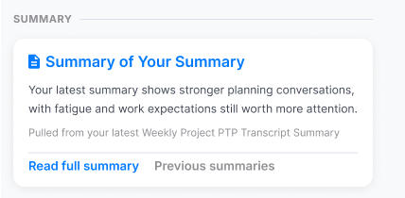
FACTORLAB · ABOUT ME / INFORMATION ARCHITECTURE, 2026
Organize content by
the question it answers
Summaries. Recommendations. Simple 7. Comparisons. Accomplishments.
I explored content density and reusable widget structures, then worked with engineers on what each action opened.
Original design detail · sample content
05
Notes:
Sources: About Me original Figma design and April–May 2026 walkthroughs, canonical design.json. Kyle developed page directions, content families and visual alternatives. Product lead and engineering clarified data availability, existing capabilities and routes into detail. Team release of web/server changes is confirmed September 2, 2026; the exact pictured layout is unverified. The crop preserves original source pixels.

Slide 6
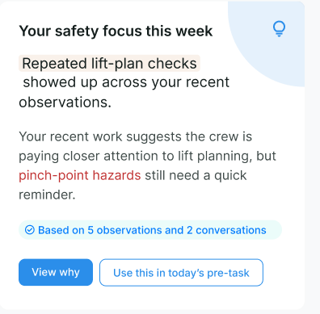
FACTORLAB · ABOUT ME / SUMMARY TO SUPPORTING DETAIL
Let people inspect
a recommendation
A short summary needs a route to the observations behind it and to a useful next action.
I explored that connection before expanding the range of widgets and content on the page.
Original direction exploration · sample content
06
Notes:
Source: original About Me widget-system direction and canonical detail for the summary decision. Source values and content are design examples, not measured user results. The screenshot shows View why and an action route. Exact released layout is unverified.

Slide 7


OAK AI / LOGIN FEEDBACK
Error feedback
beside the field
Original
Proposed
I made the problem field visible where a person could act on it.
The recommendation gave the team a specific behavior to discuss and prioritize.
Original error at the page footer
Proposed feedback beside the field
07
Notes:
Source: original Oak error-message recommendation artifact containing Before and After panels. Displayed interface panels retain source pixels and are labeled Original and Proposed to clarify the work state. Kyle connected an evaluation finding to visual alternatives and implementation recommendations. No conversion or task-success percentage is asserted.

Slide 8
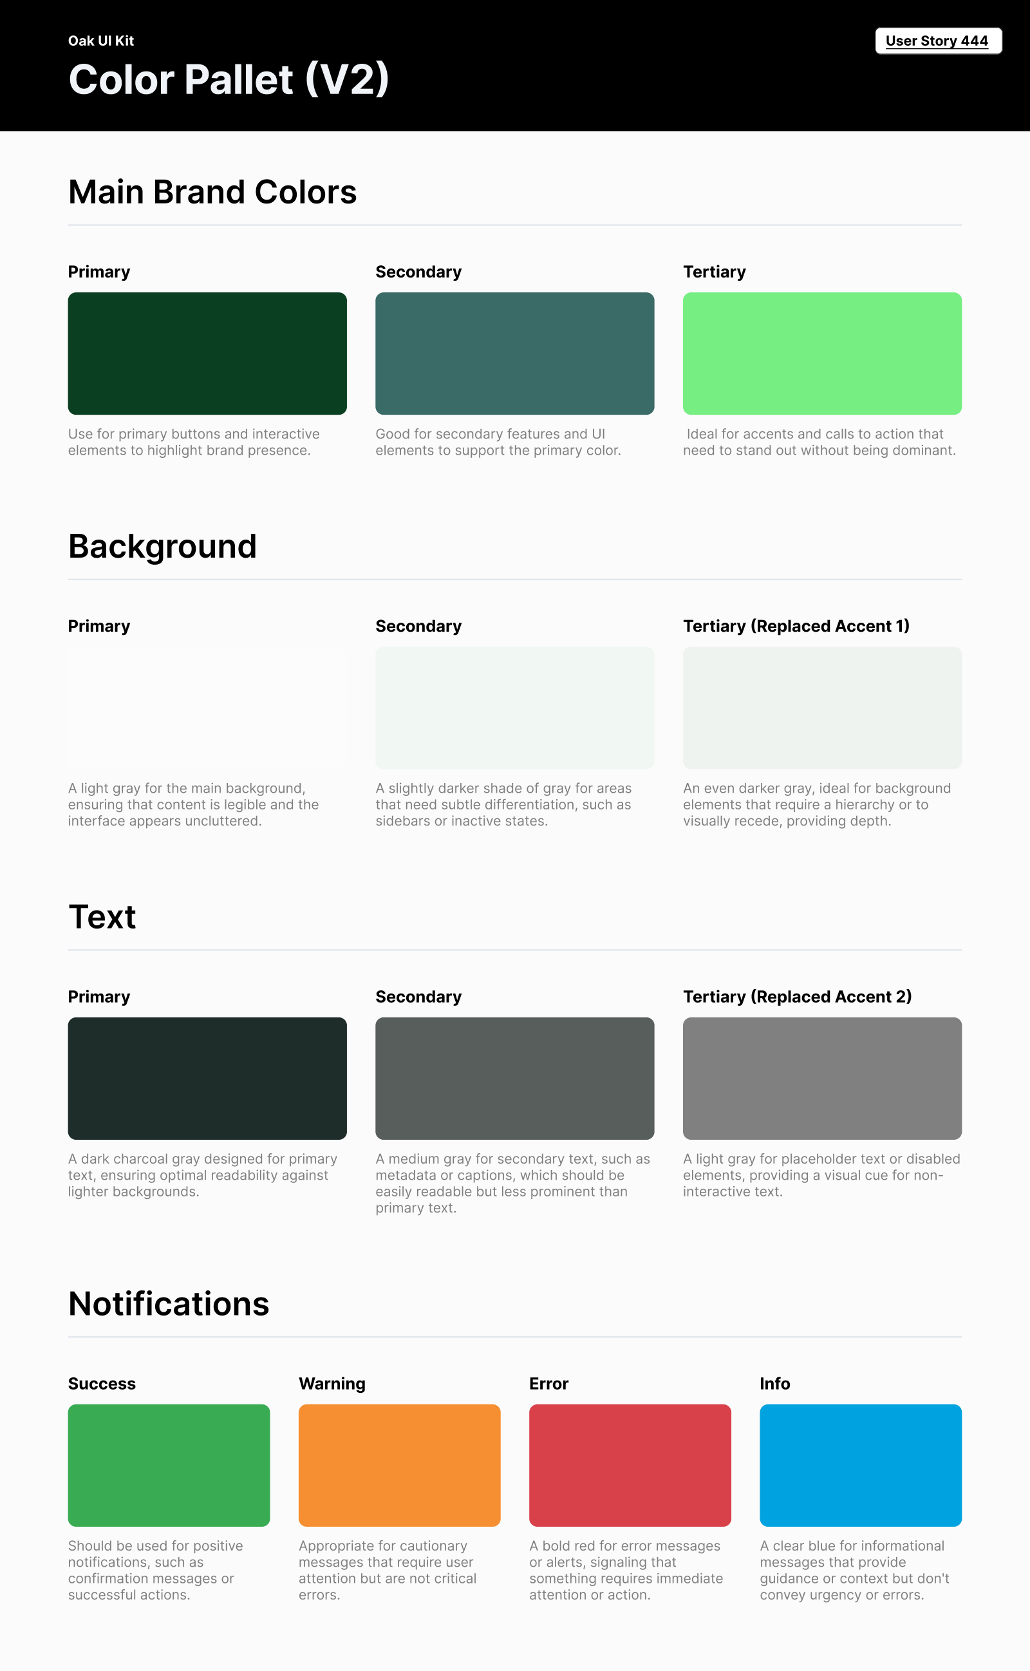
OAK AI / VISUAL GUIDANCE
Give color
a defined job
Brand, backgrounds, text and feedback needed consistent roles across the interface.
I documented those roles for the next design iteration. This focused guide did not establish a complete component library.
08
Notes:
Source: original Oak UI Kit V2 export tied to User Story 444 and canonical design.json. Focused color specification; no complete design-system coverage or accessibility-compliance claim.

Slide 9
PROPOSED APPROACH / LEARNING TRIPSUITE’S WORKFLOWS
Follow one operational task end to end
Learn the actual task
Map the states and exceptions
Observe an agency manager or advisor.
Understand the decision, supporting records
and handoffs involved.
Work with engineers on available data,
permissions and failure states. Keep domain
assumptions open for review.
Compare a small flow
Test and hand off the decision
Prototype one task with reusable patterns.
Explain alternatives and scope before
expanding the design.
Check whether people understand the state
and choose a useful next action. Document
behavior and remaining questions.
09
Notes:
Proposed learning/design approach for a future TripSuite project. Official https://www.tripsuite.com/ describes CRM, commissions, accounting, itineraries, analytics and permissions; the role expects close engineering collaboration. No travel-finance expertise, existing interface defect, prior TripSuite work or tested solution is claimed.

Slide 10
KYLE HOBSON / TRIPSUITE · PRODUCT DESIGN
Let’s make complex work
easier to follow
Mesa, Arizona. Full U.S. work authorization. Available to start as soon as possible.
JonathanKyleHobson@gmail.com
jonathankhobson.github.io/application-portfolios/tripsuite-product-designer
10
Notes:
The complete portfolio and six application files are tailored for TripSuite’s current US-based fully remote role. Kyle’s history combines research and hands-on product design; no prior founding design-function ownership or unverified three years solely in product design is asserted. Compensation is unpublished and no offer is accepted.

